Slide 1
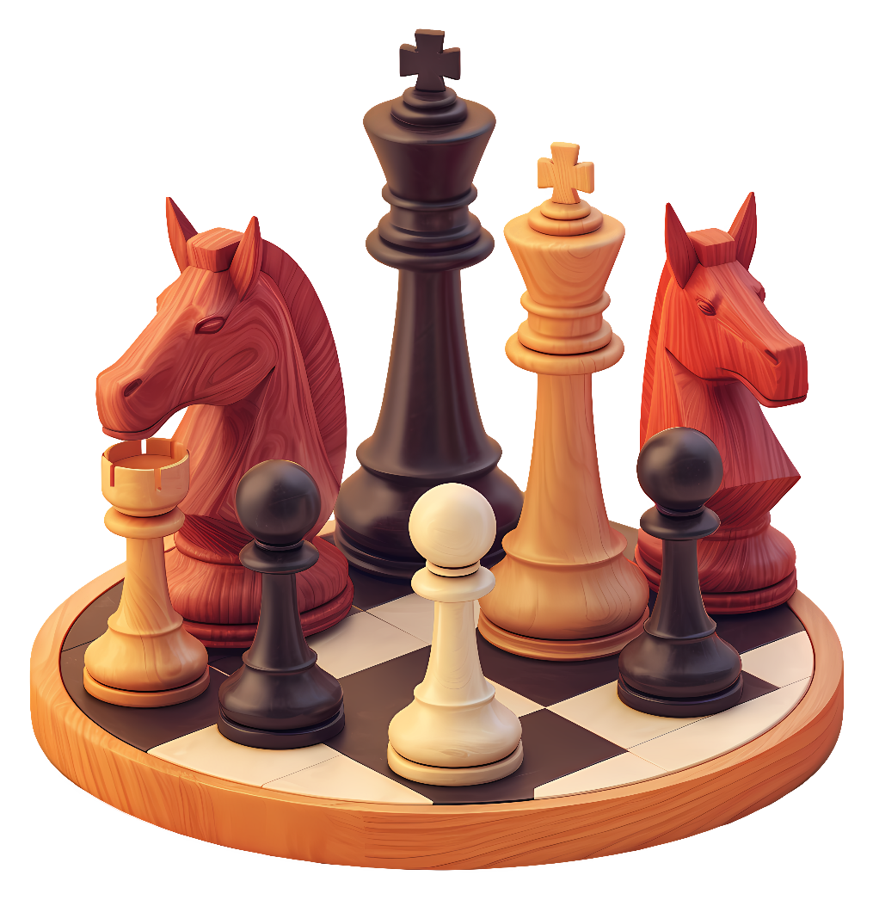
Predicting Chess Game Outcomes
Deep learning study
Mohammed Al-Khudhair

Slide 2
Problem & I/O
Goal: Predict White vs Black outcome from first 30 moves (60 plies).
Input:
Move Sequence (SAN tokens)
Board snapshots (at plies 20, 40, 60)
Light numeric stats (Elo, checks, captures, mobility)
Output:
1 = White win, 0 = Black win
Why?
If early & middle plays already signal outcomes, we can analyse openings, study plans, and build tools that rank games in real time.

Slide 3
Data Pipeline
Notebook 1 – Down-sampling
Reduce raw games (≈4 GB) to a balanced, decisive-only subset.
Fix seeds/IDs for reproducible loading across notebooks.
Notebook 2 – Pre-processing
Leak-safe: drop result/termination/etc., truncate to 60 plies, stratified 70/15/15 split.
Build & persist inputs: 60 move tokens, 8×8×36 boards @ 20/40/60, numeric stats.
Notebook 3 – Training
Train hybrid model (GRU + small CNN + MLP, fused) with AdamW and early-stopping.
Save best checkpoint, run threshold sweep (~0.445), and export metrics/plots to results/.

Slide 4
Model
Why this model? We need temporal + spatial reasoning and a light context signal.
Architecture: Three branches → fuse → dense + sigmoid
GRU(128) on move tokens (captures sequence patterns efficiently)
Light CNN on board tensors (local spatial structure)
Small MLP on numeric stats (strength/context)
Fuse + Dense (128) + Dropout(0.1) + Sigmoid
Training: AdamW, BCE loss, batch 512, EarlyStopping + ReduceLROnPlateau

Slide 5
Results
Validation: Acc 0.655, F1-macro 0.655, AUC 0.714
Test: Acc 0.642, F1-macro 0.641, AUC 0.705
Threshold from sweep: 0.445 (balanced precision/recall)
Confusion matrices near-symmetric → balanced errors
Re-runs vary ±0.5–1.0%; stable around 65%
Mild overfitting after ~epoch 7; best val AUC checkpoint saved

Slide 6
Demo
Now let’s view the demo and evaluate the results!

Slide 7
Q/A
You might ask me about…
Why 30 moves?
Why GRU not LSTM/Transformer?
Why AUC?
Leakage prevention?
Reproducibility?
Feel free to ask anything!

