Slide 1


Workshop
Demo and tutorial
Annual AMIDST meeting
Trondheim, June 28 2016

Slide 2
Introduction
Downloading and setting up material for the tutorial

Slide 3
System Requirements
Check your java version:
http://www.oracle.com/technetwork/java/javase/downloads/
$ java -version
https://www.jetbrains.com/idea/
Notes:
Notes:
$ java -version : note that there is only one dash ‘-’.
Explain that for making the toolbox work, we need Java8. But the IntelliJ IDEA is only needed for following this tutorial

Slide 4
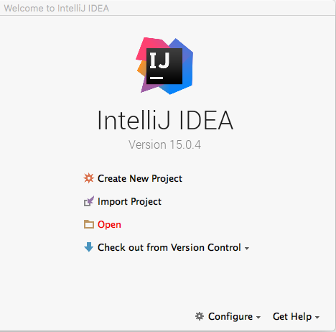
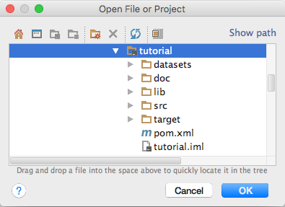
Setting up
Step 1: Download the example project
(or go to https://github.com/amidst/toolbox)
Step 2: Open the downloaded project with IntelliJ:
$ git clone https://github.com/amidst/tutorial.git

Slide 5
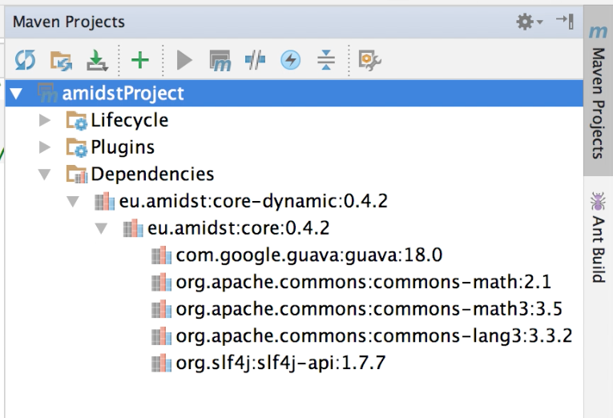
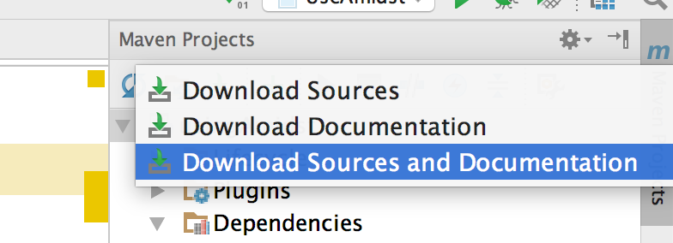
Setting up
Step 3: Download source code and javadoc

Slide 6


Overview
tutorial
AMiDST
core-dynamic
java
core
moalink
clients
latent-variable-models
flinklink
huginlink
streaming
wekalink

Slide 7

Project Structure
The downloaded project contains:
datasets: ARFF files used in the tutorial
doc: these slides
lib: hugin library
src/main/java: code examples using AMiDST
pom.xml: maven dependencies definition

Slide 8
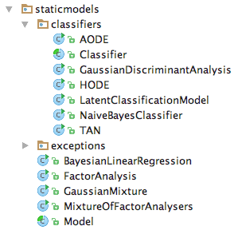
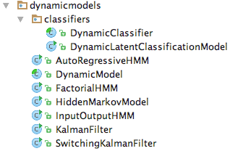
Latent-variable-models
The module latent-variable-models contains a large set of classes for easily learning some of the models in the literature.
H1
H2
H3
X1
X2
X3
X4

Slide 9
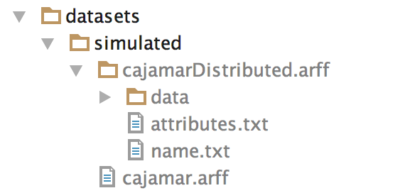
Datasets
We will see some examples using two datasets:
H1
H2
H3
X1
X2
X3
X4
The data can be generated with CreateCajamarDataContinuous.java

Slide 10
Static Models
A set of code examples for easily learning and making inference with static PGMs

Slide 11
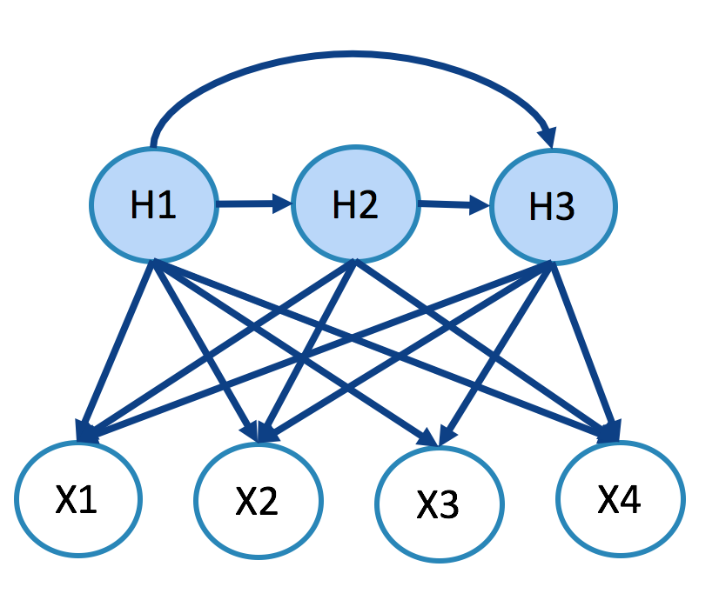

Static models (learning)
H1
H2
H3
X1
X2
X3
X4
latent-variable-models
ARFF file
Factor Analysis Model

Slide 12
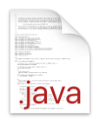
Static models (learning)
//Load the datastream String filename = "datasets/simulated/cajamar.arff"; DataStream<DataInstance> data = DataStreamLoader.open(filename); //Learn the model Model model = new FactorAnalysis(data.getAttributes()); model.updateModel(data); BayesianNetwork bn = model.getModel(); System.out.println(bn);
StaticModelLearning.java

Slide 13
Static models (save to disk)
H1
H2
H3
core
X1
X2
X3
X4
Factor Analysis Model
.bn file
.net file
Notes:
Dibujo inference?
Inference with flink?

Slide 14
Static models (save to disk)
// Save with .bn format BayesianNetworkWriter.save(bn, "networks/simulated/exampleBN.bn"); // Save with hugin format BayesianNetworkWriterToHugin.save (bn, "networks/simulated/exampleBN.net");
Note: make sure that you have the following files in your classpath:
hgapi83_amidst-64.jar
libhgapi83_amidst-64.jnilib
For adding folders to your class path:
-Djava.library.path=“….”
StaticModelLearning.java
Notes:
-Djava.library.path=“lib/”
Note: attention with “ “

Slide 15
Static models (learning from flink)
H1
H2
H3
X1
X2
X3
X4
latent-variable-models
ARFF folder
Factor Analysis Model

Slide 16
Static models (learning from Flink) [Spark coming soon]
//Load the datastream String filename = "datasets/simulated/cajamarDistributed.arff"; final ExecutionEnvironment env = ExecutionEnvironment.getExecutionEnvironment(); DataFlink<DataInstance> data = DataFlinkLoader.loadDataFromFolder(env, filename, false); //Learn the model Model model = new FactorAnalysis(data.getAttributes()); model.updateModel(data); BayesianNetwork bn = model.getModel(); System.out.println(bn);
StaticModelFlink.java

Slide 17
Static models (Inference)
H1
H2
H3
P(X2|H1=0.6)?
core
huginlink
X1
X2
X3
X4
Static BN
Answer to a query
Notes:
Dibujo inference?
Inference with flink?

Slide 18
Static models (inference) [Flink support coming soon]
Add the following code after learning the model
//Variabeles of interest Variable varTarget = bn.getVariables().getVariableByName("LatentVar1"); Variable varObserved = null; //we set the evidence Assignment assignment = new HashMapAssignment(2); varObserved = bn.getVariables().getVariableByName(”Income"); assignment.setValue(varObserved,0.0); //we set the algorithm InferenceAlgorithm infer = new VMP(); infer.setModel(bn); infer.setEvidence(assignment); //query infer.runInference(); Distribution p = infer.getPosterior(varTarget); System.out.println("P(LatentVar1|Incomce=0.0) = "+p);
new HuginInference();
new ImportanceSampling();
StaticModelInference.java

Slide 19
Parallel TAN (Hugin/AMIDST)
Hugin: learn the structure with a subsample of the data
AMIDST: learn the parameters in AMIDST using the whole data.
ParallelTAN tan = new ParallelTAN(); tan.setNumCores(4); tan.setNumSamplesOnMemory(1000); tan.setNameRoot(var01); tan.setNameTarget(classVar); BayesianNetwork model = tan.learn(data);
ParallelTANExample.java

Slide 20
Static models (practice)
Create your custom model: gaussian mixture
H
Discrete hidden variable
X1
X2
Xn
Continuous variables
Assume that observed variables are not connected

Slide 21
Static models (practice)
Some tips:
public class CustomGaussianMixture extends Model{ public CustomGaussianMixture(Attributes attributes) throws WrongConfigurationException { super(attributes); //TODO: Write the contructor code here }
@Override protected void buildDAG() { //TODO: Write the code building a DAG for your custom model } }
Useful methods:
public Variable Variables::newMultinomialVariable(String name, int nOfStates)
public List<ParentSet> DAG::getParentSets()

Slide 22
Dynamic Models
A set of code examples for easily learning and making inference with dynamic PGMs

Slide 23
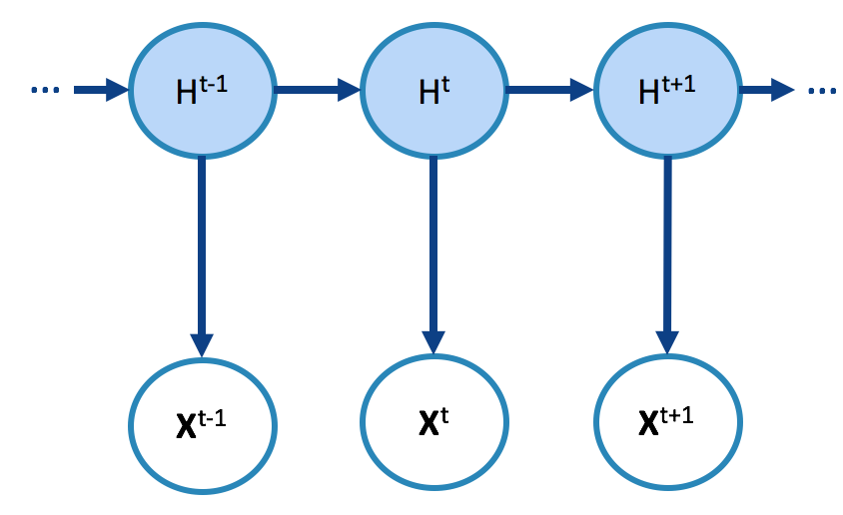
Static models (learning)
…
…
H^{t-1}
H^{t}
H^{t+1}
latent-variable-models
X^{t-1}
X^{t}
X^{t+1}
ARFF file
Hidden Markov Model
(Dynamic BN)

Slide 24
Dynamic models (learning) [Flink support coming soon]
//Load the datastream String filename = "datasets/simulated/cajamar.arff"; DataStream<DynamicDataInstance> data = DynamicDataStreamLoader.loadFromFile(filename); //Learn the model DynamicModel model = new HiddenMarkovModel(data.getAttributes()); model.updateModel(data); DynamicBayesianNetwork dbn = model.getModel(); System.out.println(dbn);
DynamicModelLearning.java

Slide 25
Static models (save to disk)
H1
H2
H3
core-dynamic
X1
X2
X3
X4
huginlink
Hidden Markov Model
(Dynamic BN)
.dbn file
.net file
Notes:
Dibujo inference?
Inference with flink?

Slide 26
Dynamic models (save to disk)
// Save with .dbn format DynamicBayesianNetworkWriter.save (bn, "networks/simulated/exampleDBN.dbn"); // Save with hugin format. Not full compatibility. DynamicBayesianNetworkWriterToHugin.save(bn, "networks/simulated/exampleDBN.net");
Note: make sure that you have the following files in your classpath:
hgapi83_amidst-64.jar
libhgapi83_amidst-64.jnilib
For adding folders to your class path:
-Djava.library.path=“….”
DynamicModelSaveToDisk.java
Notes:
-Djava.library.path="huginlink/huginlib/"

Slide 27


Static models (save to disk)
H1
H2
H3
$$P(H^{t}|X^{t}=x)$$
core-dynamic
$$P(H^{t+5}|X^{t}=x)$$
X1
X2
X3
X4
huginlink
Hidden Markov Model
(Dynamic BN)
Query

Slide 28
Dynamic models (inference)
Add the following code after learning the process
//Testing dataset String filenamePredict = "datasets/simulated/cajamar.arff"; DataStream<DynamicDataInstance> dataPredict = DynamicDataStreamLoader.loadFromFile(filenamePredict);
//Select the inference algorithm InferenceAlgorithmForDBN infer = new FactoredFrontierForDBN(new VMP()); infer.setModel(dbn); Variable varTarget = dbn.getDynamicVariables().getVariableByName("discreteHiddenVar"); UnivariateDistribution posterior = null; //Classify each instance int t = 0; for (DynamicDataInstance instance : dataPredict) { infer.addDynamicEvidence(instance); infer.runInference(); posterior = infer.getFilteredPosterior(varTarget); System.out.println("t="+t+", P(discreteHiddenVar | Evidence) = " + posterior); }
new HuginInference();
new ImportanceSampling();
DynamicModelInference.java

Slide 29
Dynamic models (inference)
For predicting 5 steps ahead, replace:
posterior = infer.getFilteredPosterior(varTarget);
posterior = infer.getPredictivePosterior(varTarget, 5);
DynamicModelInference.java

Slide 30
Dynamic models (practice)
Create your custom dynamic model: Kalman filter
H₁
H_{m}
H₁
H_{m}
H₁
H_{m}
X₁
X₂
X₃
X_{n}
X₁
X₂
X₃
X_{n}
X₁
X₂
X₃
X_{n}
t₀
t_{i-1}
t_{i}
Assume that hidden variables are not connected among them
All the variabels are continuous

Slide 31
Dynamic models (practice)
Some tips:
public class CustomKalmanFilter extends DynamicModel {
public CustomKalmanFilter(Attributes attributes) throws WrongConfigurationException { super(attributes); //TODO: Write the constructor code here } @Override protected void buildDAG() { }
}
Useful methods:
public DynamicVariable DynamicVariables::newGaussianDynamicVariable (String name)
public Variable DynamicVariable ::getInterfaceVariable()
public ParentSet DynamicDAG::getParentSetTimeT(Variable var)

Slide 32
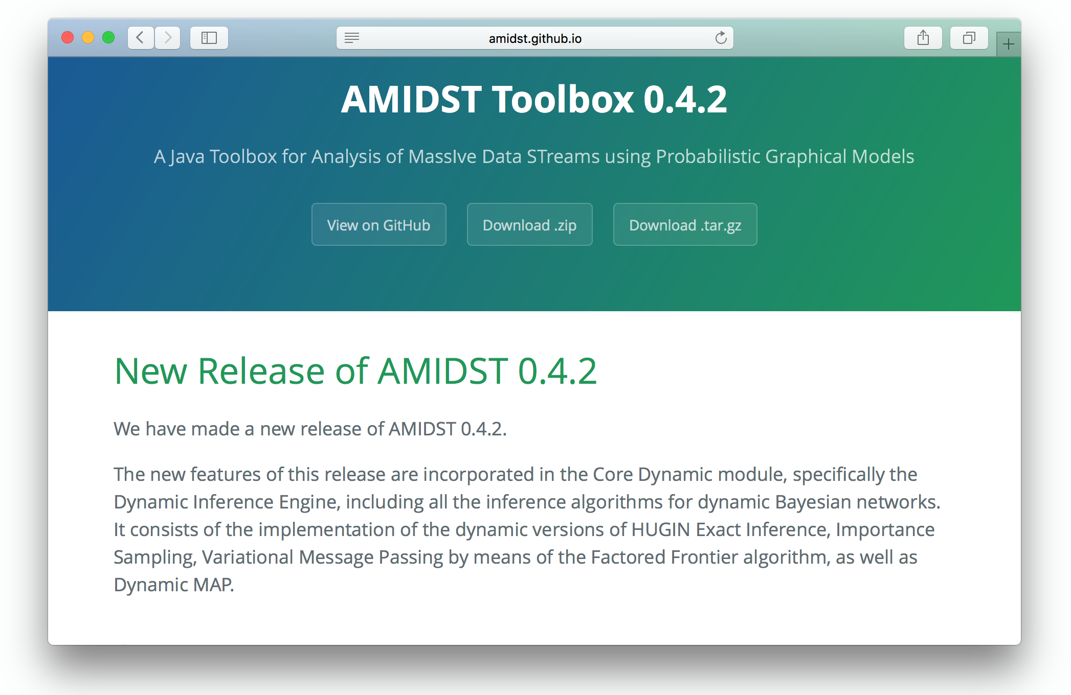
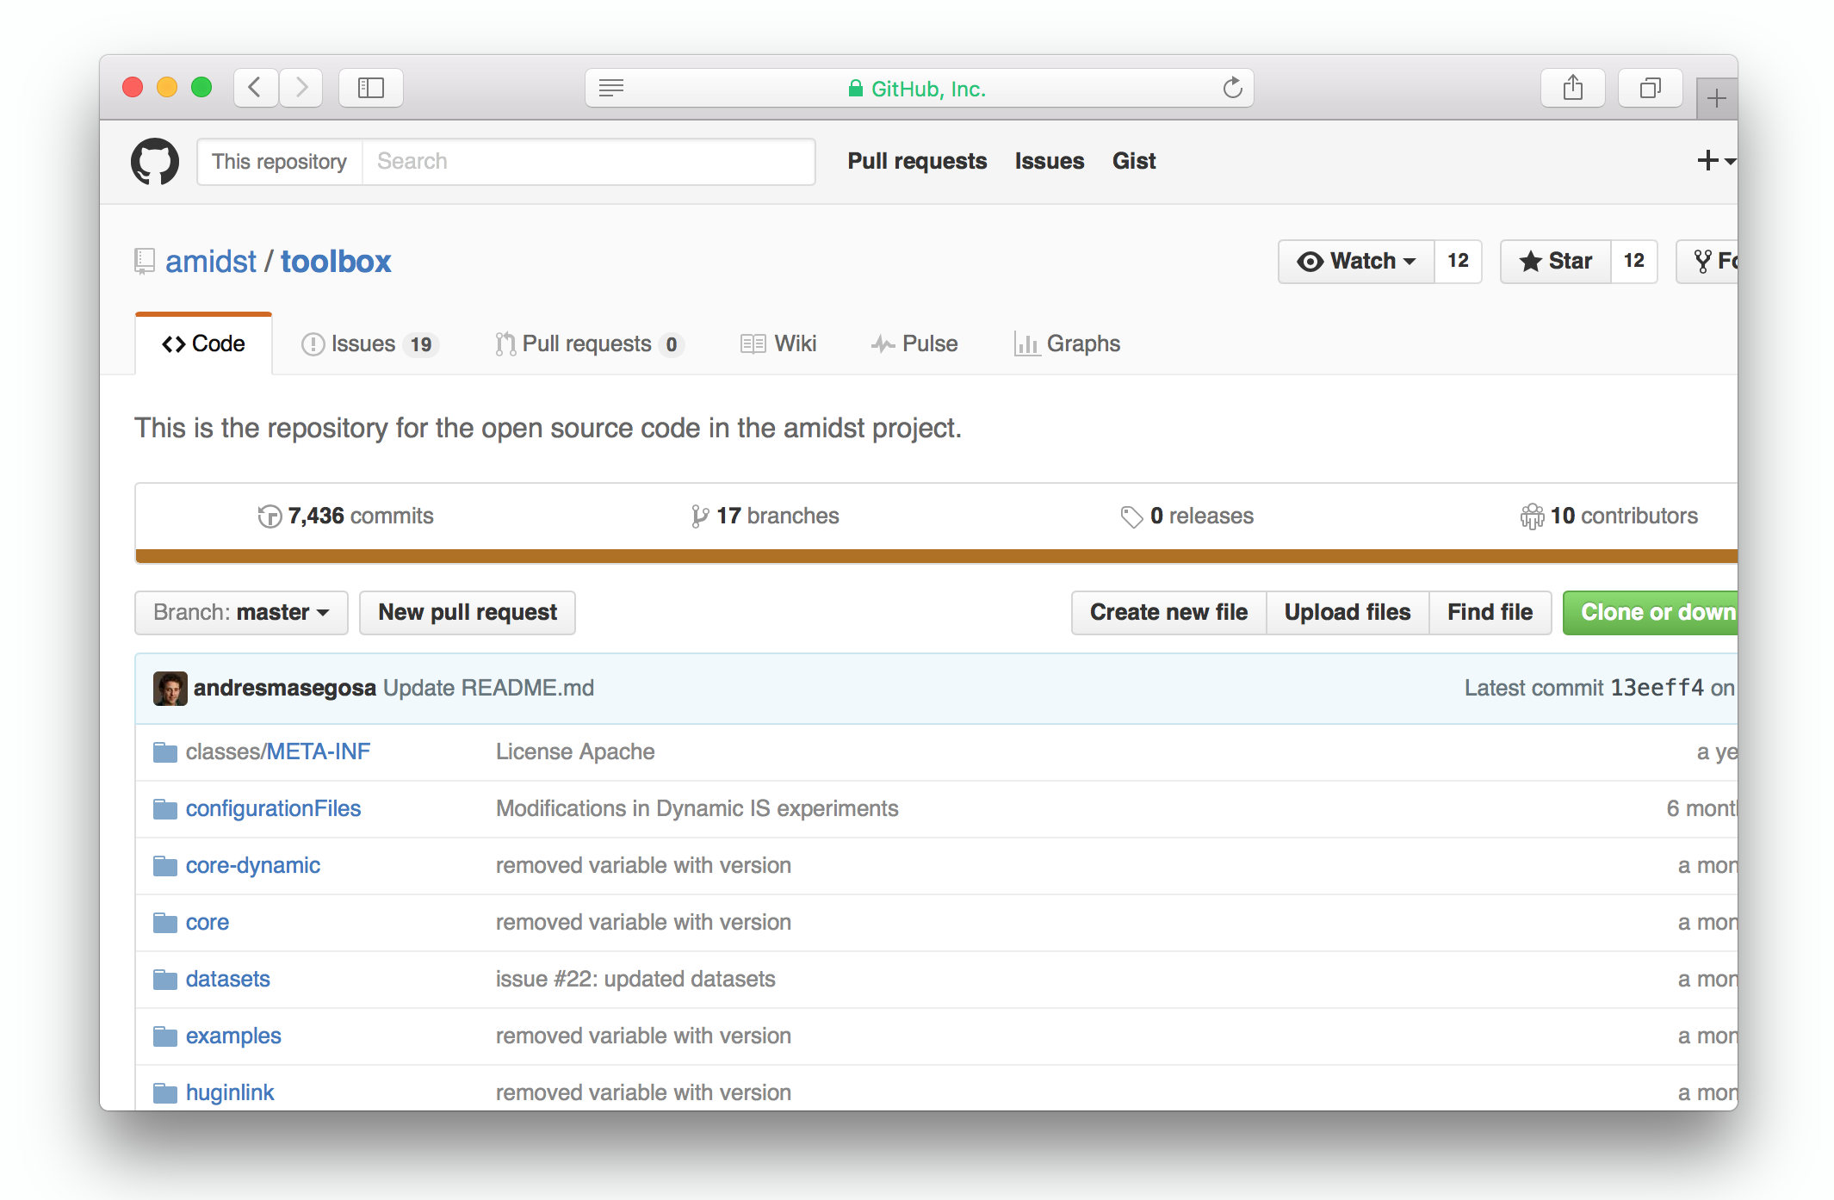
Important URLs
http://amidst.github.io/toolbox/
(Documentation, tutorials and more)
https://github.com/amidst/toolbox
(source code)
Notes:
Notes:
$ java -version : note that there is only one dash ‘-’.
Explain that for making the toolbox work, we need Java8. But the IntelliJ IDEA is only needed for following this tutorial

Slide 33
Thanks for your attention

