Slide 1



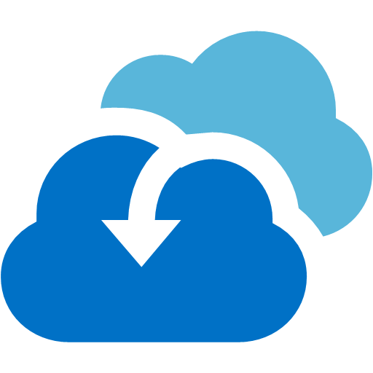
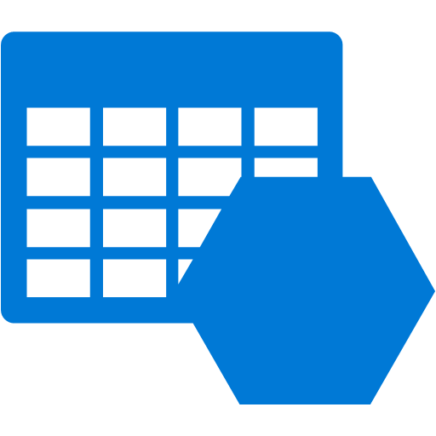


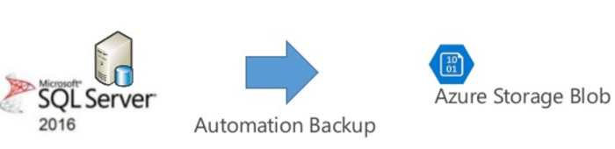
Common scenarios – Infrastructure as a Service
Azure Infrastructure as a Service (IaaS)
Backup and Business Continuity
Virtual Machines
Virtual Networks
VPN Gateways
Azure Backup
Hybrid Connectivity
Load Balancers
Storage
Azure Site Recovery
SQL Server Managed Backup

Slide 2


7
NSG
Availability Set
C:\OS Only
F:\SYSVOL
F:\NTDS
BackupVault1
ADDC-1
ADDC-2
Virtual Network
East US 2
Peering
NSG
C:\OS Only
F:\SYSVOL
F:\NTDS
Availability Set
BackupVault2
ADDC-3
ADDC-4
Virtual Network
Central US

Slide 3


7
External Load Balancer Web (HTTP Health Probe)
NSG
Virtual Network
East US 2
Internal Load Balancer SQL
Availability Set
SQL Server Always On – Configured with Cloud Storage as witness
SQLVM-0
SQLVM-1
SQL Backup Storage
Cloud Storage as Witness
Storage configuration for SQL Server
Drive | Type | Purpose
C:\ | S10 | OS
D:\ | Local SSD | TempDB broken into multiple files (match number of cores)
F:\ | P20 | SQL Database Files
G:\ | P20 | SQL Database Log Files

Slide 4
Network Security Group usage (West Central S)
Network security groups (NSGs) will be used to help secure the configuration by limiting traffic flow exactly as a firewall rule does. NSGs may be applied to either individual NICs or to Subnets. In Contoso’s case there will be a single NSG applied to each subnet.
Apps Tier NSG
Name | Priority | Source | Protocol | Source Port Range | Destination | Dest. Port Range | Action
HTTP | 100 | ANY | TCP | ANY | 10.0.0.0/24 | 80 | ALLOW
HTTPS | 110 | ANY | TCP | ANY | 10.0.0.0/24 | 443 | ALLOW
RDP | 120 | 192.168.1.0/23 | ANY | ANY | 10.0.0.0/24 | 3389 | ALLOW
Data Tier NSG
Name | Priority | Source | Protocol | Source Port Range | Destination | Dest. Port Range | Action
 | 100 | 192.168.1.0/23 | TCP | ANY | 10.0.2.0/24 | 1433 | ALLOW
SQLINT | 110 | 10.0.0.0/24 | TCP | ANY | 10.0.2.0/24 | 1433 | ALLOW
RDP | 120 | 192.168.1.0/23 | ANY | ANY | 10.0.2.0/24 | 3389 | ALLOW
Identity Tier NSG
Name | Priority | Source | Protocol | Source Port Range | Destination | Dest. Port Range | Action
RDP | 100 | 192.168.1.0/23 | ANY | ANY | 10.0.3.0/24 | 3389 | ALLOW
ADDS Replication1 | 110 | 192.168.1.10 | ANY | ANY | 10.0.3.0/24 | ANY | ALLOW
ADDS Replication2 | 120 | 192.168.1.11 | ANY | ANY | 10.0.3.0/24 | ANY | ALLOW
On-Premise Domain Controllers

Slide 5
Network Security Group usage (West US 2)
Since Contoso has not deployed any additional infrastructure to West US 2 the only ports needed are for administration and replication of Active Directory.
Identity Tier NSG
Name | Priority | Source | Protocol | Source Port Range | Destination | Dest. Port Range | Action
RDP | 100 | 192.168.1.0/23 | ANY | Any | 172.16.3.0/24 | 3389 | Allow
ADDS Replication1 | 110 | 192.168.1.10 | ANY | Any | 172.16.3.0/24 | ANY | Allow
ADDS Replication2 | 120 | 192.168.1.11 | ANY | Any | 172.16.3.0/24 | ANY | Allow
On-Premise Domain Controllers

