Slide 1
PIP-103: PROFESSIONAL PRACTICE-III (PROJECT) Review-1 Presentation Good Works Connect- Corporate Social Responsibility Web Portal
Submitted to the Presidency University, Bengaluru in partial fulfillment of the requirements for the PIP-103: PROFESSIONAL PRACTICE-III (INTERNSHIP)
by
Under the supervision of
Mr. Pajany M Assistant Professor Department of Computer Science & Engineering
Name Roll Number
Alavalapati veera bharath kumar reddy | 20201COD0033
Uday kumar S | 20201COD0034
Boggadi raja reddy | 20201COD0027
Dodda jagaeesh reddy | 20201COD0041

Slide 2
Project Title:
Good Works Connect - CSR:- This name implies that the website is a place where people can connect with others who are doing good works and get inspired.
Abstract:-
Corporate Social Responsibility (CSR) is the idea that a company should play a positive role in the community by consider the environmental and social impact. CSR can be beneficial to a company in several ways. The first is by improving its brand image. When customers or clients see evidence that a business is socially responsible, they tend to respond positively. Some examples of CSR components are encouraging charity, volunteer work, supporting local communities, improving labour policies, engaging in wildlife conservation initiatives, ensuring diversity and equality in the workplace, investing in non-profit organizations, and guaranteeing ethically sourced materials. In this project we aim to design a common CSR portal to connect many organizations in a single platform, through the common platform it will be easy for the people or communities to use the CSR initiative effectively.

Slide 3
Literature Survey:
[1] Corporate Social Responsibility Practices – A Study Of Select Large-Scale Companies, Dr. Vrushali Rajaram Kadam, International journal Of Multidisciplinary Educational Research Issn:2277-7881; Impact Factor :6.514(2020); Ic Value:5.16; Isi Value:2.286 Peer Reviewed And Refereed Journal: Volume:10, Issue:1(6), January :2021
In present globalized scene the concept of Corporate Social Responsibility (CSR) cannot be ignored by the corporate world. Taking into consideration the changing market scenario, firms have to alter their work culture according to the market demands. Indian firms are not at all lagging behind in this initiative and some are already proceeding with it. Corporate Social Responsibility refers to the activities of the company that meet the needs and welfare of the society. Under the new Companies Bill, the section states that large companies have to spend two percent of their average net profits on CSR activities. The aim of this Bill is to make the companies discharge their social commitment towards their stakeholders like customers, government and mainly the community at large. Alongside enhance the economic development of the company. This research paper seeks to explain the importance of corporate social responsibility in today’s global era. It also gives a picture about the CSR focus areas in which the large-scale companies are carrying out their activities more intensively.

Slide 4
[2] Nadia Reckmann, Contributing Writer, Updated Feb 22, 2023, Businesses that practice corporate social responsibility aim to improve their communities, the economy or the environment.
Corporate social responsibility, or CSR, is a form of self-regulation that reflects a business’s accountability and commitment to contributing to the well-being of communities and society through various environmental and social measures.
CSR plays a crucial role in a company’s brand perception; attractiveness to customers, employees, and investors; talent retention; and overall business success.
A company can implement four types of CSR efforts: environmental initiatives, charity work, ethical labor practices and volunteer projects.

Slide 5
[3] Corporate Social Responsibility (CSR): A Literature Review Hussam Al Halbusia*& Shehnaz Tehseenb, Malaysian Journal of Business and Economics Vol. 4, No. 2, 2017, 30 – 48 ISSN 2289-6856 (Print), 2289-8018 (Online)
This paper amis to give an overview on the topic and impact of the corporate social responsibility on employee’s attitudes and behaviours (CSR), it can be noticed that different scholars still continue to look at the concept of CSR from different perspectives. In 1970, Milton Friedman was the first scholar who wrote an article regarding the responsibilities of corporations. After that academicians started to look at the concept of CSR in more details, and made a move from the general debates discussing about the legitimacy of CSR to other perspectives to get deeper understanding about the concept of CSR. But, most of the researches that have been conducted with regard to CSR were mainly focused on macro perspective with their great emphasis on the relationship between CSR initiatives and financial performance

Slide 6
[4] "CORPORATE SOCIAL RESPONSIBILITY (CSR) IN INDIA- ISSUES AND CHALLENGES",Mr. Ravindra Kumar,Research Scholar, Ms. Preeti Ruhela , Research Scholar,Palarch’s Journal of Archaeology Of Egypt/Egyptology 18(4). ISSN 1567-214x, PJAEE, 18(4) (2021)
CSR as a significant subject of public policy has been occupying a vital place in the Indian corporate scenario, as it has build up sustainable relationship with the society at large with the increasing socio-regulatory forces. The theory of Social responsibility says that an organization or individual, has an obligation to act to benefit society at large. Social responsibility is the duty of every individual or organization has to perform so as to maintain a balance between the economy and the ecosystem. The first reference of the term corporate social responsibility was mentioned in the publication ‘Social Responsibilities of Business’ by William. Bowen in 1953. In India, there has been a persistent close business involvement in societal issues for national development, known as social duty or charity donations, philanthropy, and service to community, industrial welfare, now particularly termed as CSR. All the economic enterprise presumes Human resource as the backbone. The main purpose of this research will be to investigate the attitudes towards Corporate Social Responsibility (CSR) among India’s future business leaders. In India companies like Tata & Nestle are practicing the Corporate Social Responsibility (CSR) for decades, long before CSR become a popular basis. In spite of having such good illustrious examples; In India Corporate Social Responsibility (CSR) is in an extremely risining stage. Many large companies are undertaking these Corporate Social Responsibility (CSR) activities superficially and promoting/ highlighting the activities in Media. This research paper bases on the finding & reviewing of the issues and challenges faced by Corporate Social Responsibility (CSR) activities in India.

Slide 7
[5] Analyzing the Role of Corporate Social Responsibility for Sustainable Environmental Performance: Mediating Roles of Environmental Strategy and Environmental Outcomes, Xiaodong Wang1 and Weijun Bian1,2, 1 School of Humanities and Social Sciences, Xi’an Jiaotong University, Xi’an, China, 2 School of Literature and Business,Xi’an Siyuan University, Xi’an, China, Jun 2022, Volume 13, Artical 906610.
This study examines the relationship between corporate social responsibility (CSR) and environmental performance, utilizing data from 415 small and medium-sized enterprises (SMEs) in China as a case study. We found that CSR has a direct and significant impact on environmental performance (EP) and is positively correlated to environmental strategy (ES) and environmental outcomes (EO), both of which improve environmental performance, i.e., they serve as a significant mediating factor between CSR and environmental performance. Our study will help general managers and policy maker of SMEs, provides a beneficial model for managing CSR, ES, and EO to achieve sustainable environmental performance. Specifically, it can assist general managers of SMEs in strengthening their internal resources such as CSR, ES, and EO in order to improve long-term environmental performance.

Slide 8
Aims & Objectives
To create a common web portal to connect corporate and various organization to enhance CSR activities.
To provide research, training, practice, capacity building, standard setting, activities rating, monitoring, recognition and related support in the field of CSR.
To facilitate exchange of experiences and ideas between various stakeholders for developing a framework for strengthening of CSR activities.
To facilitate any other assistance directly or indirectly for activities which seek to promote CSR practices.
To establish a database of credible implementing outfits with whom the corporate entities as well as the donor organisations can collaborate and work.
To conduct activities relating to public health, environment and employment enhancing.

Slide 9
Proposed Method
Creating a responsive web portal through suitable dashboards for user and admin access.
Developing a CSR Web Portal using scripts like HTML, CSS, Bootstrap, Jquery, Java Scripts Technologies, Php and Mysql database.
Create a modules for CSS activities: adding users to the portal, register corporate to the portal, adding events of CSR, register for activities, common discussion, view information and other activities.
Creating suitable database to store different categories of data and writing sql queries for easy access.
Ensure testing of the portal through software testing standards.

Slide 10
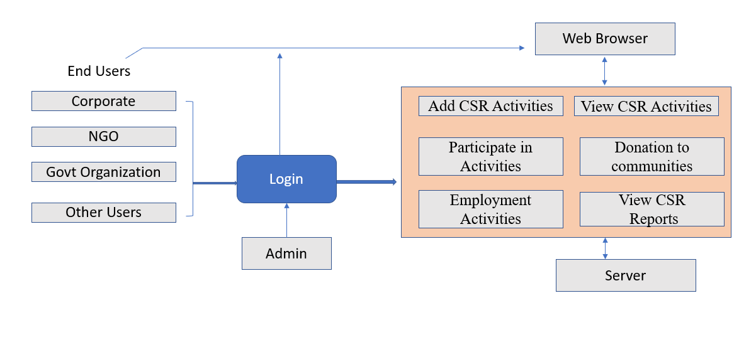
Architecture Diagram

Slide 11
Modules
A. Signup Procedure:
a. Login creation and store the login details in webserver.
B. Authentication: login access for users (corporate, people and communities)
a. Authentication using username and password
b. Forgot password support
C. Portal Options
a. Add CSR Activities
b. View CSR Activities
c. Participate in Activities
d. View CSR Reports
e. Donation to communities: charity, non-profit organization
f. Employment Enhancing Program

Slide 12
Hardware and Software Details
Hardware Details:
Operating System: Windows OS 8/10,
RAM: 8GB
Processor: Intel I5/I7
Software Requirements:
Front End: HTML, CSS, Java Script, JQuery
Frame work: Bootstarp for Responsive Deign
Backend: PhP, Javascript
Database: MySql
Software: Sublime Text Editor

Slide 13
References
Responsibility for Sustainable Environmental Performance: Mediating Roles of Environmental Strategy and Environmental Outcomes, Xiaodong Wang1 and Weijun Bian1,2, 1 School of Humanities and Social Scienc[1] Corporate Social Responsibility Practices – A Study Of Select Large-Scale Companies, Dr. Vrushali Rajaram Kadam, International journal Of Multidisciplinary Educational Research Issn:2277-7881; Impact Factor :6.514(2020); Ic Value:5.16; Isi Value:2.286 Peer Reviewed And Refereed Journal: Volume:10, Issue:1(6), January :2021
[2] Nadia Reckmann, Contributing Writer, Updated Feb 22, 2023, Businesses that practice corporate social responsibility aim to improve their communities, the economy or the environment.
[3] Corporate Social Responsibility (CSR): A Literature Review Hussam Al Halbusia*& Shehnaz Tehseenb, Malaysian Journal of Business and Economics Vol. 4, No. 2, 2017, 30 – 48 ISSN 2289-6856 (Print), 2289-8018 (Online)
[4] "CORPORATE SOCIAL RESPONSIBILITY (CSR) IN INDIA- ISSUES AND CHALLENGES",Mr. Ravindra Kumar,Research Scholar, Ms. Preeti Ruhela , Research Scholar,Palarch’s Journal of Archaeology Of Egypt/Egyptology 18(4). ISSN 1567-214x, PJAEE, 18(4) (2021)
[5] Analyzing the Role of Corporate Social es, Xi’an Jiaotong University, Xi’an, China, 2 School of Literature and Business,Xi’an Siyuan University, Xi’an, China, Jun 2022, Volume 13, Artical 906610.

Slide 14
Thank you !!

