Slide 1

Waltham Forest Servicestore
Customer Feedback Analysis

Slide 2
Data Pre-Processing
Data Cleaning: Removed duplicates, filled missing values, corrected data types.
Data Transformation: Standardized sentiments, categorized issues.
Columns Used: Service Type, Sentiment, Issue Description, Resolution Time.

Slide 3
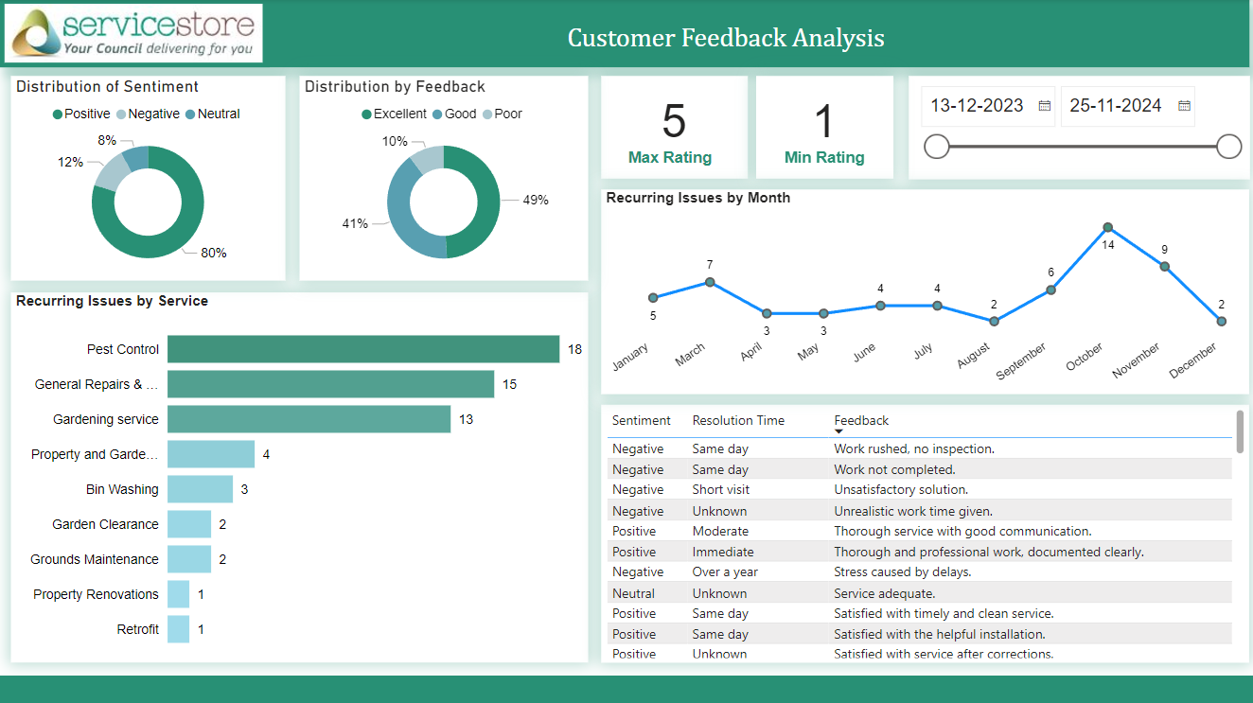

Slide 4
Identifying Trends & Key Insights
Key Insights:
Sentiment Analysis:
Positive: Higher in Pest Control and Gardening.
Negative: Predominantly in Bin Cleaning and Repair & Maintenance.
Recurring Issues:
Bin Cleaning: Delays and poor quality.
Repair & Maintenance: Long resolution times and incomplete repairs.
Resolution Times:
Faster in Pest Control and Gardening.
Slower in Repair & Maintenance and Bin Cleaning.

Slide 5
Recommendations
1. Service Improvement Plan:
Bin Cleaning: Implement quality checks, improve scheduling systems.
Repair & Maintenance: Dedicated follow-up team, introduce feedback loop post-service.
2. Training and Development:
Regular customer service training sessions.
Use feedback scenarios in training to better handle common issues.

Slide 6
Conclusion
Summary:
Emphasized key findings and trends from the analysis.
Highlighted actionable recommendations to enhance service quality and customer satisfaction.
Next Steps:
Implementation of recommended action plans.
Continuous monitoring and improvement based on ongoing feedback.

Slide 7
Thank You…

