Slide 1
Sentence Simplification with Deep Reinforcement Learning
Xingxing Zhang and Mirella Lapata
EMNLP 2017
http://aclweb.org/anthology/D17-1063

Slide 2
What is sentence simplification
Section 1: Introduction
Deletion-based sentence compression:
A man suffered a serious head injury after a morning car crash today .
A man suffered a injury after a crash .
Sentence simplification:
  Delete elements of the original text
  Substitute rare words with more common words or phrases
  Make syntactically complex structures simpler

Slide 3
Application of sentence simplification
Section 1: Introduction
Improve the performance of parsers (Chandrasekar et al., 1996)
Summarizers (Beigman Klebanov et al., 2004)
Semantic role labelers (Woodsend and Lapata, 2014)
Benefit people with low-literacy skills such as children and non-native speakers (Watanabe et al., 2009)

Slide 4
Previous work V.S. Recent work
Section 1: Introduction
Previous works focused on individual aspects of the simplification problem:
(1) perform syntactic simplification only.
(2) lexical simplification by substituting difficult words with more common WordNet synonyms or paraphrases.
Recent works view it as a monolingual text-to-text generation task

Slide 5
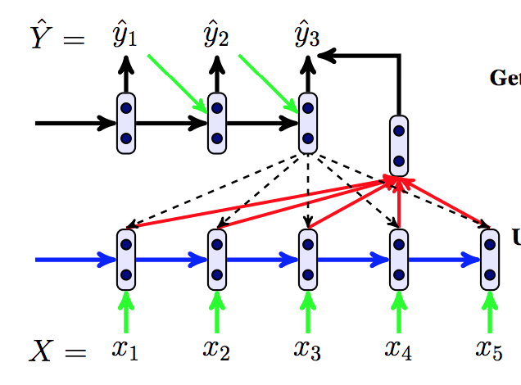
Vanilla Encoder-Decoder with Attention Model
Section 2: Neural model
Given a (complex) source sentence: X = (x₁, x₂, . . . , x_{|X|} ),
Predict its simplified target: Y = (y₁, y₂, . . . , y_{|Y|} ).

Slide 6
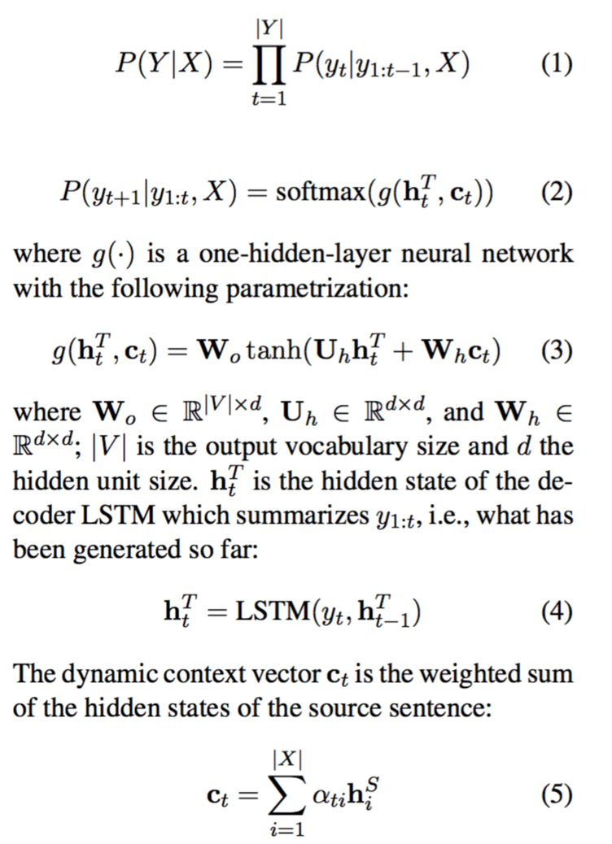
Minimizing the negative log-likelihood of the training source-target pairs
c_{t}
h_{t}

Slide 7
Vanilla seq2seq is not ideal for sentence simplification
Section 2: Neural model
Rewrite operations (e.g., copying, deletion, substitution, word reordering)
Problem
- Copy occupied of 73% operation in Newsela dataset, and 83% operation in Wikipedia-based dataset

Slide 8
Vanilla seq2seq may not be ideal for considering the sentence as a whole
Eposide
Apple product launches
Apple tree grows?
Apple released a new iphone
Apple released a new iphone
During training
During testing

Slide 9
Motivation
To encourage a wider variety of rewrite operations while remaining fluent and faithful to the meaning of the source.

Slide 10
Section 3: Reinforcement Learning
What leads to a good simplification - Simplicity
Simplicity: System output Against References and against the Input sentence (SARI) which is the arithmetic average of n-gram precision and recall of three rewrite operations: addition, copying, and deletion.
- reward the addition operations where system output was not in the input but occurred in the references.
What the paper used is: SARI score(e.x. 0.7594)

Slide 11
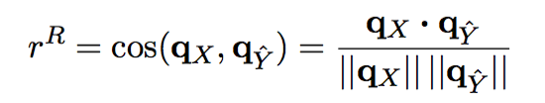
Section 3: Reinforcement Learning
What leads to a good simplification - Relevance
Relevance: while encouraging changes, generated sentence should preserve the meaning of the source.
  - Cosine similarity between original one and simply one.
- q_{x} and q_{y} are vector representation of source and target.

Slide 12
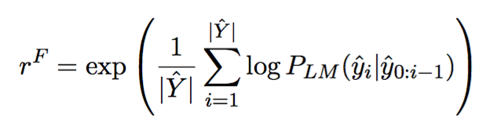
Section 3: Reinforcement Learning
What leads to a good simplification - Fluency
Fluency: be readable & be grammatical
- LSTM language model trained on simple sentences
perplexity
We take the exponential of Y’s perplexity to ensure that r^{F} ∈[0,1]

Slide 13
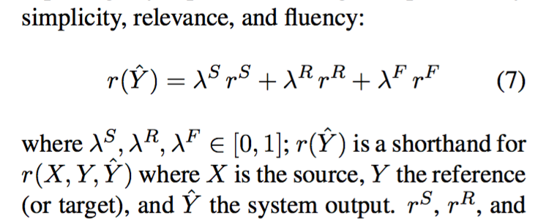
Section 3: Reinforcement Learning
Put them together
The reward r(Yˆ) for system output Yˆ is the weighted sum of the three components

Slide 14
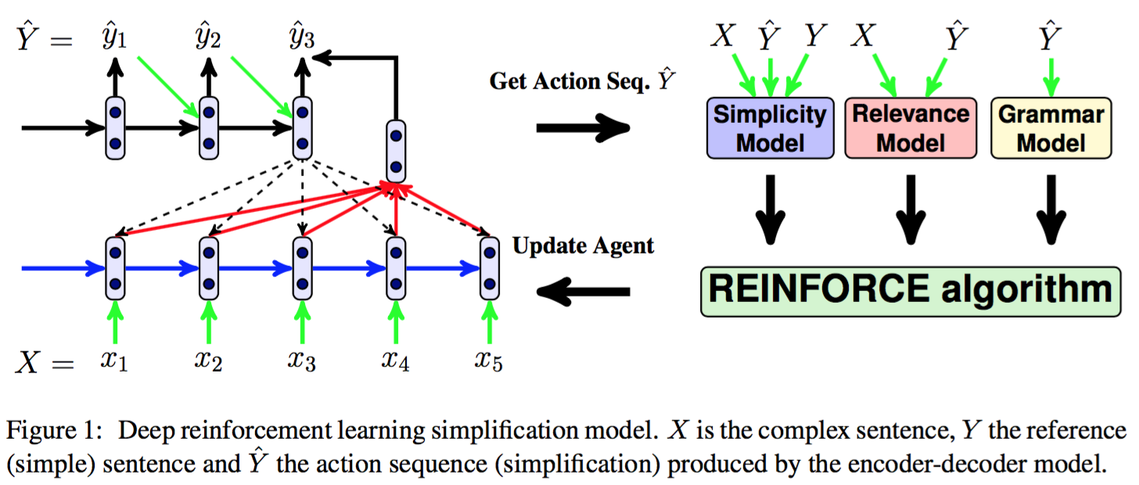
Section 3: Reinforcement Learning
Put them together

Slide 15
Section 5: Experimental Setup
Datasets
Automatic alignment
Parallel corpus₁ WikiSmall
- It contains automatically aligned complex and simple
sentences from the ordinary and simple English Wikipedias.
- train/val/test 89,042/205/100
Parallel corpus₂ WikiLarge
- It contains 8 (reference) simplifications for 2,359 sentences partitioned into 2,000 for development and 359 for testing.
- train/val/test 296,402/2,000/359
Parallel corpus₃ Newsela
-It consists of 1,130 news articles, each rewritten four times
by professional editors for children at different grade levels
- train/val/test 94,208/1,129/1,076
professional
editors

Slide 16
Automatic Evaluation
Section 5: Experimental Setup
Bilingual Evaluation Understudy BLEU[blε：]
- To assess the degree to which generated simplifications
differed from gold standard references
2. Flesch-Kincaid Grade Level (FKGL) score
- To measure the simplicity of the output (lower FKGL implies simpler output)
3. System output Against References and against the Input sentence (SARI)
- To evaluate the quality of the output by comparing it against the source and reference simplifications

Slide 17
Human Evaluation
Section 5: Experimental Setup
Native English speakers were asked to rate simplifications on three dimensions:
-Fluency (is the output grammatical and well formed?),
-Adequacy (to what extent is the meaning expressed in the original sentence preserved in the output?)
-Simplicity (is the output simpler than the original sentence?)
All ratings were obtained using a five point Likert scale.

Slide 18
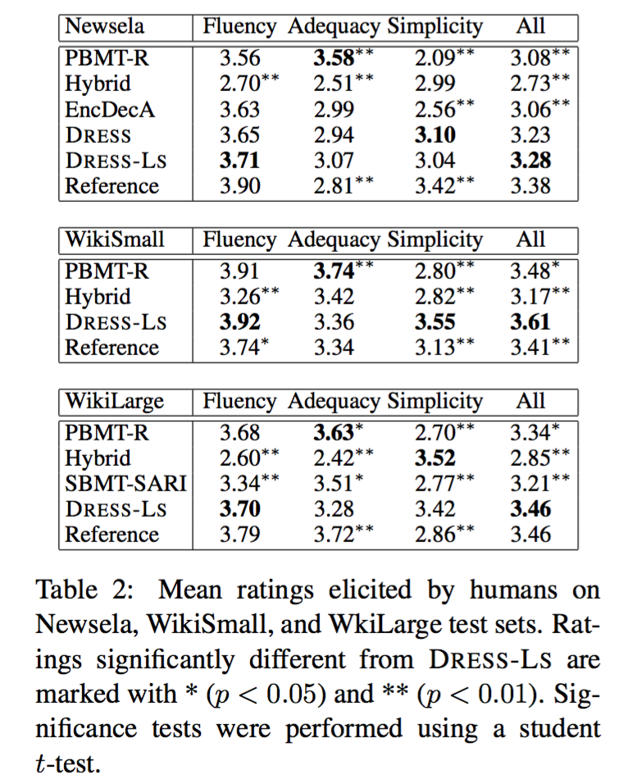
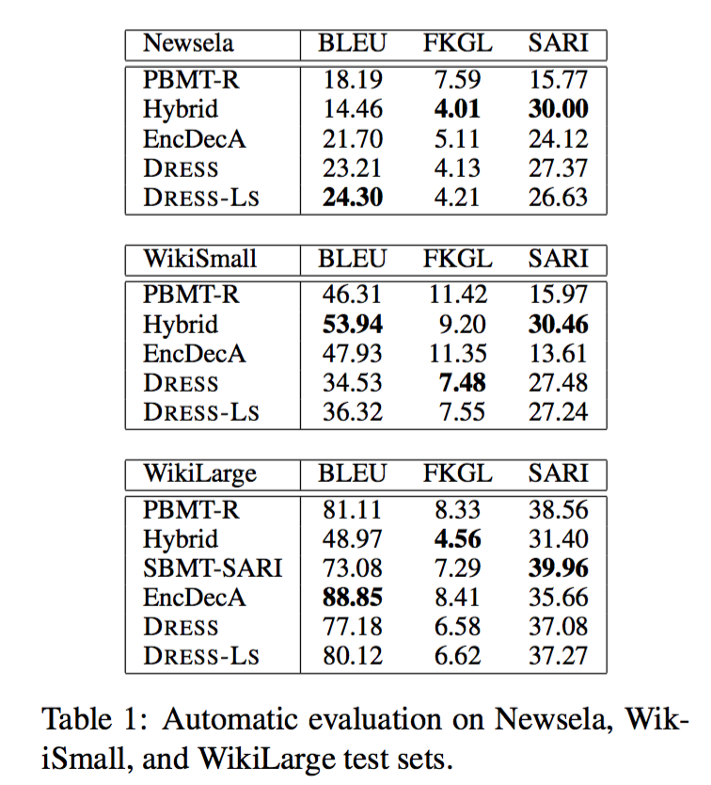
Section 6: Results
Results

Slide 19
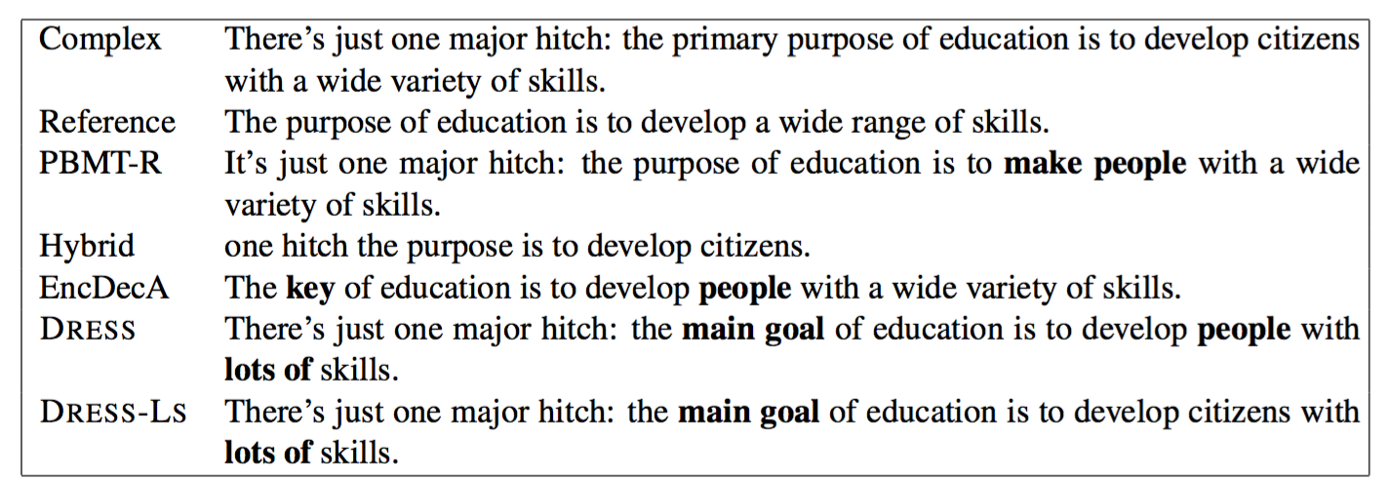
System output for example sentence
Section 6: Results
Substitutions are shown in bold.

Slide 20
Conclusion
Definition of the reward function is the key.
Take the evaluation metric itself as optimization objective (like SARI score)
- evaluation is thus important
…

