Slide 1

Software Design & Architecture
Faculty of Informatics and Computer Science
Lab 7
Topic 7
UML - Activity Diagram
MARIAM KHALED
Supervised by, Dr. AHMED MAGHAWRY

Slide 2

OUTLINE
Activity Diagram
Activity Diagram Drawing
Activity Diagram Symbols
ATM Activity Diagram

Slide 3
ACTIVITY DIAGRAM
What is Activity diagram?
Activity diagram is another important behavioral diagram in UML diagram to describe dynamic aspects of the system.
Activity diagram is essentially an advanced version of flow chart that modeling the flow from one activity to another activity.
What is the purpose of Activity diagram?
Show the flow of one activity to another within a system or process.
Even complex systems can be visualized using activity diagrams.
A good way to demonstrate the logic of an algorithm.
Show the workflow progress amongst the users and the system.

Slide 4
ACTIVITY DIAGRAM DRAWING
How to draw Activity diagram?
Start Node: The black small filled circle is the standard notation for an initial state before an activity takes place.
In the flow chart we draw in an oval shape label with Start whereas in the activity diagram we draw with fill small circle to represent the start of the activity.
Final Activity node: The Black circle that looks like a selected radio button is the symbol for the end state of activity.
In the flow chart we represent in oval shape label with the end in it whereas in the activity diagram we represent with small fill circle include borderline circle.
Activity: The activity symbols are the basic building blocks of an activity diagram and usually have a short description of the activity they represent. It is represented by the oval shape as well as a round-edged rectangle box.
Control Flow: A solid line with an arrow represent the direction flow of the activities.
Join: A join combines two concurrent activities back into a flow where only one activity is happening at a time.
Fork: A fork splits single activity flow into two concurrent activities.
Decision Symbol: It is similar to the flow chart which is represented by the diamond shape where two paths coming out of a decision and the condition text lets you know which options are mutually exclusive.
Condition: condition text is placed next to a decision marker to let you know under what condition an activity flow should split off in that direction.
Merge Node: Merge is similar to the join where two activities are merged with the condition and only one activity flows forward.
Final Flow node: It may be confusing with the final activity node. It represents the end of a specific process flow which is denoted by a circle with cross lines inside the circle.

Slide 5
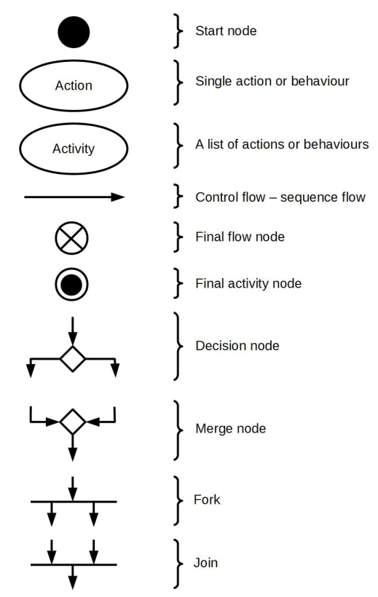
ACTIVITY DIAGRAM SYMBOLS

Slide 6
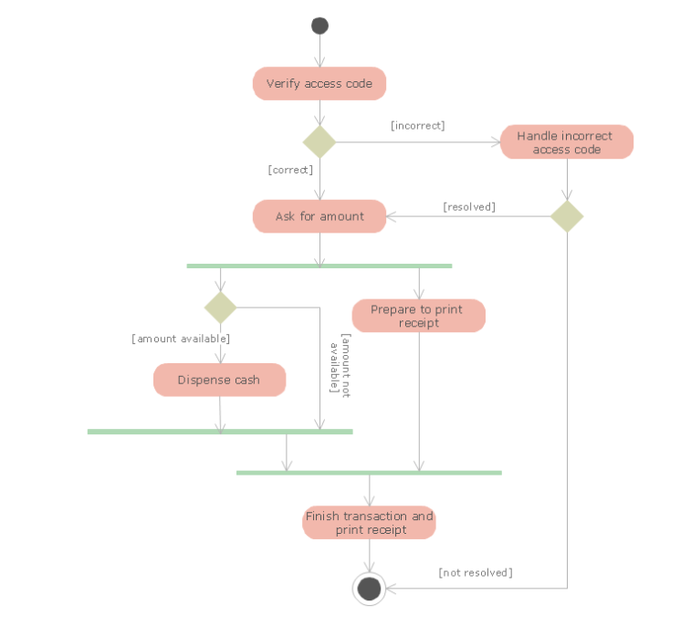
ATM ACTIVITY DIAGRAM

Slide 7

THANK YOU ;)
Faculty of Informatics and Computer Science

