Slide 1
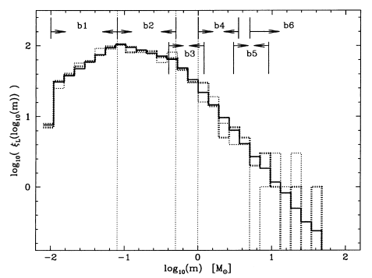
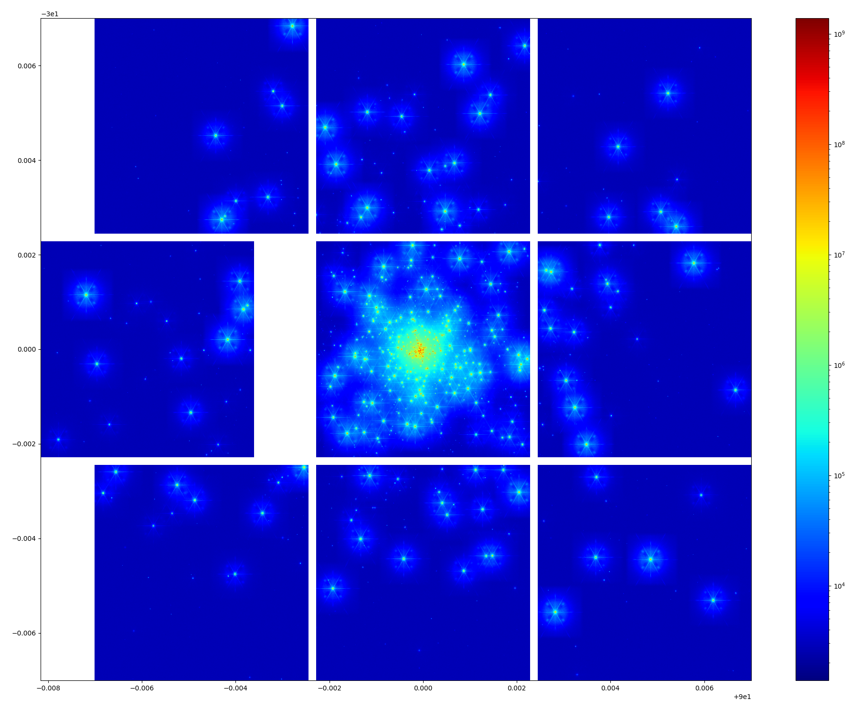
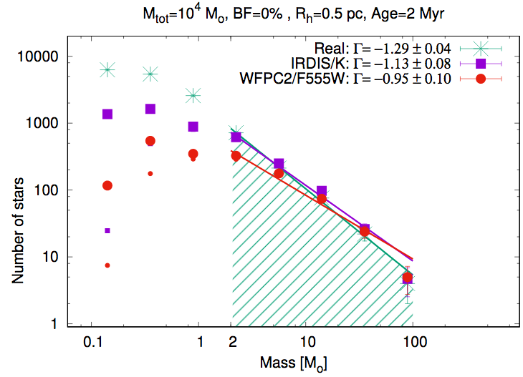
Modeling and observing Young Massive Clusters with SimCADO : a simulation package for MICADO at the ELT
ELT VLT
Diffraction limit at 1µm: 40au 200au @8kpc, Arches, galactic center
260au 1290au @50kpc, R136 in LMC
- Crowding problem
- Resolving binaries
MICADO-MAORY is required
Kroupa+2001
Khorrami+2019
R136 model as seen with SimCADO - MCAO

