Slide 1
Data Structures
Variations to Linked List

Slide 2
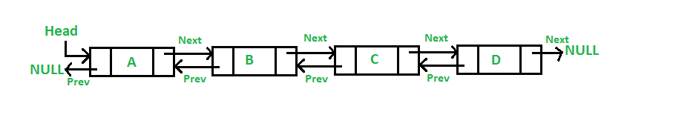
Doubly Linked List
class Node:
def __init__(self, data):
self.data = data
self.prev = None
self.next = None
class DLL:
def __init__(self):
self.length = 0
self.head = None
self.tail = None

Slide 3
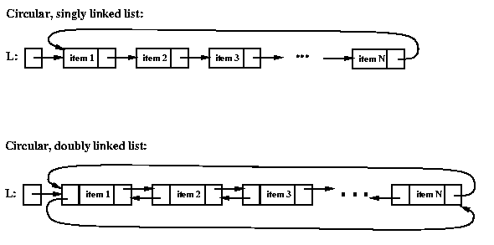
Circular Linked List

Slide 4
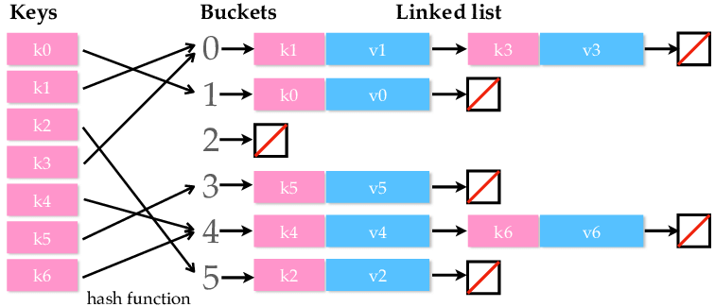
Hashmap

Slide 5
Hash Table
Consider looking for a card in a shuffled deck v.s. if the cards are grouped by the suits.
Why Array?
What is a hash function?
Simplest hash function: value % n
Collision? Why Linked List?
Worst case and best-case scenario.

Slide 6
Skeleton
class Node:
def __init__ (self, data):
self.data = data
self.prev = None
self.next = None
class List:
pass
class HashTable:
def __init__ (self, nbuckets):
self.nbuckets = nbuckets
#option: use Numpy array
self.table = [None] * nbuckets
def hash (self, value):
return value % self.nbuckets

Slide 7
What still need Implementations
ADD – SEARCH – DELETE from hash table.
Loop and print hash table

Slide 8

Questions?

