Slide 1
Data Structures
Red-Black Tree. Part 2: Node Deletion

Slide 2
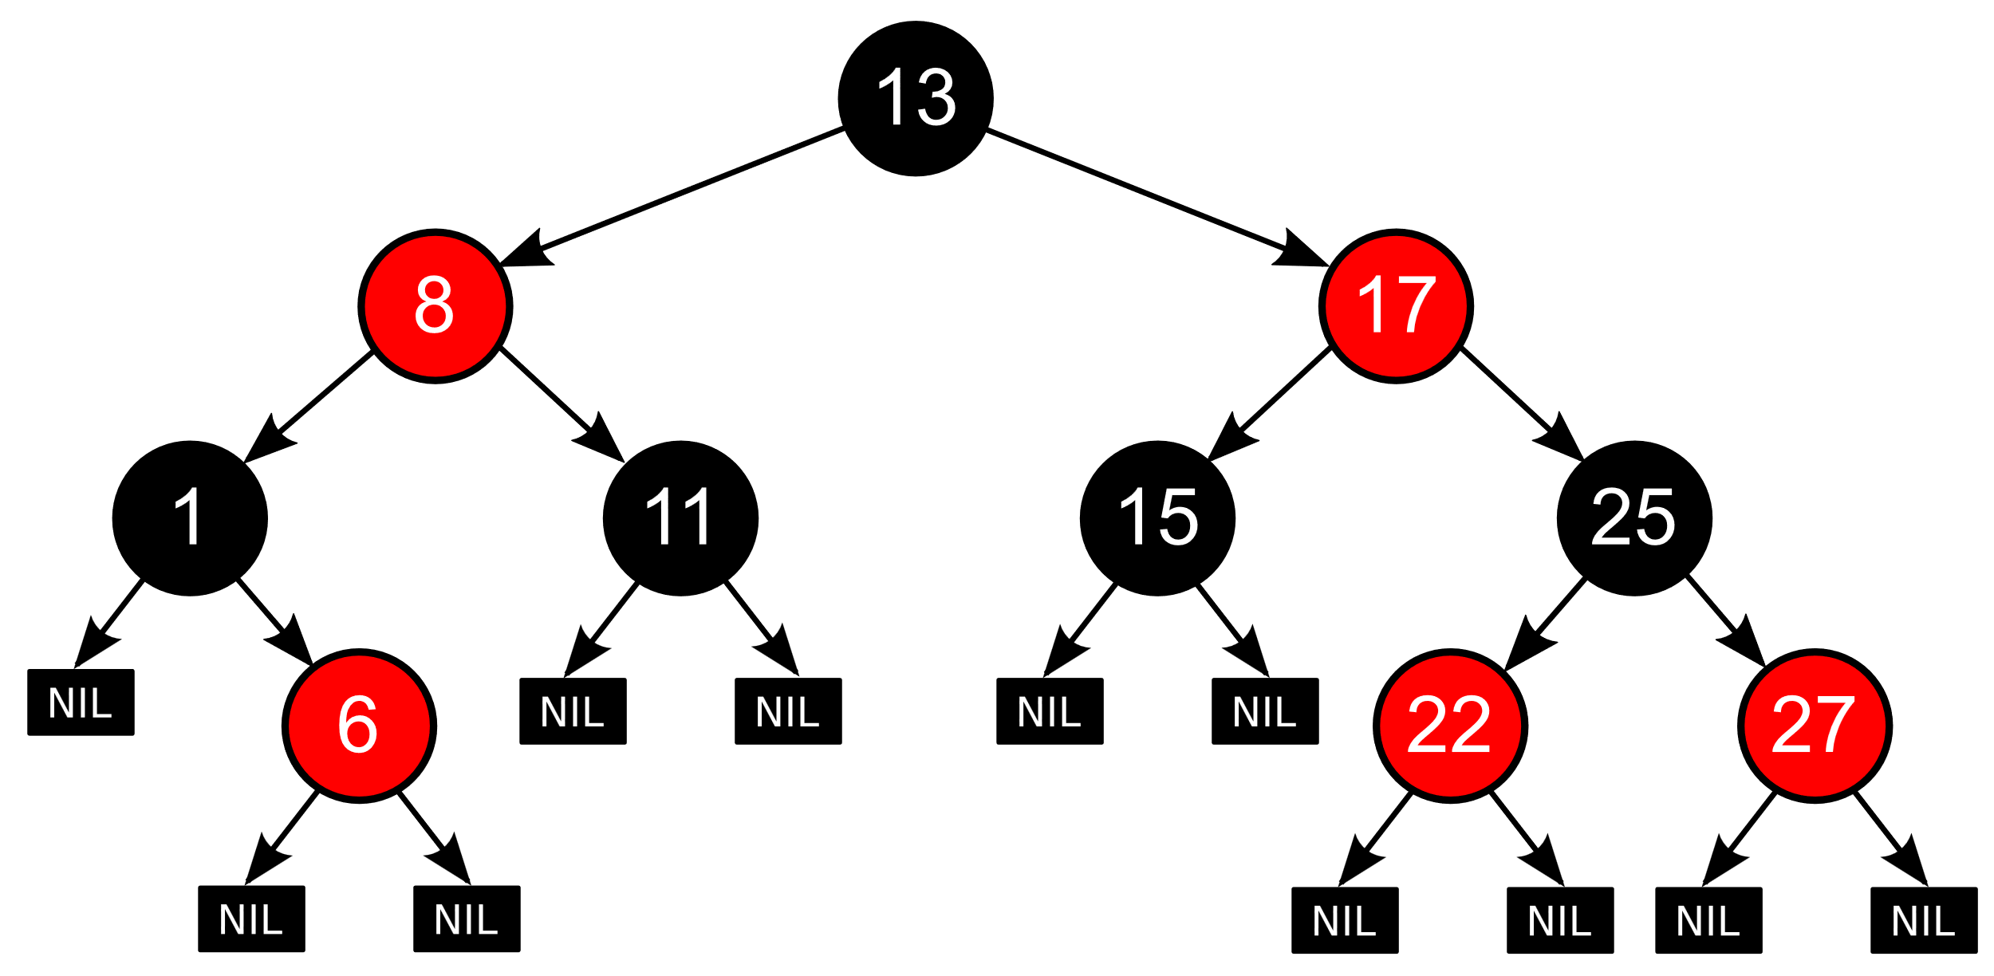
Red-Black Tree

Slide 3
Delete
As in insertion case, the algorithm for deletion can be summarized to:
Perform deletion as in Binary Search Tree.
Case 1: 0 child. Just do it.
Case 2: 1 child. Replace the node with its child.
Case 3: 2 children. Replace the node with the smallest larger successor. Delete the successor following case 1 or case 2.
Fix any Red-Black Tree property violation.
Red node property: there are no 2 consecutive red nodes.
Black node property: the number of black nodes from the root to any leaf are the same (black height).
Root & leaf property: the root and all the null(none) leaves are colored black.

Slide 4
Delete V.s. Insert
In insertion algorithm, we need to inspect the color of the node’s uncle. In deletion, we need to see the color of its sibling, and the sibling’s children.
Insertion algorithm is more likely to violate red property (double red), while deletion algorithm breaks the black property, by deleting a black node and changing the black height of a single path.

Slide 5
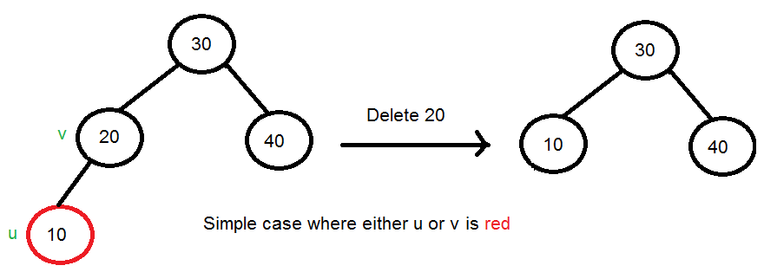
Simple Case
Case 1: Deleting a red node.
Simply delete the node, since the black height will not change.
Case 2: Delete a black node with a red replacement.
Replace the deleted node with a successor and recolor to black.

Slide 6
Not so simple case
Case 3: Deleting a non-root black node with a black replacement (double black). Remember that a none (null) leaf is also considered a black node.
Case 3.1: Sibling is black with a least one red child.
Case 3.2: Sibling is black with no red children.
Case 3.3: Sibling is a red node.

Slide 7
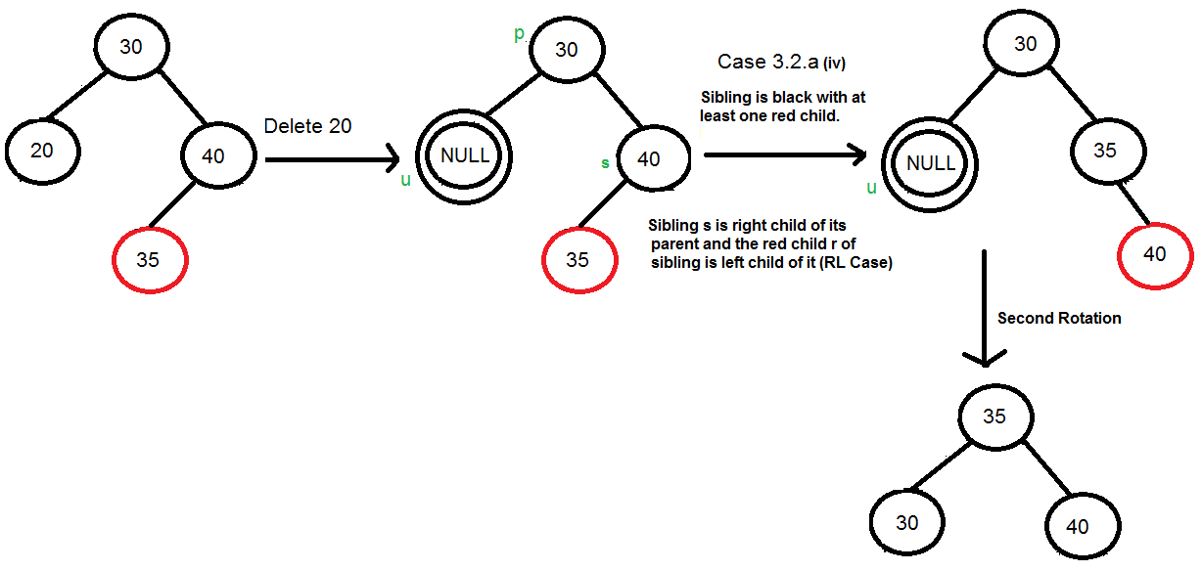
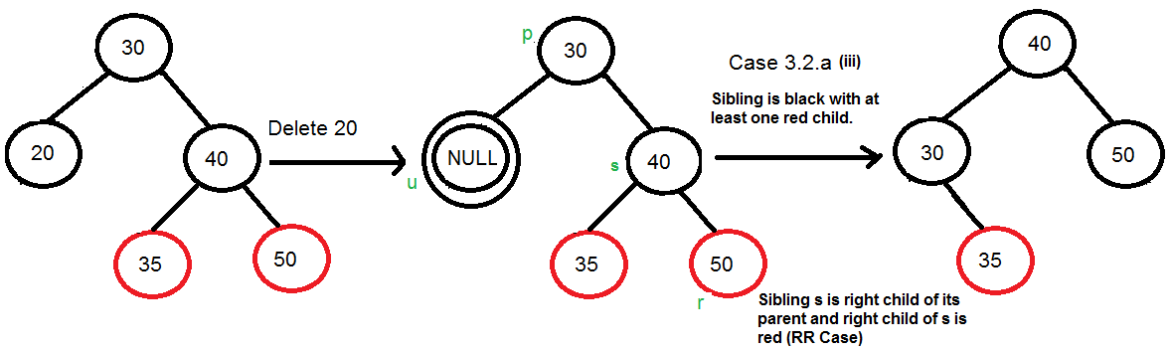
Case 3.1: Sibling is black with a least one red child.
Left-right or right-left case →
Rotate the sibling once to become left-left or right-right case (see below).
Left-left or right-right case ↓
Rotate on parent.

Slide 8
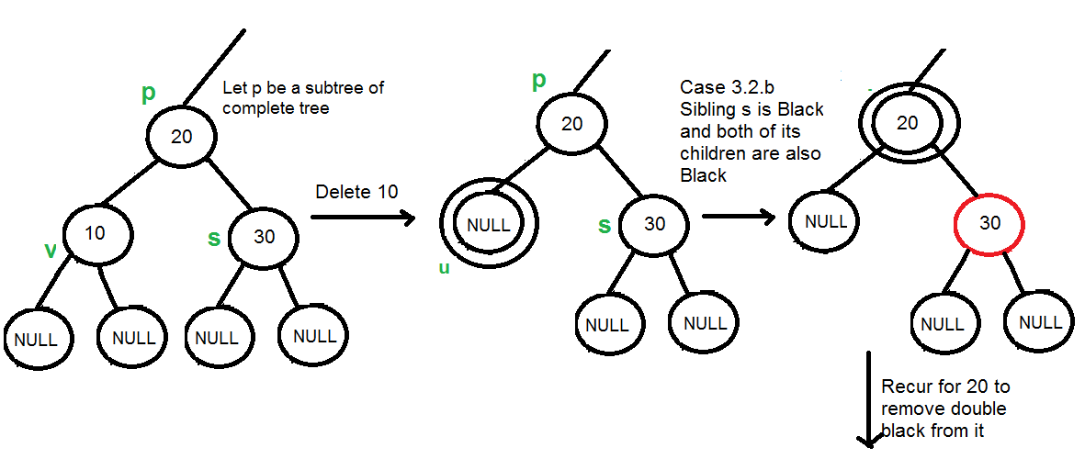
Case 3.2: Sibling is black with no red children.
Recolor the sibling to red, fix double black at parent level.

Slide 9
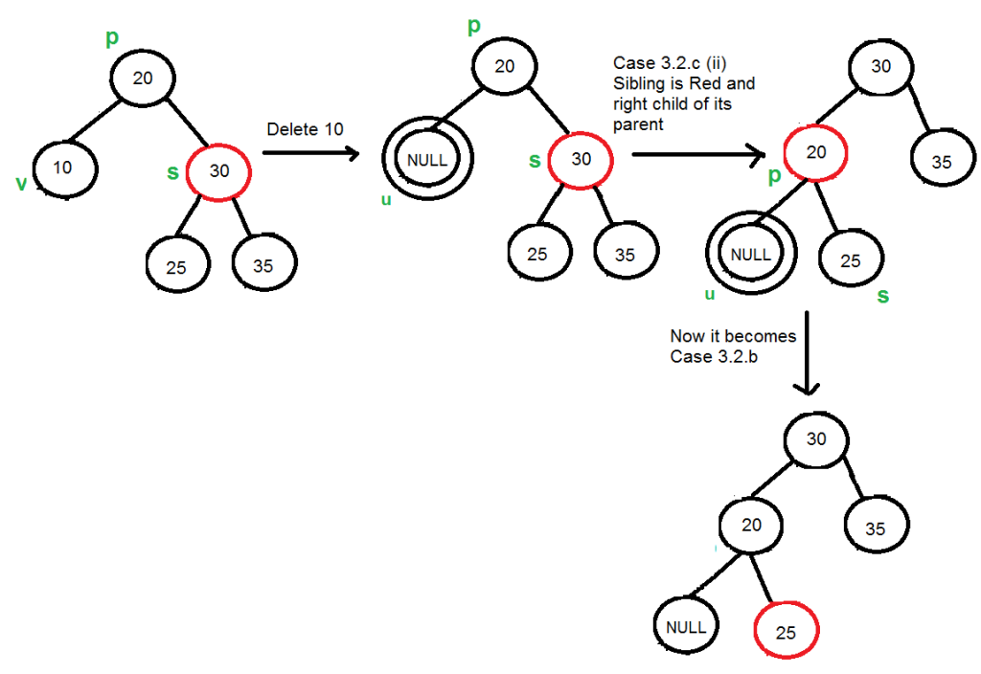
Case 3.3: Sibling is a red node.

Slide 10
TO DO
Review & learn the algorithm and code given at:
https://www.geeksforgeeks.org/deletion-in-red-black-tree/
Or
https://www.cs.purdue.edu/homes/ayg/CS251/slides/chap13c.pdf

Slide 11

Questions?

