Slide 1
MegaPipe : A New Programming Interface for Scalable Network I / O
Sangjin Han⁺, Scott Marshall⁺, Byung-Gon Chun*, and Sylvia Ratnasamy⁺
⁺University of California, Berkeley; *Yahoo! Research
OSDI, 2012
Presented By Dong Yuan, 2015210938

Slide 2



Backgroud
Message-Oriented Workload
Short connections or small messages
Examples: HTTP, RPC, DB
Issues with message-oriented workloads
System call overhead
Shared listening socket
File abstraction overhead

Slide 3
Solved Issues Comparison with mTCP & Fastsocket
MegaPipe (OSDI, 2012)
System call overhead
Shared listening socket
File abstraction overhead
mTCP (NSDI, 2014)
Shared resources
Broken locality
Per packet processing
Fastsocket (ASPLOS, 2016)
Shared resources
Broken locality
Uncompatible API
Notes:
Fast socket solve file abstraction overhead by their Fastsocket-aware VFS, and it’s compatible to normal BSD API.

Slide 4
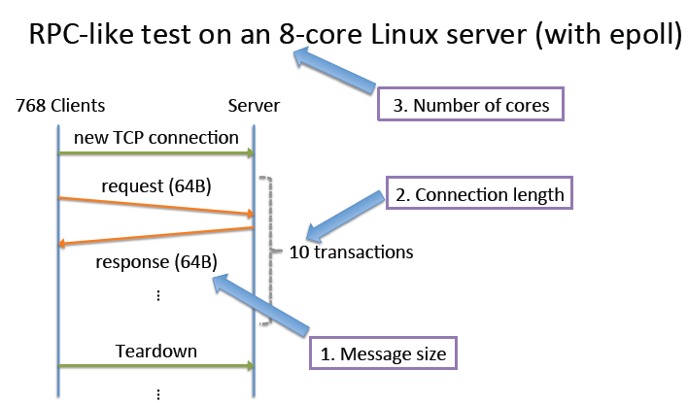
Microbenchmark

Slide 5
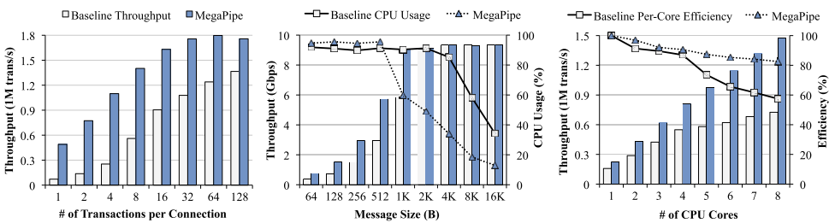
Performance of Message-Oriented Workloads

Slide 6
Design Goal
API, applicable to existing event-driven server applications with moderate efforts
Unified interface for various I/O types, TCP connection, UNIX domain sockets, disk files…
Low overhead & multi-core scalability

Slide 7
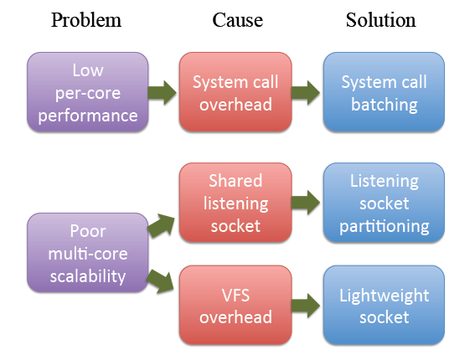
Overview

Slide 8
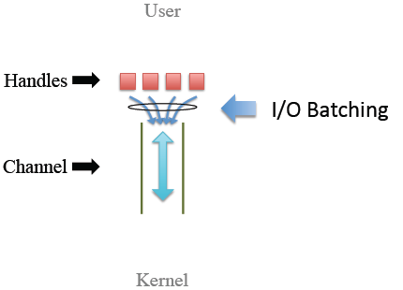
Key Primitives
Handle
Similar to file descriptor
But only valid with in a channel
TCP connection, pipe, disk file…
Channel
A per-core, bi-directional pipe between the kernel and user
Multiplexes I/O operations of its handles

Slide 9
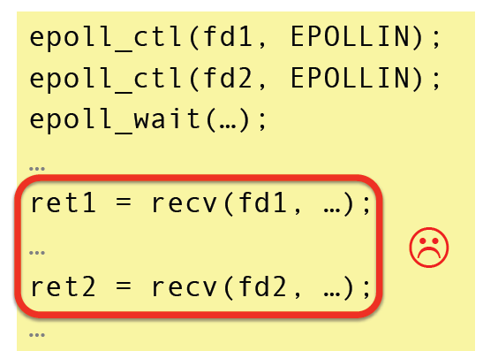
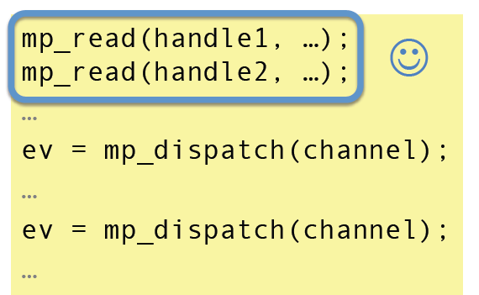
Completion Notification Model
Application issue asynchronous I/O commands
Kernel notifies the application when the commands are complete
Why CNM?
CNM allows transparent batching of I/O commands and notifications
It is compatible with not only sockets but also disk files
Simplify the complexity of I/O multiplexing
Readiness Model
CNM

Slide 10
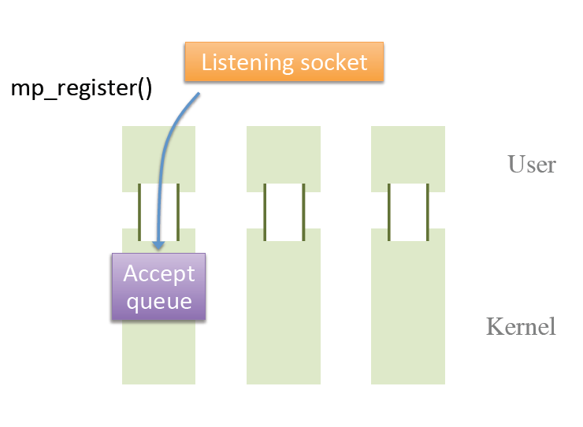
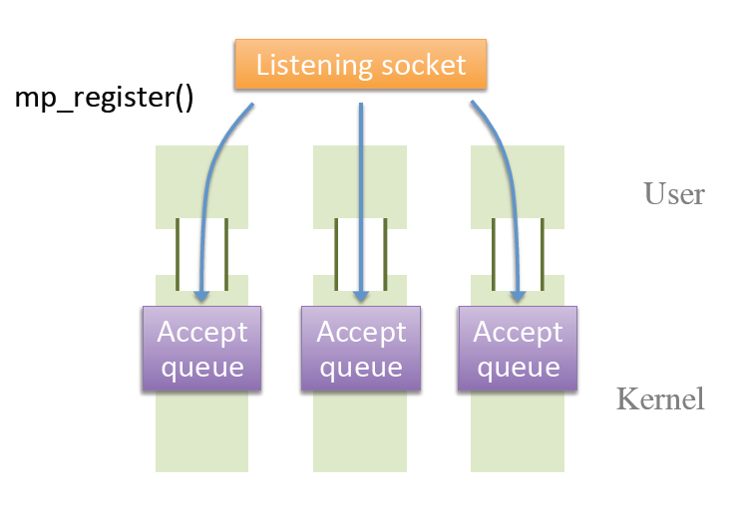
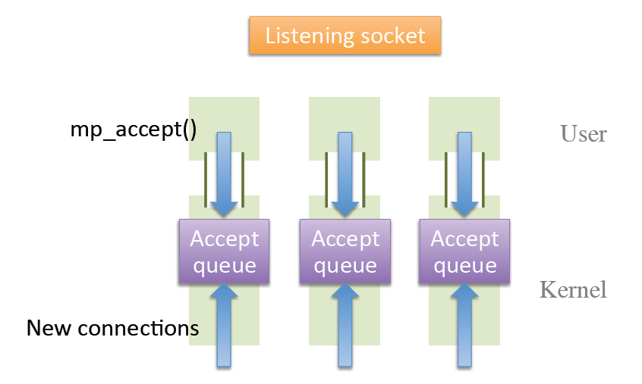
Listening Socket Partitioning
Per-core accept queue for each channel
Instead of the globally shared accept queue

Slide 11
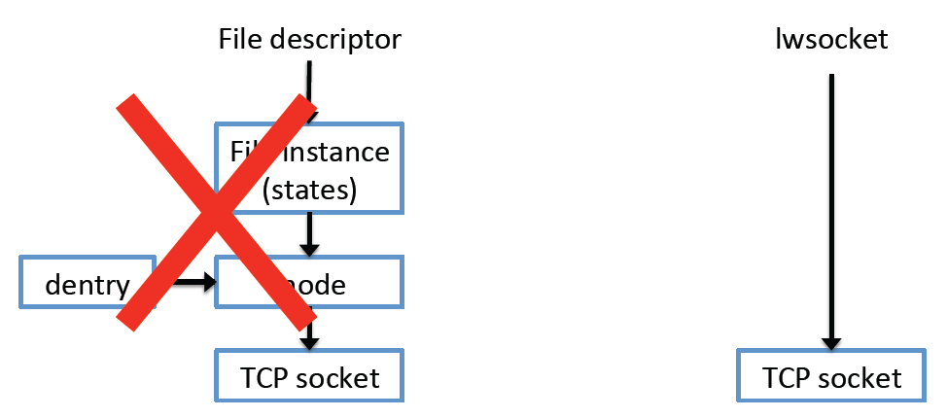
Lightweight Socket
Sockets are ephemeral and rarely shared
Bypass the VFS layer
Convert into a regular file descriptor only when necessary
Notes:
More elegant in FastSocket

Slide 12
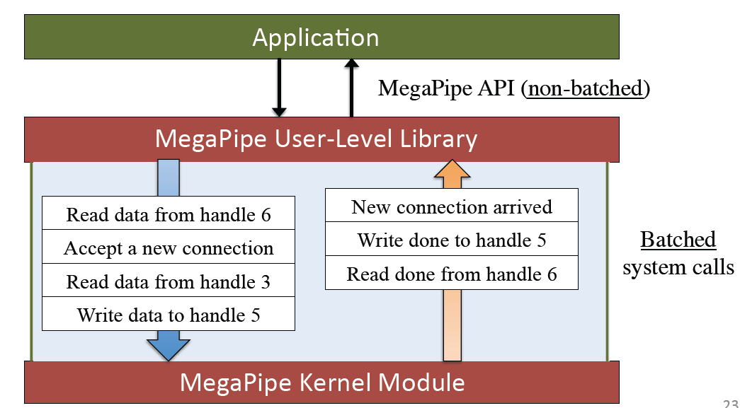
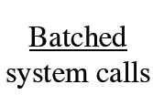
System Call Batching
System calls are expensive due to cost of mode switching and bad cache locality
Transparent batching

Slide 13
Implementation
Kernel
One kernel module (~1800 lines)
Kernel itself (~400 lines)
User-Level Library
~400 lines
Application
Supportive to event-driven server
~hundreds of lines

Slide 14
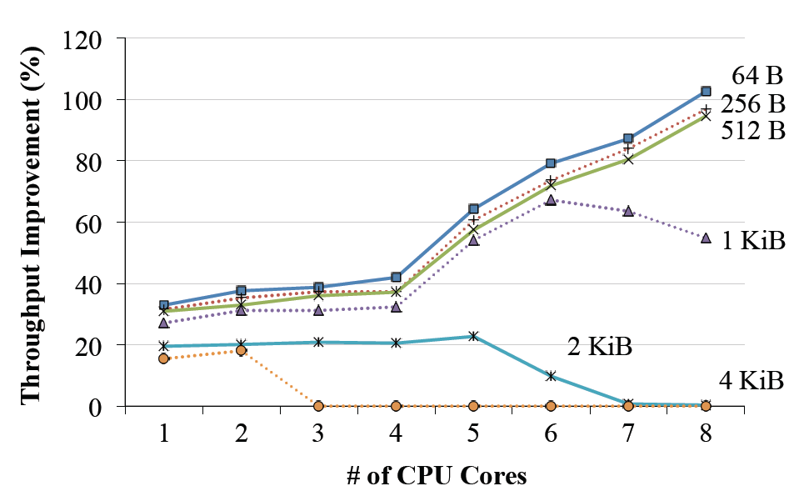
Evaluation
Multi-core scalability
Throughput improvement with various message sizes

Slide 15
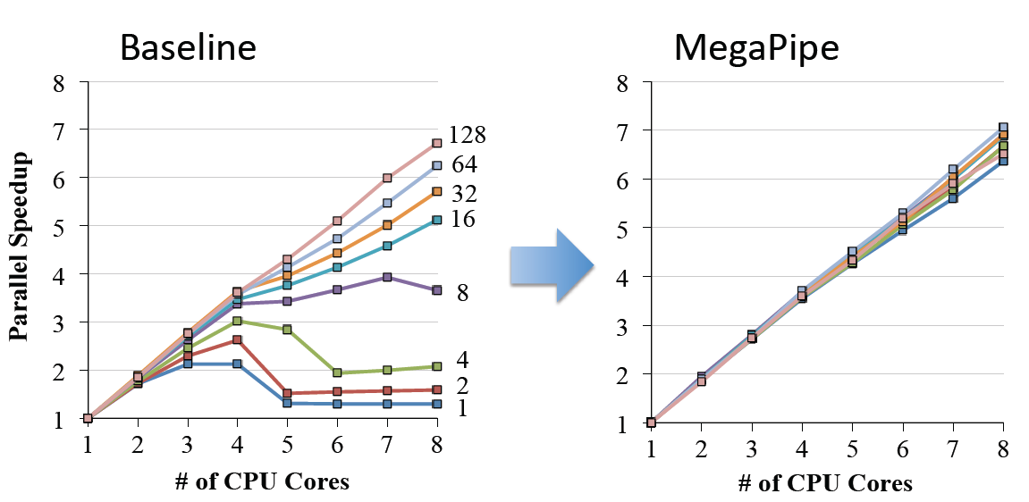
Evaluation
Multi-core scalability
Throughput improvement with various connection lengths (# of transactions)

Slide 16
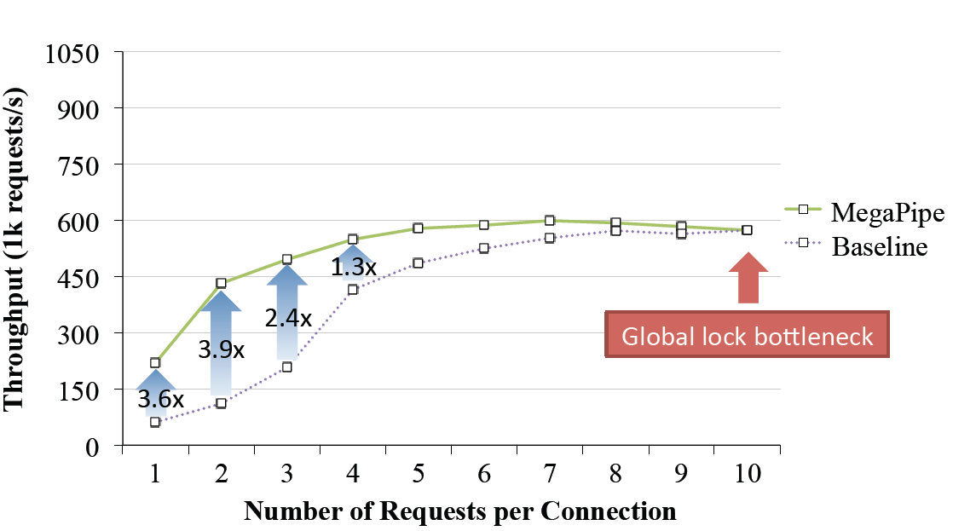
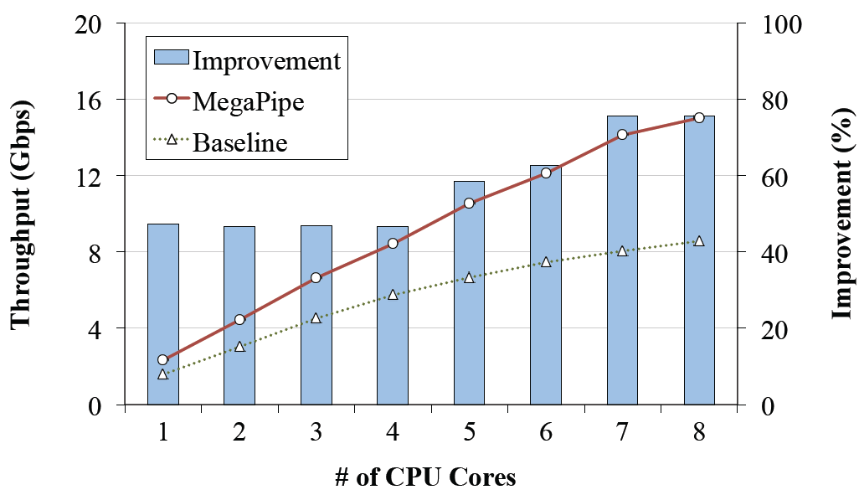
Application Evaluation
Memcached
nginx

Slide 17
Conclusion
MegaPipe
Key abstraction: per-core channel
Enabling three optimization:
Batching, partitioning, lwsocket
Performance improvement in multi-core scalability and application

Slide 18
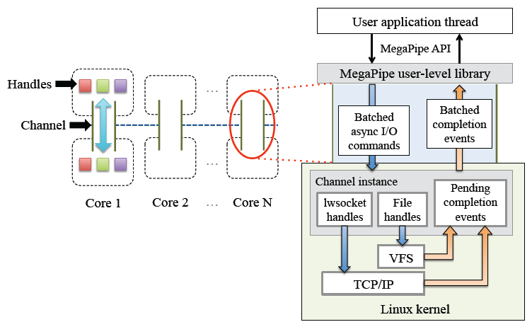
Comments About This Paper

