Slide 1
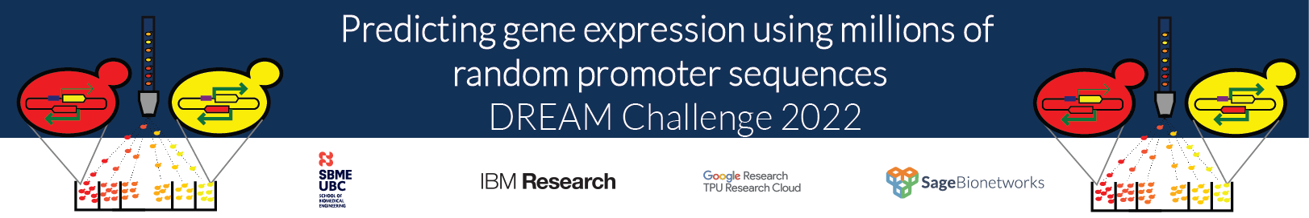

Proformer: a hybrid macaron transformer model predicts expression values from promoter sequences
Wuming Gong¹, Byeong-Chan Kim², Juhyun Lee², Il-Youp Kwak²
¹ Lillehei Heart Institute, University of Minnesota, USA
² Department of Applied Statistics, Chung‑Ang University, Seoul, Republic of Korea
https://github.com/gongx030/dream_PGE

Slide 2
Proformer: an end-to-end Transformer encoder architecture to predict the expression values from DNA sequences
Head
Macaron Encoder
FFN x 0.5
+
N x
Multi-head Attention
Macaron Encoder
Layernorm
+
Strands
0 | 0 | 0 | 0 | 0 | 0 | 0 | 0 | 0 | 1 | 1 | 1 | 1 | 1 | 1 | 1 | 1 | 1
Dropout
Positions
1 | 2 | 3 | 4 | 5 | 6 | 7 | 8 | 9 | 1 | 2 | 3 | 4 | 5 | 6 | 7 | 8 | 9
SeparableConv1D
K-mer representations
Layernorm
A | C | G | G | A | T | G | A | A | T | T | C | A | T | C | C | G | T
FFN x 0.5
Reverse Complement

Slide 3
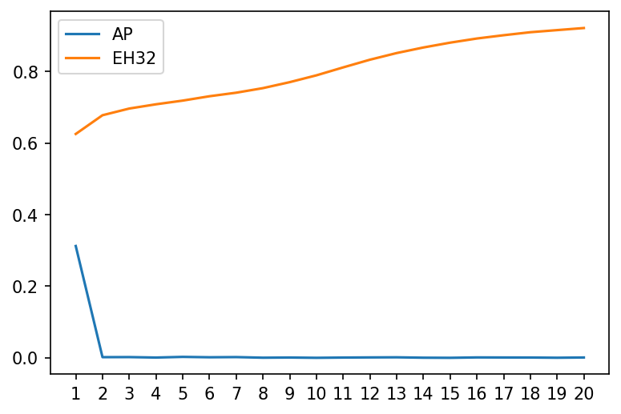
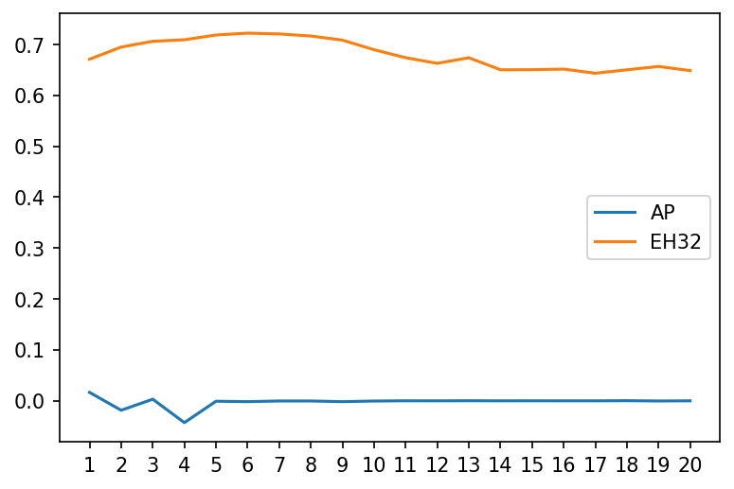

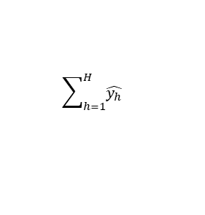
Large over-parameterized models with global average pooling layer failed to converge
Global average pooling
Multiple expression heads with
mask filling
$$\hat{y}$$
$$\sum_{h=1}^{H}{\hat{y_{h}}}$$
Prediction
Prediction
Mask filling
Global Average Pooling
1 | 0 | 2 | 0 | 0
A | C | G | G | A | T | G | A | A | T | T | C | A | T | C | C | G | T
Model
Model
Dimension of 256 and Macaron blocks of 8 on ~500k samples
Training
Validation
Pearson’s R
Pearson’s R
Epochs
Epochs

Slide 4
Multiple expression heads with mask filling produce better performance on large over-parameterized models
Dim. | Attention heads | Macaron Blocks | Average Pooling | Expression heads (H) | P=8 | P=
 |  |  |  | 1 | 8 | 16 | 32 | 64
64 | 2 | 1 | 0.7026 | 0.7046 | 0.7011 | 0.6977 | 0.6977 | 0.6943
64 | 2 | 2 | 0.7094 | 0.7086 | 0.7122 | 0.7119 | 0.7136 | 0.7088
64 | 2 | 4 | 0.7140 | 0.7196 | 0.7162 | 0.7184 | 0.7190 | 0.7200
64 | 2 | 8 | 0.7151 | 0.7198 | 0.7223 | 0.7138 | 0.7191 | 0.7214
128 | 4 | 1 | 0.7033 | 0.7153 | 0.7137 | 0.7075 | 0.7069 | 0.7047
128 | 4 | 2 | 0.7164 | 0.7209 | 0.7142 | 0.7197 | 0.7147 | 0.7175
128 | 4 | 4 | 0.7189 | 0.7224 | 0.7207 | 0.7218 | 0.7139 | 0.7192
128 | 4 | 8 | 0.0145 | 0.6627 | 0.7223 | 0.7200 | 0.7207 | 0.7226
256 | 8 | 1 | 0.7109 | 0.7177 | 0.7104 | 0.7124 | 0.7058 | 0.7152
256 | 8 | 2 | 0.7157 | 0.7219 | 0.7197 | 0.7185 | 0.7207 | 0.7177
256 | 8 | 4 | 0.6406 | 0.6616 | 0.7210 | 0.7186 | 0.7213 | 0.7211
256 | 8 | 8 | 0.0165 | 0.0603 | 0.7188 | 0.7194 | 0.7222 | 0.7173
Pearson’s R
10% of training sequences / expression pairs
Adam optimizer with base learning rate of 0.001 and clipping
Linear warmup (one epoch) with cosine decay
Batch size of 512
Best Pearson’s R in the first 20 epochs
Masking 5% of positions
K-mer of 5 with stride of one

Slide 5
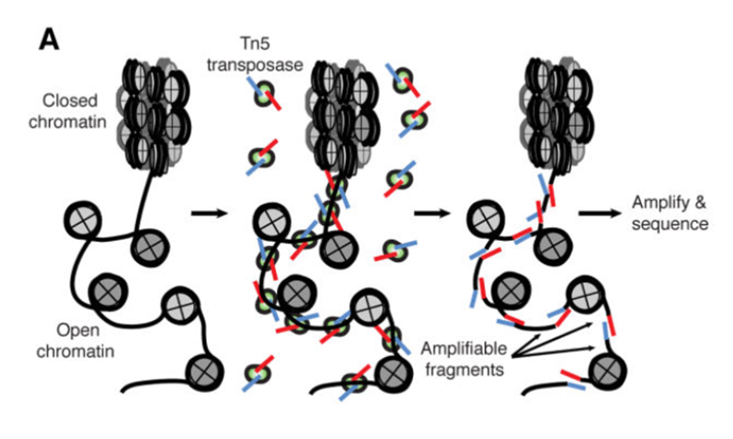
Predicting chromatin accessibility from DNA sequences
Assay for Transposase-Accessible Chromatin with high-throughput sequencing (ATAC-seq)
20 nt
ATAC-seq signal
Prediction
A | C | ... | G | G | T | G | A | A | T | T | C | A | C | ... | C | G | T
100 nt
ATAC-seq data of GM12878 (human LCL)
100,000 genomic sub-regions were randomly sampled from the 1,000 bp region surrounding each of ~80,000 ATAC-seq summits.
Each genomic sub-region includes 100 nucleotides.
We built models to predict mean ATAC-seq signals of the central 20 bp from DNA sequences.

Slide 6
Multiple expression heads with mask filling have better performance on predicting chromatin accessibility from DNA sequences
Dim. | Attention heads | Macaron Blocks | Average Pooling | Expression heads (H) | P=8 | P=
 |  |  |  | 1 | 8 | 16 | 32 | 64
64 | 2 | 1 | 0.4726 | 0.4497 | 0.4450 | 0.4570 | 0.4467 | 0.4528
64 | 2 | 2 | 0.4832 | 0.4353 | 0.4739 | 0.4677 | 0.4660 | 0.4626
64 | 2 | 4 | 0.4434 | 0.4871 | 0.4823 | 0.4855 | 0.4834 | 0.4783
64 | 2 | 8 | 0.4222 | 0.4888 | 0.4767 | 0.4828 | 0.4875 | 0.4848
128 | 4 | 1 | 0.4434 | 0.4451 | 0.4660 | 0.4651 | 0.4627 | 0.4574
128 | 4 | 2 | 0.4177 | 0.4711 | 0.4889 | 0.4802 | 0.4847 | 0.4850
128 | 4 | 4 | 0.2346 | 0.3977 | 0.4964 | 0.4868 | 0.4880 | 0.4882
128 | 4 | 8 | 0.0155 | 0.0858 | 0.0335 | 0.4946 | 0.4910 | 0.4915
Pearson’s R
80k training samples
20k testing samples
Adam optimizer with base learning rate of 0.001 and clipping
Linear warmup (one epoch) with cosine decay
Batch size of 512
Best Pearson’s R in the first 20 epochs
Masking 5% of positions
K-mer of 5 with stride of one

Slide 7
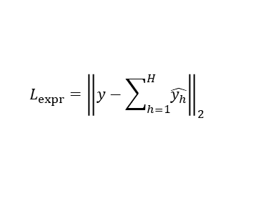

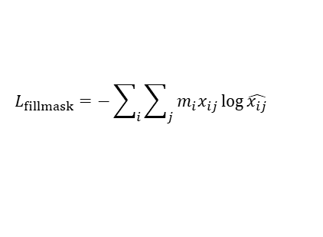
Proformer: A hybrid Macaron transformer model predicts expression values from promoter sequences
Expression loss
Mask filling
$$L_{expr}={\left\|y−\sum_{h=1}^{H}{\hat{y_{h}}}\right\|}_{2}$$
$$L_{fillmask}=−\sum_{i}{\sum_{j}{m_{i}x_{ij}\log{\hat{x_{ij}}}}}$$
$$L=L_{expr}+{βL}_{fillmask}$$
Expression
heads (H)
1 | 0 | 2 | 0 | 0
A | C | G | G | A | T | G | A | A | T | T | C | A | T | C | C | G | T
Macaron Encoder
N x
Macaron Encoder
Strands
0 | 0 | 0 | 0 | 0 | 0 | 0 | 0 | 0 | 1 | 1 | 1 | 1 | 1 | 1 | 1 | 1 | 1
Positions
1 | 2 | 3 | 4 | 5 | 6 | 7 | 8 | 9 | 1 | 2 | 3 | 4 | 5 | 6 | 7 | 8 | 9
K-mer representations
A | C | G |  |  | T | G |  | A |  | T | C | A |  | C |  | G | T
Masking
A | C | G | G | A | T | G | A | A | T | T | C | A | T | C | C | G | T
Reverse Complement

Slide 8
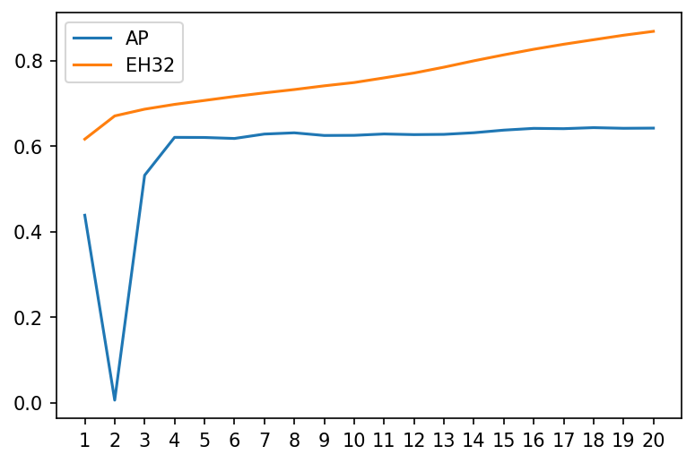
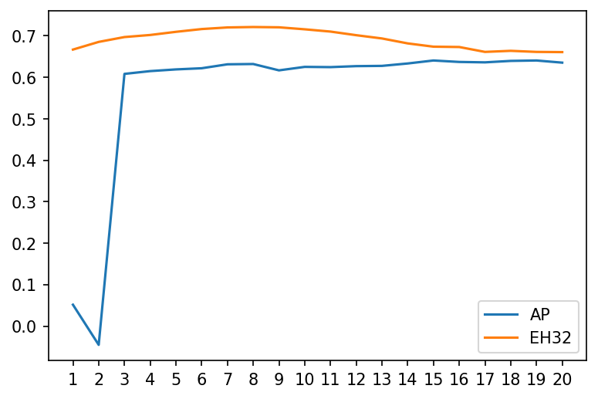
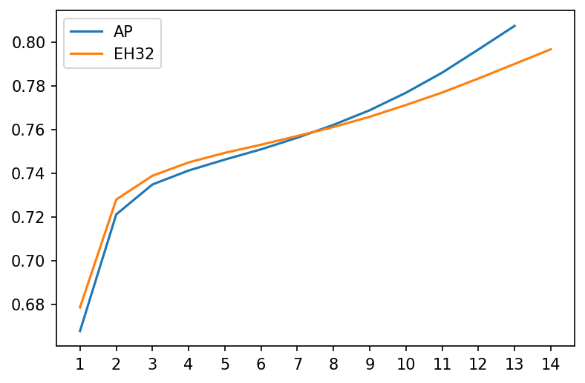
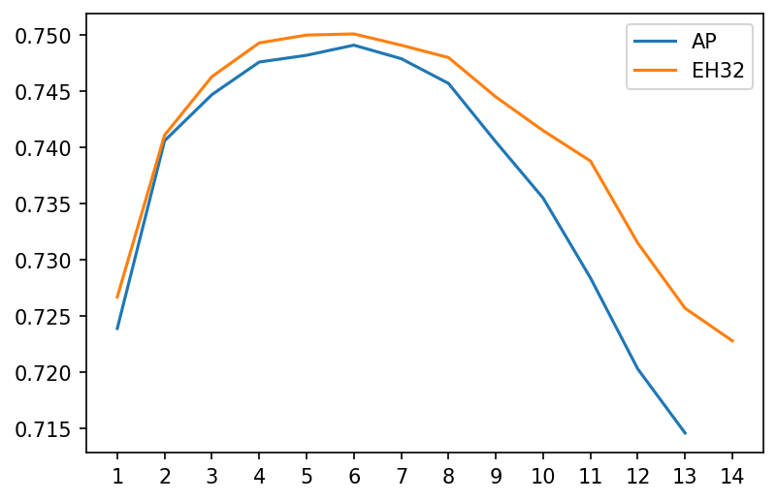
Multiple expression heads with mask filling produce better performance on larger models
10% data
Training
Validation
Pearson’s R
Pearson’s R
Epochs
Epochs
full data
Training
Validation
Pearson’s R
Pearson’s R
Epochs
Epochs

Slide 9
Multiple expression heads with mask filling are critical for improving the prediction performance on hold-out validation data
Ablation analysis
Global average pooling | Mask filling | Expr. heads | Score PearsonR | Score Spearman | PearsonR | Spearman
X |  |  | 0.766 | 0.819 | 0.918 | 0.961
 | X | 1 | 0.765 | 0.817 | 0.921 | 0.964
 | X | 32 | 0.781 | 0.827 | 0.926 | 0.965
 | X | 32* | 0.765 | 0.810 | 0.929 | 0.967
* with GLU

Slide 10


Challenge Organizers
Carl de Boer
Abdul Muntakim Rafi
Jake Albrecht
Pablo Meyer
Paul Boutros
CAU ET lab
Byeong-Chan Kim
Juhyun Lee
Il-Youp Kwak
Lillehei Heart Institute
Nikita Dsouza
Xiao Ma
Daniel J Garry
All participants
We thank for providing computation resource.
We thank for providing travel grant of $2,000.

