Slide 1
Regional Airline — Fuel Shock & UDAN Analysis
Diagnosis, UDAN scenario & recommendation (IIT Guwahati Winter Consulting)

Slide 2
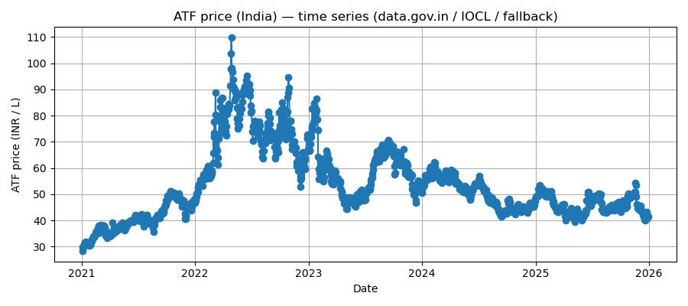
Slide 1 — ATF time series (India)

Slide 3
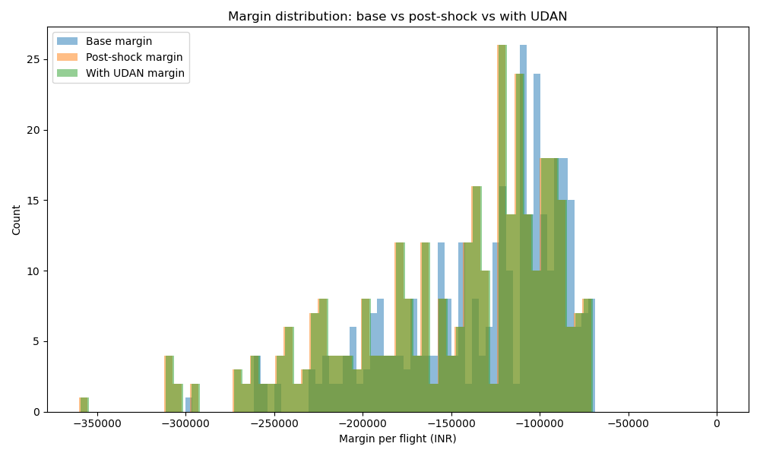
Slide 2 — Margin impact: base vs post-shock vs UDAN

Slide 4
Slide 3 — Vulnerable routes (post-shock)
IXZ-DEL | dist 2485.0 km | post_shock margin -360179 INR
BOM-GAU | dist 2071.1 km | post_shock margin -310115 INR
GAU-BOM | dist 2071.1 km | post_shock margin -310115 INR
DEL-COK | dist 2048.9 km | post_shock margin -307430 INR
COK-DEL | dist 2048.9 km | post_shock margin -307430 INR
GAU-BLR | dist 2039.4 km | post_shock margin -306281 INR

Slide 5
Slide 4 — UDAN impact & Recommendation
Option B (UDAN) can stabilize a subset of fragile regional routes short-term.
It saves 0 routes from being loss-making under a +25% fuel shock.
Recommendation: Use UDAN selectively as downside insurance; prioritize network optimization on core routes.

Slide 6
Slide 5 — KPIs & Exit Triggers
KPIs: Route-level EBITDA margin, CASK, Cash burn rate.
Triggers: Exit route if margin < threshold for 2 consecutive quarters.
Begin structural redesign planning (fleet mix) as Phase 2; do not lock entire fleet into UDAN.

