Slide 1

CFPB DATA PROJECT
DOUGLAS LEUNG

Slide 2
MOTIVATION
I had recently applied to the Consumer Finance Protection Bureau. For the first part of the application process, a skills assessment test was given.
One requirement was to use open source software. So without prior experience, I decided to give Python a shot. Naturally, this has lead me to take this Data Science class to broaden my skillset.

Slide 3
QUESTION
Can I predict the type of Product complaint based on the following factors or combinations of:
Income
Population
Native to state/From Another State
Foreign born
Poverty status
Note: I am not a subject matter expert, but this question was developed to make use of the involved data sources of the exercise.

Slide 4
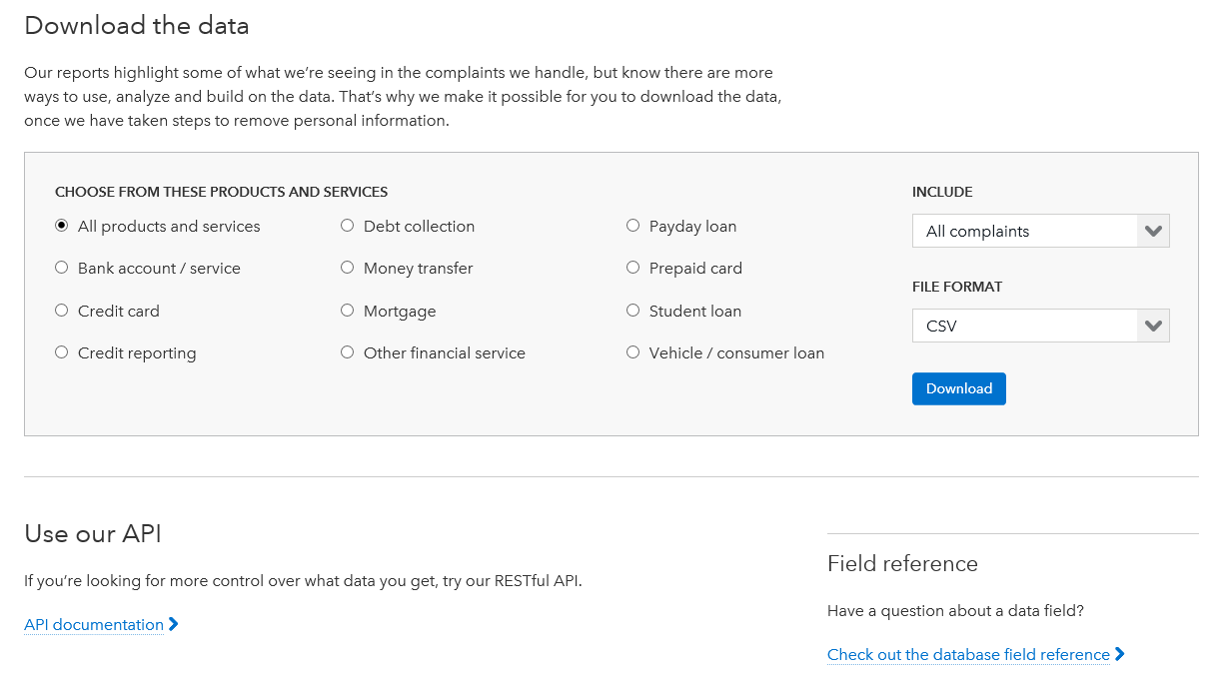
COMPLAINTS DATA
CFPB’s public complaint database
File Download or API (http://www.consumerfinance.gov/complaintdatabase/)

Slide 5
INCOME & GEOGRAPHY DATA
Income data from the 5-year ACS survey file from census.gov
Data File Starting with E is for Estimates, M file is for Margin (http://www2.census.gov/acs2013_5yr/summaryfile/2009-2013_ACSSF_By_State_By_Sequence_Table_Subset/UnitedStates/All_Geographies_Not_Tracts_Block_Groups/20135us0015000.zip)
Header in Seq15.xls (http://www2.census.gov/programs-surveys/acs/summary_file/2013/data/2013_5yr_Summary_FileTemplates.zip)
Geography information for the 5-year ACS survey file from census.gov
CSV data file (http://www2.census.gov/acs2013_5yr/summaryfile/2009-2013_ACSSF_By_State_By_Sequence_Table_Subset/UnitedStates/All_Geographies_Not_Tracts_Block_Groups/g20135us.csv)
Header on Page 10 of PDF (http://www2.census.gov/acs2013_5yr/summaryfile/ACS_2013_SF_Tech_Doc.pdf)

Slide 6
DATA EXAMINATION
Complaint Data (419985, 15)
Range (12/1/2011 - 07/15/2015)
NaN’s exist in more detailed fields
Need to Reduce the response variable classifications
Currently 11 unique products
Without subject matter expertise, regrouping may be more difficult.
Excluding the less prominent products may make more senses
Income Data (43600, 165)
From the 5-Year ACS (2009-2013)
Many NaN fields, specifically for Puerto Rico
Geography Data (43600, 52)
Can be reduced down to two fields

Slide 7
MERGING & CLEANING
Merging
Headers for the ACS data needed to be attached
Complaint Data Indexed on Complaint ID
Income & Geography Data Indexed and joined on Log Record Number
Geography Data used to bridge the Income & Complaint
Cleaning
Need to limit to the 50 states only
Unnecessary columns will be discarded (too much detail)
ZCTA /Zipcode (Imperfect Bridge)
Unmatched rows counts: ZIP_code 12246, ZCTA5 12566
“XX”, “HH” and 3-digit codes need to be excluded

Slide 8
CURRENT STATUS & CONCERNS
Scope of the project may need to refocus if too many features are found to be irrelevant
Can shift over to purely income data ranges
May explore using the 1-year ACS files instead of the 5-year
Contingent on the ability to join onto Complaint data
Less precision and more current
Good for large populations vs. Small populations
Digging through the Census file system, potentially there are many choices for additional data features.
(http://www2.census.gov/acs2013_5yr/summaryfile/Sequence_Number_and_Table_Number_Lookup.xls)

