Slide 1
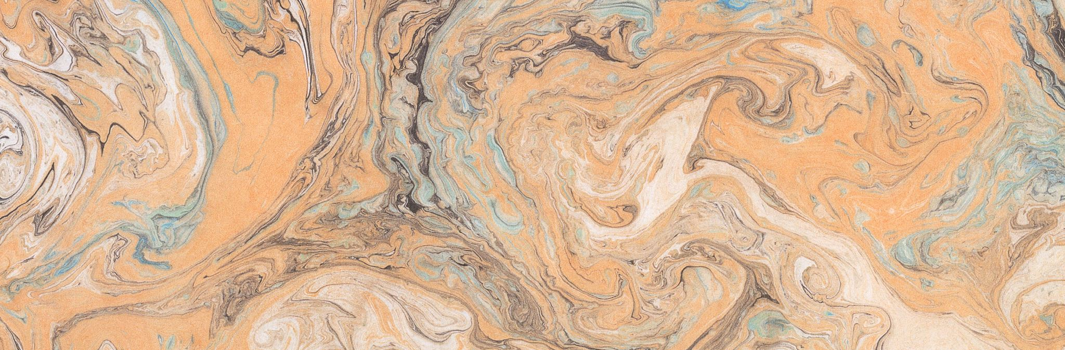
Pathfinding T00158237 Daniel Jameson
How Modern Mapping and Graphs can Enhance Navigation Techniques
Notes:
This is a title page. It doesn’t really need notes.

Slide 2
Research Question
This report will investigate modern mapping and pathfinding techniques to examine the possibility of generating routes for a range of purposes.
Notes:
The research area from the paper is: The purpose of the research is to determine what kind of technology would be best suited to the task of mountain navigation, and how to apply with modern technologies.

Slide 3
Research Breakdown
Pathfinding Techniques – Pathing Algorithms such as A*, Dijkstra’s, etc.
Hardware – Python, IDEs, Virtual Environments, etc.
Area Assessing Techniques – LiDar, Photogrammetry, etc.
Geography – Carrauntoohil Area Assessment, using Elevation Data.
Global Positioning System(GPS) – Modern Navigation Comparison.
Notes:
Pathfinding – Lazy Theta* Algorithm, modification for complex graphs.
Hardware – Python Libraries such as MatPlotLib for data visualisation, NumPY for advanced computational capabilities, Folium for Map visualisation.
Area Assessment – Light Detection and Ranging, Photogrammetry.

Slide 4
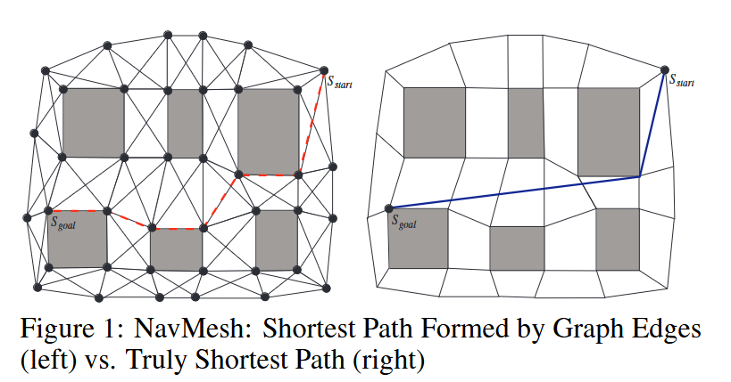
Graph Examination – Pathing Example
Dijkstras’ Algorithm
A* Algorithm
Lazy Theta* Algorithm
Notes:
Dijkstras’ Algorithm – The Granddaddy of modern pathing algorithms.
Lazy Theta* - Finds nodes not necessarily connected to source, but destination must be viewable to the source node.
A* - Modification of Dijkstras’, can use next and previous nodes to determine lowest cost path. Only uses adjacent nodes.
Image Source – Alex Nash, 2010. Computer Science Department, University of California. https://idm-lab.org/bib/abstracts/papers/socs10a.pdf

Slide 5
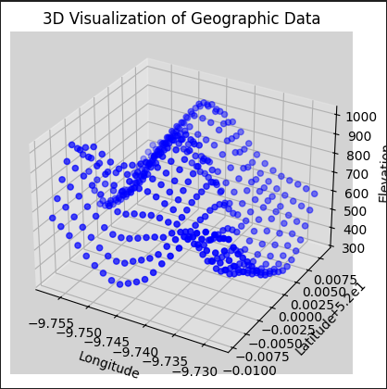
Prototype - Gathering Relevant Dataset
The data was gathered using Google Elevation API. Returning the values over the course of a bounding box.
Notes:
This dataset was gathered with a nested array, of steps + 1 for the boundaries. When returning a response from the endpoint, it produces Lats and Longs over the course of the array.

Slide 6
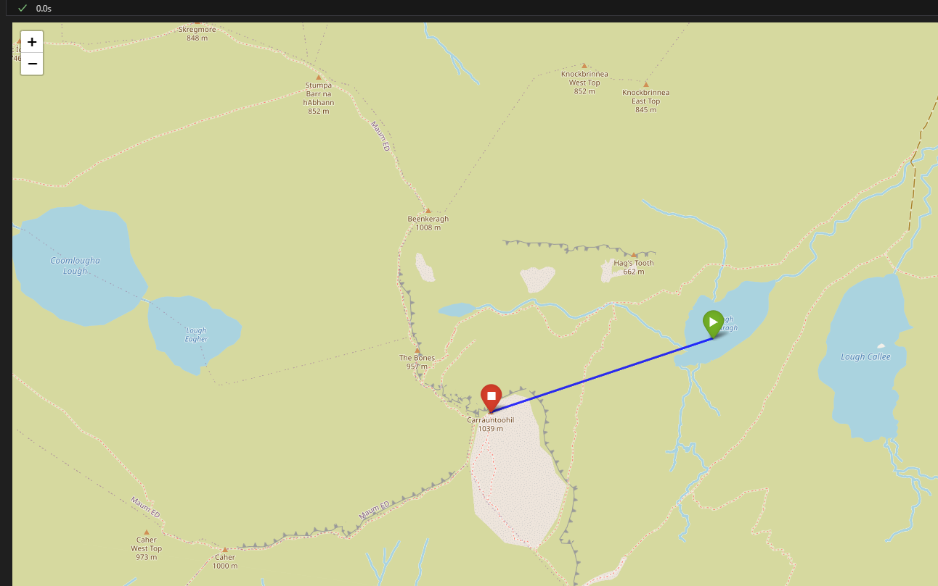
Prototype – Basic Pathfinding Implementation
Using Pythons Folium Library, we can draw a line between the lowest and highest points on the dataset. It produces a HTML response.
Notes:
Folium library - https://pypi.org/project/folium/
This library has methods for returning HTML and Javascript responses that, in this case, uses a map to draw a line between points.

Slide 7
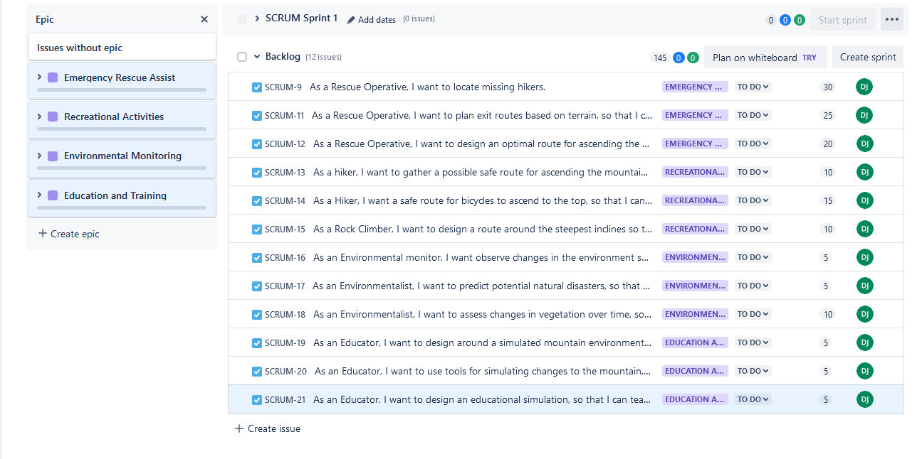
JIRA – Boards for User Stories
Mountain Rescue – Locating Hikers
Recreational Users – Rock Climbing
Environmental Activists – Terrain Assessment
Educational Providers – Educating in Simulated Environments
Notes:
JIRA implementation can be found at the following address: https://mountain-navigation.atlassian.net/jira/software/projects/SCRUM/boards/1/

Slide 8
Further Resources and Links
Project links
Study links
Project Github Repository
JIRA Work Board
Carrauntoohil Summit
Alex Nash - Pathfinding Study
Python Libraries
National Search and Rescue Plan
Notes:
All links worked, last I checked. Assigned the Github Repository to public, and we’re good.

