Slide 1
Project: Minesweeper
CS622 advanced Java Programming
Notes:
My name is CC.Liang or you can simply call me Hank. Today, I will introduce my project mine sweeper

Slide 2
Minesweeper
A classic puzzle game
Notes:
Before I get down to brass tacks, I'd like to briefly explain why I choose this topic.
When I was thinking about the project topic, the first thing came into my mind was to remake an app in the good old days.
Then I recalled there was an app called MSN messenger. I used to use it everyday when I was in high school.

Slide 3
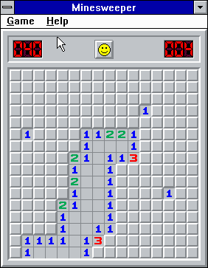
Windows 3.1 (1992)

Slide 4

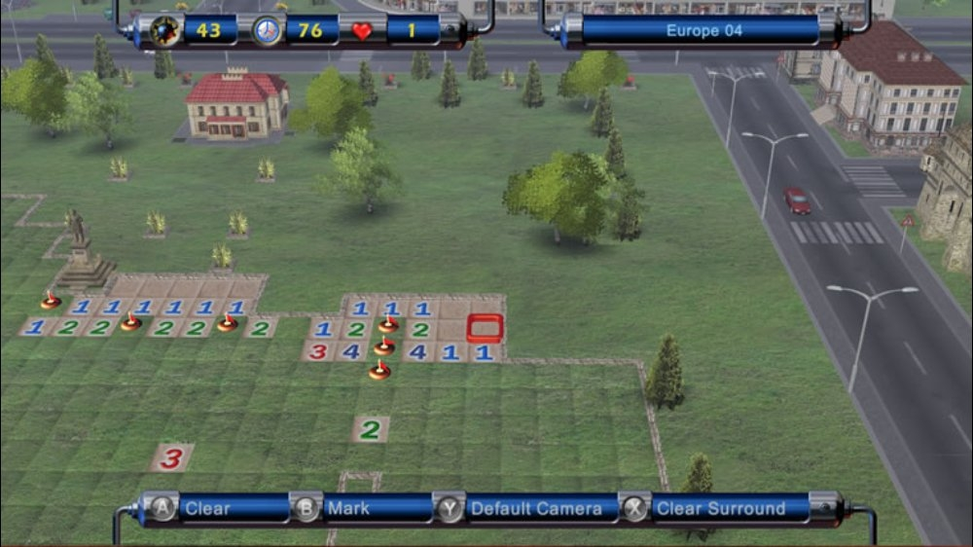
Variations
Notes:
For those who is not familiar with MSN messenger, this is the interface.
As you can see, you can send and receive messages in those boxes.
You can imagine there was no cellphone.
A simple but interactive game can be a worthwhile diversion.
At that time, Minesweeper is one of my favorite games.
The MSN version of Minesweeper is slightly different from the original version.
While the original aims to avoid touching the mines, the MSN version needs to find the mines.
The first one who finds out 26 out of 50 mines will win the game.

Slide 5
The Rules of minesweeper
The Algorithm

Slide 6
Board
Notes:
The game begins with a grid of squares.

Slide 7
Interaction
1. Left-click: reveal
2. Right-click: flag
Notes:
There are only two operations: left-click & right click
The pic here will help me explain the rules

Slide 8
Rule
Left-click on a cell:
If this cell is not a mine
If neighbor cell(s) have mine(s), this cell shows count of the mine(s)
M
M
M

Slide 9
Rule
Left-click on a cell:
If this cell is not a mine
If neighbor cell(s) have mine(s), this cell shows count of the mine(s)
M
M
3
M

Slide 10
Rule
Left-click on a cell:
If this cell is not a mine
If neighbor cell(s) have mine(s), this cell shows count of the mine(s)
If neighbor cells have no mines, the neighbor cells open

Slide 11
Rule
Left-click on a cell:
If this cell is not a mine
If neighbor cell(s) have mine(s), this cell shows count of the mine(s)
If neighbor cells have no mines, the neighbor cells open
1
1
2

Slide 12
Rule
Left-click on a cell:
If this cell is not a mine
If neighbor cell(s) have mine(s), this cell shows count of the mine(s)
If neighbor cells have no mines, the neighbor cells open
If this cell is a mine, boom!
M

Slide 13
Rule
Left-click on a cell:
If this cell is not a mine
If neighbor cell(s) have mine(s), this cell shows count of the mine(s)
If neighbor cells have no mines, the neighbor cells open
If this cell has a mine, boom!
Right-click on a cell: Put a flag on this cell
1
1
1
1
1
1
1
1

Slide 14
Pseudocode
openCell (this cell)
if this cell is not a mine:
if neighbor cell(s) have mine(s):
this cell shows count
else:
openCell (neighbor cell)
else:
gameover

Slide 15
Show counts
j - 1
j
j + 1
i - 1
0
0
0
i
0
0
0
i + 1
0
0
0

Slide 16
Set cells’ Information
for (int i=0; i < board.length; i++)
for(int j=0; j < board.width; j++) {
if( cellInformation[i][j] == MINE) {
// previous row
MineCountAt(i-1, j-1);
MineCountAt(i-1, j);
MineCountAt(i-1, j+1); // left and right cells
MineCountAt(i, j-1);
MineCountAt(i, j+1);
// next row
MineCountAt(i+1, j-1);
MineCountAt(i+1, j);
MineCountAt(i+1, j+1);
}
}
j - 1
j
j + 1
i - 1
+1
+1
+1
i
+1
M
+1
i + 1
+1
+1
+1
Notes:
// previous row
// left and right cells
// next row

Slide 17
Set cells’ Information
j - 1
j
j + 1
j - 1
j
j + 1
i - 1
+1
M
i - 1
+1
M
i
+1
+1
i
+1
+2
+1
i + 1
M
+1
i + 1
M
+1
Notes:
// previous row
// left and right cells
// next row

Slide 18
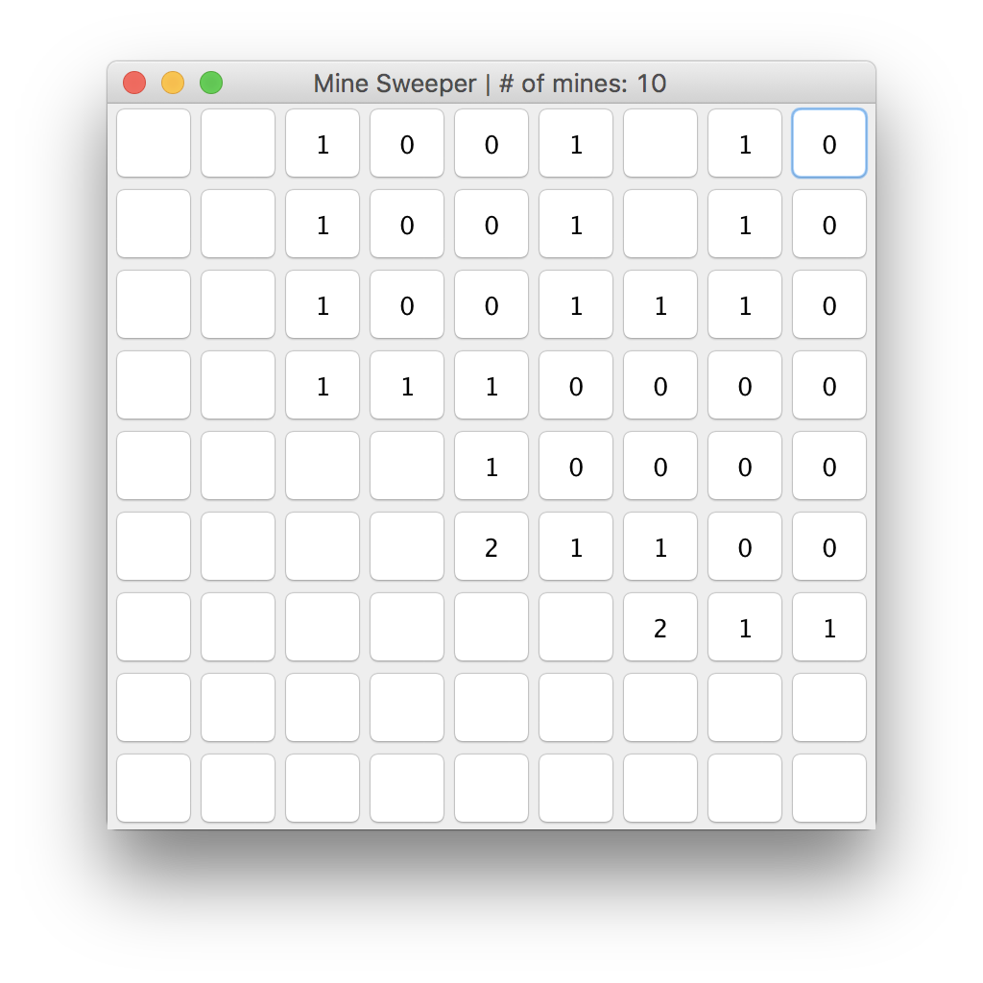
M
M
M

Slide 19
DEMO
Contribute to JMines by Juliana Peña
Under GNU general public license

Slide 20
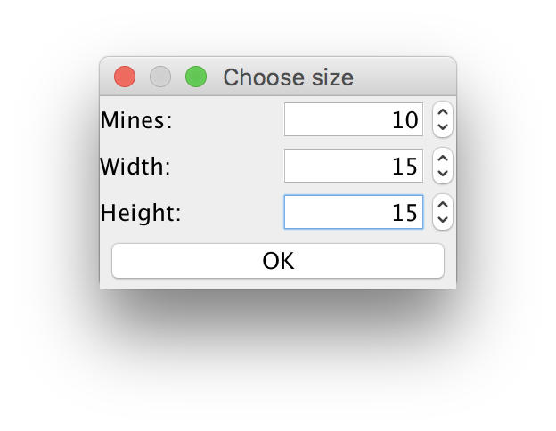
Notes:
Set Difficulty

Slide 21
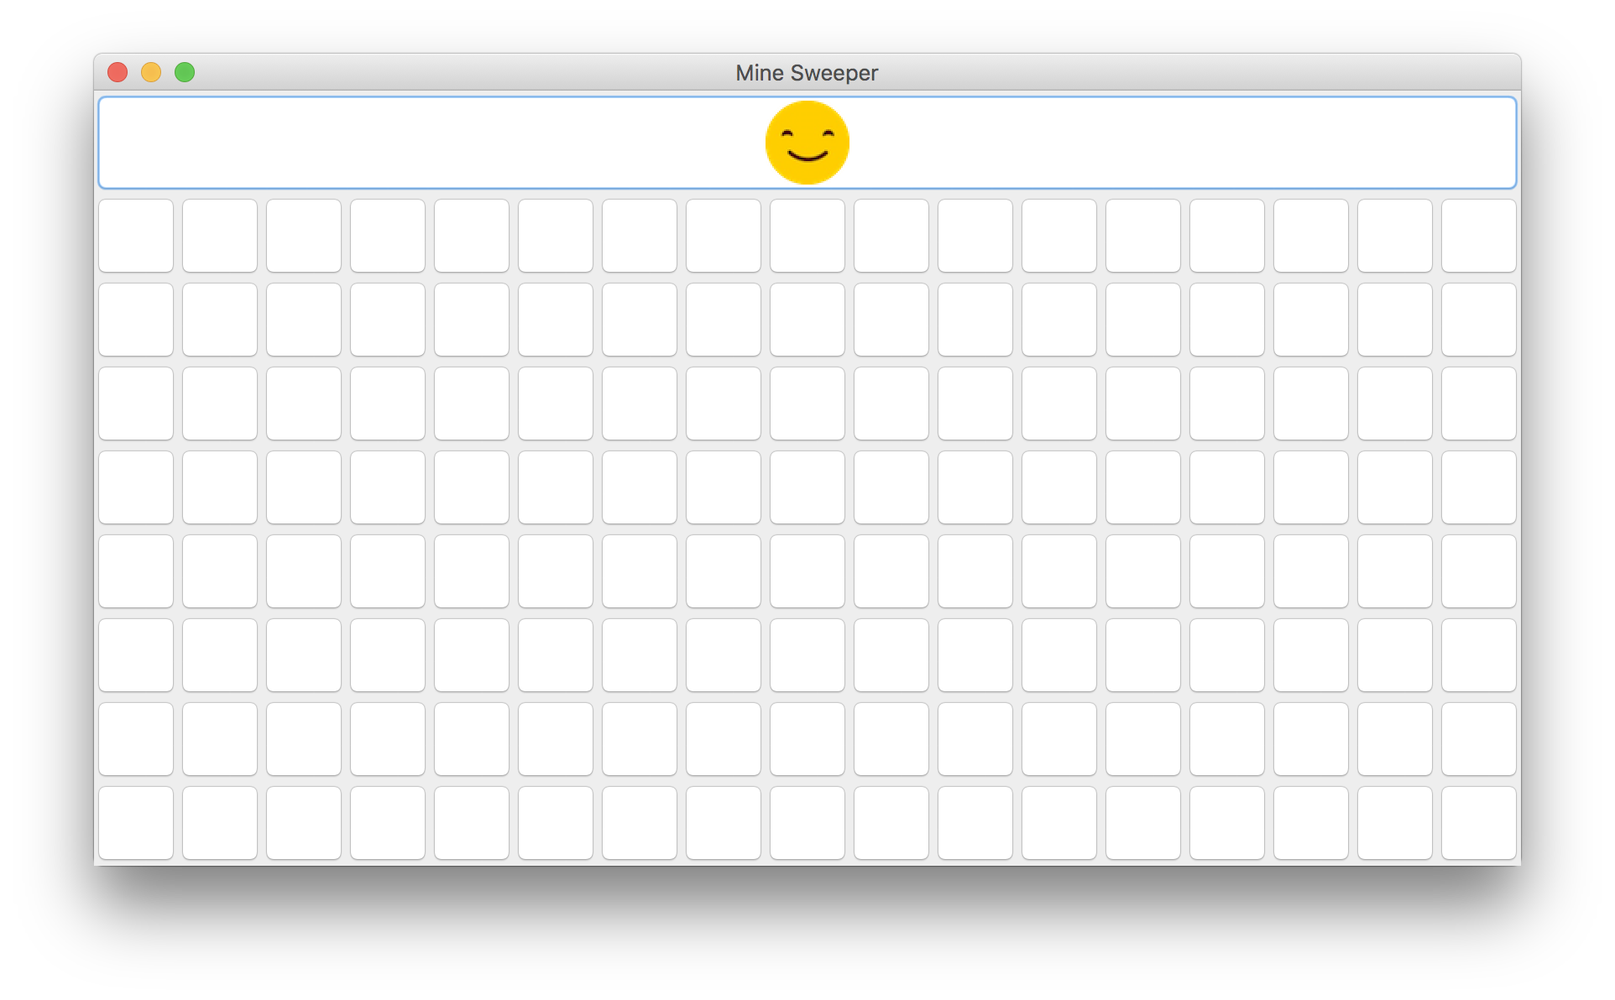
Notes:
ImageIcon from javaSwing

Slide 22
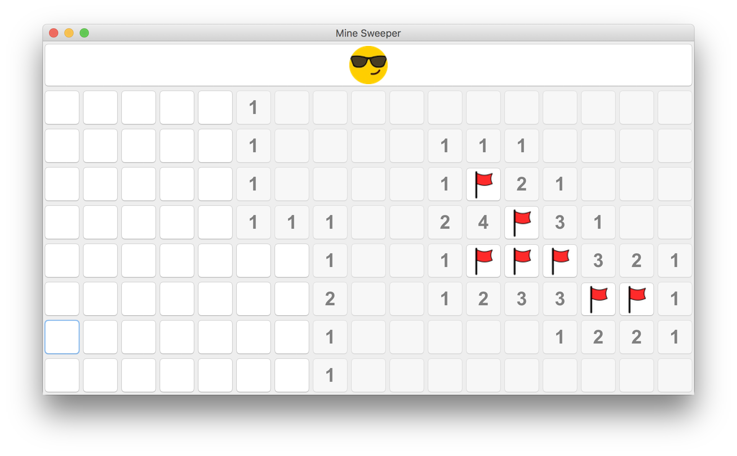

Slide 23
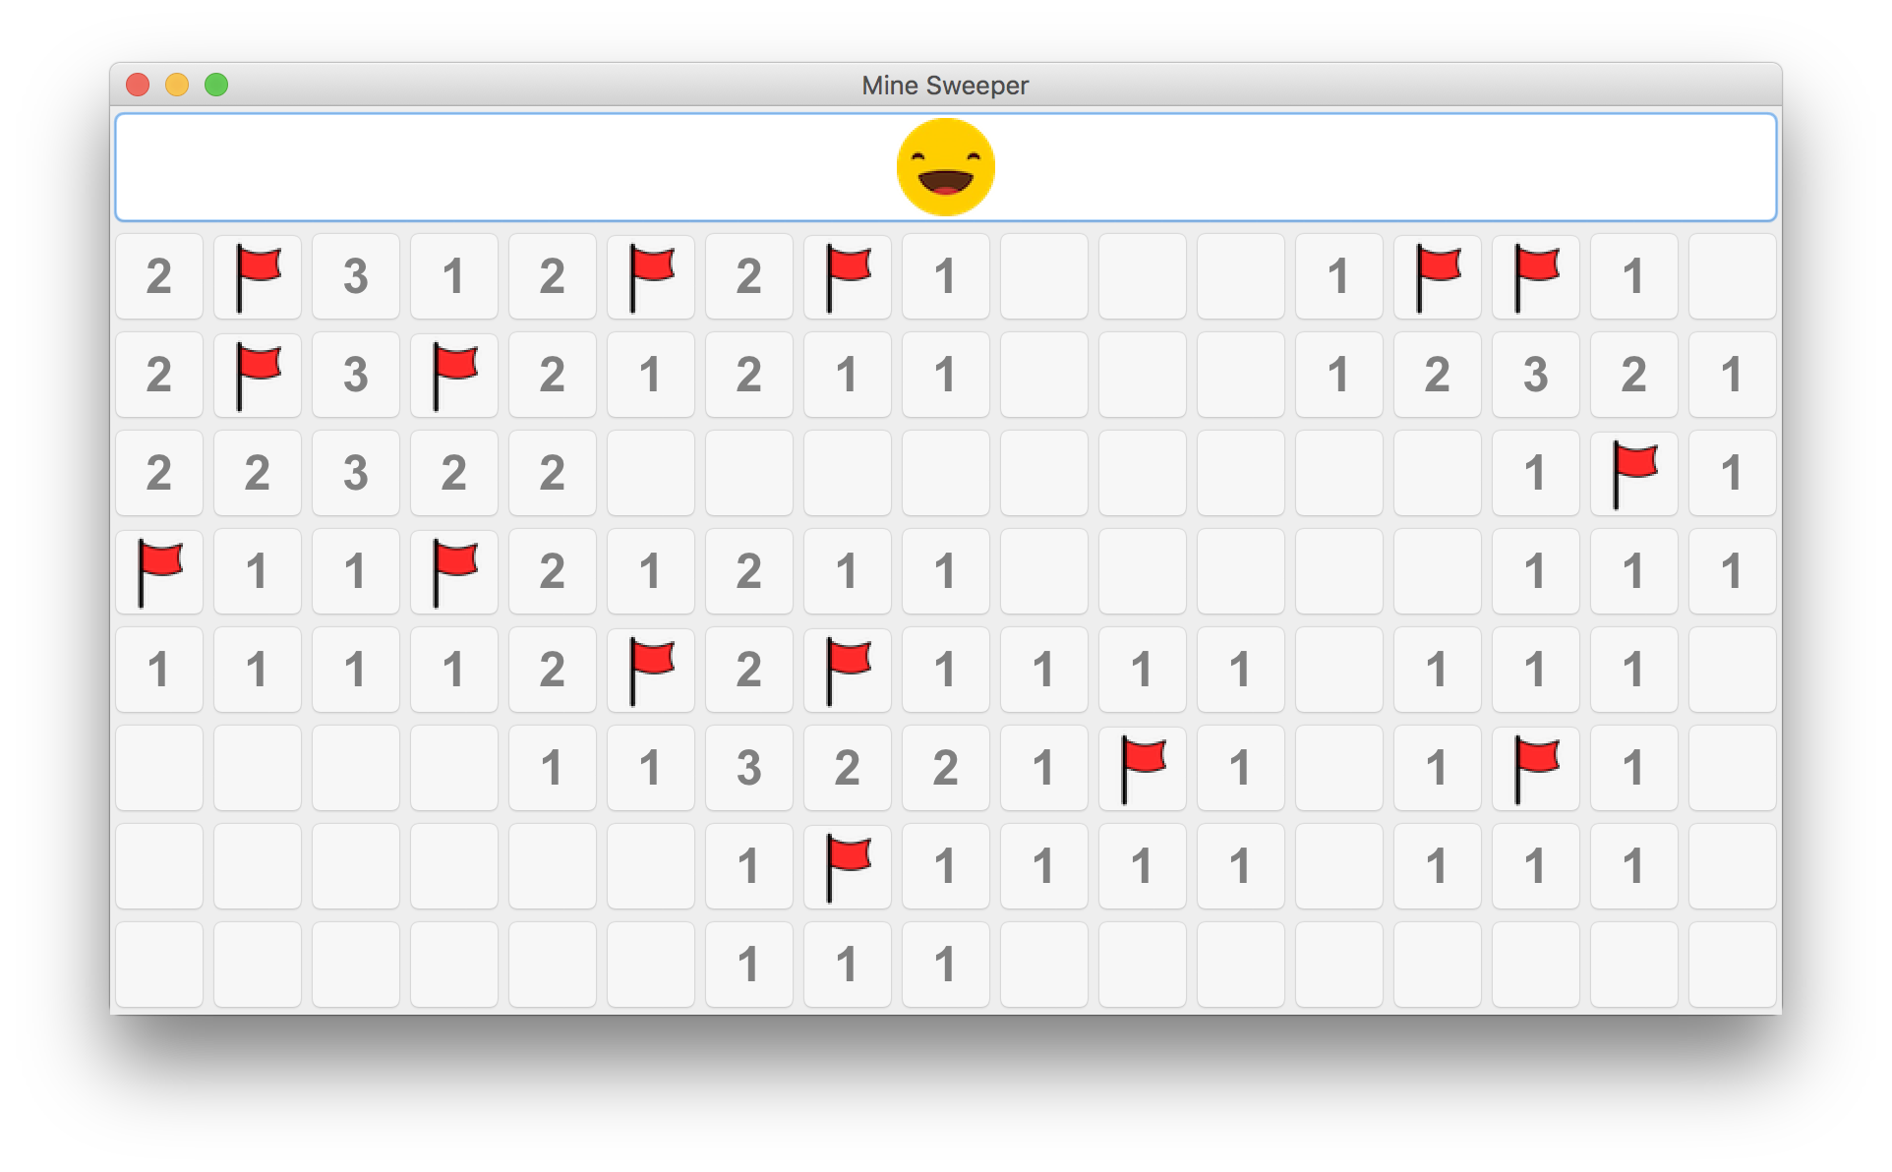

Slide 24
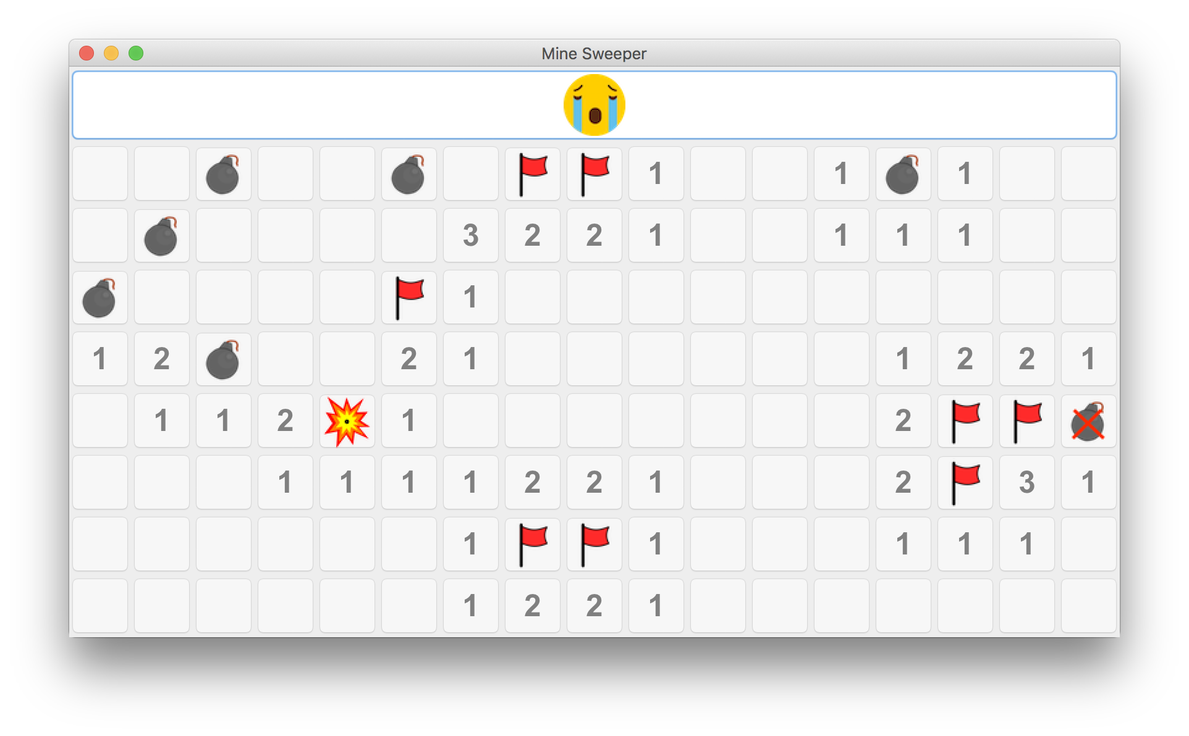

Slide 25
Challenge

Slide 26
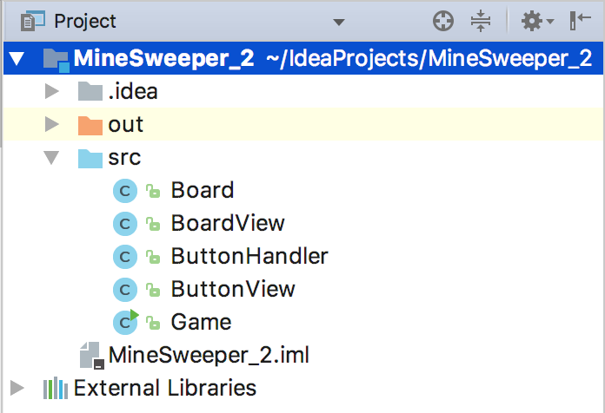
MVC
Notes:
When I was doing research for topic, I learned Spring, a MVC architectural framework.
So I aimed to implement MVC design pattern to this project.

Slide 27
Future plan
Notes:
Network connection for two players

Slide 28
Multi-player: Socket
Stopwatch: Thread

Slide 29
Thank You
Thanks for your attention!
Notes:
My presentation ends here

