Slide 1
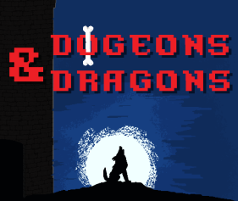
The Team
Olivia Krafft (Team Leader) Loi Huynh (Software Engineer) Austin Kue (Software Engineer) John Jaklic (Graphics Designer)
Marcel Jonas (Graphics Designer) Donovan Cummins (Web Developer) Joe Waldrup (Sound Engineer)

Slide 2
What we planned to do...
-Add Admin Form Functionality with GCS DB (Web Team) -Add User View Database Features (Web Team) -Battle Screen Functionality (Unity Team) -Sprint 3 Code Review & Cleanup (Unity Team) -Unit Rarity Algorithm (Unity Team) -Damage Calculation Function (Unity Team) -Design Pattern Development & Testing (Unity Team) -Generate Visual Backgrounds for the Different App Scenes (Graphics Team) -Generate Visual Representations for 2D Sprite Units (Graphics Team) -Add Animations to Graphical Assets in Unity (Graphical Team) -Collect/Create Sounds for all Interactions and Entities in the App (Sound Team)

Slide 3
What we did...
Added Admin Insert Unit Form stored on GCS DB (Web Team) Added User View Units stored on GCS DB (Web Team) Added Admin Delete Unit Function stored on GCS DB (Web Team) Battle Screen Functionality (Unity Team) Attack w/Animation, Damage Taken w/Animation, Special Attack w/Animation
Sprint 3 Code Review & Cleanup (Unity Team) Unit Summoning System (Unity Team) Damage Calculation (Unity Team) Design Pattern Development & Testing (Unity Team) Generate Visual Backgrounds for the Different App Scenes (Graphics Team) Generate Visual Representations for 2D Sprite Units (Graphics Team) Add Animations to Graphical Assets in Unity (Graphical Team) Collect/Create Sounds for all Interactions and Entities in the App (Sound Team)

Slide 4
Unity Team - Next Sprint
More Battle Screen Functionality (Unity Team)
Damage Calculations
Basic Timer for Attacks
Proper UI Representation for Data Including…
HP
Damage Dealt
Complete Full Unit Stat List for Implementation => Fully Balanced (Unity Team)
Improve User Interface/User Experience (Unity Team)

Slide 5
Graphics and Sound Team - Next Sprint
Generate Visual Backgrounds for the Different App Scenes (Graphics Team)
Focus on Battle Screens
Generate Visual Representations for 2D Sprite Units (Graphics Team)
Focus on Battle Screens
Add Animations to Graphical Assets in Unity (Graphical Team)
Focus on Battle Screens
Collect/Create Sounds for all Interactions and Entities in the App (Sound Team)
Add Sound Effects for Button Presses

Slide 6
Web Team - Next Sprint
Add User and Admin Functions for Equipment stored on GCS DB (Web Team)
Create, Retrieve, Update, Delete
Add Admin Update Function for Units stored on GCS DB (Web Team)
Add User and Admin Functions for Chewables on GCS DB (Web Team)
Create, Retrieve, Update, Delete
Add User and Admin Functions for Tutorials on GCS DB (Web Team)
Create, Retrieve, Update, Delete

Slide 7
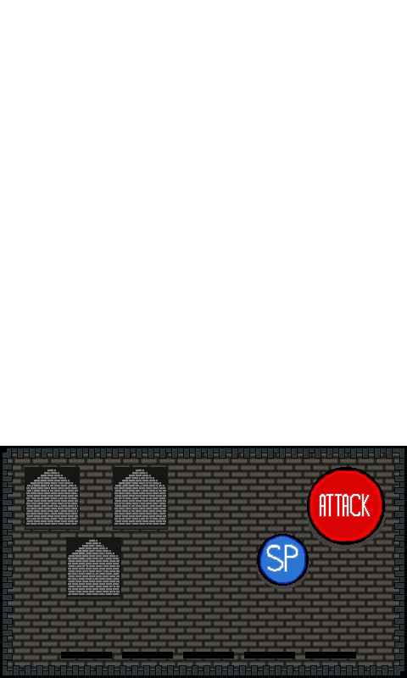
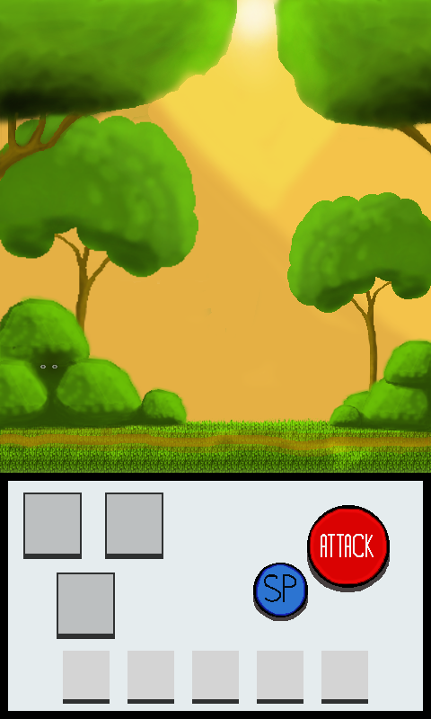
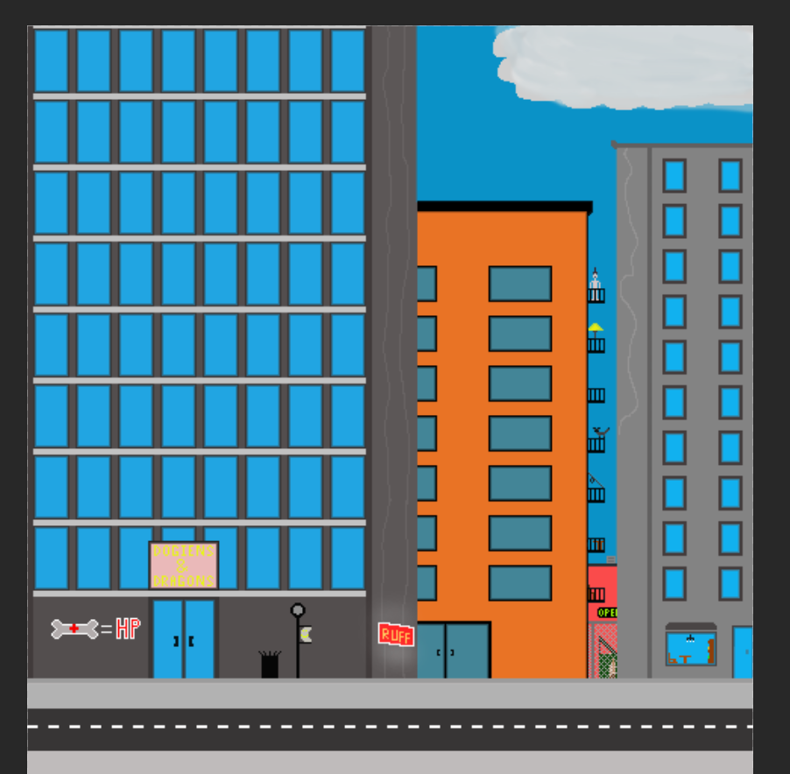
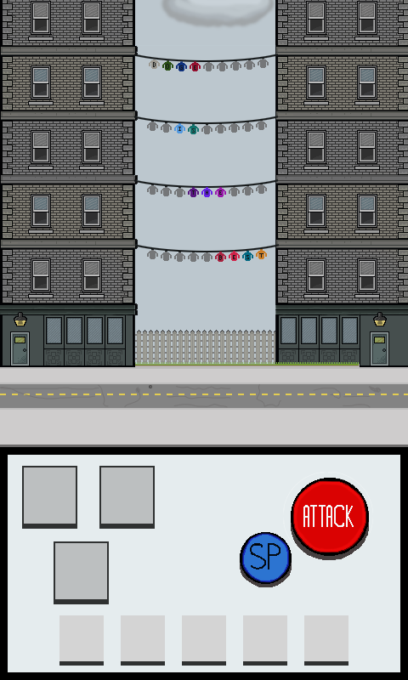



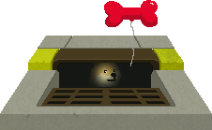

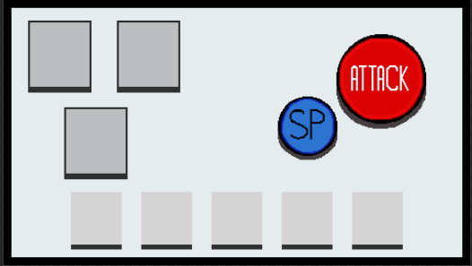
Demonstration()

Slide 8
Challenges, Risks, Mitigation
Time Management
Other classes, Midterms, family
Meetings
Should be longer and more often
Integrating Graphics and Sounds with Unity Team working on the same project with Github
Clean up Github

Slide 9
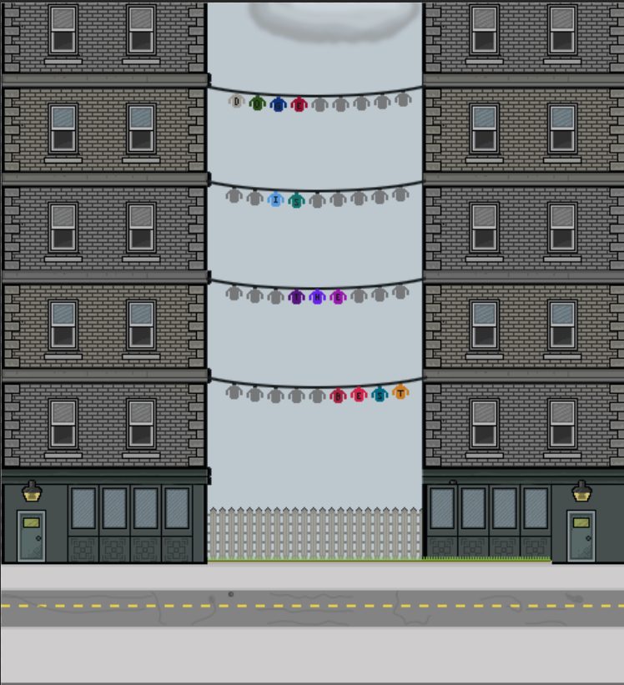
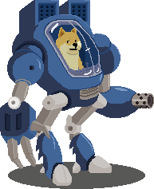
Game Over
Caricatures courtesy of www.16personalities.com

