Slide 1

By Oakland Express
Olivia Krafft (TL)
Loi Huynh (SE), Austin Kue (SE), John Jaklic (GD)
Marcel Jonas (GD), Donovan Cummins (WD), Joe Waldrup (SD)

Slide 2
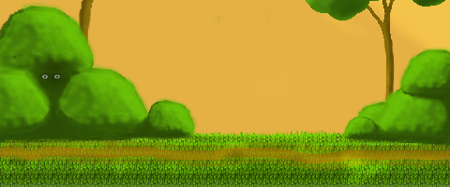
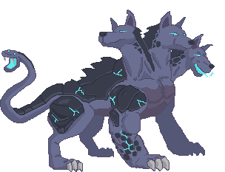

What we planned to do this sprint...
Generate Visual Backgrounds for the Different App Scenes (Graphics Team)
Final Designs
Generate Visual Representations for 2D Sprite Units (Graphics Team)
Final Designs
Add Animations to Graphical Assets in Unity (Graphical Team)
Integrate and Test
Update Database Design (Web Team)
Add more Admin and User Webpages (Web Team)
Collect/Create Sounds for all Interactions and Entities in the App (Sound Team)
Integrate and Test
Start Summoning Development (Unity Team)
Formulate, code, integrate test
Continue Battle Screen Development (Unity Team)
Bringing units to battle
Spawning enemies in battle
Progressing from state to state (Start, Battle, Win/Lose)
Integrate scoring
Complete health

Slide 3


What we did this sprint...
A player will fight enemies visually represented as 2d sprites.
A player will have chewables visually represented as 2d sprites.
A player will have units visually represented as 2d sprites.
A player will see a unit animated when attacking in battle.
Animation system updated
More animations added
A player will see a unit is hurt in battle.
A player see a unit is healthy in battle.
A player will experience custom backgrounds on each screen of the application.
A player will use custom UI buttons.
A player is able to navigate between all Dogeons and Dragons app activities.
UI roadmap finalized
Finalized UI implementation in the works
A player will be able to attack with their selected unit during battle.
A player will be able to take damage with their selected unit during battle.
During battle system - complete
A player will be able to summon new units.
Summoning units is almost done
A player will be able to access a webapp about Dogeons and Dragons.
Updated design & graphics
Added more pages
Updated DB design

Slide 4
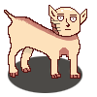
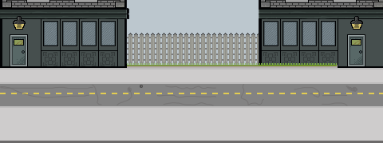
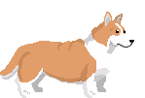
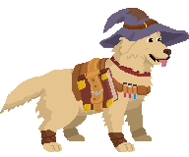
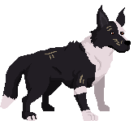
What we plan to do next sprint...
A player will have chewables visually represented as 2d sprites.
A player is able to navigate between all Dogeons and Dragons app activities.
A player will be able to collect units.
A player will be able to collect chewables.
A player will be able to select chewables to use during a level.
A player will be rewarded after a victory.
A player will progress to harder levels after each level victory.
A player can restart a level if they lose.
A player will be able to collect currency after a level victory.
A player will be able to summon new units.
A player is able to download Dogeons and Dragons from Google Play store.
A player will be able to access a webapp about Dogeons and Dragons.
A player will be able to view all available chewables in the game on the webapp.
A player will be able to view all tutorials about the game on the webapp.
A player will be able to view all stories about the game on the webapp.
An admin will be able to view, add, delete or update all available chewables in the game on the webapp.
An admin will be able to view, add, delete or update all available tutorials about the game on the webapp.

Slide 5
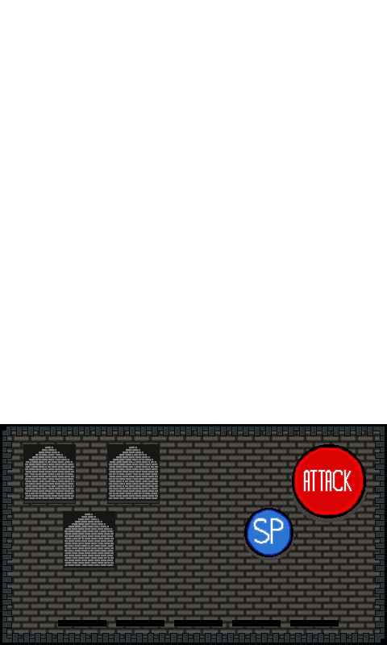
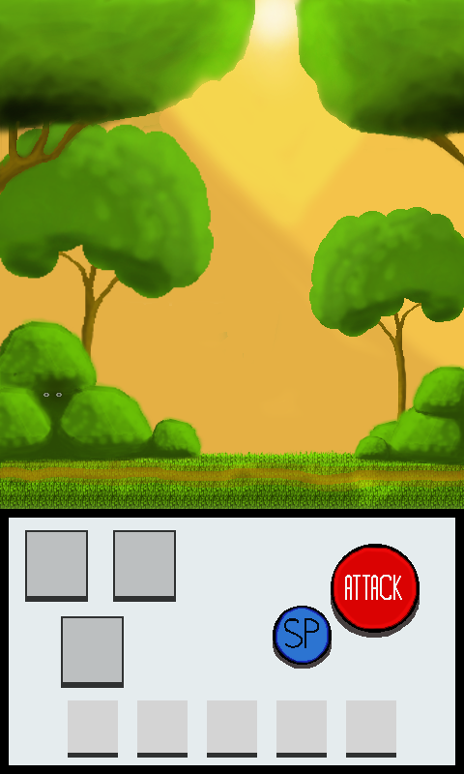
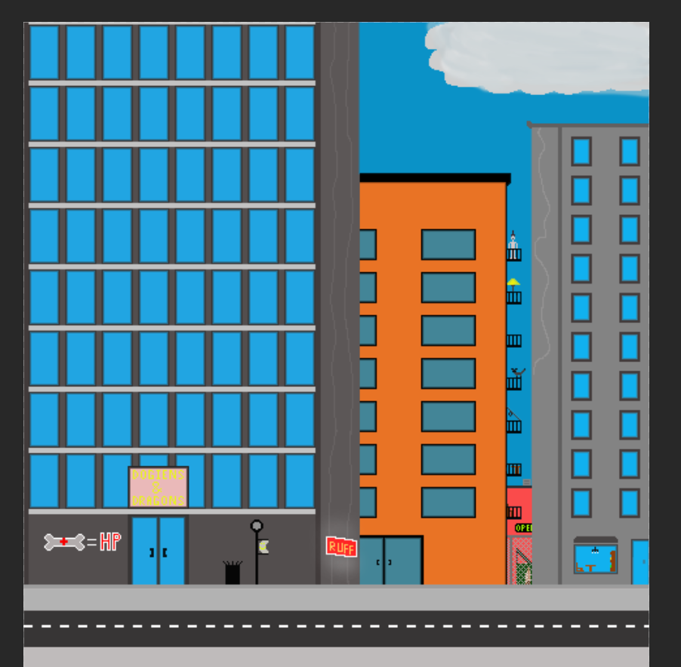
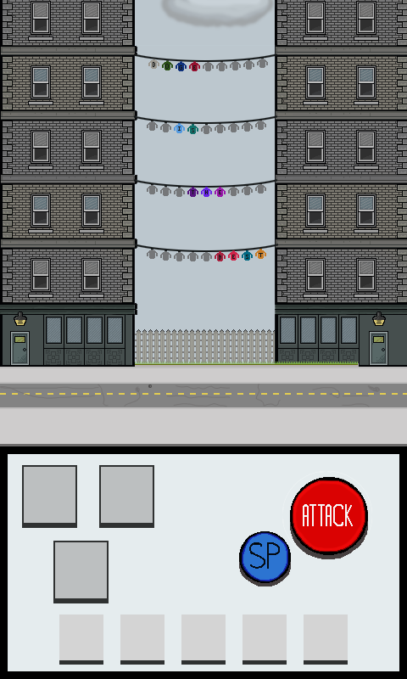



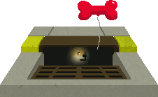

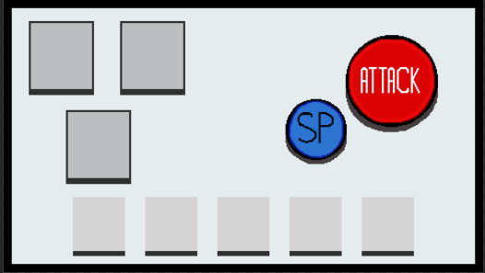
Demonstration()

Slide 6
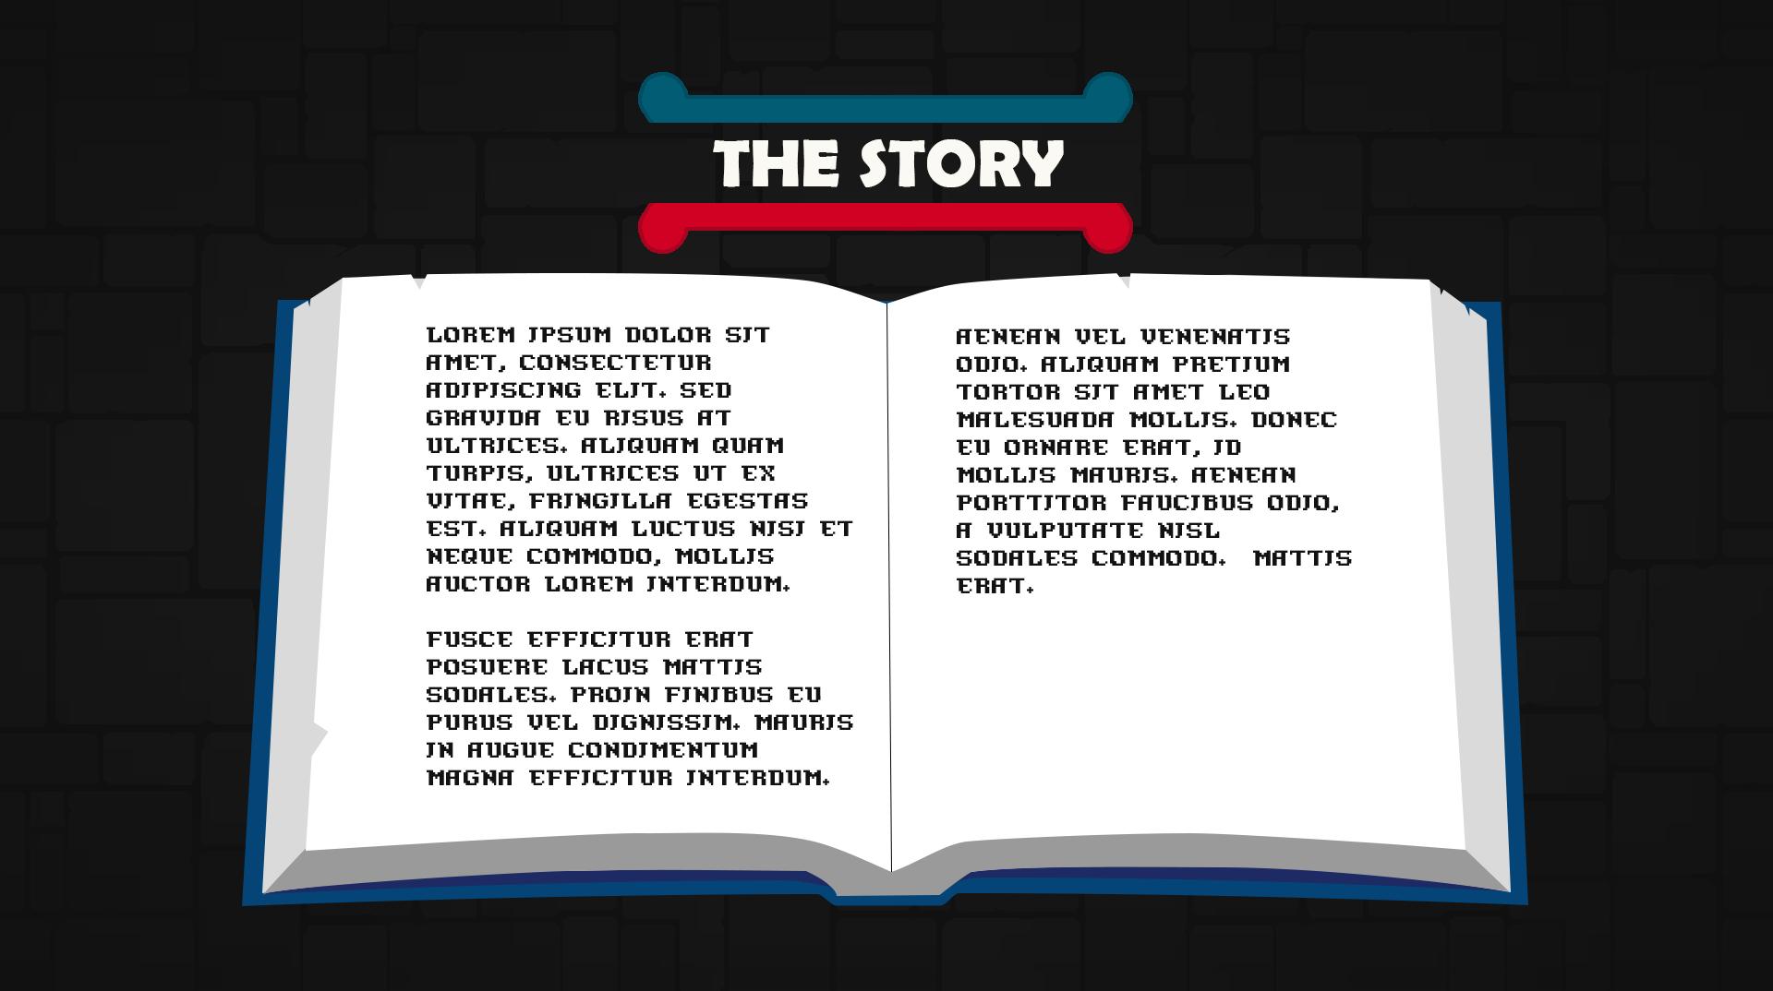
Game Over

