Slide 1
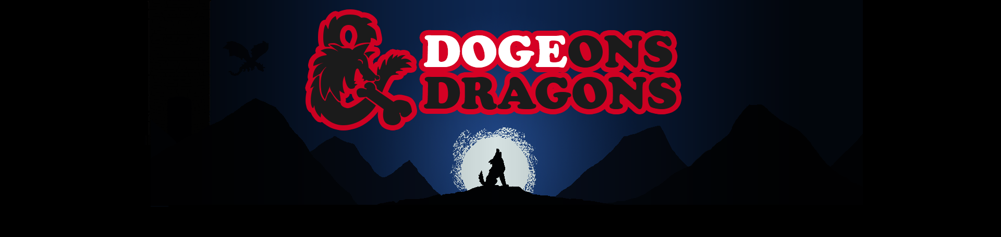
By Oakland Express
Olivia Krafft (TL)
Loi Huynh (SE), Austin Kue (SE), John Jaklic (GD)
Marcel Jonas (GD), Donovan Cummins (WD), Joe Waldrup (SD)

Slide 2
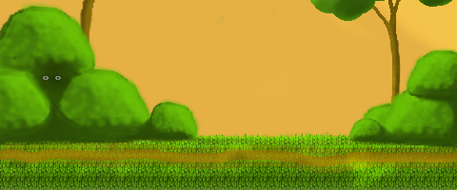


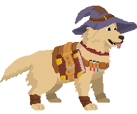
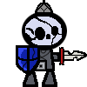

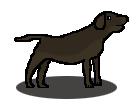
What we planned to do this sprint...
A player will have chewables visually represented as 2d sprites.
A player is able to navigate between all Dogeons and Dragons app activities.
A player will be able to collect units.
A player will be able to collect chewables.
A player will be able to select chewables to use during a level.
A player will be rewarded after a victory.
A player will progress to harder levels after each level victory.
A player can restart a level if they lose.
A player will be able to collect currency after a level victory.
A player will be able to summon new units.
A player is able to download Dogeons and Dragons from Google Play store.
A player will be able to access a webapp about Dogeons and Dragons.
A player will be able to view all available chewables in the game on the webapp.
A player will be able to view all tutorials about the game on the webapp.

Slide 3

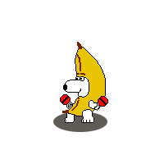
What we did this sprint...
A player will have chewables visually represented as 2d sprites.
A player is able to navigate between all Dogeons and Dragons app activities.
A player will be able to collect units.
A player will be able to collect chewables.
A player will be able to select chewables to use during a level.
A player will be rewarded after a victory.
A player will progress to harder levels after each level victory.
A player can restart a level if they lose.
A player will be able to collect currency after a level victory.
A player will be able to summon new units.
A player is able to download Dogeons and Dragons from Google Play store.
A player will be able to access a webapp about Dogeons and Dragons.
A player will be able to view all available chewables in the game on the webapp.
A player will be able to view all tutorials about the game on the webapp.

Slide 4
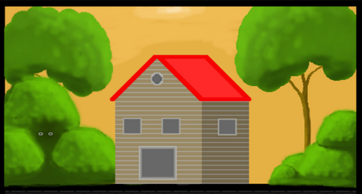

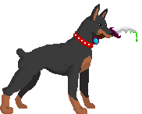

What we plan to do before final judgement...
Finish Backlog of Features in Final Scope.
Summoning
Level System
User View of Units
Unit Selection for Battle
User Manual (Webapp)
Tutorial (Webapp)
Test! Test Every User Story Implemented in the Final Demo!
Polish, Finalize and Prepare for the Final Judgement.
Organize, Design and Create Material for the Display Booth.
Finalize Documentation and Final Document.
Rehearse before the dry run. Have everyone on the same page.

Slide 5
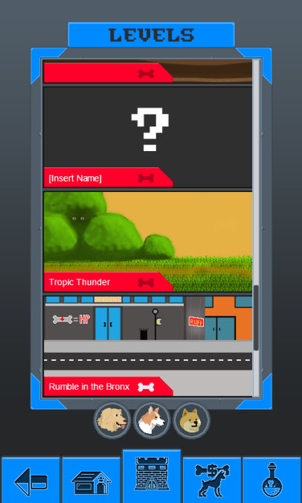
Demonstration()

Slide 6
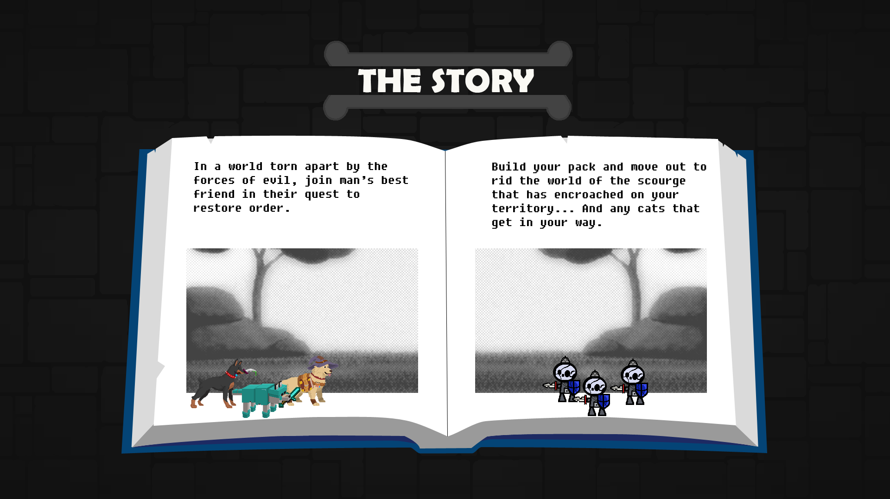
Game Over

