Slide 1
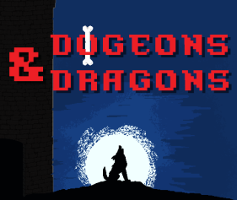
The Team
Olivia Krafft (Team Leader) Loi Huynh (Software Engineer) Austin Kue (Algorithm Architect) John Jaklic (Graphics Designer)
Marcel Jonas (Graphics Designer) Donovan Cummins (Web Developer) Joe Waldrup (Web Developer)

Slide 2





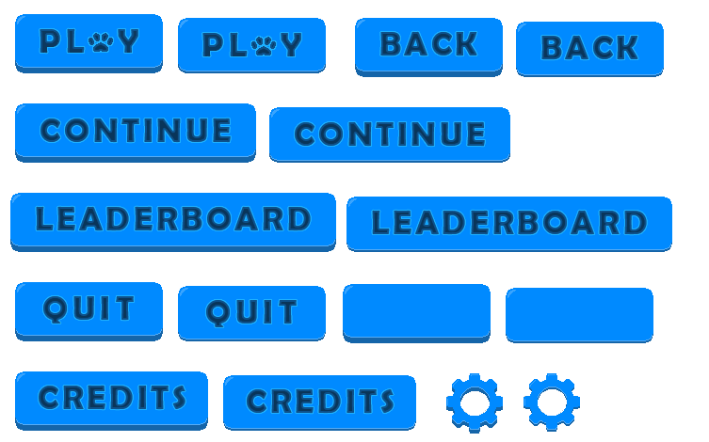

John Jaklic
UI Graphics
Heroes
Enemies

Slide 3
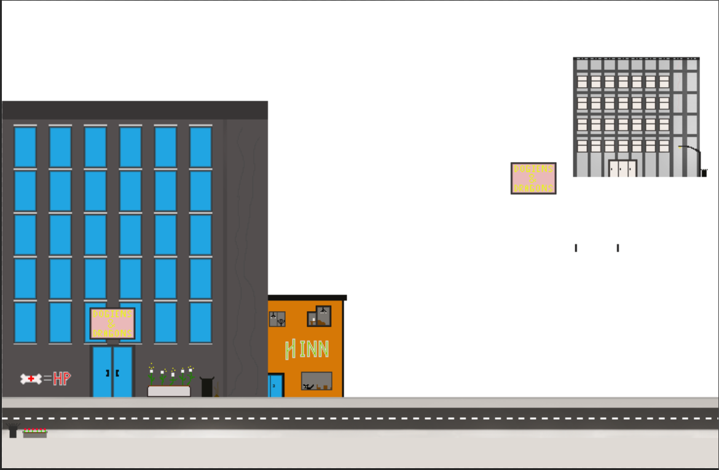

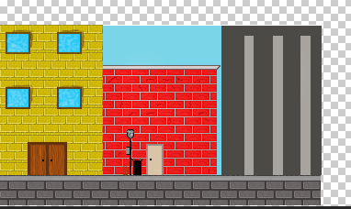
Background Design

Slide 4
Joe Waldrup
User Story

Slide 5
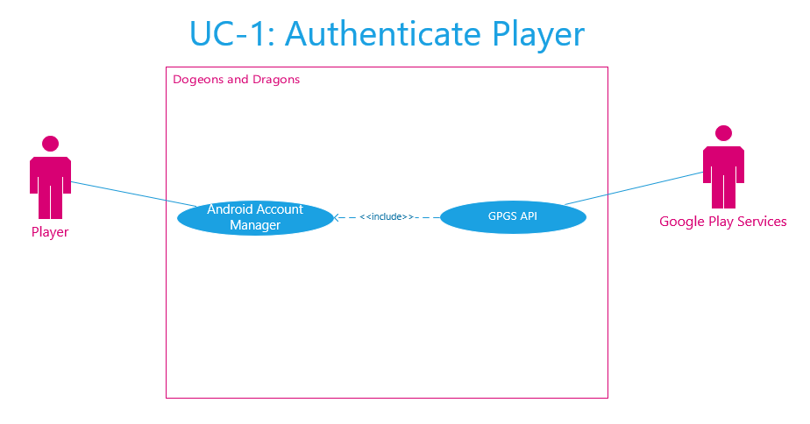
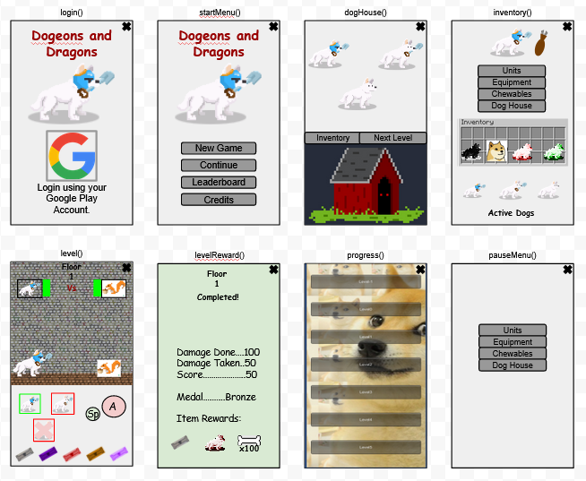
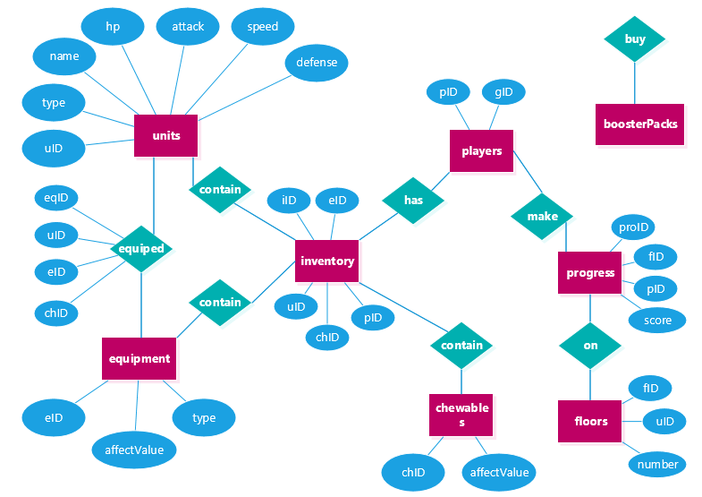
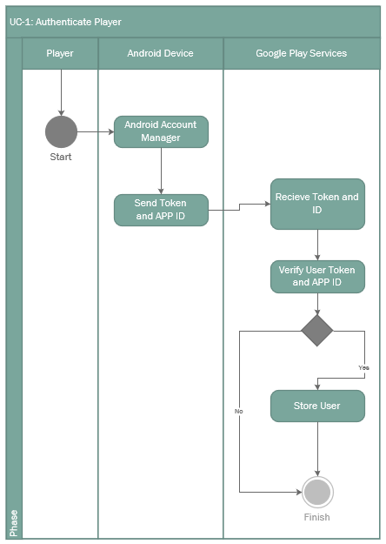
Donovan Cummins
Getting Started with Unity
Authenticate Player UC Diagram
Setting Up the Development Environment
Services
Google Developer Console
Google Play Services
Google Cloud Services
Unity
Required External Tools
Android SDK, NDK
JDK
UI Concept
DB Concept Chen’s Notation
Authenticate Player Activity Diagram

Slide 6

Loi Huynh
Google Play Services Login Demo

Slide 7
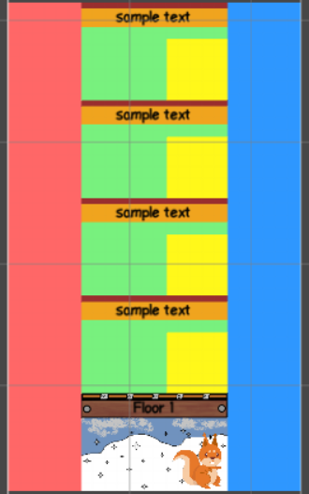
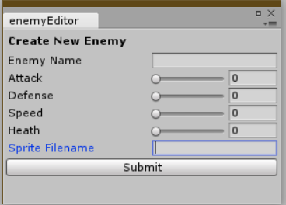
Austin Kue?

