Slide 1
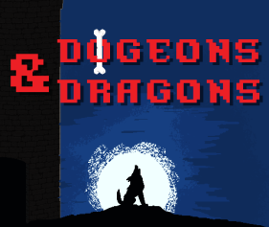
The Team
Olivia Krafft (Team Leader) Loi Huynh (Software Engineer) Austin Kue (Algorithm Architect) John Jaklic (Graphics Designer)
Marcel Jonas (Graphics Designer) Donovan Cummins (Web Developer) Joe Waldrup (Web Developer)

Slide 2
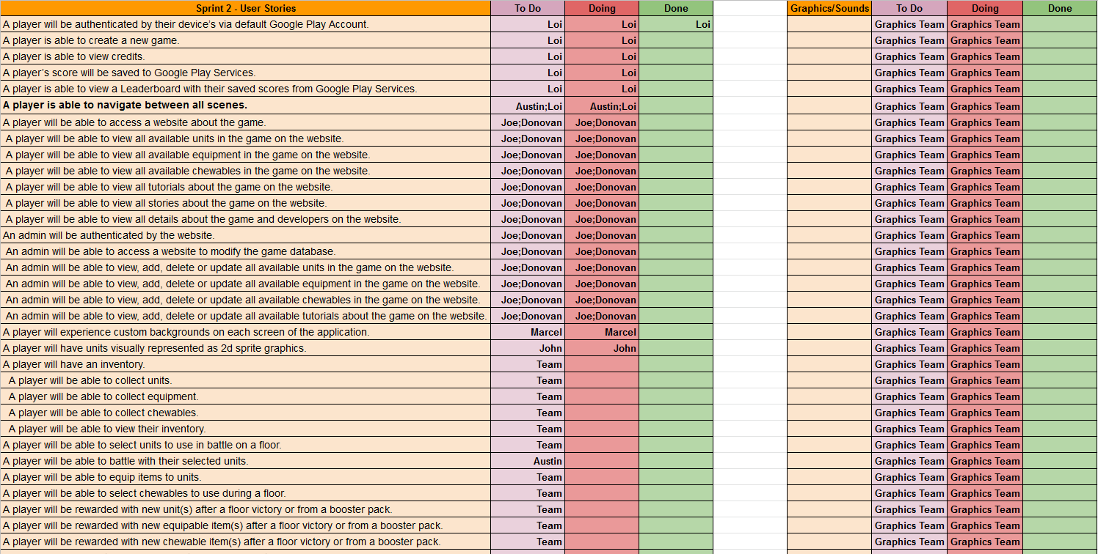
Growing List of Use Cases/User Stories

Slide 3
What we planned to do...
Navigation Between Scenes & Testing (Unity Team) Pause Screen Menu & Testing (Unity Team) Design Pattern Development & Testing (Unity Team) Score Algorithm Design & Testing (Unity Team) Unit Rarity Algorithm (Unity Team) Generate Visual Representations for 2D Sprite Units (Graphics Team) Generate Visual Backgrounds for the Different App Scenes (Graphics Team) Website Framework (UC-6:18 (Web Team)) Database Schema and Implementation (UC-6:18 (Web Team)) Website Interacting with Database - User View (UC-6:18 (Web Team)) Website Interacting with Database - Admin View (UC-6:18 (Web Team))

Slide 4
What we did...
Completed Navigation Between Scenes & Testing (Unity Team) Completed Pause Screen Menu & Testing (Unity Team) Backlogged Design Pattern Development & Testing (Unity Team) Completed Score Algorithm Design & Testing (Unity Team) Backlogged Unity Rarity Algorithm (Unity Team) Backlogged Generate Visual Representations for 2D Sprite Units (Graphics Team) Backlogged Generate Visual Backgrounds for the Different App Scenes (Graphics Team) Completed Website Framework (UC-6:18 (Web Team)) Completed Database Schema and Implementation (UC-6:18 (Web Team)) Backlogged Website Interacting with Database - User View (UC-6:18 (Web Team)) Backlogged Website Interacting with Database - Admin View (UC-6:18 (Web Team))

Slide 5
What we plan to do next sprint...
Use jHipster to Implement Web Application (Web Team) Add Admin Form Functionality with GCS DB (Web Team) Add User View Database Features (Web Team) Attacking and Taking Damage in App (Unity Team) Unity Rarity Algorithm (Unity Team) Design Pattern Development & Testing (Unity Team) Generate Visual Backgrounds for the Different App Scenes (Graphics Team) Generate Visual Representations for 2D Sprite Units (Graphics Team) Continue Unit and Background Development (Graphical Team) Add Animations to Graphical Assets in Unity (Graphical Team)

Slide 6
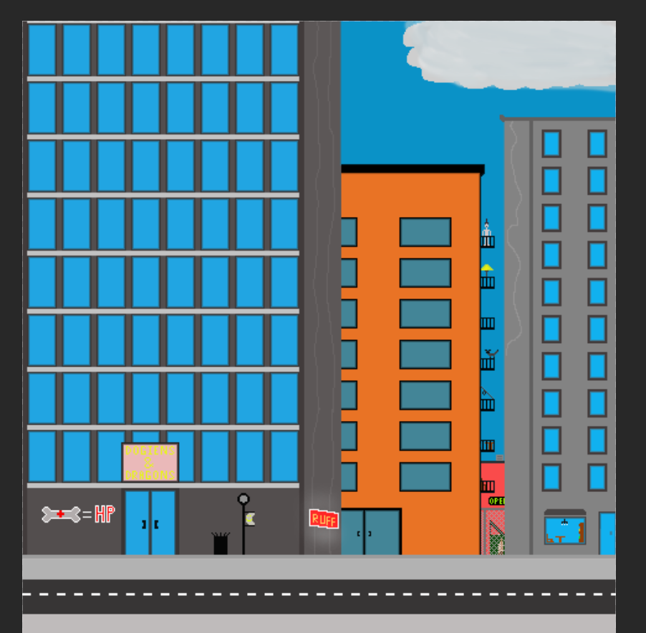




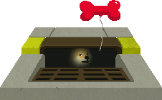
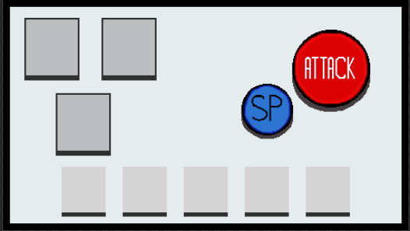
Demonstration()

Slide 7
Challenges, Risks, Mitigation
Understanding how our Effort Logs are graded
What do we need to do to ensure the best possible outcome for each team member from sprint to sprint?
How do we divide up tasks and ensure equal shares of credible work are obtainable during each sprint while working toward our teams development cycle goals?
Encountering new Tools, Technologies, Frameworks, Programming Languages
Takes time to introduce yourself to things you have no experience with.
Knowing where to start and focus.
Security Concerns for Handling Database Credentials
Implementing “out of the box” security correctly.
Protecting our Keystores and Cloud Server Credentials.

Slide 8
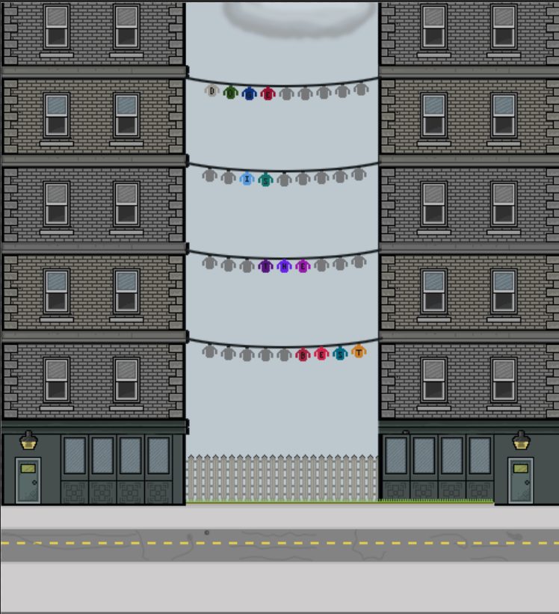
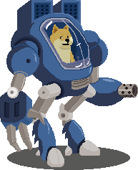
Game Over
Caricatures courtesy of www.16personalities.com

