Slide 1
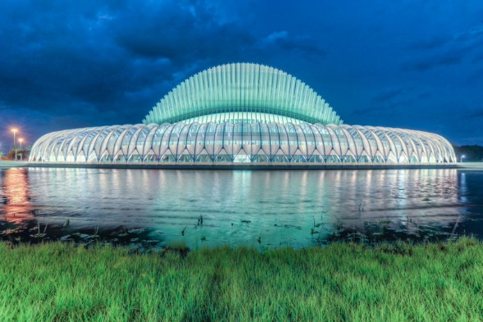
Mini Project 2 Presentation
FLORIDA POLYTECHNIC UNIVERSITY
Josh Baldwin, Nathan Rabideau, Steve Zhao
April 2020

Slide 2
Reference
https://github.com/ageron/handson-ml
https://towardsdatascience.com/resnets-for-cifar-10-e63e900524e0
https://github.com/yuengdelahoz/Resnet/blob/master/detailed_implementations/resnet_50.py

Slide 3
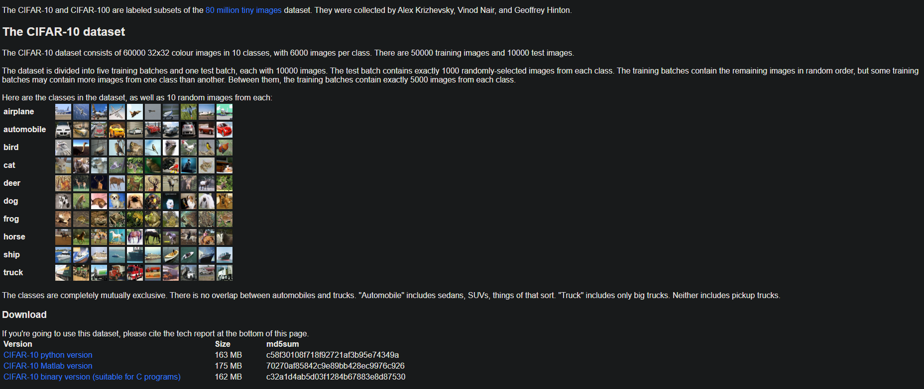
What is this project?
In this project we used ResNet to create a neural network and use cifar10 to train it.

Slide 4
Code
We used code from here and modified it to make it work on our end.

Slide 5
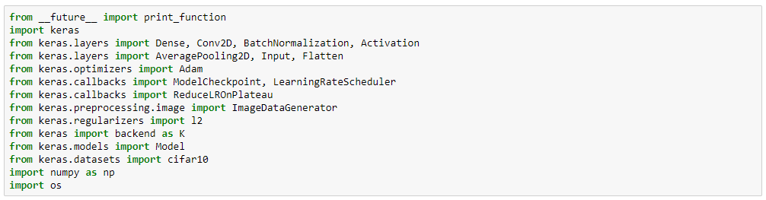
Code
This block code imports all the necessary library for the project.

Slide 6
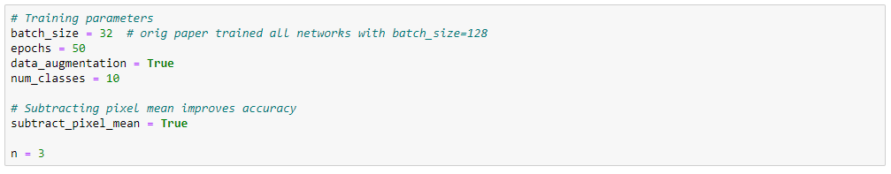
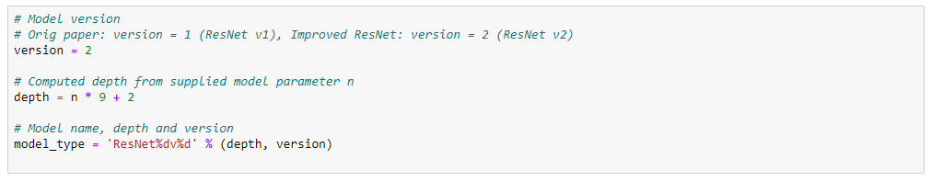
Code
This block of code initialize all the parameters necessary for the project.

Slide 7
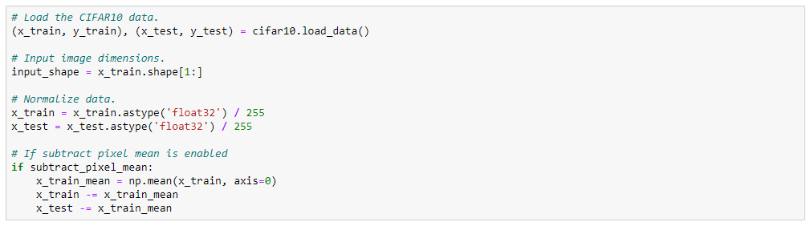
Code
This block of code get the data ready and prepare the training and testing set.

Slide 8
Code
This block of code prints out what the data look like.

Slide 9
Code
This block of code covert the format of data.

Slide 10
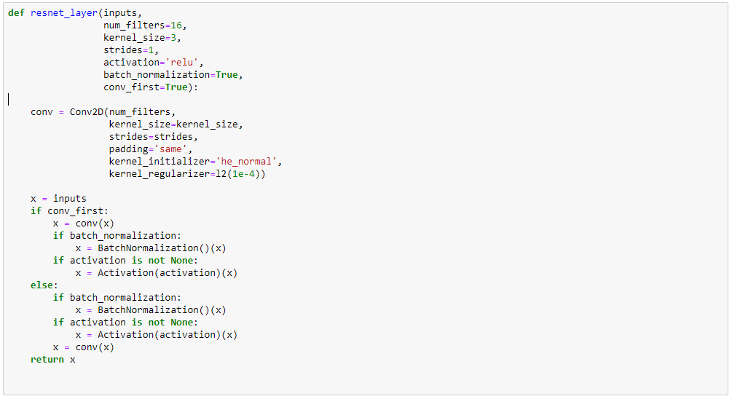
Code
This block of code define what every ResNet layer will do.

Slide 11
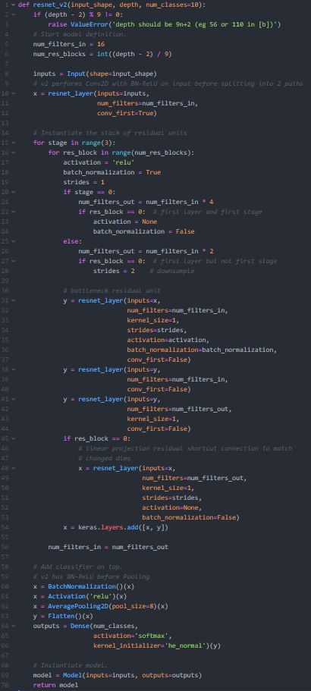
Code
This block of code is the main model and what it going to looks like

Slide 12
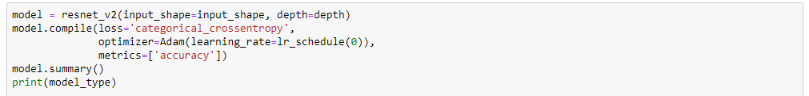
Code
This block of code initialize parameters of model

Slide 13
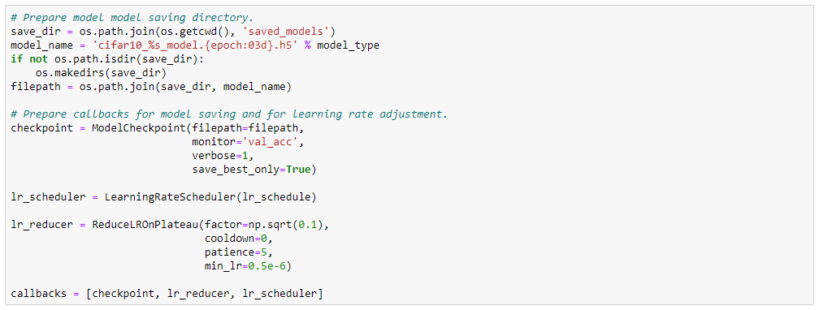
Code
This block of code save the model to local directory.

Slide 14
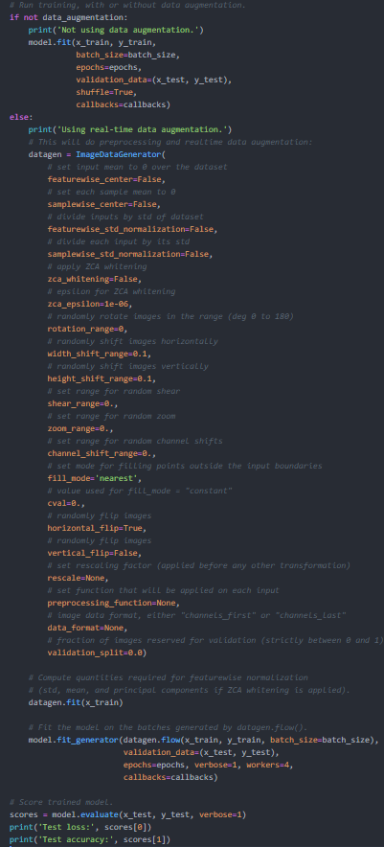
Code
This block of code runs the model.

Slide 15
Result
Using real-time data augmentation.
Epoch 1/50
Learning rate: 0.001
1563/1563 [==============================] - 961s 615ms/step - loss: 1.8605 - accuracy: 0.4849 - val_loss: 1.8985 - val_accuracy: 0.4818
…
Epoch 26/50
Learning rate: 0.001
166/1563 [==>...........................] - ETA: 13:10 - loss: 0.5978 - accuracy: 0.8697
​
Due to time constraint, we were only managed to complete 25 out of 50 runs, but the result here is clear, the accuracy is improved quite a lot.

Slide 16
Summary
In this assignment we reviewed the concepts of ResNet and have some hands on experience on it.

