Slide 1
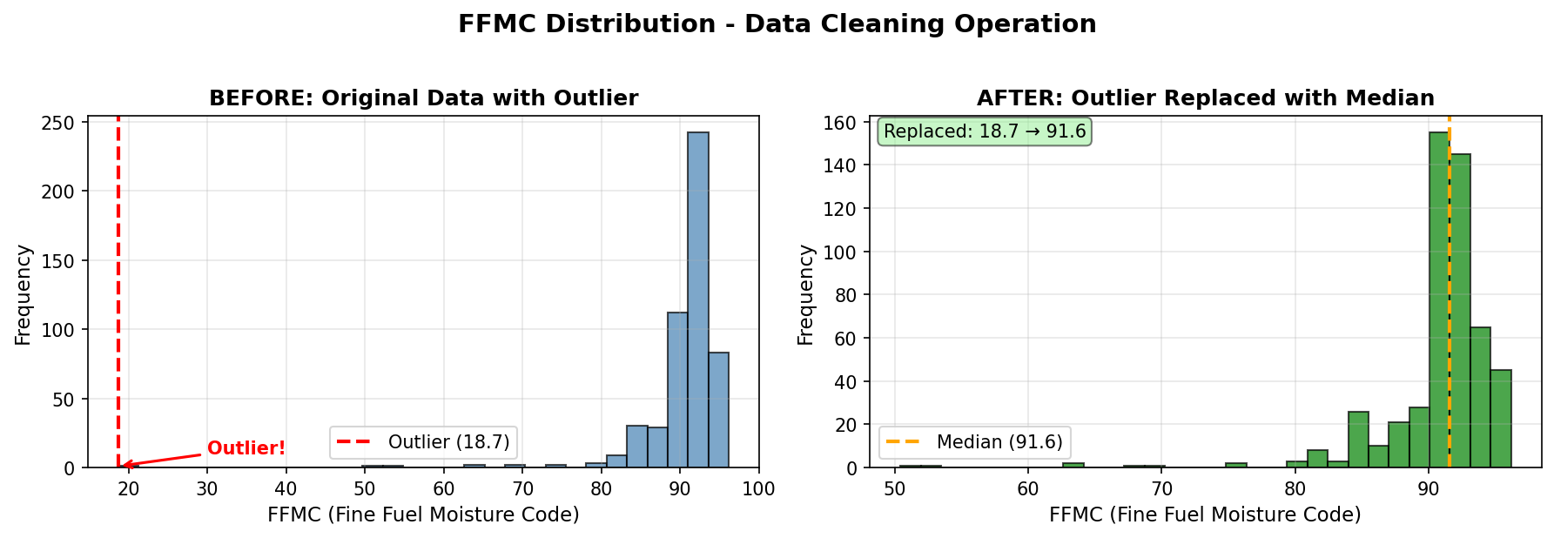
Student ID: 3308299
Forest Fires Classification Using Machine Learning
Predicting Burned Area Exceeding 4% Using CRISP-DM Methodology
1. PROJECT METHODOLOGY
2. DATA UNDERSTANDING
3. DATA PREPARATION
• Data Loading & Initial Exploration (517 samples, 13 features)
• Data Quality Assessment & Outlier Detection
• Data Cleaning: Fixed FFMC outlier (18.7 → 91.6 median)
• Feature Engineering: Encoded categorical variables
• Data Split: 60% Train (309), 20% Validation (104), 20% Test (104)
• Model Training: 15 models across 3 algorithms
• Hyperparameter Search: Grid search with validation metrics
• Final Model: Trained on combined train+validation sets
• Evaluation: Confusion matrix & performance metrics on test set
Variable | Type Used | Include
X, Y | Numeric (Discrete) | Yes
month, day | Categorical | Yes (Encoded)
FFMC | Numeric (Continuous) | Yes
DMC, DC | Numeric (Continuous) | Yes
ISI | Numeric (Continuous) | Yes
temp | Numeric (Continuous) | Yes
RH | Numeric (Discrete) | Yes
wind, rain | Numeric (Continuous) | Yes
area | Categorical | Target (T/F)
Data Cleaning Operation: Replaced FFMC outlier (18.7) with median (91.6) - FFMC typically ranges 80-95 in forest fire conditions
4. MODELLING
5. RESULTS AND ERRORS
Model | Algorithm | Hyperparameters | Val Acc | Val F1
RF_1 | Random Forest | n_est=50, depth=5, split=5 | 0.837 | 0.860
RF_2 | Random Forest | n_est=100, depth=10, split=2 | 0.846 | 0.869
RF_3 | Random Forest | n_est=200, depth=15, split=2 | 0.837 | 0.860
RF_4* | Random Forest | n_est=100, depth=None, split=2 | 0.856 | 0.876
RF_5 | Random Forest | n_est=150, depth=20, split=3 | 0.856 | 0.876
SVM_1 | SVM | linear, C=0.1 | 0.558 | 0.589
SVM_3 | SVM | rbf, C=1.0, gamma=scale | 0.683 | 0.736
SVM_5 | SVM | poly, C=1.0, degree=3 | 0.654 | 0.747
NN_1 | Neural Net | layers=(50,), relu, lr=0.001 | 0.673 | 0.717
NN_2 | Neural Net | layers=(100,), relu, lr=0.001 | 0.721 | 0.760
NN_5 | Neural Net | layers=(64,32,16), relu, lr=0.001 | 0.702 | 0.744
Model Justification:
Random Forest (RF_4) selected for highest validation F1-score (0.876) and balanced performance. Ensemble method provides robustness against overfitting.
Confusion Matrix (Test Set):
 | Pred: F | Pred: T
Actual: F | 38 | 7
Actual: T | 6 | 53
Test Performance:
Model Utility:
• Accuracy: 87.5%
• Precision: 88.3%
• Recall: 89.8%
• F1-Score: 89.1%
High recall (89.8%) ensures most high-risk fires are detected, crucial for early warning systems. Balanced performance suitable for deployment.
*Best model selected | Hyperparameter Selection: Grid search with predefined values based on best practices
6. INSIGHTS
7. REFERENCES
Key Feature Importance:
1. DC (Drought Code): 23.9% - Long-term moisture deficit indicator
2. DMC (Duff Moisture Code): 22.0% - Medium-term fuel moisture
3. Temperature: 10.4% - Direct fire behavior influence
4. Month: 8.8% - Seasonal fire patterns
5. FFMC: 7.7% - Surface litter moisture content
Model Characteristics:
• Random Forest provides feature importance insights for interpretability
• No significant bias detected across spatial coordinates (X, Y)
• Ensemble approach balances variance-bias tradeoff effectively
• Breiman, L. (2001). Random forests. Machine learning, 45(1), 5-32.
• Cortez, P., & Morais, A. (2007). A data mining approach to predict forest fires using meteorological data.
• Pedregosa, F. et al. (2011). Scikit-learn: Machine learning in Python. Journal of machine learning research, 12, 2825-2830.
• Wirth, R., & Hipp, J. (2000). CRISP-DM: Towards a standard process model for data mining.
Tools Used: Python 3.x, scikit-learn 1.0+, pandas, numpy, matplotlib
AI Assistance: Claude AI used for suggestions and helping with research
CSCU9M5 - Introduction to Machine Learning (2025/6) | Forest Fires Classification Assignment

