Slide 1




SMARTRIDE
Presented by: Swathi H Rao,Swastik Mohapatra,Swathi D
TRACK-3

Slide 2
PROBLEM STATEMENT:
One of the biggest challenges in urban mobility is the imbalance between supply and demand during peak hours. Riders often struggle to find autos when they need them the most, while drivers may reject trips due to traffic, distance, or fare concerns. This leads to lost earnings for drivers and frustration for customers, ultimately affecting Namma Yatri’s growth and brand trust

Slide 3

OUR UNDERSTANDING OF THE PROBLEM STATEMENT:
1)DRIVERS OFTEN REJECT RIDE REQUESTS NEAR THE END OF THEIR SHIFTS IF THE DESTINATION TAKES THEM FARTHER FROM HOME, LEADING TO INEFFICIENCIES AND RIDE CANCELLATIONS.
2)DRIVERS OFTEN RECEIVE RIDE REQUESTS FAR FROM THEIR PREFERRED AREAS, LEADING TO FRUSTRATION AND SUBOPTIMAL RIDE DISTRIBUTION.
3)LONG-DISTANCE TRIPS REDUCE DRIVER AVAILABILITY, CAUSE FATIGUE, AND CREATE INEFFICIENCIES IN FLEET MANAGEMENT.

Slide 4
OUR UNDERSTANDING OF THE PROBLEM STATEMENT:
4)DRIVERS FREQUENTLY RETURN EMPTY AFTER TRIPS, RESULTING IN LOST EARNINGS AND INEFFICIENT RESOURCE UTILIZATION.
5)RIDE-HAILING SERVICES STRUGGLE WITH DRIVER AVAILABILITY DURING PEAK HOURS, CAUSING LONG WAIT TIMES AND UNMET DEMAND.
6)DRIVERS USUALLY REJECT SHORT RIDES AS WELL AS THEY USE UP TOO MUCH FUEL AND DONT GET ADEQUATE COMMISSIONS

Slide 5
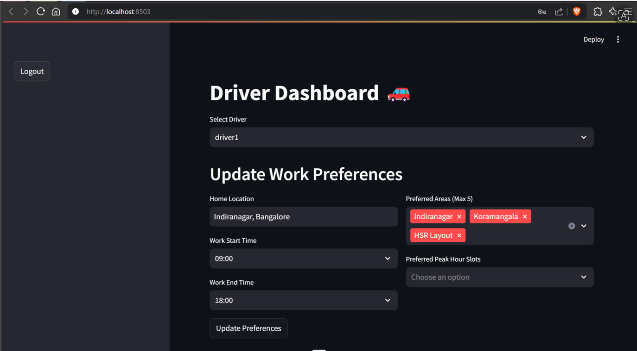

SOLUTION-1
1)DRIVERS INPUT THEIR HOME LOCATION AND PREFERRED WORK HOURS, AND THE SYSTEM SUGGESTS RIDES IN THEIR LAST 1-2 HOURS TO MOVE THEM CLOSER TO HOME, ENSURING FEWER RIDE DENIALS.

Slide 6
SOLUTION-2
DRIVERS SET THEIR TOP 5 PREFERRED AREAS EACH MORNING AND AFTERNOON.
THE SYSTEM PRIORITIZES RIDES WITHIN THESE AREAS AND AVOIDS OPPOSITE ROUTES.
ENSURES DRIVERS ARE ASSIGNED RIDES THEY ARE COMFORTABLE WITH.

Slide 7
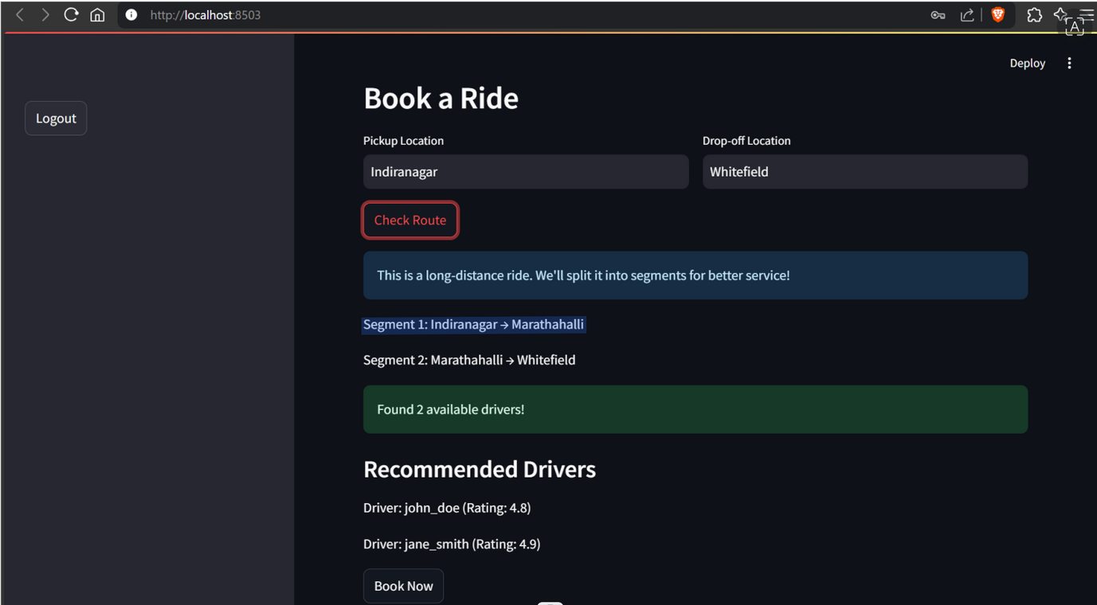
SOLUTION-3
LONG TRIPS ARE SEGMENTED INTO SMALLER RIDES (E.G., JALAHALLI → MALLESHWARAM → JAYANAGAR).
SEAMLESS HANDOVER SYSTEM ENSURES PASSENGERS DON’T HAVE TO BOOK SEPARATELY.
IMPROVES DRIVER UTILIZATION AND REDUCES DOWNTIME.

Slide 8
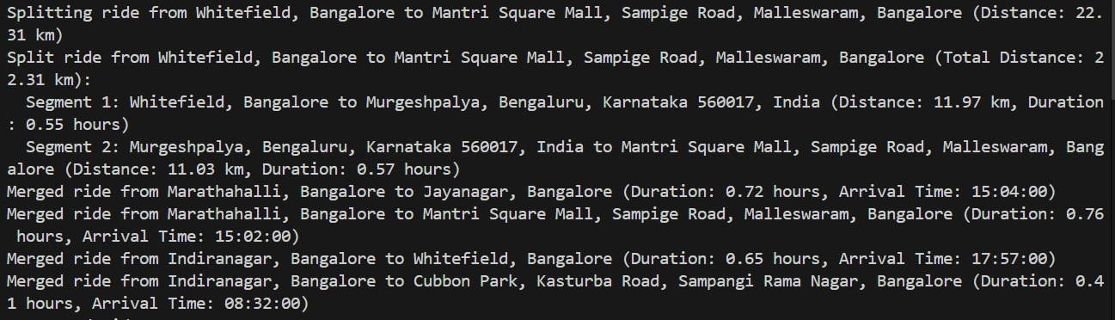
BACKEND OF RIDE SEGMENTATION

Slide 9
SOLUTION-4
PASSENGERS ARE MERGED IN RIDE-SHARING WHEN THEY HAVE A COMMON DESTINATION OR OVERLAPPING ROUTES, WITH SIMILAR PICKUP TIMES AND WITHIN VEHICLE CAPACITY CONSTRAINTS, OPTIMIZING EFFICIENCY AND REDUCING COSTS,ONLY IF THE PASSENGERS AGREE TO IT.

Slide 10
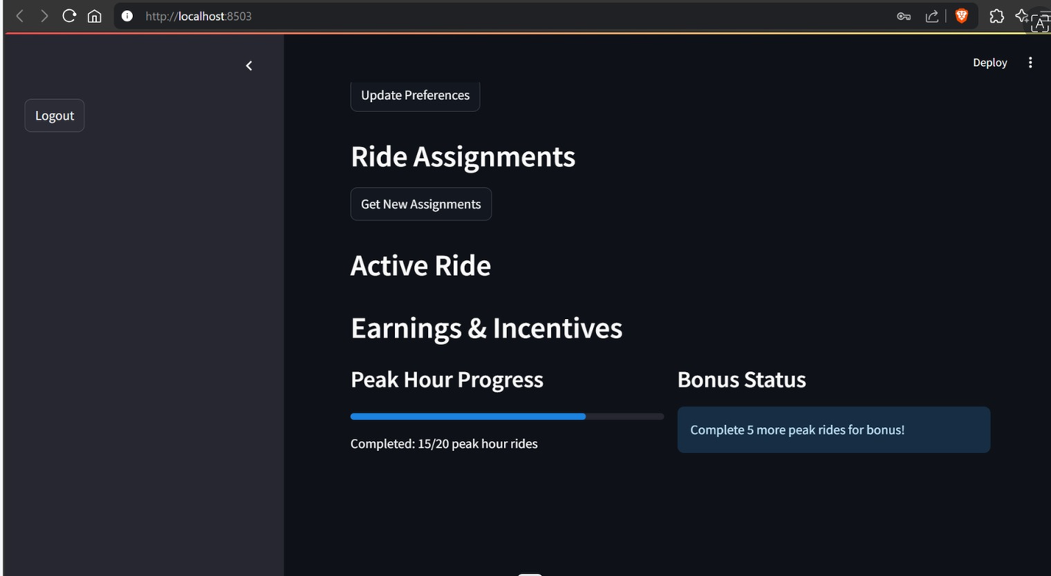
SOLUTION-5
EACH DRIVER MUST COMPLETE A SET NUMBER OF PEAK-HOUR RIDES PER WEEK, BUT THEY CAN CHOOSE THEIR PREFERRED SLOTS.
Additional peak-hour rides beyond the required quota earn drivers extra commission and incentives/vouchers.

Slide 11
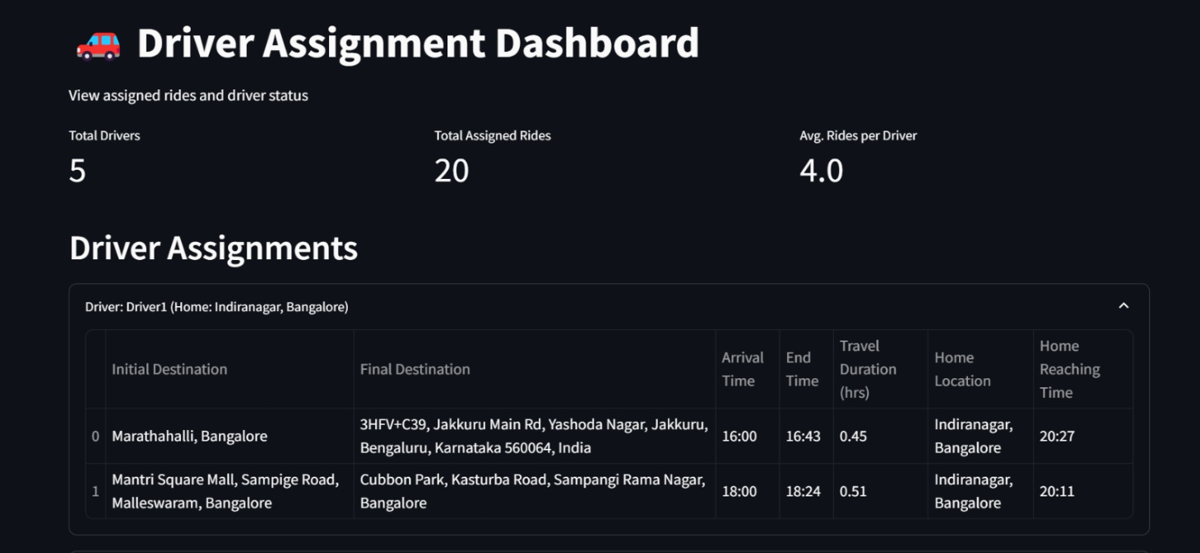

Slide 12
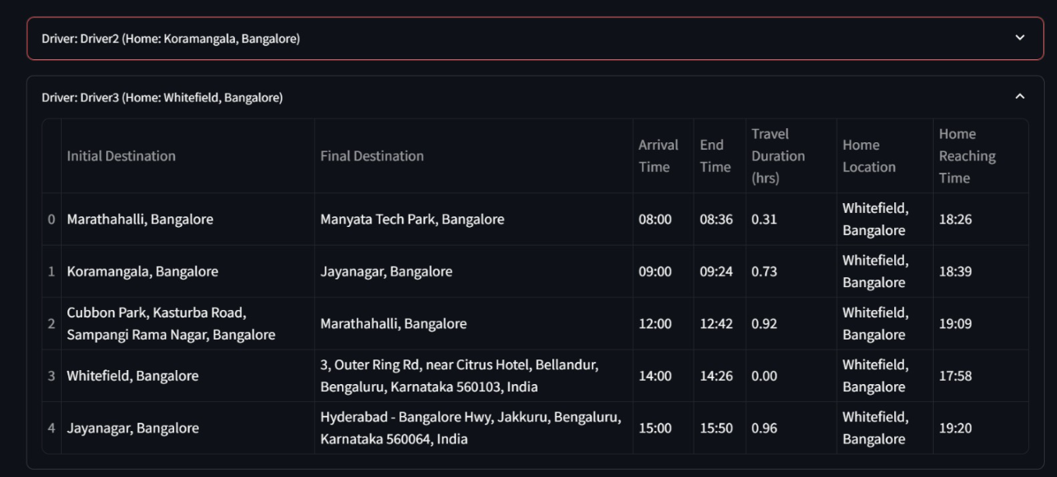

Slide 13
TECH STACK AND API USED
1)ROUTES API(GOOGLE MAPS)
2)GEOCODE API(GOOGLE MAPS)
3)LRU CACHE
4)STREAMLIT AND PYTHON
ALGORITHMS
1)PRIORITY BASED QUEUING
2)FIRST COME FIRST SERVE
3)NEAREST NEIGHBOR(GREEDY ALGORITHM)

Slide 14
THANK YOU

