Slide 1
AttriSense
Explainable, fair, and resilient workforce retention analytics
Streamlit · scikit-learn · SHAP · LangChain · EconML
Project pitch — 12 minutes
Notes:
Open with: 'Most retention dashboards stop at *who is leaving*. AttriSense answers four harder questions — why, what-if, is it fair, and what if the LLM is down. Twelve minutes, three demos.' Pause for two seconds before clicking next.

Slide 2
The problem
HR teams act on retention scores they can't explain, audit, or contest.
Black-box scores
No fairness gate
Brittle AI features
• Risk = 0.83 — but why?
• No driver decomposition.
• Reviewer can't contest.
• Group-level disparity ignored.
• Four-fifths rule not enforced.
• EEOC LL144 readiness — zero.
• OpenAI down → app crash.
• No fallback ranker.
• No reachability probe.
Notes:
Three pain points, three columns. Land hard on the first one — 'every dashboard I evaluated showed me a number with zero explanation.' Then say AttriSense fixes all three.

Slide 3
What AttriSense is
A production-grade retention dashboard that explains, audits, and degrades gracefully.
Why is this person at risk?
SHAP per-employee waterfall + driver tables
What if we change something?
What-if sliders + EconML T-Learner uplift
Is the model fair?
EEOC four-fifths audit on every dashboard load
What if the LLM is down?
TF-IDF + hashing fallbacks for AI features
Notes:
This is the elevator slide. Read all four left-side questions out loud, pause two seconds, then say 'every one of these has a working implementation in the repo'. Each row is an interactive demo I can open if asked.

Slide 4
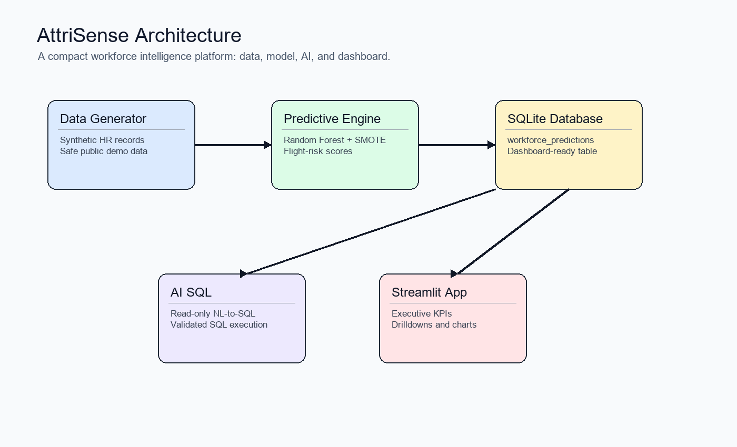
Architecture
Six layers; replace any one without touching the rest.
Notes:
Trace the data path: CSV → SQLite → 4 features → three parallel models → SHAP → Streamlit. Stress that each layer has one job and one entry point. If asked 'what does the production package give you?' point at the Application Layer card.

Slide 5
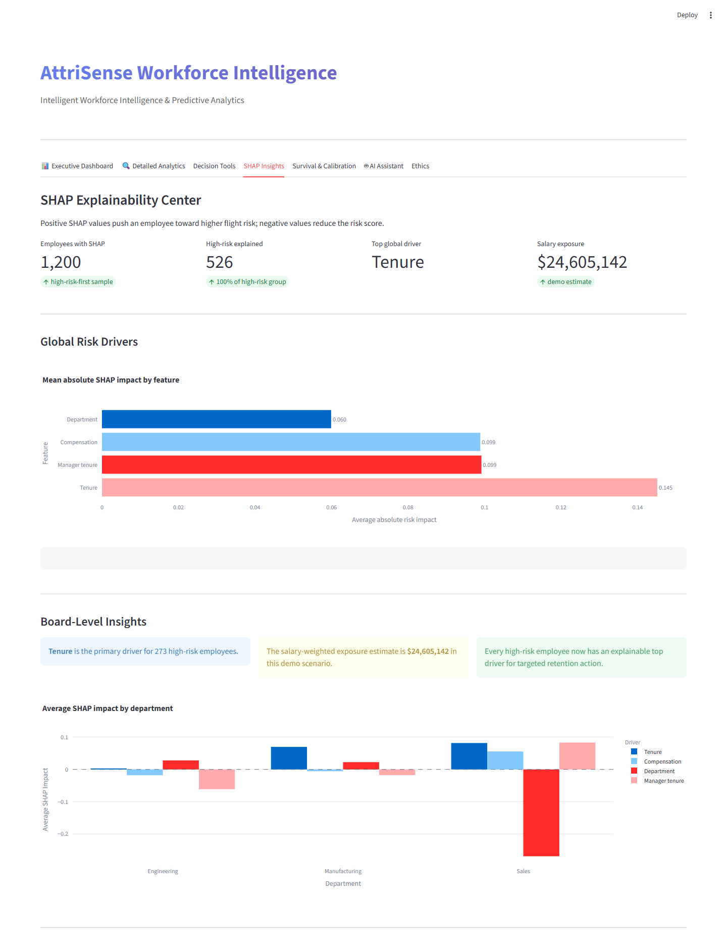
Demo 1 — Why is EMP_2417 at risk?
Talk track
• baseline 0.32
• +0.21 short tenure (7 mo)
• +0.18 below-median salary
• +0.09 Manufacturing dept
• +0.03 new manager (4 mo)
• = 0.83 final risk
• All bars sum to (final − baseline). Always.
Notes:
This is the *aha* slide. Read each contribution out loud and tap the matching bar in the dashboard if it's open. End with: 'and these five numbers always sum to the final score — that's SHAP's only guarantee, and it's the one that matters'.

Slide 6
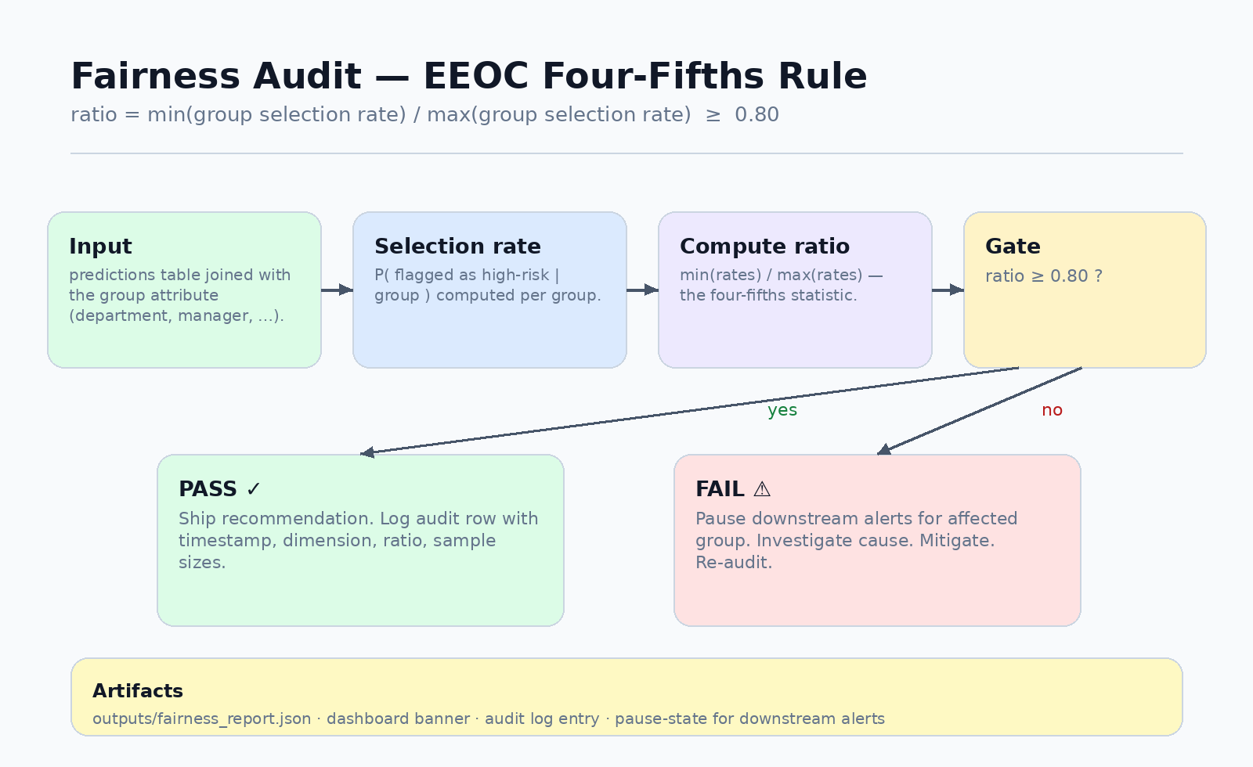
Demo 2 — Fairness audit
Four-fifths rule
• ratio = min/max selection rate
• ≥ 0.80 → ship
• < 0.80 → pause group alerts
• audit row logged either way
• outputs/fairness_report.json
Notes:
EEOC's bright line since 1978. Show the dashboard banner — green if the ratio holds, red if it doesn't. Mention 'we don't auto-mitigate — mitigation is a human decision; the audit surfaces it'.

Slide 7
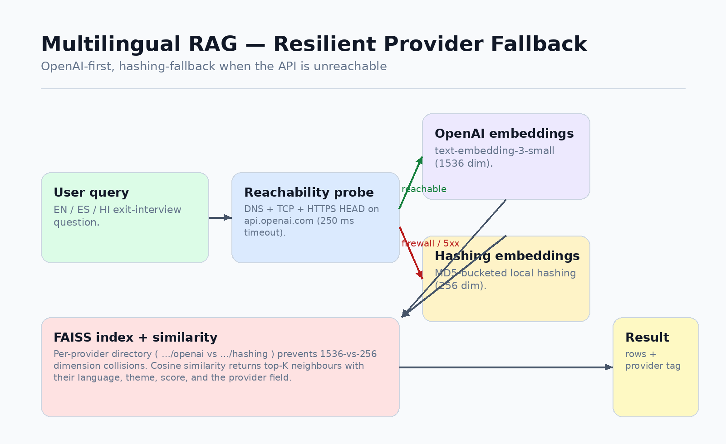
Demo 3 — RAG that survives a firewall
Why this matters
• Corp firewalls block OpenAI
• Probe + per-provider FAISS dirs
• 1536-dim ↔ 256-dim never collide
• App stays up; reviewer sees provider tag
Notes:
This is the resilience pitch. Live demo: pull network cable, query the assistant, point at the green 'provider: hashing' tag in the results. End with 'graceful degradation isn't a nice-to-have for an HR tool — pause means the team falls back to gut feel'.

Slide 8
Production discipline
What lifts this from a notebook to something you'd ship.
Tests
CI
Docker
31 pytest tests across 8 files
GitHub Actions: ruff + pytest on push
python:3.11-slim · non-root · health probe
Docs
Secrets
Ethics
MkDocs Material site + ASCII mirrors
.env auto-load · read-only SQL allow-list
Model card · fairness policy · intended use
Notes:
Don't read each card. Pick two — Tests and Ethics — and explain why those matter for *this* problem space. Anyone can show a dashboard; showing a tested, audited, documented dashboard is the differentiator.

Slide 9
A subtle bias the model can't fix
The model never sees employee_id — but the human reviewer does.
• Verified: FEATURE_COLUMNS = [Tenure, Salary, DeptCode, MgrTenure] — no ID.
• Risk: a reviewer recognises EMP_2417 as 'Ravi' and anchors on memory.
• Mitigation: pseudonymize at the dashboard boundary.
• review_id_map (private, access-controlled) ↔ workforce_predictions (review_id only)
• rotate quarterly · audit every reverse-lookup · no name in any table the dashboard queries.
• Status in this demo: synthetic IDs only; pattern documented in fairness-policy.md.
Notes:
This is the slide that signals senior thinking. Most candidates stop at 'we removed protected attributes from features'. Make it clear that *identification* is itself a bias vector, and that the proposed review_id mapping is a real production pattern, not academic.

Slide 10
What I'd do next (90-day plan)
Hardening
Coverage gate, image signing, GHCR push, Playwright smoke
Fairness
Manager + tenure-band audit, intersectional, review_id mapping
Causal
Replace simulated treatments with observed; DR-Learner / DML
Data
snapshot_date column → MoM drift KPI + calibration sparkline
Slack feedback
Reaction-loop labels feed back into training
Notes:
Show that the roadmap is concrete and prioritised, not a wishlist. If pressed for time pick the top two and skip the rest.

Slide 11
Things I'm deliberately NOT doing
Restraint is a feature. Each item below is a PR that would be closed.
• Auto-mitigate fairness failures — mitigation is a human call, not a build-time toggle.
• MLflow / W&B / experiment tracking — one model, one joblib, in git is enough.
• Airflow / Prefect — make pipeline is the pipeline.
• GraphQL API — the dashboard *is* the API.
• Mobile app — Streamlit is responsive enough.
• Self-serve CSV upload — no column provenance ⇒ privacy hazard.
Notes:
Closes a typical interview gap. Senior candidates name what they *won't* build. Lean into 'restraint is a feature' — quote that line.

Slide 12
Built for explainability,
audited for fairness,
designed to fail gracefully.
github.com/Dogiparthi-Sharada/AttriSense
Questions?
Notes:
End on the three-line tagline. Pause. Then say 'questions?' and stop talking. The first interviewer to break the silence is signaling what they care about — the rest of the conversation should follow.

