Slide 1
SITING ATLAS
Volume I | Last-Mile Delivery
An open model of where private infrastructure gets built
— and who bears the consequences.
Sharada Dogiparthi · Srilekha Budithi · Rakshitha Venigalla
MS Business Analytics, CSU East Bay
Course instructor: Surendra Sarnikar, Ph.D.
Not affiliated with, endorsed by or sponsored by any operator analysed. Operator names are used descriptively.
Notes:
OPEN "Siting Atlas. One sentence: we rebuild a private billion-dollar
decision from public data, and then check whether we got it right."
LAND The name is operator-neutral on purpose - it survives past delivery,
and it keeps other people's trademarks out of our product name.
TIMING 30 seconds. Do not linger.

Slide 2
Big retailers decide which ZIP codes get same-day delivery.
Each one costs them $3–5 million.
Those decisions happen inside private models nobody outside
the company can see — but the consequences are public.
We build an open version of that decision, from free public data — and then check whether it actually predicts what they did.
That last part is the whole project. Anyone can build a model. Very few get scored against reality.
Siting Atlas | Volume I: Last-Mile Delivery
2
Notes:
OPEN "Here is the whole project before any jargon."
LAND The last line is the project: we get SCORED. Anyone can build a model;
almost nobody submits it to reality.
IF ASKED "Why does it matter that it's public?" - because a council that
wants to contest a decision cannot contest a model it cannot see.
TIMING 1 minute.

Slide 3
The decision, in plain terms
Turning on same-day delivery in one ZIP code is a capital project, not a software setting.
IT NEEDS A BUILDING
IT IS DECIDED ZIP BY ZIP
IT IS EXPENSIVE TO GET WRONG
Same-day is not '2-day but faster'. It needs different buildings, closer to customers — a delivery station within about 30 minutes of the door.
Service is switched on per ZIP code. Two neighbouring ZIPs in the same city can differ. So the ZIP is the unit of decision.
$3-5M per ZIP. Across the 2,413 ZIPs we model, that is $7.2B-$12.1B billion of capital being allocated.
And the three things that decide whether a ZIP is profitable all interact.
1. How many orders are genuinely NEW 2. How DENSE the deliveries are 3. How many orders were STOLEN from 2-day shipping
Siting Atlas | Volume I: Last-Mile Delivery
3
Notes:
OPEN "Three things to know about the decision itself."
LAND Same-day is a BUILDING problem, decided ZIP by ZIP, at $3-5M each.
That is why the unit of analysis is the ZIP.
IF ASKED "Why not model at city level?" - because service is switched on per
ZIP. Two neighbouring ZIPs in one city can differ.
TIMING 1.5 minutes.

Slide 4
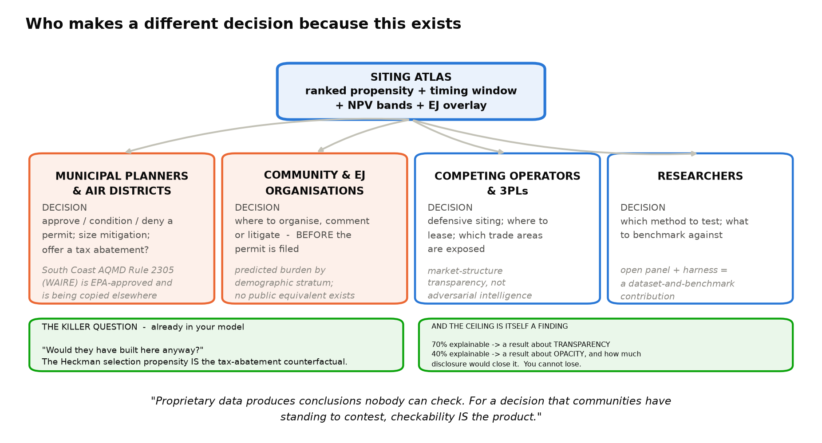
Who actually uses this
Four groups, each with a decision the model changes — and none of them can buy this today.
Notes:
OPEN "Before the method - who actually uses this."
LAND The tax-abatement counterfactual. A council is asked for $2M and cannot
answer 'would they have built here anyway?'. Our propensity score IS
that answer.
IF ASKED "Isn't this just helping competitors?" - competitive use is real but
it is the least interesting user. The ones who cannot buy an
alternative are councils, air districts and community groups.
TIMING 2 minutes. This slide earns the rest of the talk - do not rush it.

Slide 5
What exactly are we predicting?
The single most important design choice in the project.
THE QUESTION WE ASK
WHY THAT MATTERS
For each ZIP code:
Will the operator turn on same-day
delivery here — and when?
Both are visible from outside. You can type a ZIP into their own delivery checker.
Because it means we can be SCORED.
We make a prediction. Reality tells us whether we were right.
Most student projects cannot do this. It is the difference between a model and a forecast.
Example: in 2023 the model says ZIP 85008 has a 72% chance of same-day within 18 months. Then we check 2024–25.
The tempting alternative was to predict order VOLUME per ZIP. Nobody outside the company can see that number — so it would have to be invented. The next slide shows why inventing it is a trap.
Siting Atlas | Volume I: Last-Mile Delivery
5
Notes:
OPEN "What exactly are we predicting? This is the most important design
choice we made."
LAND Observable outcome = we can be scored.
IF ASKED "Why not order volume?" - that is the next slide. Say so and move.
TIMING 1.5 minutes.

Slide 6
The trap we avoided
Worth understanding properly — it is the best story in the project.
IF WE HAD PREDICTED ORDER VOLUME
THE SAME MISTAKE, IN EVERYDAY TERMS
Step 1. Nobody publishes volume per ZIP,
so we would have to invent it —
split total orders by income and
shop density.
Step 2. Then build a model that uses income
and shop density to predict it.
The answer is made of the same ingredients
as the question.
I define a student's 'talent score' as
0.6 x height + 0.4 x shoe size
Then I build a model predicting talent score
from height and shoe size.
It scores 97% accurate — and has learned
nothing about talent. It rediscovered my own
formula.
And the dangerous part: the BETTER the score looked, the more completely it proved the bug.
Switching to "did they turn it on here?" fixes it, because that number comes from the world, not from us.
Siting Atlas | Volume I: Last-Mile Delivery
6
Notes:
OPEN "We nearly got this wrong, and the way we nearly got it wrong is
worth two minutes."
LAND The talent-score analogy. Deliver it slowly - pause after 'and has
learned nothing about talent.'
Then: the better the score looked, the more it proved the bug.
IF ASKED "How did you catch it?" - by asking what the metric would look like
if the model were useless. It looked identical. That is the tell.
TIMING 2.5 minutes. This is the strongest story in the deck.

Slide 7
Idea 1 — cannibalization
Why more orders does not mean more money.
THE PROBLEM
AND IT LEAKS NEXT DOOR
Before same-day, a household orders 8 items
a month on 2-day shipping.
After same-day launches, they order 9 —
all same-day.
Naive read: 'same-day generated 9 orders!'
Reality: 1 new order, and 8 that were
switched to a more expensive method.
Same-day launches in Berkeley — not in
neighbouring Emeryville.
But an Emeryville resident works in Berkeley,
now has a same-day address at the office, and
shifts their ordering.
Emeryville's numbers move even though
Emeryville was never switched on.
That leak is why the usual statistical methods break here — your 'untreated' comparison group was partly treated.
So instead of assuming how far the leak reaches, we measure it.
Siting Atlas | Volume I: Last-Mile Delivery
7
Notes:
OPEN "Idea one of three. Why more orders is not more money."
LAND 8 to 9 orders is ONE new order and EIGHT switched to a costlier
method. And it leaks into neighbours, which breaks the standard
methods.
IF ASKED "How big is the leak?" - next slide, we measured it.
TIMING 1.5 minutes.

Slide 8
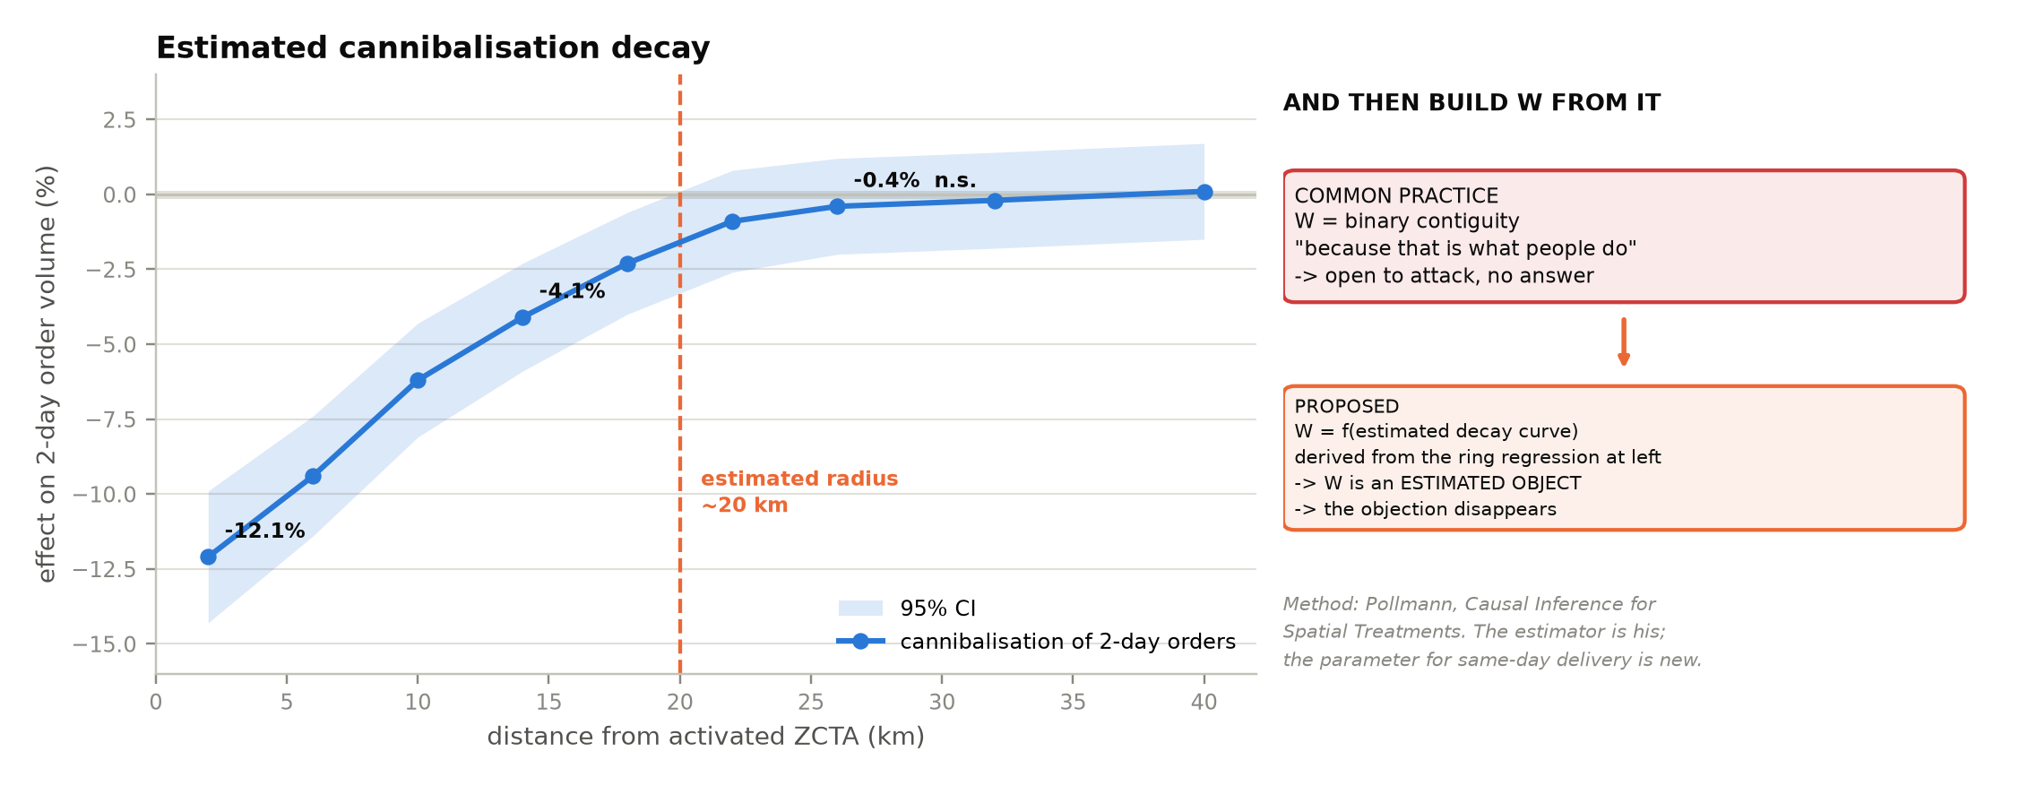
Idea 1 — how far the leak reaches, and how we would measure it
We draw rings around each launched ZIP and estimate the effect in each ring separately. The curve shown is illustrative: this estimand has not been touched.
Do NOT read a number off this slide. The decay curve is four literal arrays in the figure source; nothing has been estimated. What is real here is the design — Pollmann's distance-band estimator, credited, with the spatial weight matrix derived from the estimate rather than assumed. If asked why it is in the deck at all: because it is the second estimand in the proposal and it is the one that may be more tractable than siting with the data we have.
Notes:
OPEN "So the plan is to measure it rather than assume it."
LAND Say plainly, before anyone asks: the curve on this slide is
illustrative. This estimand has not been touched. Do not read the
numbers off it - they are four literal arrays in the figure source.
What is real is the design: rings around each launched ZIP, an effect
estimated separately in each ring, and W derived from the result
instead of assumed.
IF ASKED "Is the method new?" - no. It is Pollmann's estimator and we credit
it. The parameter would be what is new, if we estimate it.
IF ASKED "Why show an unestimated curve?" - because it is the second
estimand in the proposal and it may be more tractable than siting
with the data we have. It is on the roadmap, not in the results.
TIMING 2 minutes.

Slide 9
Idea 2 — the AI agent, and the thing that surprised us
The agent reads competitor news and updates our data. Letting it write is where it gets interesting.
THE FOUR OBVIOUS SAFETY CHECKS
A REAL EXAMPLE
1. Is the data shaped correctly?
2. Do the coordinates exist on Earth?
3. Is the AI confident enough?
4. Is it logged so we can undo it?
Everybody building these systems has these.
The agent reads: "Walmart opens a sortation
centre in Plano, Texas." It writes the record.
Schema OK. Plano is real. Confidence 0.94.
Logged. ALL FOUR CHECKS PASS.
The data is perfect.
But Plano's neighbours just changed -> our comparison group changed -> the estimate changed -> the answer moved by millions.
The data is fine. The conclusion is broken. And nothing checked for that.
So we add two more checks: (5) did this move a comparison ZIP into the treated group? (6) did the answer move more than we agreed in advance? If so, stop and ask a human.
Siting Atlas | Volume I: Last-Mile Delivery
9
Notes:
OPEN "Idea two. This is the part that surprised us."
LAND Walk the Plano example one line at a time. Land hard on:
'The data is fine. The conclusion is broken.'
Pause there. Then give gates 5 and 6.
IF ASKED "Isn't that just a bug?" - no, it is a category of bug nobody
checks for, because every existing gate protects the data.
TIMING 3 minutes. The most important slide in the deck.

Slide 10
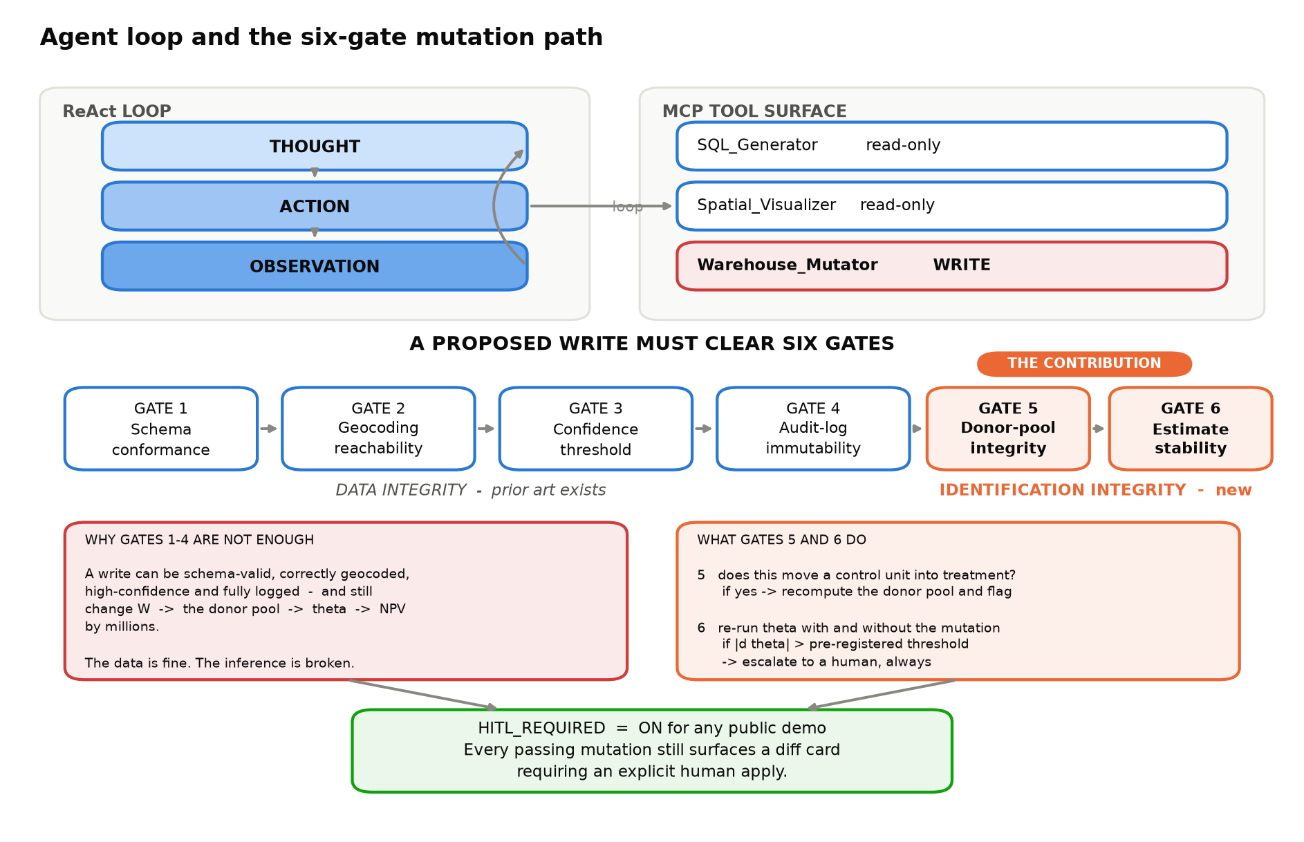
Idea 2, drawn — six checks, not four
Checks 1–4 protect the DATA. Checks 5–6 protect the CONCLUSION. That distinction is our main contribution.
Notes:
OPEN "Drawn out, so you can see where the boundary is."
LAND Four checks protect DATA. Two protect the CONCLUSION. Point at the
orange boxes.
TIMING 1 minute - the previous slide did the work.

Slide 11
Idea 3 — it is a shopping basket, not a ranked list
The instinct is to score every ZIP and take the top 20. That is wrong.
TWO ZIPS, JUDGED ALONE
THE SAME TWO, TOGETHER
ZIP A on its own: loses $200,000
too few deliveries to justify a station
ZIP B on its own: loses $150,000
same problem
A ranked list rejects both.
They are next to each other, so they can
SHARE one delivery station.
Combined deliveries cross the efficiency
threshold. Cost per package drops 30%.
Together: makes $1,100,000
A ranked list never even evaluates the pair. So we choose bundles instead.
Honest note: this is not our invention. Supply-chain software has optimised multi-site networks for twenty years. We include it because a ranked list is simply the wrong model of the decision — it is a correctness fix, not a claim to novelty.
Siting Atlas | Volume I: Last-Mile Delivery
11
Notes:
OPEN "Idea three. A shopping basket, not a ranked list."
LAND Two ZIPs each lose money alone and make $1.1M together, because they
share a station. A ranking never evaluates the pair.
IF ASKED "Is that novel?" - no, and say so first. Supply-chain software has
done multi-site optimisation for twenty years. We include it because
a ranking is the wrong model of the decision.
TIMING 2 minutes.

Slide 12
How we say how confident we are
"Accuracy" means four different things. We report all four.
DOES IT RANK WELL?
ARE THE ODDS HONEST?
HOW WRONG COULD WE BE?
WOULD THE ANSWER CHANGE?
AUC. Pick one ZIP that got service and one that didn't — how often does the model score the right one higher?
0.5 = coin flip. We targeted 0.80 and measured 0.6894.
Calibration. When the model says '60% chance', does it happen about 60% of the time?
Matters because councils act on that number.
Conformal intervals. We give a range — and then CHECK the range works on held-out data.
A measured guarantee, not an assumed one.
Rank stability. Re-run everything many times with slightly different assumptions; does this ZIP stay in the top ten?
SPECIFIED, NOT YET RUN.
What the third one measured: we asked for 90% coverage and got 88.19% — inside the 3.2pp band that 351 independent units allow.
That is the question an executive actually has, and almost no student project answers it.
Siting Atlas | Volume I: Last-Mile Delivery
12
Notes:
OPEN "How we say how confident we are - accuracy means four things."
LAND The fourth one. Rank stability is what an executive actually needs and
almost nobody reports it. Say plainly that we have not run it yet.
IF ASKED "What is conformal prediction?" - we give a range and then CHECK
the range works on held-out data. A measured guarantee, not an assumed
one.
TIMING 2 minutes.

Slide 13
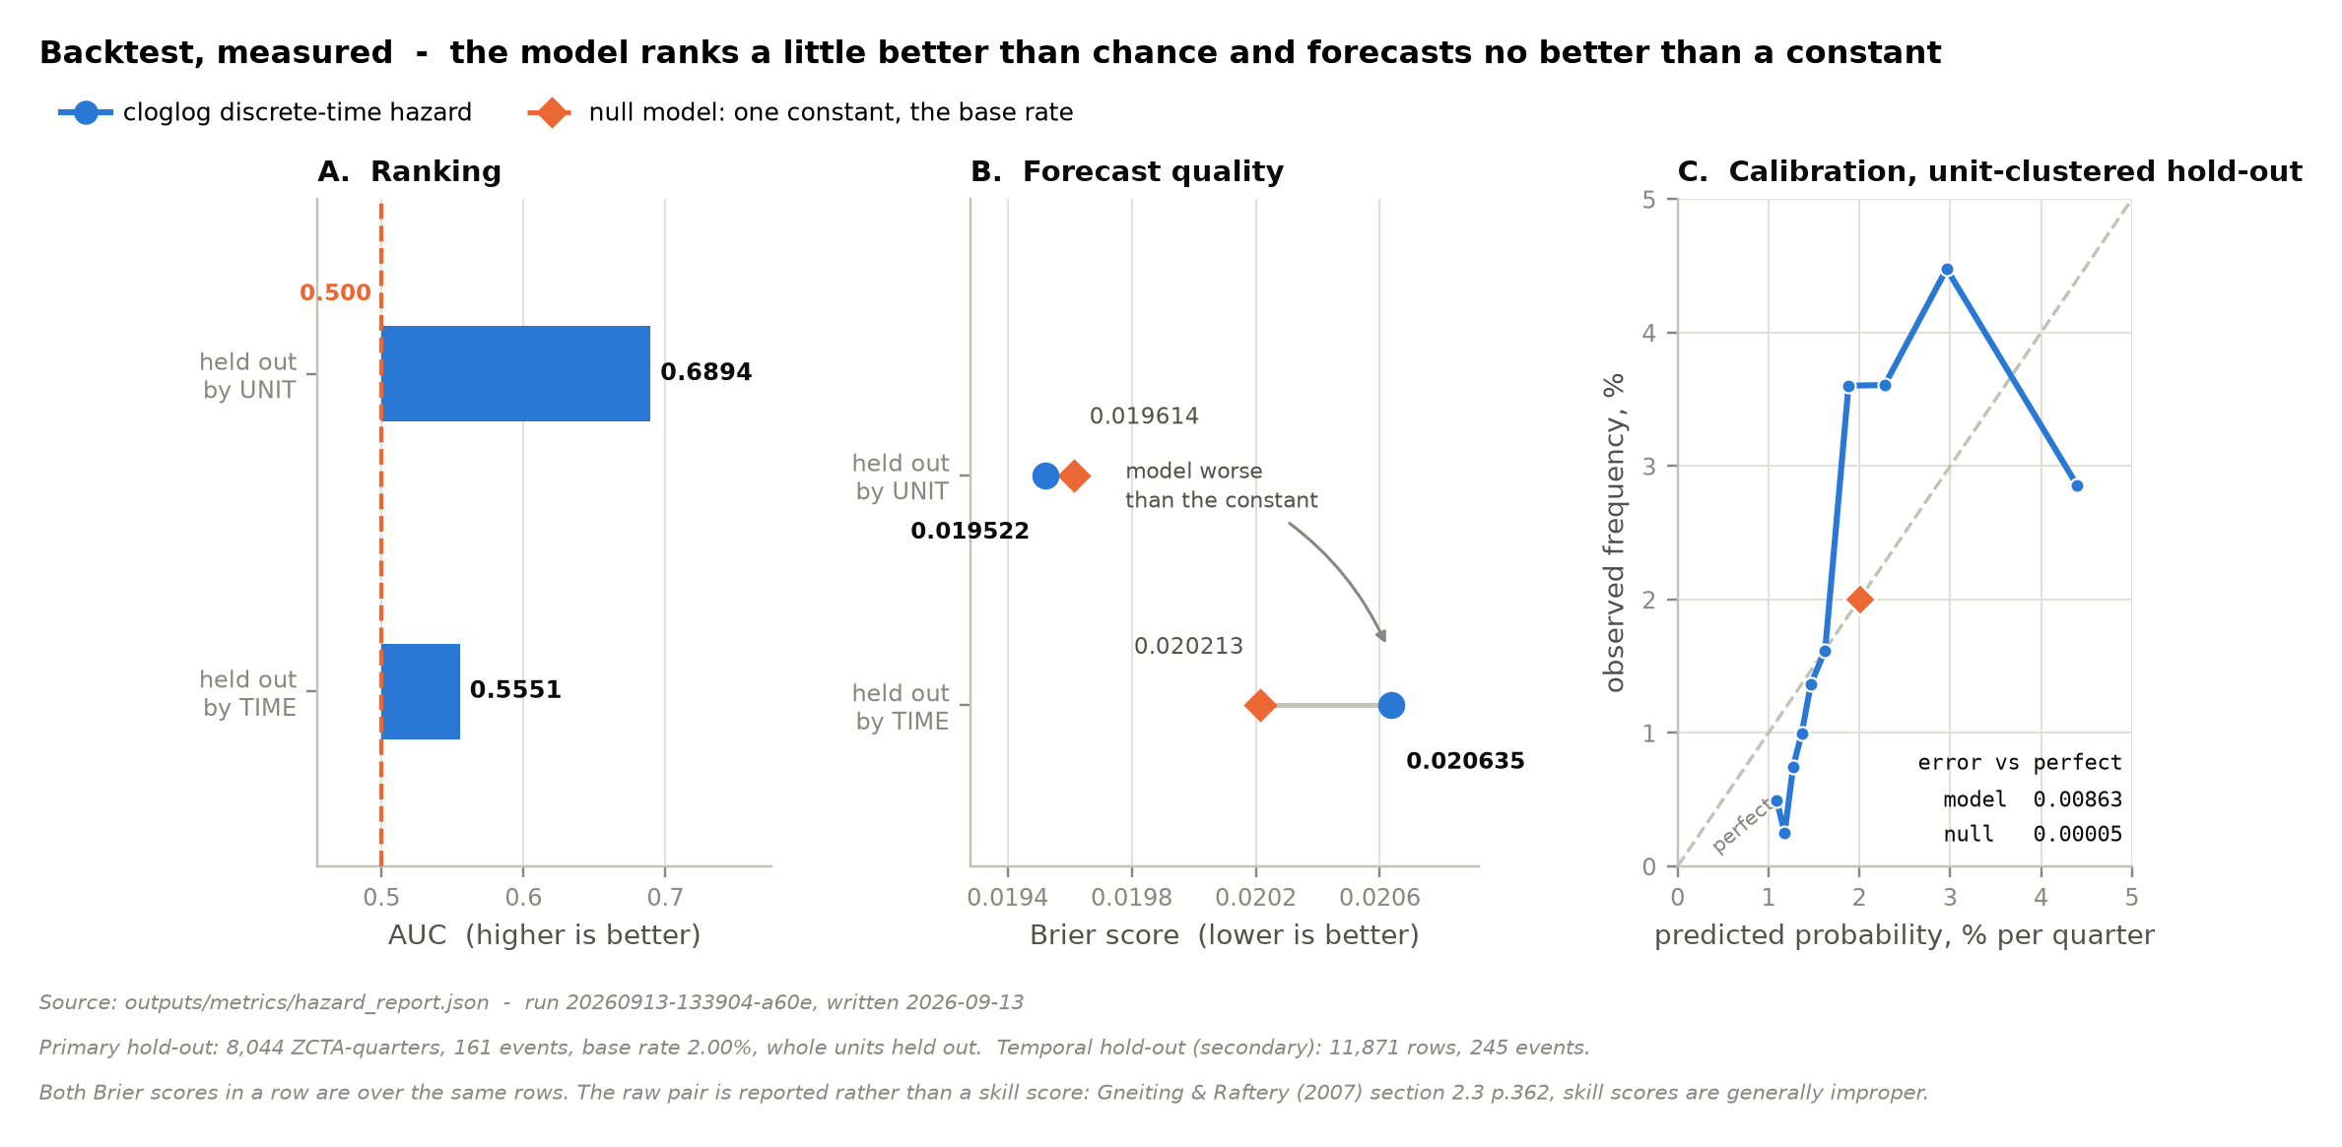
We scored it, and it failed
AUC 0.6894 against 0.5000 for a constant. Brier 0.019522 against 0.019614. Calibration error 0.00863 against 0.00005.
Every number on this slide is read from outputs/metrics/hazard_report.json. The model ranks slightly better than chance and forecasts no better than a constant, and is worse calibrated than one. That is the finding: the unit of analysis was wrong, not the sample size.
Notes:
OPEN "And this is the test that makes it a forecast rather than a fit.
We ran it. We failed it."
LAND Say the three numbers out loud: AUC 0.6894 against 0.5000 for a
constant; Brier 0.019522 against 0.019614; calibration error
0.00863 against 0.00005. A model that ignores every covariate is better
calibrated than ours. Then say why that is worth showing: most
projects never find out.
IF ASKED "So the project failed?" - no, the SPECIFICATION failed, and it
failed for a statable reason. One station switches on a median of 58
ZIP codes at once, so the events are not independent. We are
respecifying as a conditional choice over ZIP codes given a station
opens.
IF ASKED "Why not quote the skill score?" - Gneiting and Raftery 2007,
section 2.3: skill scores are generally improper even when the
underlying score is proper. We quote the raw pair.
TIMING 2 minutes. This is the slide to slow down on.

Slide 14
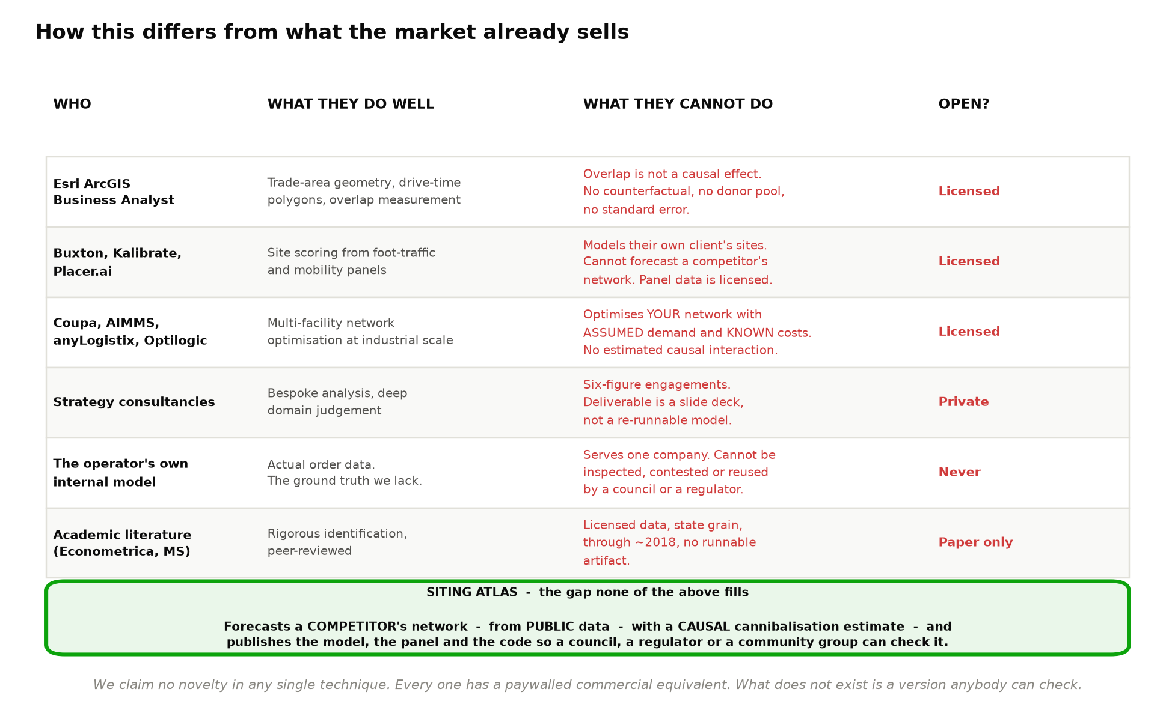
How this differs from what the market already sells
The honest version: every single technique here already exists somewhere, behind a paywall.
Notes:
OPEN "Now the uncomfortable part. Here is everything that already exists."
LAND Read the right-hand column, not the left. The gap is not capability -
it is CHECKABILITY.
IF ASKED "So you built a worse version of Esri?" - a worse version on
geometry, a different thing on causality, and the only one a council
can open.
TIMING 2 minutes. Volunteering this buys credibility for the next slide.

Slide 15
So what is actually new?
Four claims. Each written so a product brochure cannot disprove it.
# | What we claim | Why it survives checking
1 | A new kind of safety check for AI systems that write to a statistical model | Everyone else protects the DATA. Nobody checks whether a valid write breaks the CONCLUSION.
2 | The first published number for how far delivery cannibalization reaches | The method is borrowed and credited. The number for same-day delivery is not published anywhere.
3 | How much of a giant company's expansion is visible from public data alone | Nobody has measured this. 70% is a finding about transparency; 40% is a finding about opacity.
4 | The artifact itself — free, open, checkable | Every commercial equivalent is licensed and unauditable. A council cannot inspect any of them.
We never write "first" or "novel". We write "not published in the open literature" and "not available as something anybody can check."
Those statements stay true no matter what Esri ships or what the operator runs internally — because none of it can be inspected.
Siting Atlas | Volume I: Last-Mile Delivery
15
Notes:
OPEN "So what is actually new. Four claims."
LAND Point at the wording rule at the bottom. We never say 'first'.
IF ASKED "Isn't claim 3 just a descriptive statistic?" - yes, and nobody has
computed it. 70 percent is a finding about transparency, 40 percent
about opacity.
TIMING 2 minutes.

Slide 16
And three things we deliberately do NOT claim
We checked our own claims against the literature and the market. Three did not survive.
Tempting claim | Why it fails | What we say instead
"Nobody has gated an AI write before" | Extensive published work and shipped open-source tools already do this. | We claim only the identification check — a distinct failure nobody covers.
"Spatial models always fix the neighbour matrix" | Several papers estimate it. One prominent paper argues results barely depend on it. | We use it as live state instead, and TEST whether that changes anything.
"We react faster than the operator" | Compares our compute time to their approval process. Their process is slow because a human signs off $4M. | Dropped entirely. It was a category error and the number was unsourceable.
Saying this out loud is not a weakness. It is the reason to believe the four claims we kept.
Siting Atlas | Volume I: Last-Mile Delivery
16
Notes:
OPEN "And three we deliberately do not make."
LAND We checked our own claims and three did not survive. Saying so is the
reason to believe the four we kept.
IF ASKED "How did you find these?" - a literature check and a commercial
prior-art check, both documented.
TIMING 1.5 minutes.

Slide 17
The awkward questions, answered
Every limitation, paired with what we do about it.
The objection | What we do | What still bites
"Census data is two years old" | The operator faced the SAME lag — there is no private census. And decisions take 18–36 months, so old data matches the decision date. We add monthly rents and building permits for what moves fast. | An area that changed in the last 18 months with no permit signal. We flag it.
"You cannot measure revenue" | Six of our eight outputs do not need it — ranking does not change if every number is scaled the same. We report profit as a multiple of margin, with the break-even value. | If margin varies by area, ranking shifts. We test that as a worst case.
"Your facility dates might be wrong" | Hand-check 100, publish the error rate, and deliberately corrupt dates in a simulation to measure how much accuracy would drop. | Small stations are under-reported. Stated.
Four things have NO workaround, and we say so. That is what makes the rest believable.
Siting Atlas | Volume I: Last-Mile Delivery
17
Notes:
OPEN "The three questions I would ask if I were you."
LAND Every row has a mitigation AND a residual. Then the red banner: four
things have no workaround and we say so.
IF ASKED "Which is the weakest part?" - the cannibalisation coefficient.
No public number to check it against. Have that answer ready.
TIMING 2.5 minutes.

Slide 18
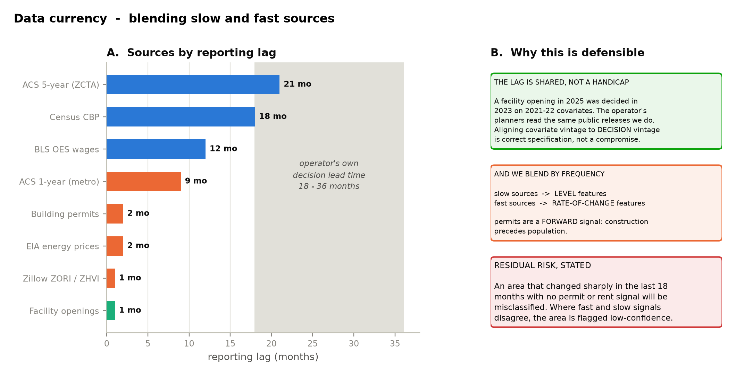
"But the data is old" — the full answer
We are not behind the decision-maker. They read the same public releases we do.
Notes:
OPEN "The data-is-old objection, in full."
LAND The operator faced the SAME lag. There is no private census. And a
2025 opening was decided in 2023 on 2021-22 data, so our vintage
matches the decision.
TIMING 1.5 minutes.

Slide 19
Can three people actually build this?
We sized it before committing. The answer is yes, and here is why.
1,081,312
$0
16 GB
rows in the table we actually model on.
This fits in memory on any laptop.
compute cost. Everything runs locally or
on free tiers.
RAM is enough. No GPU is needed
anywhere in the project.
THE ONE THING THAT WOULD HAVE BROKEN IT
THE FIX — DELETE IT AFTERWARDS
Road-network processing. Doing it for ten cities at once needs about 30 GB of working files and more memory than a student laptop has.
We nearly put that on the critical path.
We do not need a routing SERVICE. We need a TABLE of drive times.
Process one city, save the table, delete everything else, move on. Peak disk drops from 60 GB to 8 GB, and the finished app carries a 10 MB file instead of a routing engine.
This is the kind of decision that makes a project ship on time.
Siting Atlas | Volume I: Last-Mile Delivery
19
Notes:
OPEN "Can three people actually build this? We sized it first."
LAND The routing story. We nearly put a 30 GB dependency on the critical
path, then realised we needed a table, not a service.
IF ASKED "What if you need routing later?" - regenerate that metro. It is
an offline job.
TIMING 2 minutes.

Slide 20
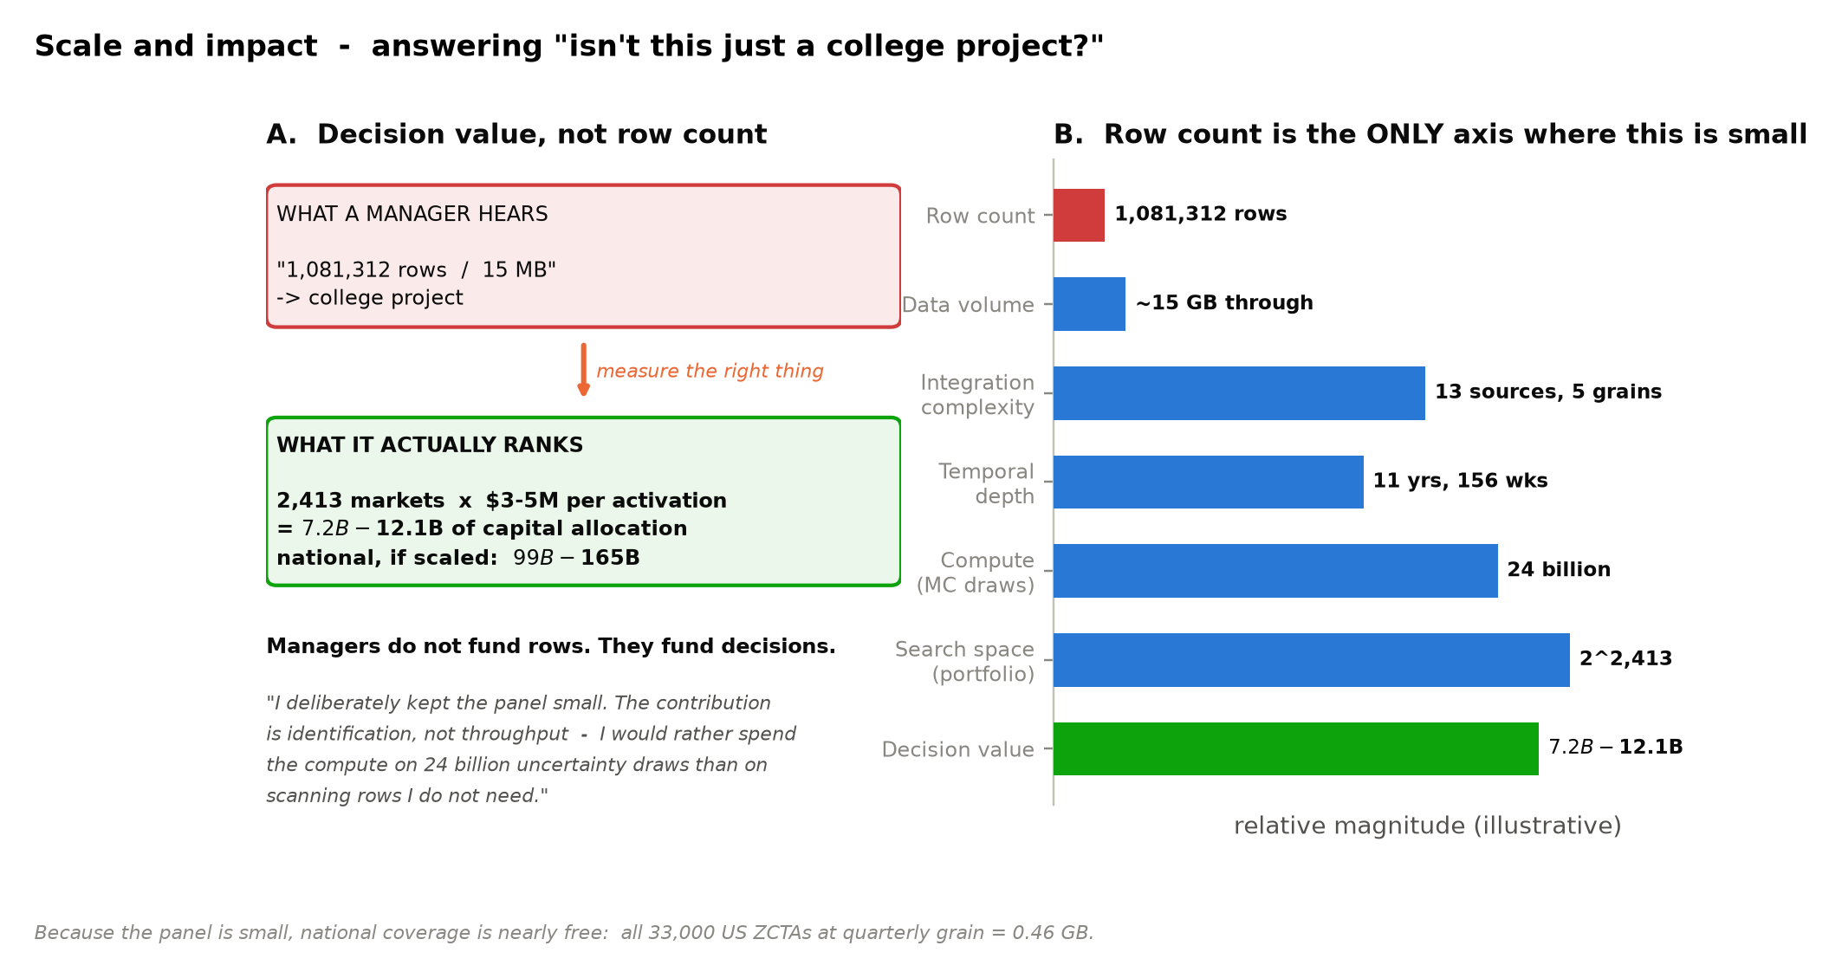
"Isn't 1,081,312 rows small?"
Row count is the only dimension on which this project is small — and it is small on purpose.
Notes:
OPEN "And the scale question, since a million rows sounds small."
LAND Row count is the ONLY axis where this is small. Say the deliberate
line: I would rather spend compute on 24 billion uncertainty draws
than on scanning rows I do not need.
WARNING Never claim this is big data. It collapses in thirty seconds.
TIMING 1.5 minutes.

Slide 21
Where the data comes from
Eleven sources. All free, all public, all re-downloadable by a stranger.
Source | What it gives us | How fresh
Census ACS (5-year and 1-year) | Income, age, population, household size | 9–24 months
Census TIGER/Line | The map — ZIP-area boundaries | Annual
Zillow rent and value indices | Local cost of space | Monthly
Census County Business Patterns | How many shops and businesses are nearby | Annual
Census Building Permits Survey | Construction — a signal of change BEFORE it shows up | Monthly
BLS wages · EIA energy prices | What it costs to run a station in each city | Monthly–annual
Facility openings | What we are predicting | Continuous
EPA EJScreen | Pollution and demographic burden, for the equity map | Periodic
OpenStreetMap | Drive times — used once, then deleted | Continuous
No paid API, no licensed panel, no login. That is what makes the whole thing reproducible — and it is the point.
Siting Atlas | Volume I: Last-Mile Delivery
21
Notes:
OPEN "Eleven sources, all free and public."
LAND No paid API, no licensed panel, no login. That constraint IS the
contribution, not a budget limit.
IF ASKED "Wouldn't paid data be better?" - yes, and it would destroy the
point. A model on licensed data produces conclusions nobody can check.
TIMING 1.5 minutes.

Slide 22
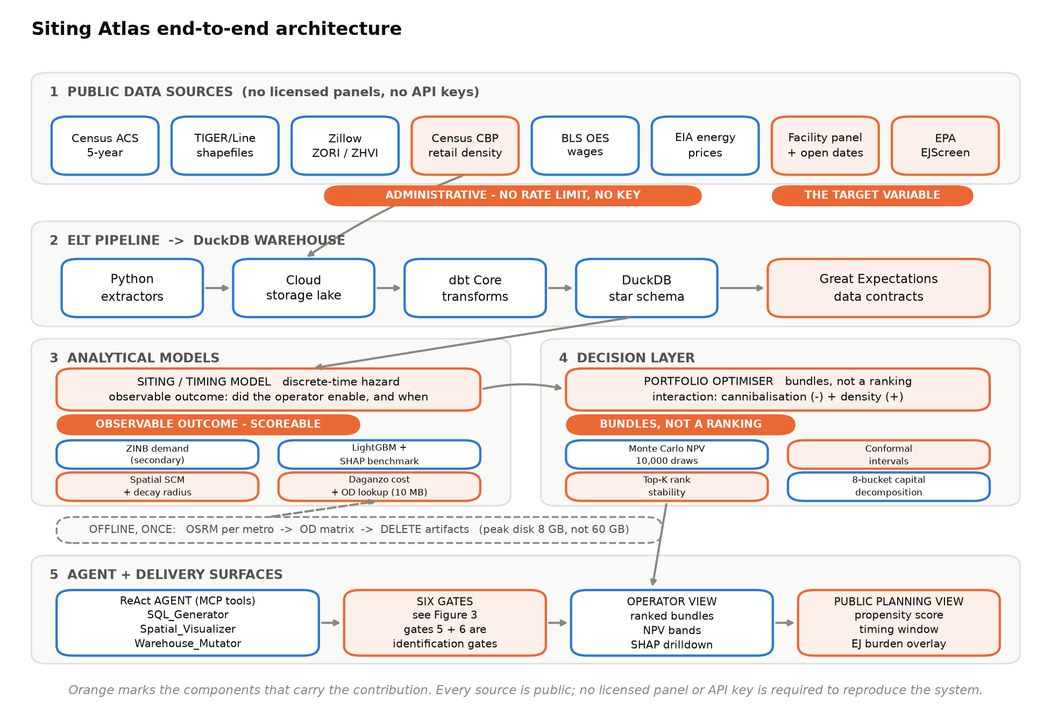
How the pieces fit together
Public sources on top, the decision at the bottom. Orange marks the parts that carry the contribution.
Notes:
OPEN "How the pieces fit together."
LAND Nothing above the feature layer knows where the bytes came from. That
is why Volume II - data centres - is a data swap, not a rewrite.
TIMING 1.5 minutes.

Slide 23
The plan
Nine weeks. Week 0 exists because some decisions are cheap now and expensive later.
Week | What happens | Done when…
0 | Decisions: what we predict, routing strategy, scope, budget | All six settled in writing
1–2 | Pipeline and the facility table | Builds from scratch in one command, offline
3 | Drive times and cost model | Tables saved, big files deleted
4 | The model and the backtest | A real accuracy number we can defend
5 | Cannibalization and the decay curve | A published number with error bars
6 | Money layer and the app | Deployed, loads in under 5 seconds
7 | The agent and the six checks | Adversarial test set passing
8 | Paper, dataset release, write-up | Dataset public
9 | Buffer | Presentation delivered
Siting Atlas | Volume I: Last-Mile Delivery
23
Notes:
OPEN "Nine weeks. Week zero is decisions."
LAND Six decisions that are cheap now and expensive later. That is what we
want signed off today.
TIMING 1 minute.

Slide 24
Who does what
Split by pipeline stage, not just by module — so nothing is nobody's job.
SHARADA DOGIPARTHI
SRILEKHA BUDITHI
RAKSHITHA VENIGALLA
Modelling and identification
Warehouse and data models
The siting and timing model
Cannibalization and the decay curve
The agent and the six checks
Data and reproducibility
All eleven data sources
Drive-time tables
Automated data checks
Tests and continuous integration
Delivery and communication
The application, both views
Charts and the equity map
Executive deck and write-ups
The public dataset release
Owns the answer to:
"How do you know it's cause,
not coincidence?"
Owns the answer to:
"Does it build from scratch,
in one command?"
Owns the answer to:
"What decision does
someone actually make?"
Siting Atlas | Volume I: Last-Mile Delivery
24
Notes:
OPEN "Who does what - split by pipeline stage, not just module."
LAND Read the italic question under each name. Assigning modules without
stages is how a shared pipeline becomes nobody's job.
TIMING 1 minute.

Slide 25
Budget
One number, inside the cap. Compute is free; the only cost is AI usage.
$80
$100
$0
estimated total spend
hard cap from the course rubric
compute, hosting, storage and data
Line item | Cost | How it is controlled
AI usage — reading news, agent tools | $55 | Responses cached; a hard stop fires at $80
Contingency | $25 | Only released by an explicit decision
Storage, hosting, database, pipeline, CI | $0 | Free tiers and open-source tools
All eleven data sources | $0 | Public — no paid API, no key
Two components a reader might expect — a fine-tuned writing model and a multi-model comparison — are out of scope. Neither answers any question that matters here.
Siting Atlas | Volume I: Last-Mile Delivery
25
Notes:
OPEN "Budget. Eighty dollars, inside the hundred-dollar cap."
LAND Compute is zero. The only cost is model inference, and it hard-stops
in config.
IF ASKED "Why drop the fine-tuned model?" - eleven days and ninety dollars
for something that answers none of the three questions that matter.
TIMING 1 minute.

Slide 26
What we would like from you today
SIX DECISIONS WE NEED SIGNED OFF
WHAT WE WILL BRING BACK
1. Predict service enablement, not order volume
2. Precompute drive times, then delete the engine
3. Use Census business counts, not a paid directory
4. Keep the fine-tuned writer and model comparison
out of scope
5. Four claims, not seven
6. Budget of $80, inside the $100 cap
A real accuracy number from a real forecast —
trained on data through 2023, scored against
what actually happened in 2024–25.
A public dataset nobody else has published.
A working tool a city council could open.
Proprietary data produces conclusions nobody can check. For a decision communities have standing to contest, checkability IS the product.
Thank you — questions welcome.
Siting Atlas | Volume I: Last-Mile Delivery
26
Notes:
OPEN "What we would like from you today."
LAND The six decisions, then the closing line - read it slowly:
'Proprietary data produces conclusions nobody can check. For a
decision communities have standing to contest, checkability is the
product.'
THEN Stop talking. Let the first question come.
TIMING 1.5 minutes, then questions.

