Slide 1
SITING ATLAS
TECHNICAL SUPPLEMENT · identification, estimation, inference
Agent-Assisted Spatial Causal Inference for Sub-24-Hour Delivery
Territory Expansion under Cannibalization Constraints
Companion to the overview deck. Assumes familiarity with potential outcomes,
panel methods and synthetic control.
Sharada Dogiparthi · Srilekha Budithi · Rakshitha Venigalla
MS Business Analytics, CSU East Bay · Surendra Sarnikar, Ph.D.
Not affiliated with any operator analysed. Operator names are used descriptively.
Notes:
OPEN "This is the technical companion. I'll assume potential outcomes,
panel methods and synthetic control."
LAND Set expectations: this deck defends identification, not the story.
TIMING 20 seconds.

Slide 2
Contribution, stated precisely
Four claims, each bounded so that neither a published paper nor a product datasheet falsifies it.
 | Claim | Bounded by | Status
C1 | Inferential integrity as a distinct failure mode for state-mutating agents: a write satisfying schema, geocoding, confidence and audit gates may still violate a downstream identification assumption | Not a claim to novelty in gating writes (arXiv:2608.14590; 2511.06778; 2211.15363) | Novel
C2 | Distance-decay parameter of same-day cannibalization, used to construct W endogenously | Estimator is Pollmann (arXiv:2011.00373). Parameter is the contribution | Novel parameter
C3 | Public-data explainability ceiling for firm siting; cross-operator transferability of the fitted preference | Descriptive, but unreported in the literature | Novel measurement
C4 | Open, re-runnable artifact: panel, harness and estimates | All techniques have licensed commercial equivalents | Access
Withdrawn after prior-art review: novelty in gated writes; novelty in relaxing fixed-W; any latency comparison against an operator's governance cycle.
Siting Atlas · technical supplement
2
Notes:
OPEN "Four claims, and I want to be precise about what each excludes."
LAND The 'Bounded by' column is the point. Each claim is fenced by the
prior art that would otherwise falsify it.
IF ASKED "Why is C2 only a parameter claim?" - because the estimator is
Pollmann's. Claiming the method would be false.
TIMING 2.5 minutes. Do not rush - this slide is the thesis.

Slide 3
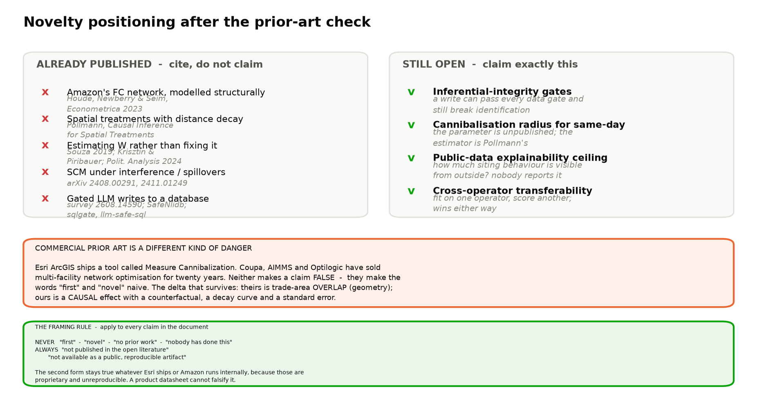
Prior art: what is closed and what remains open
Two reviews — published literature and shipped commercial product. Both reported.
Notes:
OPEN "Two prior-art reviews - literature and shipped product."
LAND Left column is closed, right column is open. We report both.
IF ASKED "Did you find these before or after writing the claims?" - after
writing, before submitting. Three claims did not survive.
TIMING 1.5 minutes.

Slide 4
Research questions
RQ1
Can a discrete-time hazard over public ZCTA covariates recover the operator's siting and timing decision at out-of-time AUC ≥ 0.80 on metros withheld from training?
Falsifiable. Pre-registered target; failure reported, no retraining on the validation set.
RQ2
Does event-driven revision of the spatial weight matrix materially change the estimated cannibalization coefficient, or are estimates robust to revision as LeSage and Pace (2014) argue?
Pre-registered before estimation. Publishable under either outcome — a moved coefficient challenges a robustness claim; an unmoved one confirms it under a novel perturbation.
RQ3
Can validation gates be constructed that detect when an agent-proposed write preserves data integrity while invalidating a causal identification assumption?
Evaluated on a seeded adversarial set of 50 perturbations; target ≥ 90% detection of mutations that move θ beyond threshold.
RQ4
What share of the operator's revealed siting behaviour is explainable from public data alone?
Descriptive. A low value is a finding about opacity, not a failed project.
Siting Atlas · technical supplement
4
Notes:
OPEN "Four questions. RQ2 is pre-registered."
LAND RQ2's note. Fixing the prediction in advance is what makes a null
result a finding rather than a rationalisation.
IF ASKED "Is RQ4 a research question or a descriptive statistic?" - it is
descriptive and unreported. Both can be true.
TIMING 2 minutes.

Slide 5
Setup and notation
Panel of ZCTA i in quarter t; treatment is first enablement of same-day service.
i = 1..N ZCTA N = 2,413 modelled / 33,791 national
t = 1..T quarter T = 44 (2015Q1 - 2025Q4)
D_it in {0,1} same-day service available
E_i = min{ t : D_it = 1 } first enablement (right-censored)
X_it public covariates, vintage-aligned
Y_it 2-day order proxy (secondary)
W(rho) spatial weights, radius rho
theta cannibalization coefficient
PRIMARY ESTIMAND
SECONDARY ESTIMAND
h_it = P( E_i = t | E_i >= t , X_it )
The conditional hazard of first enablement. Observable, right-censored, and scoreable out of time.
theta = E[ Y_it(0) - Y_it(1) | D_it = 1 ] / E[ Y_it(0) | D_it = 1 ]
Cannibalization as a proportional treatment effect on the incumbent channel.
Siting Atlas · technical supplement
5
Notes:
OPEN "Notation, briefly, so the rest is unambiguous."
LAND Two estimands: hazard of first enablement is primary; theta is
secondary. Point at the right-censoring in E_i.
TIMING 1.5 minutes. Do not read the whole block aloud.

Slide 6
Why the estimand is enablement, not volume
An identification argument, not a data-availability excuse.
THE CONSTRUCTED-TARGET FAILURE
WHAT ENABLEMENT BUYS
Volume is unobserved, so it must be allocated:
Y~_i = Q · g(X_i) / Σ_j g(X_j)
Fitting f(X_i) → Y~_i recovers g, not the data-generating
process. R² is bounded below by the approximation error of
f to g and is uninformative about the phenomenon.
A GOOD fit is evidence of the defect.
D_it is directly observable from the operator's own service
check and from facility records.
· admits a genuine out-of-time backtest
· supports proper scoring rules (Brier, log loss)
· makes 'operator-consistent desirability' literal rather
than a hedge
· censoring is handled, not mislabelled as a negative
The volume model is retained as specification recovery under a stated allocation assumption, and every dollar figure derived from it is labelled conditional.
Siting Atlas · technical supplement
6
Notes:
OPEN "Why enablement rather than volume. This is an identification
argument, not a data-availability excuse."
LAND The left panel. R-squared is bounded below by the approximation error
of f to g. It tells you nothing about the phenomenon.
IF ASKED "Couldn't you validate the allocation externally?" - only in
aggregate, which does not identify the cross-sectional split, which
is exactly what the model is being asked to produce.
TIMING 3 minutes. The strongest methodological slide in the deck.

Slide 7
Siting model — discrete-time hazard
Complementary log-log link; grouped-duration data with time-varying covariates.
cloglog( h_it ) = log( -log( 1 - h_it ) )
= alpha(t) + X_it' beta + u_m(i)
alpha(t) flexible baseline in time since nearest node opened
u_m(i) metro random effect, u ~ N(0, sigma^2)
S_i(t) = PROD_{s<=t} ( 1 - h_is ) survival to t
WHY CLOGLOG
WHY NOT A CLASSIFIER
COVARIATE VINTAGE
It is the grouped-duration analogue of a proportional-hazards model, so coefficients carry a hazard-ratio reading and the specification is invariant to the interval width we happened to choose.
A logit on 'ever enabled' mislabels censored units as negatives, discards timing, and cannot use time-varying covariates at their contemporaneous value.
X_it uses the vintage AVAILABLE at t, not the latest release. Levels from slow sources, rates of change from monthly ones. Anything else leaks future information.
Siting Atlas · technical supplement
7
Notes:
OPEN "The siting model."
LAND Cloglog is the grouped-duration analogue of proportional hazards, so
the interval width we chose does not drive the specification.
IF ASKED "Why not Cox?" - the data are grouped into quarters, ties are
pervasive, and discrete time handles that natively.
IF ASKED "Random effects or fixed?" - random, because many metros have few
events and we want partial pooling. Say we report both.
TIMING 2 minutes.

Slide 8
Selection — Heckman two-step
Treatment assignment is endogenous by construction: the operator selects on expected profitability.
STEP 1 S_i* = Z_i' gamma + X_i' delta + e_i , S_i = 1{ S_i* > 0 }
lambda_i = phi(Z_i'gamma) / Phi(Z_i'gamma) (inverse Mills ratio)
STEP 2 outcome equation augmented with lambda_i ; rho·sigma identified from its coefficient
THE INSTRUMENT, AND ITS WEAKNESS
WHAT WE REPORT INSTEAD
Z = distance to nearest commercially zoned centroid.
RELEVANCE — testable. Report first-stage F; convention F > 10.
EXCLUSION — not testable. Commercial zoning correlates with employment density and traffic, either of which could enter demand directly. We do not assert the restriction holds.
· first-stage F and partial R²
· corrected AND naive coefficients side by side
· a sensitivity analysis over an assumed direct effect gamma_direct ∈ [0, δ̄], showing the path of the corrected estimate
· the value of gamma_direct at which the sign flips
Survival under a plausible violation is worth more than a claim of no violation.
Siting Atlas · technical supplement
8
Notes:
OPEN "Selection. Treatment assignment is endogenous by construction."
LAND Do NOT defend the instrument. Say the exclusion restriction is
contestable, then show the sensitivity path.
'Survival under a plausible violation is worth more than a claim of
no violation.'
IF ASKED "Your instrument is weak / invalid" - agree that it is
contestable, give the correlation with employment density yourself,
and go to the sign-flip point.
TIMING 3 minutes. Expect the hardest question of the session here.

Slide 9
Identification assumptions, and how each is handled
Testable, partially testable, and untestable — labelled as such.
Assumption | Status | What we do
Conditional independence of enablement given X and λ | Untestable | Heckman correction on the pilot metro; explicit disclosure elsewhere
Exclusion restriction on Z | Untestable | Sensitivity path over an assumed direct effect; report the sign-flip point
Parallel trends (pre-treatment) | Partially testable | Pre-period fit reported and plotted; placebo distribution built from untreated units
No interference (SUTVA) | Known violated | Not assumed. Spillover reach estimated by distance band; contaminated donors excluded by the measured radius
Correct functional form | Partially testable | Non-parametric LightGBM benchmark; convergent-validity Spearman with bootstrap CI
Covariates measured without error | Known violated | ACS margins of error propagated; LLM-extracted fields corrected as generated regressors (Egami et al. 2023)
Target measured without error | Known violated | a 43-row census with per-row sources, a measured accuracy bound, and a label-noise simulation bounding the effect on AUC
Siting Atlas · technical supplement
9
Notes:
OPEN "Every assumption, labelled testable, partially testable or not."
LAND Three rows say 'known violated'. That is deliberate - we handle them
rather than assume them away.
IF ASKED "SUTVA is violated and you still use SCM?" - yes, and we estimate
the violation rather than assume it away. Next slides.
TIMING 2 minutes.

Slide 10
Cannibalization — spatial synthetic control
Convex-combination counterfactual with a donor pool restricted by measured spillover reach.
w* = argmin_w || X_1 - X_0 w ||_V s.t. w_j >= 0 , SUM_j w_j = 1
tau_1t = Y_1t - SUM_{j in J} w*_j Y_jt
J = { j : D_jt = 0 for all t <= T } \ { j : dist(j, treated) < rho^ }
DONOR POOL, AND WHY ρ̂ MATTERS
DIAGNOSTICS REPORTED
A contiguity rule excludes every neighbour of a treated unit. In a saturating network that empties the pool.
Because contamination is defined by the ESTIMATED radius ρ̂ rather than by shared borders, donors a conservative rule discards are recovered. Staggered adoption adds later-treated units as controls for earlier ones.
· pre-treatment RMSPE, target < 8% of outcome mean
· donor-pool size and weight concentration (max w*_j)
· the fitted covariate balance table
Where no credible pool exists the estimate is reported as NOT ESTIMABLE rather than produced.
Siting Atlas · technical supplement
10
Notes:
OPEN "Synthetic control, with one modification."
LAND The donor pool line. Contamination defined by estimated rho-hat, not
by contiguity - that is what keeps the pool non-empty in saturated
metros.
IF ASKED "How many donors survive?" - we report pool size and weight
concentration per estimate, and 'not estimable' where it collapses.
TIMING 2.5 minutes.

Slide 11
Inference — permutation, not asymptotics
With one treated unit, a distributional standard error is not credible. The null is built from the data.
RMSPE ratio R_i = RMSPE_post(i) / RMSPE_pre(i)
permutation p p^ = ( 1 + #{ j in J : R_j >= R_1 } ) / ( 1 + |J| )
IN-SPACE PLACEBO
WHY THE RATIO
IN-TIME PLACEBO
Assign the treatment date to each untreated unit in turn and re-run the full estimator. The resulting effects form a null distribution under no treatment, with no distributional assumption.
Units that fit the pre-period badly produce large post-period gaps for uninteresting reasons. Dividing by pre-period error prevents poor fit from masquerading as a large effect.
Re-date the treatment two years earlier. A detected effect there indicates something other than the treatment is driving the result.
Pre-treatment fit is necessary and not sufficient. Reporting it alone was the single clearest methodological gap in the earlier design.
Siting Atlas · technical supplement
11
Notes:
OPEN "Inference. With one treated unit an asymptotic standard error is not
credible."
LAND The null is built from the data. Then the RMSPE ratio and why the
denominator matters.
IF ASKED "Isn't the permutation p-value coarse with a small donor pool?" -
yes, and we report the pool size alongside it. With 40 donors the
finest attainable p is 1/41.
TIMING 2.5 minutes.

Slide 12
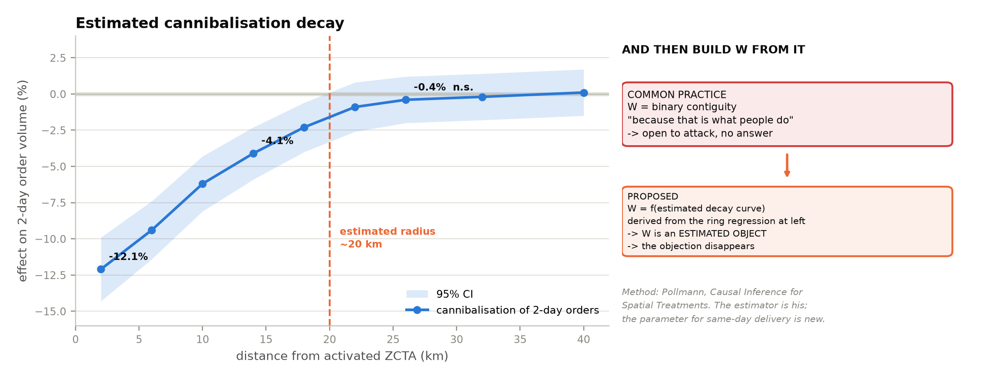
Interference — estimating the spillover kernel
Distance-band estimation (Pollmann, arXiv:2011.00373). The estimator is his; the parameter for same-day delivery is the contribution.
ρ̂ is then used twice: to construct W, and to define donor contamination in the synthetic control.
Notes:
OPEN "The spillover kernel, estimated rather than assumed."
LAND Credit Pollmann explicitly and immediately. The parameter is the
contribution.
IF ASKED "Why bands rather than a smooth kernel?" - bands are
non-parametric in the decay shape. A smooth kernel imposes one.
TIMING 2 minutes.

Slide 13
Constructing W from the estimated kernel
W becomes an estimated object with a standard error rather than a modelling convenience.
band estimates tau^(d_k) for bands d_1 < d_2 < ... < d_K
reach rho^ = min{ d_k : H_0( tau(d_k) = 0 ) not rejected }
weights w_ij = f( dist_ij ; rho^ ) , normalised row-wise
f decreasing, f(d) = 0 for d > rho^
WHAT THIS ANSWERS
WHAT IT DOES NOT CLAIM
The standard objection to a contiguity matrix is 'why contiguity?' — why not 5 km, why not drive time. There is no principled answer.
Deriving W from the measured reach replaces an assumption with an estimate, and propagates its uncertainty into the spatial term.
Estimating W is not new. Souza (2019), Krisztin and Piribauer, and Political Analysis (2024) all estimate or select it from the outcome panel.
Our difference is the channel: W is revised BETWEEN estimation cycles from an exogenous text stream, not fitted in-sample once.
Siting Atlas · technical supplement
13
Notes:
OPEN "And then W is built from the estimate."
LAND The right-hand panel first, not the left. Say what we do NOT claim
before saying what we do.
IF ASKED "Souza and Krisztin already estimate W" - correct, and that is on
the slide. Our difference is the update CHANNEL: exogenous text
between cycles, not in-sample fitting once.
TIMING 2.5 minutes.

Slide 14
RQ2 — a pre-registered test with two publishable outcomes
LeSage and Pace (2014) argue spatial estimates are less sensitive to W than practitioners assume. This is a direct test.
H_0 : | theta( W_t+1 ) - theta( W_t ) | <= kappa
kappa pre-registered materiality threshold, fixed before estimation
W_t+1 W revised by a gated agent write at time t
IF H_0 IS REJECTED
IF H_0 IS NOT REJECTED
Event-driven revision of W materially moves the causal estimate. That challenges a well-known robustness claim, using an update channel the literature has not applied.
→ workshop paper in spatial econometrics.
The robustness claim survives a novel perturbation — itself a contribution — and we report an honest engineering finding: the mutable-W machinery is elegant and not decision-relevant.
→ negative result, reported.
κ is fixed in advance precisely so the negative result reads as a finding rather than a rationalisation.
Siting Atlas · technical supplement
14
Notes:
OPEN "RQ2, pre-registered."
LAND Both branches are publishable, and kappa is fixed in advance.
IF ASKED "How did you choose kappa?" - from the decision, not the data:
the change in theta that would move a ZIP across the top-100
boundary. Have a number ready.
TIMING 2 minutes.

Slide 15
Generated regressors
Machine-extracted covariates enter downstream estimators as if measured exactly. They are not.
observed X^_i = X_i + eta_i , E[eta] != 0 possible
naive Var( beta^ ) understated; inference anti-conservative
correction design-based supervised learning on a hand-labelled subsample
(Egami, Hinck, Stewart & Wei, NeurIPS 2023) ; PPI (Angelopoulos et al. 2023)
WHY IT MATTERS HERE
WHY IT IS CHEAP
Facility attributes parsed from text feed both W and the gravity term. Treating an estimate as an observation makes the model look more certain than the evidence supports — precisely the failure this project exists to avoid elsewhere.
The 43-row census built for target-quality assessment is exactly the labelled set these estimators require. One artefact, two uses; roughly one day of work.
Not novel. Correct — and rarely done in the agent literature.
Siting Atlas · technical supplement
15
Notes:
OPEN "A quieter problem: generated regressors."
LAND Almost nobody in the agent literature corrects for this. It is not
novel, it is correct, and it costs a day because the labelled sample
already exists.
IF ASKED "How large is the correction?" - unknown until we run it, which is
precisely why we run it.
TIMING 1.5 minutes.

Slide 16
Uncertainty — split conformal prediction
Distribution-free, finite-sample coverage under exchangeability. A verified guarantee rather than an assumed one.
fit on D_train ; scores s_i = | y_i - f^(x_i) | on D_cal
q^ = Quantile( s ; ceil((n+1)(1-alpha)) / n )
C(x) = [ f^(x) - q^ , f^(x) + q^ ]
guarantee P( y in C(x) ) >= 1 - alpha for any underlying model
WHAT IT REPLACES
WHAT WE REPORT
CAVEAT WE STATE
Model-derived intervals inherit every specification assumption. If the model is misspecified the interval is wrong and nothing signals it.
Nominal 90% against MEASURED coverage on held-out ZCTAs. Target: within 2 percentage points. The claim is checkable and can fail.
Exchangeability is violated under temporal drift. We report coverage separately by year, and use the out-of-time split so drift is visible rather than hidden.
Siting Atlas · technical supplement
16
Notes:
OPEN "Uncertainty."
LAND The guarantee holds for ANY underlying model. Then the caveat slide
tile: exchangeability fails under drift, so we report coverage by
year.
IF ASKED "Doesn't the out-of-time split break exchangeability?" - yes, and
that is why we report coverage by year rather than pooled. Good
question to concede.
TIMING 2 minutes.

Slide 17
Evaluation protocol
Targets fixed before estimation. They were missed, and the next slide reports the miss rather than retraining it away.
Metric | Target | Rationale
AUC-ROC, out-of-time | ≥ 0.80 | Rank quality on a forecast that was scored. Above ~0.95 would suggest leakage on public covariates
PR-AUC (base rate ≈ 0.06) | ≫ base rate | Positive class is rare; ROC is flattered by abundant true negatives
Brier score | ≤ 0.06 | Proper scoring rule; calibration and sharpness jointly
Expected calibration error | < 0.05 | Councils act on the stated probability, so it must mean what it says
precision@100 | ≥ 0.60 | Matches the decision: a shortlist, not a full ranking
Conformal coverage | within 2pp of nominal | Empirically verified, not assumed
Spearman vs LightGBM, top decile | ≥ 0.80, bootstrap CI | Convergent validity across parametric and non-parametric forms
AUC under 15% label noise | ≥ 0.78 | Bounds the effect of target measurement error
Top-100 overlap, H3 vs ZCTA | ≥ 0.70 | Ranking is not an artefact of the spatial partition
Siting Atlas · technical supplement
17
Notes:
OPEN "The evaluation protocol, fixed before estimation."
LAND The last two rows - label noise and H3 - exist because the first
seven could all be artefacts.
TIMING 1.5 minutes.

Slide 18
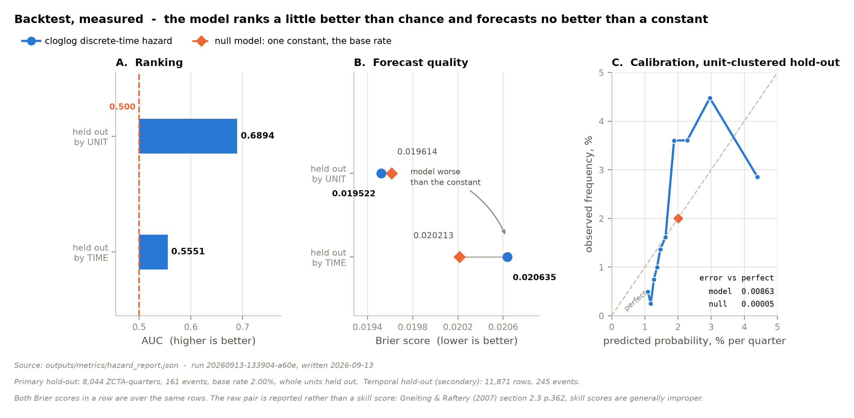
Measured, against every target on the previous slide
Primary hold-out splits whole units; the secondary split is temporal. AUC 0.6894 and 0.5551 against 0.5000. Brier 0.019522 against 0.019614 for a constant.
The raw Brier pair, not a skill score: Gneiting and Raftery (2007) section 2.3 p.362, skill scores are generally improper even when the underlying rule is proper. The geographic hold-out is not on this slide because Phoenix and Boise hold two dated stations between them, which is a smoke test, not a transfer test.
Notes:
OPEN "And here is what those targets actually produced."
LAND Every target on the previous slide was missed. The proper score is
the row to read: the model's Brier is essentially the constant's on
the unit-clustered split and WORSE than the constant's on the
temporal one. Calibration is worse than a constant outright.
IF ASKED "Random splits would have looked better" - yes, and that is the
point. Whole units are held out because a random row split lets the
model see 2025 rows for a ZIP while predicting its 2024 rows.
IF ASKED "Where is the geographic hold-out?" - deliberately absent. The two
withheld metros hold two dated stations between them. It is a smoke
test for gross failure, not a test of transfer, and quoting it as
one would overstate the evidence against our own model.
TIMING 2 minutes.

Slide 19
Robustness programme
Each check targets a specific way the headline result could be an artefact.
Threat | Check | Failure would mean
Target measurement error | Corrupt a known fraction of open dates by ±1 quarter; re-run the backtest across the grid | Reported AUC is not interpretable without a stated error rate
Spatial partition artefact (MAUP) | Re-run at H3 hexagonal grain; compare top-100 overlap | The ranking reflects ZIP boundaries, not geography
Functional form | LightGBM benchmark; Spearman on top decile with bootstrap CI | The result is an artefact of the cloglog specification
Selection | Corrected vs naive coefficients; sensitivity path over an assumed direct instrument effect | The estimate confounds viability with revealed preference
Spillover mis-specification | Vary ρ̂ across its confidence band; re-estimate θ at each | θ is an artefact of the assumed neighbourhood
Covariate noise | Propagate ACS margins of error through the Monte Carlo | Rankings are spuriously precise
Margin heterogeneity | Re-rank under a margin varying with income; measure top-100 churn | Scale-invariance of the ranking does not hold
Siting Atlas · technical supplement
19
Notes:
OPEN "Each robustness check targets one specific way the result could be
an artefact."
LAND Read the third column, not the second. 'Failure would mean' is what
makes each check meaningful.
TIMING 2 minutes.

Slide 20
Cost model — continuous approximation
Beardwood–Halton–Hammersley (1959); Daganzo (1984). The distance term is precomputed, not served.
BHH tour length ~ k * sqrt( N * A )
per stop ~ k * sqrt( A / N ) = k / sqrt( delta )
c_i = c_fixed + b_stem * d_stem(i) + b_local * A_i / sqrt( delta_i * N_i )
THE ENGINEERING CONSEQUENCE
AND THE FALLBACK
d_stem is a finite precomputable set — ~800,000 within-metro OD pairs, 10 MB as parquet.
Routing is therefore an offline, one-time job. Process one metro, extract the matrix, delete every artifact. Peak disk 8 GB rather than 60; the deployed system carries no routing dependency.
Daganzo is already a continuous approximation, so exact routing is precision in the wrong place.
Circuity: road ≈ great-circle × k, k ≈ 1.35, calibrated on one metro against routed truth with the residual reported. A large residual is a finding; a small one saves two weeks.
Siting Atlas · technical supplement
20
Notes:
OPEN "Cost. Continuous approximation, and one engineering consequence."
LAND d_stem is a finite set, so routing is an offline job. Peak disk 8 GB
rather than 60, and no runtime dependency.
IF ASKED "Doesn't circuity lose road topology?" - yes, and Daganzo is
already an approximation. We calibrate k and report the residual.
TIMING 2 minutes.

Slide 21
NPV under an unobservable margin
Contribution margin is not identified from public data. We factor it out rather than invent it.
NPV_i = SUM_{t=1..5} [ (1 - theta_i) N_it m - c_it N_it ] / (1+r)^t - K_i
reported as NPV_i = a_i * m - b_i
break-even m*_i = b_i / a_i
WHAT SURVIVES WITHOUT m
WHAT DOES NOT, AND THE TEST
Ranking is invariant to a common positive scale factor, so the ranked list, bundle selection, rank stability, break-even thresholds, timing and the selection propensity are all unaffected.
Six of eight outputs need no margin at all.
If m varies systematically across areas, scale-invariance fails and the RANKING moves, not just the level.
We re-rank under m varying with median income as a plausible worst case and report top-100 churn. K_i is validated externally against disclosed capital expenditure, target within 25%.
Siting Atlas · technical supplement
21
Notes:
OPEN "NPV without an observable margin."
LAND Ranking is invariant to a common positive scale factor. Six of eight
outputs are unaffected. Then immediately the failure case: if m
varies systematically the ranking moves.
IF ASKED "So you can't say what a ZIP is worth?" - correct, and we say so.
We give a_i, b_i and the break-even m.
TIMING 2.5 minutes.

Slide 22
Decision layer — set selection, not ranking
The objective is neither submodular nor supermodular, so no greedy guarantee applies.
maximise V(S) = SUM_{i in S} v_i - SUM_{i,j in S} theta_ij + g( delta(S) )
cannibalisation shared-density gain
theta_ij induces DIMINISHING returns -> submodular
g(delta) induces INCREASING returns -> supermodular
V is neither -> the (1 - 1/e) greedy bound does not apply
SEARCH SPACE
WHAT WE ACTUALLY SOLVE
NOT A CONTRIBUTION
ranking → 2,413 independent decisions
bundling → 2^2,413 candidate sets
top 200 → ≈ 1.6 × 10^60
Greedy construction plus pairwise-swap local search over the top candidate set. We report the optimality gap against pure greedy ranking, not a claim of optimality.
Multi-facility location optimisation is textbook OR (p-median, maximal covering) and a mature commercial category. We include it because ranking is the wrong model of the decision.
Siting Atlas · technical supplement
22
Notes:
OPEN "The decision layer."
LAND Neither submodular nor supermodular, so the greedy bound does not
apply and the gap is empirical.
IF ASKED "Is this a contribution?" - no, and it is on the slide. Textbook
OR and a mature commercial category. We include it because ranking is
the wrong model.
TIMING 2 minutes.

Slide 23
Inferential integrity — a definition
The failure class the gated-write literature does not cover.
Let M be a proposed mutation to warehouse state s.
DATA INTEGRITY G_data(M) = 1 iff schema, geocoding, confidence, audit all hold
INFERENTIAL INTEGRITY G_inf(M) = 1 iff the identification assumptions of
the estimator on s + M still hold
CLAIM there exist M with G_data(M) = 1 and G_inf(M) = 0 , and no published gate detects them
GATE 5 — DONOR-POOL INTEGRITY
GATE 6 — ESTIMATE STABILITY
Reject or escalate if M moves any j ∈ J into treatment or within ρ̂ of a treated unit.
Formally: J(s + M) ≠ J(s) ⇒ recompute and flag. Never silently re-weight — a silent re-weight keeps producing a plausible number.
Re-estimate θ on s and on s + M. Escalate to human review if
| θ(s + M) − θ(s) | > κ
κ is pre-registered. Fixing it after seeing results would make the gate a rationalisation rather than a control.
Siting Atlas · technical supplement
23
Notes:
OPEN "Now the definition that carries claim C1."
LAND Read the CLAIM line aloud. There exist M with data integrity 1 and
inferential integrity 0, and no published gate detects them.
IF ASKED "Is that not just a stale-cache problem?" - no. The state is
correct and current. It is the ESTIMATOR's assumptions that break.
TIMING 3 minutes. This is the slide the workshop paper comes from.

Slide 24
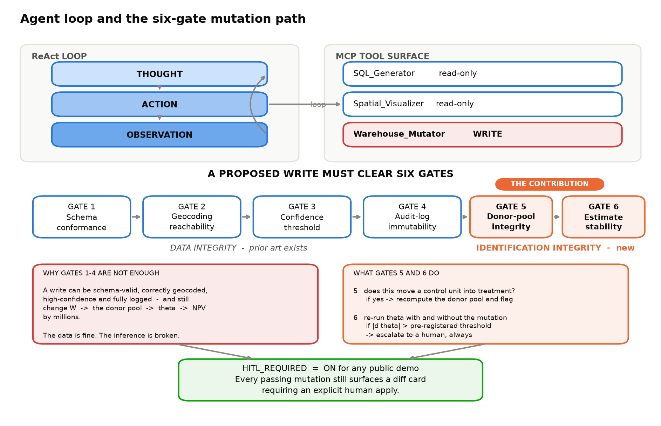
The six-gate mutation path
Gates 1–4 protect data integrity and have prior art. Gates 5–6 protect identification and are the contribution.
Evaluated on a seeded adversarial set of 50 perturbations; target ≥ 90% detection of mutations that move θ beyond κ.
Notes:
OPEN "Drawn, with the boundary marked."
LAND Point at where data integrity ends and identification begins.
TIMING 1 minute.

Slide 25
Agent evaluation, calibrated against the field
A self-authored benchmark is unfalsifiable unless it is positioned against a public one.
~80%
~93%
75%
best public systems, BIRD execution accuracy
(Li et al., NeurIPS 2023)
human baseline on the same benchmark
our target, at n ≥ 100, reported per tier
SAMPLE SIZE IS NOT A DETAIL
AND FOR THE MODEL COMPARISON WE DEFERRED
At n = 40 an observed 0.85 carries a 95% Wilson interval of roughly [0.71, 0.93]. A 'pass' at 0.85 and a 'fail' at 0.72 are not distinguishable.
n ≥ 100, intervals reported, stratified into four difficulty tiers — spatial joins are where these systems fail and our warehouse is spatial.
At n = 200 with a hit rate near 0.8, SE ≈ 2.8pp, so differences below ~8pp are not detectable.
Stating the minimum detectable effect in advance is what stops an 82 / 84 / 85 result being reported as a ranking.
Siting Atlas · technical supplement
25
Notes:
OPEN "Agent evaluation, positioned against a public benchmark."
LAND The Wilson interval. At n=40 a pass and a fail are indistinguishable.
Then the MDE for the deferred comparison.
IF ASKED "Why defer the model comparison entirely?" - because at the sample
size we can afford, an 8-point difference is the smallest detectable,
and the plausible spread is smaller than that.
TIMING 2 minutes.

Slide 26
Threats to validity
Internal, external, construct and statistical — with the response to each.
Type | Threat | Response
Internal | Endogenous treatment assignment | Heckman on the pilot metro; explicit disclosure elsewhere; sensitivity over the exclusion restriction
Internal | Interference contaminating controls | Donor exclusion by estimated ρ̂ rather than contiguity; staggered adoption
Construct | Enablement ≠ viability | Framed throughout as operator-consistent desirability; equity audit by demographic stratum
Construct | Proxies for land cost and retail attraction | External capex validation of the composite; per-proxy sensitivity
Statistical | One treated unit per SCM estimate | Permutation inference rather than asymptotic standard errors
Statistical | Generated regressors understate variance | Design-based supervised learning on the labelled subsample
External | Ten metros, one operator, one country | Cross-operator transfer test; national propensity fit; explicit scope statement
External | Regime change in the network architecture | Out-of-time design surfaces drift; coverage reported by year
Siting Atlas · technical supplement
26
Notes:
OPEN "Threats to validity, by type."
LAND Do not read the table. Pick the two you think this room cares about
and speak to those.
TIMING 1.5 minutes.

Slide 27
What we cannot identify
Stated plainly, because it is the reason to believe everything else.
Order volume, revenue and margin
Not observable in public data and not recoverable by any transformation. No accuracy claim is made on dollar figures; results are reported as a multiple of margin with break-even thresholds, and the capital side is validated externally.
The true cannibalization coefficient
Estimated with placebo inference and confidence bands, but no public number exists to check it against. We claim identification under assumptions, not correctness — and it feeds NPV directly.
Internal constraints on the operator
Lease obligations, capital rationing, portfolio strategy and outright mistakes are unobservable. Hence operator-consistent desirability rather than viability.
Whether the public-data ceiling is high enough
This is RQ4, not an aside. If public data explains too little for the decision, that is the finding and we publish it.
Siting Atlas · technical supplement
27
Notes:
OPEN "And what we cannot identify at all."
LAND Four items, no mitigation. Say clearly: this is the reason to believe
everything on the previous twenty-five slides.
IF ASKED "What is the weakest part?" - the cannibalization coefficient.
Say it before they do.
TIMING 2 minutes. Do not apologise while delivering it.

Slide 28
Named extensions
Out of scope for this build, and named as directions rather than commitments.
Direction | What it would add | Why not now
Causal forests (Wager & Athey 2018); DoubleML (Chernozhukov et al. 2018) | Heterogeneous treatment effects at ZCTA grain; extends the selection correction beyond one metro | Engineering cost of ten formal corrections exceeds the window
Graph neural network over the ZCTA adjacency graph (Kipf & Welling 2017) | Cross-metro transfer without a parametric form; a natural comparison against the hazard model | Adds a benchmark, not an identification argument
Bayesian synthetic control with spillovers (arXiv:2408.00291) | Full posterior over θ and over the donor weights | Permutation inference already gives assumption-light inference
Volume II — data-centre siting | Same machinery, hotter subject: opaque siting, large capital, abatements, an active civic ecosystem | A data swap below the feature layer; post-capstone
Public forecast registry with periodic scoring | Timestamped predictions scored later by anyone | Cheap; scheduled for the release phase
Siting Atlas · technical supplement
28
Notes:
OPEN "Named extensions - directions, not commitments."
LAND The 'why not now' column. Each is a scoping decision with a reason.
TIMING 1.5 minutes.

Slide 29
Reproducibility
The claim is that a stranger can rebuild every number. That has to be literally true.
DETERMINISM
PROVENANCE
SCENARIO REPLAY
Every stochastic step reads its seed from reproducibility/seeds.toml. Nothing hardcodes one, so changing a seed is a reviewable act.
Content-addressed acquisition cache plus a manifest recording source, URL, SHA-256, timestamp and size for every fetch. A reviewer can re-download and verify hashes.
dim_scenario records which W version, which agent mutation and which seed produced each published figure. A system whose parameters change in response to text is otherwise not auditable.
ARTIFACTS RELEASED
· the ZCTA-quarter facility-opening panel, with a data card and the measured date-error rate
· the estimation harness and the evaluation protocol
· the deployed application, operator view and public planning view
· a timestamped forecast registry so predictions can be scored by third parties
· model card stating intended use, out-of-scope use and known biases
Siting Atlas · technical supplement
29
Notes:
OPEN "Reproducibility, since the whole argument rests on checkability."
LAND dim_scenario. A system whose parameters change in response to text is
not auditable by default; this is what makes it so.
TIMING 1.5 minutes.

Slide 30
Summary
WHAT WE CLAIM
WHAT WE DO NOT
C1 Inferential integrity as a distinct failure mode for state-mutating agents, with two gates that detect it
C2 A distance-decay parameter for same-day cannibalization, used to construct W endogenously
C3 The public-data explainability ceiling, and cross-operator transfer
C4 An open, re-runnable artifact
· novelty in gating agent writes
· novelty in relaxing fixed-W
· any latency comparison against a governance process
· novelty in multi-facility optimisation
· any accuracy claim on dollar NPV
· that the exclusion restriction holds
· that θ is correct rather than identified under assumptions
Every technique here has a paywalled commercial equivalent. What does not exist is a version anyone can check.
Questions.
Siting Atlas · technical supplement
30
Notes:
OPEN "To summarise: what we claim, and what we explicitly do not."
LAND Read the right-hand panel slowly. Volunteering the second list is
what makes the first credible.
THEN Read the banner. Then stop.
TIMING 1.5 minutes, then questions.

