Slide 1
Anomaly Detection in Network Traffic: Using Hybrid Techniques
Guide: Dr Bhavadharini R M
Dogiparthi Aasrith-21BAI1702
Kalla Bharath Vardhan – 21BCE5846
Varanasi Sai Charan – 21BCE5870
Notes:
Line spacing + Page numbers

Slide 2
Agenda
01 Introduction
02 Problem Statement
03 Research Objective
04 Proposed System
05 Poster
06 Results
07 Conclusion and Future Work
08 Guide Approval Mail Snapshot
09 Research Paper Status
10 References

Slide 3
Introduction
01
The widespread adoption of communication protocols, such as Internet Control Message Protocol (ICMP), User Datagram Protocol (UDP) and Transmission Control Protocol (TCP), has significantly enhanced data security and privacy in digital networks. These protocols ensure that sensitive information remains confidential, making them integral to modern communication systems. Advanced machine learning techniques have emerged as promising solutions, leveraging metadata and statistical features to detect deviations indicative of malicious activities. However, existing models often face limitations such as high computational costs, overfitting on imbalanced datasets, and difficulty adapting to evolving threats. These limitations underscore the need for robust, scalable, and privacy-preserving solutions capable of maintaining high detection accuracy without decrypting the traffic. The challenge is further exacerbated by the need to balance privacy preservation with effective threat detection. While network traffic protects user's sensitive data, it also hinders the ability to monitor network activity, creating a blind spot for security solutions .This trade-off necessitates the development of innovative approaches that can accurately detect anomalies without decrypting traffic. Achieving this balance requires a paradigm shift from traditional techniques to advanced machine learning-based models capable of leveraging network traffic metadata to identify malicious behaviors with minimal computational overhead and high accuracy.

Slide 4
Introduction
01
This study proposes a hybrid anomaly detection system that combines ANNs and CNNs with custom enhancements to address these challenges. By incorporating advanced activation functions, such as Swish and GELU, and regularization techniques tailored to mitigate overfitting, the model achieves superior generalization and performance. The hybrid architecture, designed to optimize feature learning and classification accuracy, demonstrates significant potential for anomaly detection in network traffic. This approach enhances detection capabilities, allowing it a viable solution for modern cybersecurity landscapes.

Slide 5
Problem Statement
02
Traditional anomaly detection models in network security struggle to maintain high accuracy and scalability when dealing with encrypted or privacy-sensitive traffic. These models often suffer from high computational costs, overfitting on imbalanced datasets, and an inability to adapt to evolving cyber threats. Furthermore, the challenge of detecting malicious activities without decrypting network traffic creates a significant blind spot for existing security solutions. Therefore, there is a need for a robust, privacy-preserving anomaly detection system that can efficiently process metadata and statistical features to identify threats in encrypted network traffic with high accuracy and minimal computational overhead.

Slide 6
Research Objective
03
The main objective of this research is to develop a robust hybrid anomaly detection system that combines Artificial Neural Networks (ANNs) with custom enhancements to address the unique challenges posed by encrypted traffic.
The specific goals are:
Integration of Advanced Activation Functions: Incorporating advanced activation functions such as Swish or GELU to improve the learning process and increase model efficiency in detecting anomalies.
Regularization Techniques to Mitigate Overfitting: Implementing tailored regularization methods (such as L1, L2 regularization) to combat overfitting, especially in scenarios where the dataset is imbalanced.
Efficient Feature Learning: Optimizing feature extraction and selection to improve detection capabilities without the need for decrypting traffic, thereby maintaining privacy and security.
Real-time Anomaly Detection: Ensuring that the proposed model is capable of real-time detection of malicious activities in encrypted traffic while minimizing computational costs and preserving privacy.
This research aims to enhance the detection of anomalies in encrypted traffic, ensuring that it is adaptable to new attack patterns and capable of maintaining high accuracy and efficiency in real-world applications.

Slide 7
Proposed System
04
In recent years, the growing complexity and volume of network traffic have made anomaly detection a critical component of cybersecurity systems. Traditional detection models often fall short due to their limited ability to generalize across varying traffic patterns and encrypted data. To address these limitations, this study introduces a hybrid deep learning model that integrates Convolutional Neural Networks (CNNs) and Artificial Neural Networks (ANNs) to enhance the accuracy and efficiency of anomaly detection in network traffic. The hybrid architecture leverages CNNs for extracting local and spatial features and ANNs for capturing complex, high-level feature representations. By combining the strengths of both networks and incorporating advanced techniques such as GELU activation and dropout regularization, the proposed model aims to deliver robust performance, minimize overfitting, and effectively detect anomalies in diverse and dynamic network environments. This approach presents a promising solution for improving threat detection in modern cybersecurity landscapes.

Slide 8
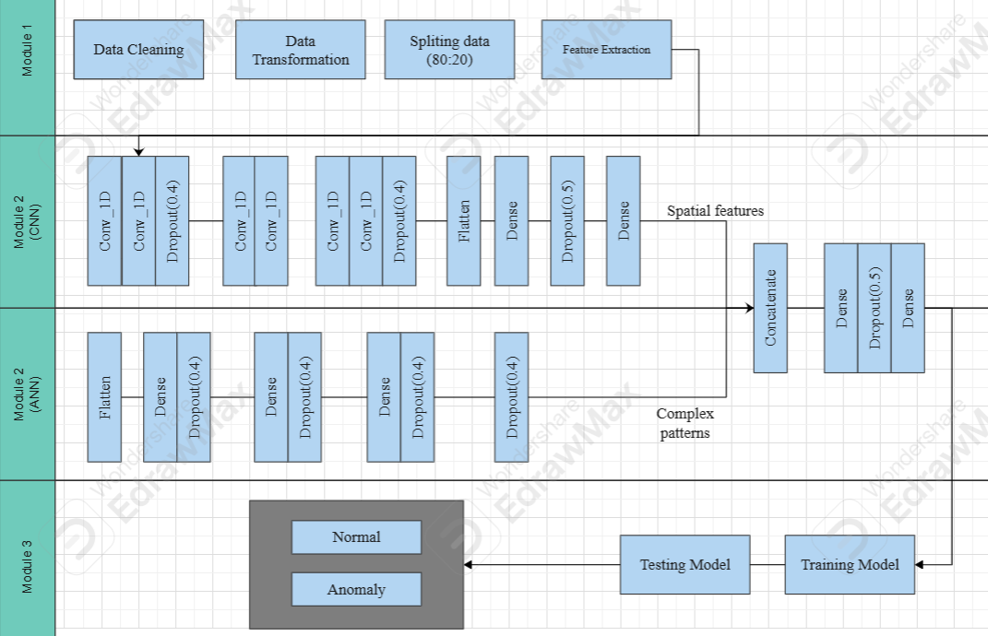
Proposed System
04

Slide 9
Proposed System
04
The architecture shows how hybrid deep learning model employs CNNs together with ANNs for classification purposes. Module-1 (Data Preprocessing) starts the process by performing data cleaning then splitting and extracting features to make the dataset ready. The preprocessed dataset enters Module-2 for training of CNN and ANN alongside each other as part of the proposed hybrid system. The model evaluation takes place during Module-3 after its training phase as part of the testing process. The proposed system produces outputs to identify instances either as "Anomaly" or "Normal."
Modules
Data Preprocessing Modules
Hybrid Architecture
Anomaly Detection Module

Slide 10
Proposed System
04
1.Data Preprocessing Module: This module is responsible for cleaning and preparing raw network traffic data from dataset: Network Intrusion Detection for effective model training. It involves handling values which are missing, and performing feature extraction to ensure that the dataset is optimized for analysis. Performed label-enconding, for protocol_type, service, flag and class columns to change categorical values to numerical values, and smote technique for class imbalance. The actual data count was normal:13449 and anomaly:11743, now we made both of them equal as 13449. These steps enhance the quality and relevance of the input data, which is critical for training a robust ANN. Techniques like data splitting further enable the separation of training and testing datasets, in 80:20 ratio to ensure unbiased evaluation.
2.Hybrid Architecture: The proposed hybrid model integrates both (CNN) and ANN architectures to enhance the accuracy and efficiency of anomaly detection in network traffic data. The model consists of two parallel branches: the CNN branch extracts local and spatial features using multiple Conv1D layers with GELU activation, followed by MaxPooling1D and dropout layers to reduce overfitting. The ANN branch, on the other hand, flattens the input features and passes them through several dense layers with GELU activations and dropout layers, focusing on learning complex patterns and relationships in the data.

Slide 11
Proposed System
04
After independent feature extraction, both branches are concatenated, allowing the model to utilize the strengths of both architectures—CNN's ability to capture spatial dependencies and ANN's capacity for high-level feature abstraction. The combined output is processed through fully connected layers with dropout for regularization and ends with a sigmoid-activated output layer for binary classification. The model is compiled using the Adam optimizer and binary cross-entropy loss function, ensuring effective learning. By combining CNN and ANN branches, this hybrid model achieves superior performance in identifying anomalies while maintaining robustness against overfitting.
3.Anomaly Detection Module: This module is responsible for monitoring of network traffic and identifying patterns indicative of Distributed Denial of Service (DDoS) attacks etc. It leverages trained hybrid models to classify traffic anomalies and trigger alerts upon detection. Additionally, it employs a secure aggregation protocol to maintain data privacy and security while aggregating model weights, ensuring safe and reliable anomaly detection. The optimized Hybrid architecture allows the system to efficiently distinguish between normal and malicious traffic, reducing false positives and enhancing overall security.

Slide 12
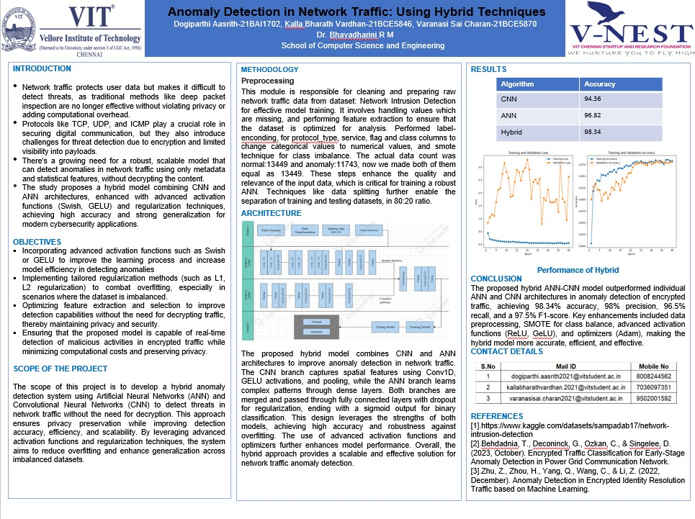
Poster
05

Slide 13
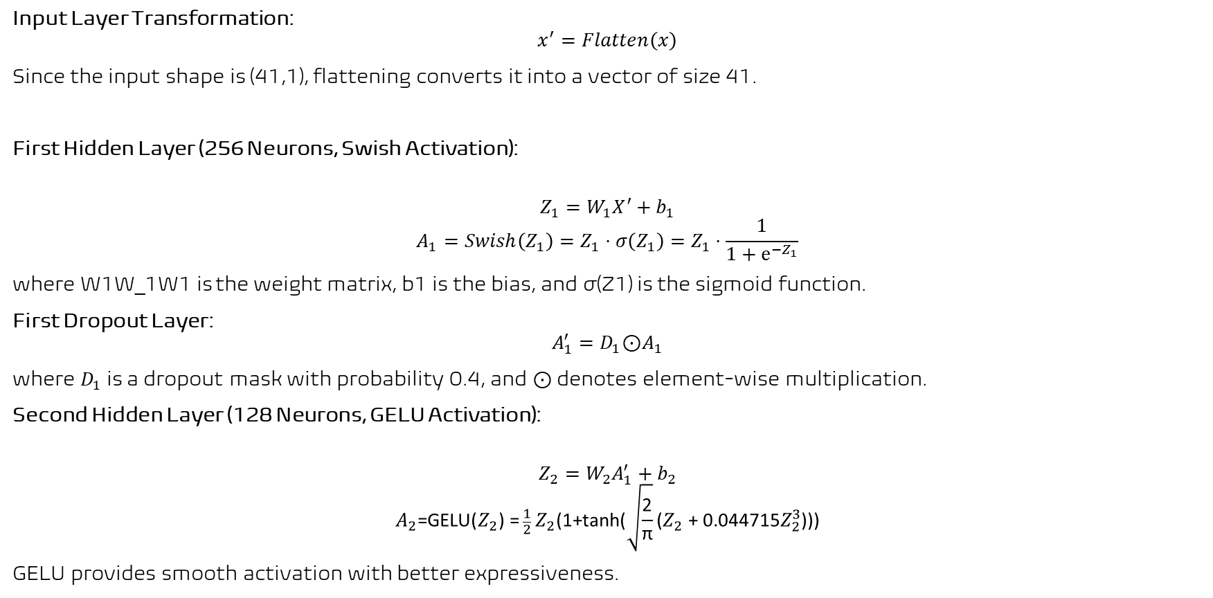
Results
06
Input Layer Transformation:
$$x^{′}=Flatten\left(x\right)$$
Since the input shape is (41,1), flattening converts it into a vector of size 41.
First Hidden Layer (256 Neurons, Swish Activation):
$$Z_{1}=W_{1}X^{′}+b_{1}$$
$$A_{1}=Swish\left(Z_{1}\right)=Z_{1}⋅σ\left(Z_{1}\right)=Z_{1}⋅\frac{1}{1+ⅇ^{−Z_{1}}}$$
where W1W_1W1​ is the weight matrix, b1​ is the bias, and σ(Z1​) is the sigmoid function.
First Dropout Layer:
$$A_{1}^{′}=D_{1}\text{⊙}A_{1}$$
where $D_{1}$is a dropout mask with probability 0.4, and ⊙ denotes element-wise multiplication.
Second Hidden Layer (128 Neurons, GELU Activation):
$$Z_{2}=W_{2}A_{1}^{′}+b_{2}$$
$$A_{2}\text{​=}\text{GELU}\text{(}Z_{2}\text{​)} \text{=} \frac{1}{2}\text{​} Z_{2}\text{​(1+}\text{tanh}\text{(}\sqrt{\frac{\text{2}}{\text{π}}}\text{​​(}Z_{2}\text{​} \text{​+} \text{0.044715}Z_{2}^{3}\text{​​)))}$$
GELU provides smooth activation with better expressiveness.

Slide 14

Results
06
Output Layer (2 Neurons, Softmax Activation):
$$Z_{4}=W_{4}A_{3}^{′}+b_{4}$$
$$\hat{Y_{i}}=\frac{e^{Z_{4i}}}{\left\{\sum_{j=1}^{2}{e^{Z_{4j}}}\right\}}, i = 1,2$$
Softmax ensures that the outputs sum to 1 and can be interpreted as class probabilities.
Loss Function (Categorical Crossentropy):
$$L = −\sum_{i=1}^{2}{Y_{i}log\hat{(Y_{i})}}$$
where $Y_{i}$​ is the true label and $\hat{Y_{i}}$​ is the predicted probability.
Adam Optimization Update Rule:
$$W_{t+1}= W_{t}− η⋅\frac{m_{t}}{\sqrt{v_{t}+ ε}}$$
where $m_{t}$​ and $v_{t}$​ are the first and second moment estimates, η is the learning rate, and ϵ is a small number to prevent division by zero.

Slide 15

Results
06
Activation Function (ReLU):
$$a=\max\left(0,z\right)$$
The ReLU (Rectified Linear Unit) activation function is used in hidden layers to introduce non-linearity. If is negative, the output is zero; otherwise, it remains the same.
Global Model Prediction (Softmax Output):
$$\hat{y}=argmax\left(P\left(y_{i}\right)\right)$$
The class with the highest probability is chosen as the predicted label.

Slide 16
Results
06
Model | Accuracy | Loss | Val-accuracy
CNN | 94.36% | 2.009% | 95.53%
ANN | 96.82% | 2.2037% | 94.63%
Hybrid | 97.65% | 2.6534% | 98.34%
For all our models we tried different epoch sizes i.e. 20, 40 and 60, and among those, 40 epochs showed better fit. Table-III shows the accuracy, loss, validation accuracy, and validation loss evaluation of the proposed models for 40 epochs from the dataset: Network Intrusion Detection. We ran all our models on same device having Intel core i5 processor with 8 cores and NVIDIA GeForce GTX 6090. The CNN model demonstrated 94.36% accuracy with 95.53% validation accuracy although it resulted in higher validation loss. The ANN delivered marginal higher accuracy of 96.82% but showed a 94.63% validation accuracy which indicates an overfitting problem. The hybrid model delivered superior performance with 98.34% accuracy and 97.65% validation accuracy compared to standalone models due to its better learning ability. The higher model complexity in this system seems to lead to a 4.58% training loss quantity.

Slide 17
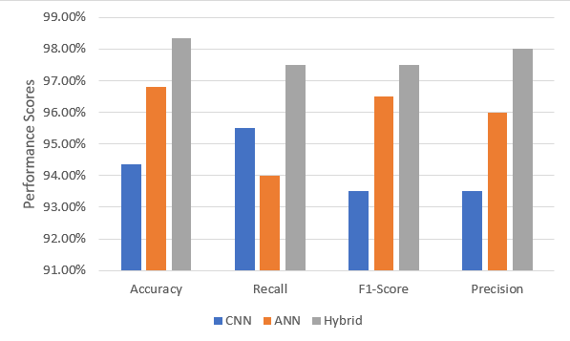
Results
06
The performance analysis of CNN, ANN, and Hybrid models through performance metrics measurements for Normal and Anomaly detection. The CNN model shows precision of 92%, recall of 94% and F1-score of 93% for normal class and 95%, 93% and 94% respectively for anomaly class. ANN demonstrates precision of 98%, recall of 93% and F1-score of 94% for normal class and 94%, 95% and 97% respectively for anomaly class. The Hybrid model surpasses both previous models with its precision reaching 100%, 95% of recall and 97% of F1-score for normal instances while achieving 96% precision, 100% of recall and 98% of F1-score for anomalies.
Comparison of Results

Slide 18
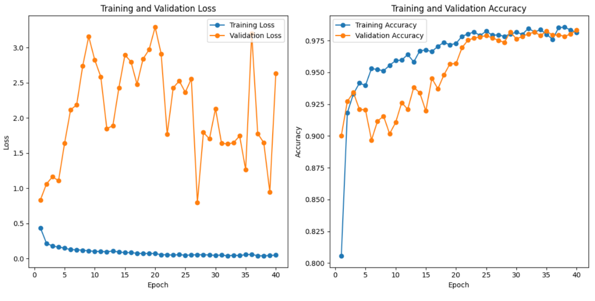
Results
06
The shows accuracy graph of hybrid model with validation accuracy as red which is 98.34% and training accuracy as blue which is 97.65% across 40 epochs. The graph shows loss graph of hybrid model with validation loss as red which is 98.34% and training loss as blue which is 2.534% across 40 epochs.
Performance of Hybrid

Slide 19
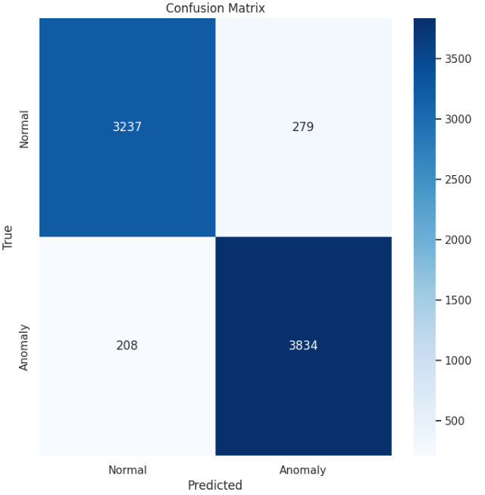
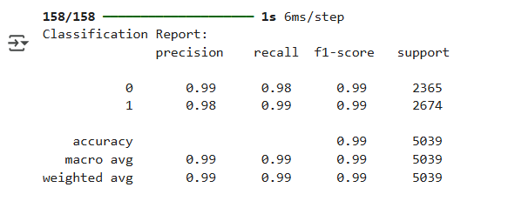
Results
06
Classification Report
Confusion Matrix

Slide 20
Conclusion and Future Work
07
The proposed hybrid model of ANN and CNN system achieve higher accuracy and shows much more promising results for anomaly detection in encryption traffic. The data preprocessing module assures that no null values existed and we performed label encoding to change categorical data to numerical data. To remove class imbalance and balance the dataset we used SMOTE technique. The ANN and CNN architectures were refined with added hidden layers to increase the efficiency, and we used ReLU and GeLU activation functions to update weights for better performance. We also used Adam and RMSprop optimizers for the model to learn more effectively. Sigmoid activation function is used to venture more accurate results for binary classification. Both of the models did give very good results with 96.82% and 94.36% accuracies respectively, but for more compelling and promising outputs we combined them both into a hybrid model, which gave us excellent results with 98.34% accuracy. Comparatively the hybrid model is more promising, efficient and effective than refined ANN and CNN architectures. The proposed hybrid model also achieved higher precision of 98%, recall of 96.5% and F1-score of 97.5%.

Slide 21
Conclusion and Future Work
07
For future enhancement of the proposed hybrid anomaly detection system, several directions can be explored. First, the model can be extended to handle multi-class classification problems for detecting a wider range of cyber threats. Incorporating attention mechanisms or Transformer-based components could further improve the system’s ability to capture long-range dependencies in encrypted traffic. Additionally, testing the model on larger and more diverse datasets, including real-time network traffic, would help validate its robustness and generalizability. Integrating explainable AI (XAI) techniques could provide deeper insights into the model’s decision-making process, increasing trust and interpretability. Finally, optimizing the system for deployment in real-time environments using lightweight architectures or model compression techniques would make it suitable for edge or IoT devices.

Slide 22

Guide Approval Mail Snapshot
08

Slide 23

Research paper submitted status
09

Slide 24
References
10
[1].Wu, Z., Li, H., Qian, Y., Hua, Y., & Gan, H. (2024). Poison-resilient anomaly detection: Mitigating poisoning attacks in semi-supervised encrypted traffic anomaly detection. IEEE Transactions on Network Science and Engineering.
[2].Xing, J., & Wu, C. (2020, July). Detecting anomalies in encrypted traffic via deep dictionary learning. In IEEE INFOCOM 2020-IEEE Conference on Computer Communications Workshops (INFOCOM WKSHPS) (pp. 734-739). IEEE.
[3].Behdadnia, T., Deconinck, G., Ozkan, C., & Singelee, D. (2023, October). Encrypted Traffic Classification for Early-Stage Anomaly Detection in Power Grid Communication Network. In 2023 IEEE PES Innovative Smart Grid Technologies Europe (ISGT EUROPE) (pp. 1-6). IEEE.
[4].Yu, T., Zou, F., Li, L., & Yi, P. (2019, October). An encrypted malicious traffic detection system based on neural network. In 2019 international conference on cyber-enabled distributed computing and knowledge discovery (CyberC) (pp. 62-70). IEEE.
[5].Lv, G., Yang, R., Wang, Y., & Tang, Z. (2020, August). Network encrypted traffic classification based on secondary voting enhanced random forest. In 2020 IEEE 3rd International Conference on Computer and Communication Engineering Technology (CCET) (pp. 60-66). IEEE.
[6].Kopp, M., Grill, M., & Kohout, J. (2018, December). Community-based anomaly detection. In 2018 IEEE International Workshop on Information Forensics and Security (WIFS) (pp. 1-6). IEEE.

Slide 25
References
10
[7].Han, S., Wu, Q., Zhang, H., & Qin, B. (2022, July). Light-weight unsupervised anomaly detection for encrypted malware traffic. In 2022 7th IEEE International Conference on Data Science in Cyberspace (DSC) (pp. 206-213). IEEE.
[8].Shen, M., Ye, K., Liu, X., Zhu, L., Kang, J., Yu, S., ... & Xu, K. (2022). Machine learning-powered encrypted network traffic analysis: A comprehensive survey. IEEE Communications Surveys & Tutorials, 25(1), 791-824.
[9].Meghdouri, F., Vázquez, F. I., & Zseby, T. (2020, October). Cross-layer profiling of encrypted network data for anomaly detection. In 2020 IEEE 7th International Conference on Data Science and Advanced Analytics (DSAA) (pp. 469-478). IEEE.
[10].Wang, Z., Wang, P., & Sun, Z. (2022, December). SDN traffic anomaly detection method based on convolutional autoencoder and federated learning. In GLOBECOM 2022-2022 IEEE Global Communications Conference (pp. 4154-4160). IEEE.
[11].Zhu, Z., Zhou, H., Yang, Q., Wang, C., & Li, Z. (2022, December). Anomaly Detection in Encrypted Identity Resolution Traffic based on Machine Learning. In 2022 IEEE 22nd International Conference on Software Quality, Reliability and Security (QRS) (pp. 264-275). IEEE.
[12].Ucci, D., Sobrero, F., Bisio, F., & Zorzino, M. (2021, December). Near-real-time anomaly detection in encrypted traffic using machine learning techniques. In 2021 IEEE Symposium Series on Computational Intelligence (SSCI) (pp. 01-08). IEEE.

Slide 26
References
10
[13].Kim, M. G., & Kim, H. (2024). Anomaly Detection in Imbalanced Encrypted Traffic with Few Packet Metadata-Based Feature Extraction. CMES-Computer Modeling in Engineering & Sciences, 141(1).
[14].Ashraf, J., Bakhshi, A. D., Moustafa, N., Khurshid, H., Javed, A., & Beheshti, A. (2020). Novel deep learning-enabled LSTM autoencoder architecture for discovering anomalous events from intelligent transportation systems. IEEE Transactions on Intelligent Transportation Systems, 22(7), 4507-4518.
[15].Long, G., & Zhang, Z. (2023). Deep encrypted traffic detection: An anomaly detection framework for encryption traffic based on parallel automatic feature extraction. Computational Intelligence and Neuroscience, 2023(1), 3316642.
[16].Pratiwi, M., & Choi, Y. H. (2024, September). Context-Aware Anomaly-based Detection for Ransomware using Multivariate Feature. In 2024 IEEE Conference on Communications and Network Security (CNS) (pp. 1-9). IEEE.
[17].Tian, Z., Cui, L., Liang, J., & Yu, S. (2022). A comprehensive survey on poisoning attacks and countermeasures in machine learning. ACM Computing Surveys, 55(8), 1-35.
[18].Anderson, B., & McGrew, D. (2016, October). Identifying encrypted malware traffic with contextual flow data. In Proceedings of the 2016 ACM workshop on artificial intelligence and security (pp. 35-46).
[19].Shekhawat, A. S., Di Troia, F., & Stamp, M. (2019). Feature analysis of encrypted malicious traffic. Expert Systems with Applications, 125, 130-141.

Slide 27
References
10
[20].Velan, P., Čermák, M., Čeleda, P., & Drašar, M. (2015). A survey of methods for encrypted traffic classification and analysis. International Journal of Network Management, 25(5), 355-374.
[21].Rezaei, S., & Liu, X. (2019). Deep learning for encrypted traffic classification: An overview. IEEE communications magazine, 57(5), 76-81.
[22].Wang, J., He, T., He, G., Zhu, H., Xu, B., & Zhang, L. (2023, December). Cooperative Detection of Camouflaged Malicious TLS Traffic. In 2023 Eleventh International Conference on Advanced Cloud and Big Data (CBD) (pp. 116-121). IEEE.
[23].Wingarz, T., See, A., Gondesen, F., & Fischer, M. (2024, September). Privacy-preserving Network Anomaly Detection on Homomorphically Encrypted Data. In 2024 IEEE Conference on Communications and Network Security (CNS) (pp. 1-9). IEEE.
[24].Bakhshi, T., & Ghita, B. (2021). Anomaly detection in encrypted internet traffic using hybrid deep learning. Security and Communication Networks, 2021(1), 5363750.
[25].Lee, I., Roh, H., & Lee, W. (2020, July). Encrypted malware traffic detection using incremental learning. In IEEE INFOCOM 2020-IEEE Conference on Computer Communications Workshops (INFOCOM WKSHPS) (pp. 1348-1349). IEEE.
[26].https://www.kaggle.com/datasets/sampadab17/network-intrusion-detection

Slide 28


