Slide 1


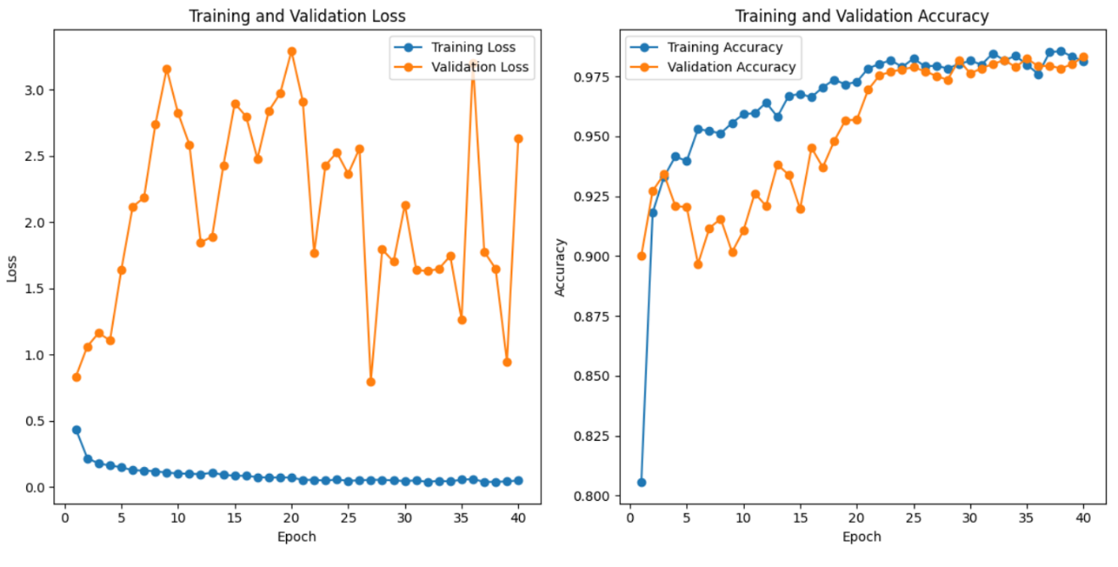
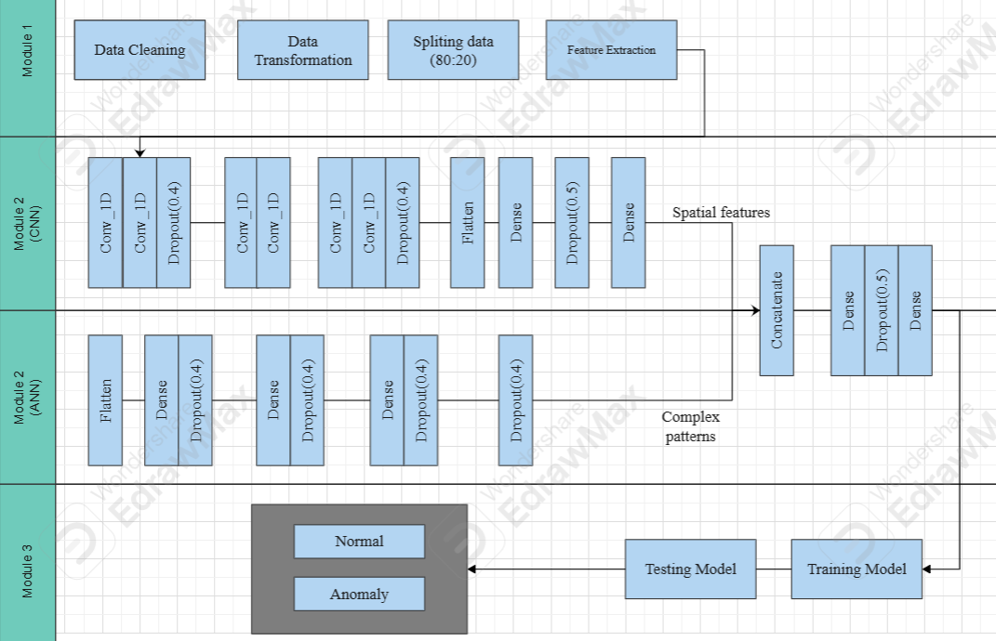
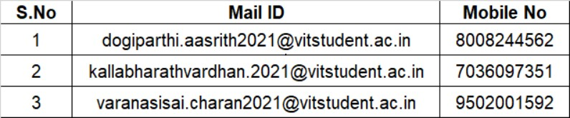
Anomaly Detection in Network Traffic: Using Hybrid Techniques
Dogiparthi Aasrith-21BAI1702, Kalla Bharath Vardhan-21BCE5846, Varanasi Sai Charan-21BCE5870
Dr. Bhavadharini R M
School of Computer Science and Engineering
INTRODUCTION
Network traffic protects user data but makes it difficult to detect threats, as traditional methods like deep packet inspection are no longer effective without violating privacy or adding computational overhead.
Protocols like TCP, UDP, and ICMP play a crucial role in securing digital communication, but they also introduce challenges for threat detection due to encryption and limited visibility into payloads.
There's a growing need for a robust, scalable model that can detect anomalies in network traffic using only metadata and statistical features, without decrypting the content.
The study proposes a hybrid model combining CNN and ANN architectures, enhanced with advanced activation functions (Swish, GELU) and regularization techniques, achieving high accuracy and strong generalization for modern cybersecurity applications.
OBJECTIVES
Incorporating advanced activation functions such as Swish or GELU to improve the learning process and increase model efficiency in detecting anomalies
Implementing tailored regularization methods (such as L1, L2 regularization) to combat overfitting, especially in scenarios where the dataset is imbalanced.
Optimizing feature extraction and selection to improve detection capabilities without the need for decrypting traffic, thereby maintaining privacy and security.
Ensuring that the proposed model is capable of real-time detection of malicious activities in encrypted traffic while minimizing computational costs and preserving privacy.
SCOPE OF THE PROJECT
The scope of this project is to develop a hybrid anomaly detection system using Artificial Neural Networks (ANN) and Convolutional Neural Networks (CNN) to detect threats in network traffic without the need for decryption. This approach ensures privacy preservation while improving detection accuracy, efficiency, and scalability. By leveraging advanced activation functions and regularization techniques, the system aims to reduce overfitting and enhance generalization across imbalanced datasets.
METHODOLOGY
Preprocessing
This module is responsible for cleaning and preparing raw network traffic data from dataset: Network Intrusion Detection for effective model training. It involves handling values which are missing, and performing feature extraction to ensure that the dataset is optimized for analysis. Performed label-enconding, for protocol_type, service, flag and class columns to change categorical values to numerical values, and smote technique for class imbalance. The actual data count was normal:13449 and anomaly:11743, now we made both of them equal as 13449. These steps enhance the quality and relevance of the input data, which is critical for training a robust ANN. Techniques like data splitting further enable the separation of training and testing datasets, in 80:20 ratio.
ARCHITECTURE
The proposed hybrid model combines CNN and ANN architectures to improve anomaly detection in network traffic. The CNN branch captures spatial features using Conv1D, GELU activations, and pooling, while the ANN branch learns complex patterns through dense layers. Both branches are merged and passed through fully connected layers with dropout for regularization, ending with a sigmoid output for binary classification. This design leverages the strengths of both models, achieving high accuracy and robustness against overfitting. The use of advanced activation functions and optimizers further enhances model performance. Overall, the hybrid approach provides a scalable and effective solution for network traffic anomaly detection.
RESULTS
Performance of Hybrid
CONCLUSION
The proposed hybrid ANN-CNN model outperformed individual ANN and CNN architectures in anomaly detection of encrypted traffic, achieving 98.34% accuracy, 98% precision, 96.5% recall, and a 97.5% F1-score. Key enhancements included data preprocessing, SMOTE for class balance, advanced activation functions (ReLU, GeLU), and optimizers (Adam), making the hybrid model more accurate, efficient, and effective.
CONTACT DETAILS
REFERENCES
[1].https://www.kaggle.com/datasets/sampadab17/network-intrusion-detection
[2].Behdadnia, T., Deconinck, G., Ozkan, C., & Singelee, D. (2023, October). Encrypted Traffic Classification for Early-Stage Anomaly Detection in Power Grid Communication Network.
[3].Zhu, Z., Zhou, H., Yang, Q., Wang, C., & Li, Z. (2022, December). Anomaly Detection in Encrypted Identity Resolution Traffic based on Machine Learning.
Algorithm | Accuracy
CNN | 94.36
ANN | 96.82
Hybrid | 98.34

