Slide 1
Potato Leaf Disease Classification Using Deep Learning
Dogiparthi Aasrith
21BAI1702

Slide 2
INTRODUCTION
The agricultural industry plays a crucial role in global food production, with plants serving as the backbone of agricultural output. Potato cultivation is a significant agricultural activity globally, contributing to food security and economic stability. However, potato plants are susceptible to various diseases, which can reduce crop yield and quality. Timely detection and classification of these diseases are crucial for effective disease management. In this project, we aim to develop a system that uses Convolutional Neural Networks (CNN) and deep learning techniques to classify potato diseases accurately and assist farmers in making informed decisions about disease control and treatment.
Traditional methods for potato disease classification have often relied on manual inspection, which can be time-consuming and prone to errors. With the advancement of deep learning techniques, there is a significant opportunity to transform potato disease classification by automating the process with high accuracy and speed.
Deep learning, particularly Convolutional Neural Networks (CNNs), has emerged as a powerful tool for image classification tasks, including disease detection in plants. By leveraging the hierarchical features learned from data, CNN models can automatically extract relevant features from images and make predictions with high accuracy. In the context of potato leaf disease classification, CNN models offer the potential to provide rapid and reliable identification of diseases, allowing farmers and agricultural experts to take appropriate actions to mitigate disease spread and minimize crop losses. The images in the dataset pertain to various categories of potato diseases, each with distinct symptoms and visual markers. The model used for training is based on a well-established CNN architecture like resnet model, a computer vision model. Pre-trained weights of the model are leveraged and customized to perform potato disease classification.

Slide 3
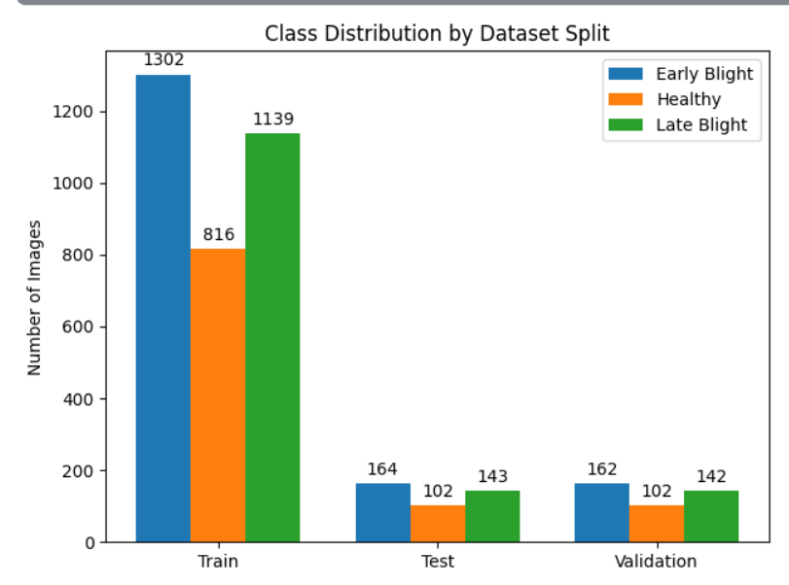
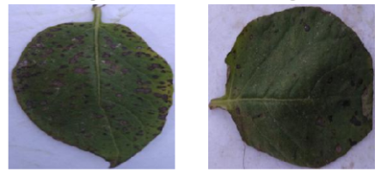
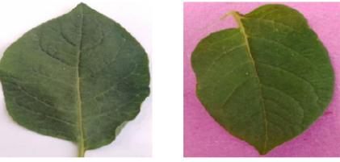
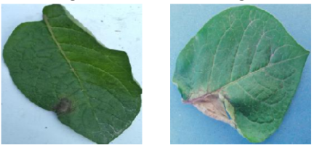
Distribution of the Classes
The dataset utilized in this study comprises chest potato leaf images sourced from the Potato Leaf Diseases dataset. This dataset is organized into three main directories: train, test, and validation.
Each directory contains subdirectories corresponding to the classes of interest: 'Early Blight’, ‘Late Blight’, and ‘Healthy' . These classes represent the presence or absence of disease in the potato leaf images, thus constituting a multi classification problem.
As we can see the distribution of the images is skewed to the side of the Potato leaf Images.
This results in an imbalance in the dataset.
We solve this imbalance by augmenting the dataset for increasing the number of images and decreasing the imbalance.
Early Blight
Healthy
Late Blight

Slide 4
BLOCK Diagram
Dataset Consisting of Images of Potato leaf images: This is the initial dataset containing potato leaf images, serving as input data.
Data Preprocessing and EDA: Images undergo preprocessing (resizing, normalization) and exploratory data analysis for insights.
Model Building: Definition of the deep learning model architecture.
Resnet50 with Transfer Learning: Utilizing pre-trained Resnet50 for feature extraction, accelerating training and enhancing performance.
Fine-tuning: Adjusting model parameters for disease detection task and dataset characteristics.
Evaluation: Assessing model performance using metrics like accuracy, precision, recall.

Slide 5
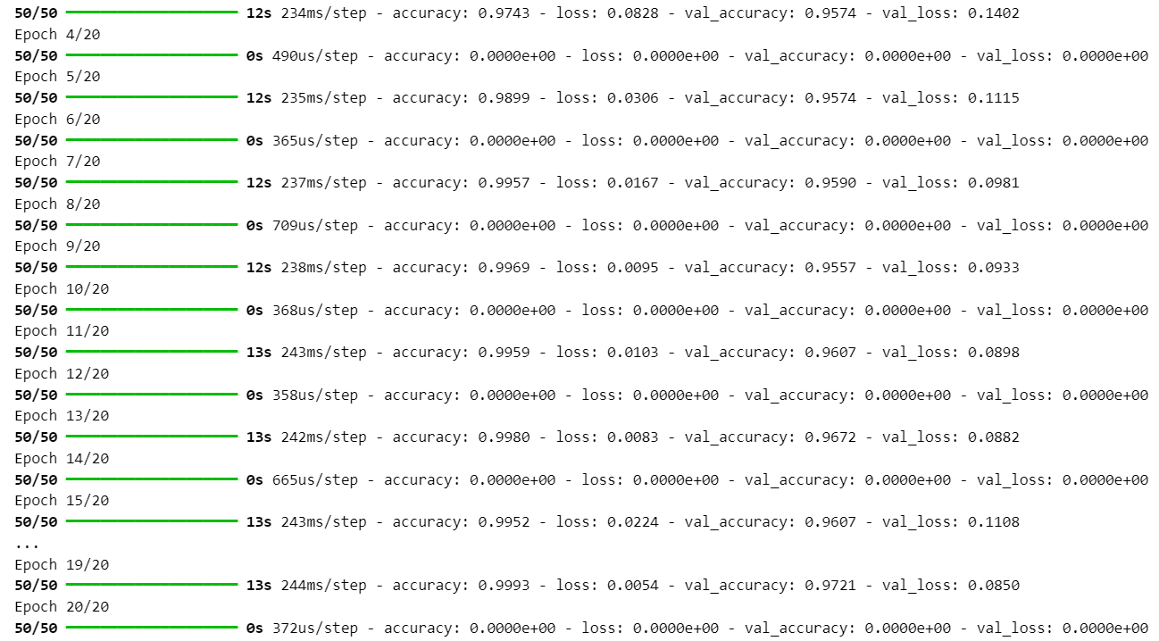
Results
We have trained the model with emphasis on accuracy score as the model’s metrics,
The training accuracy after training for 20 epochs has reached 0.9993 and the loss in the training data is at 0.0054.
The validation accuracy has reached 0.9721 and validation loss is at 0.0850

Slide 6
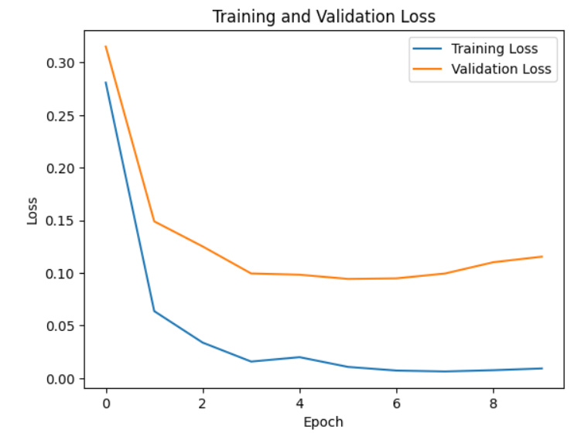
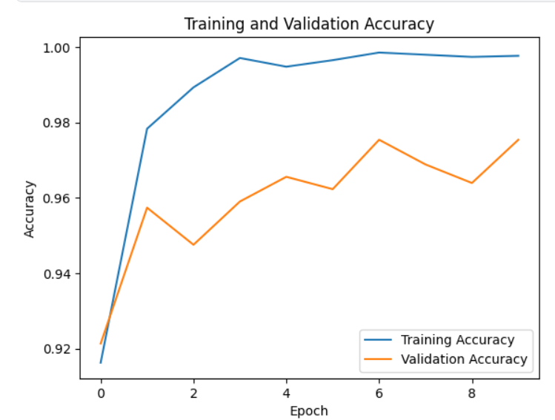
Graphs of Loss and accuracy Over the Epochs
Plotting loss over epochs helps us track how well our model is learning from the data, ensuring it minimizes errors effectively during training.
Graphing accuracy over epochs provides insights into the model's ability to discriminate between classes, guiding adjustments to enhance its performance in classification tasks.
Graph depicts the model's decreasing loss over 20 epochs, indicating improved accuracy as training progresses.
Curve shows accuracy stability or increase over epochs, reflecting the model's ability to distinguish between classes.

Slide 7
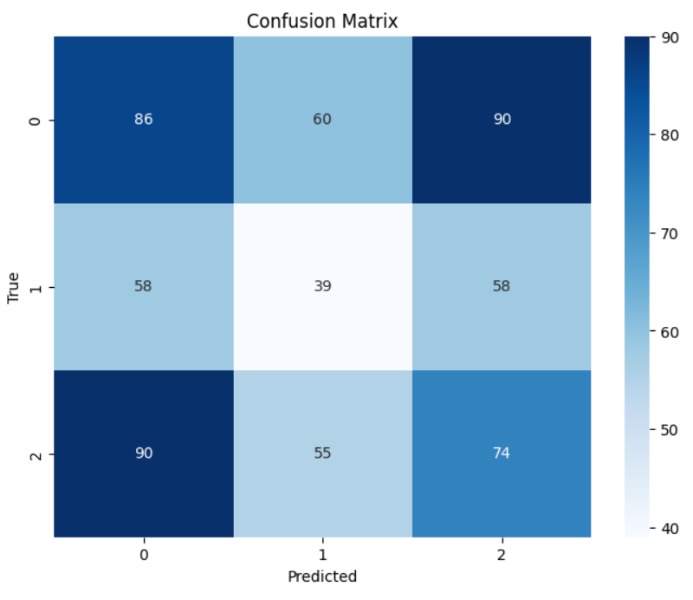
Confusion Matrix
Accuracy: The model demonstrates an accuracy of approximately 99.93%,
Precision: About 93% of the cases predicted as early blight or late blight by the model are indeed healthy leaves.
Recall (Sensitivity): The model identifies around 86.70% of actual early blight or late blight,
F1-score: The F1-score of approximately 91%,

Slide 8
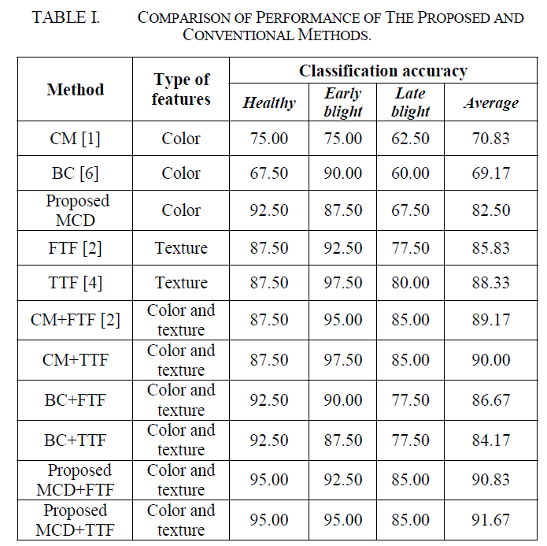
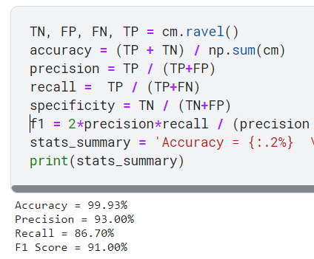
Comparison with other Papers
Paper-1: https://ieeexplore.ieee.org/abstract/document/8905128
In the paper the highest accuracy is 91.67%
In our model we have achieved accuracy is 99.93%
In all the cases our model is equal to or if not greater than the one in the given research paper.
Result of our model
Results in the Paper

Slide 9
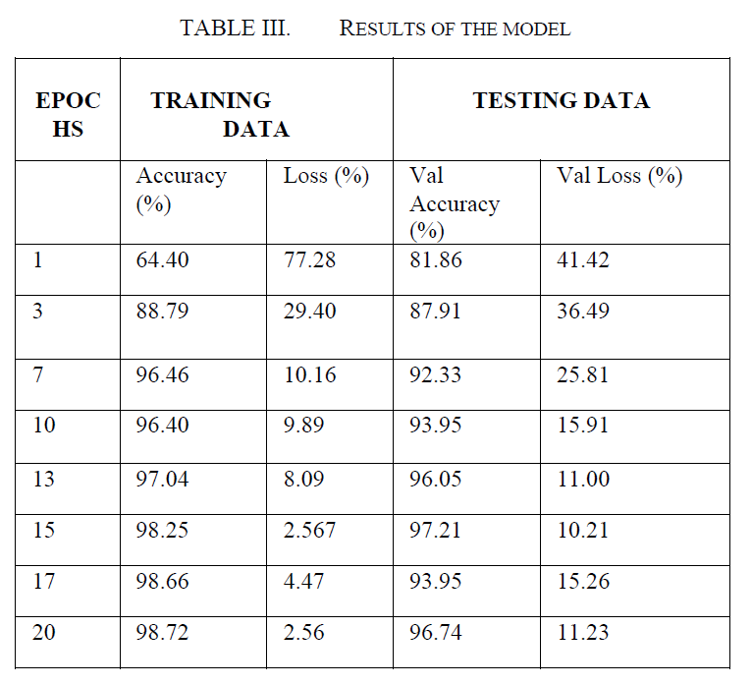
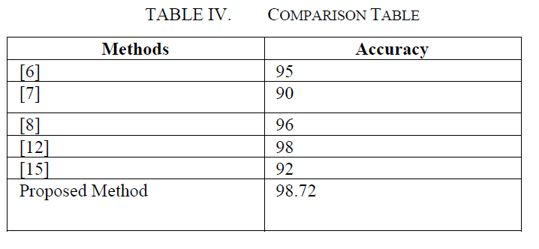
Paper-2: https://ieeexplore.ieee.org/document/10263960
In the paper the highest accuracy is 98.72%
In our model we have achieved accuracy is 99.93%
In all the cases our model is equal to or if not greater than the one in the given research paper.
Result of our model
Results in the Paper

Slide 10
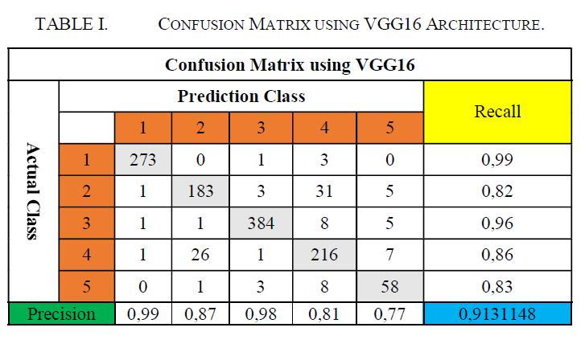
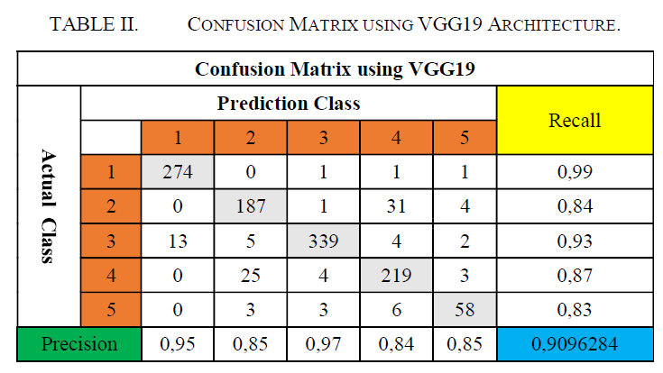
Paper-3: https://ieeexplore.ieee.org/abstract/document/9231784
In the paper the highest accuracy is 91.13% and 90.96
In our model we have achieved accuracy is 99.93%
In all the cases our model is equal to or if not greater than the one in the given research paper.
Result of our model
Result in the paper

Slide 11
Thank You

