Slide 1
NTI BIG DATA TRAINING PROGRAM
TelePulse
Big Data Analytics Platform for Urban Telecommunications
TEAM MEMBERS
Doha Ahmed
Reem Ahmed
Malak Amir
Shehab Mohammed
1

Slide 2





PROJECT OVERVIEW
What is TelePulse?
TelePulse is a Big Data analytics platform that processes telecommunications activity across Milan using distributed technologies. The project transforms raw mobile network data into business-ready insights through an automated analytics pipeline.
OBJECTIVES
Milan, Italy
Build a complete Big Data pipeline
Urban-scale telecommunications signal, transformed into actionable intelligence.
Analyze telecommunications activity
Generate analytical insights
Deliver interactive dashboards
2

Slide 3









DATASET
Telecom Italia Big Data Challenge
TelePulse uses the Telecom Italia Big Data Challenge dataset containing anonymized telecommunications activity across Milan during November 2013.
PROVIDER
LOCATION
TIME PERIOD
FORMAT
SIZE
Telecom Italia
Milan, Italy
November 2013
Daily CSV files
~1.5 GB
DATA INCLUDES
SMS
Calls
Internet Traffic
Province Interactions
3

Slide 4







TECHNOLOGY STACK
Technologies Used
Docker
Linux
Hadoop HDFS
Apache Spark
INFRASTRUCTURE
INFRASTRUCTURE
STORAGE
PROCESSING
Apache Hive
Power BI
Python
WAREHOUSE
VISUALIZATION
PROGRAMMING
4

Slide 5
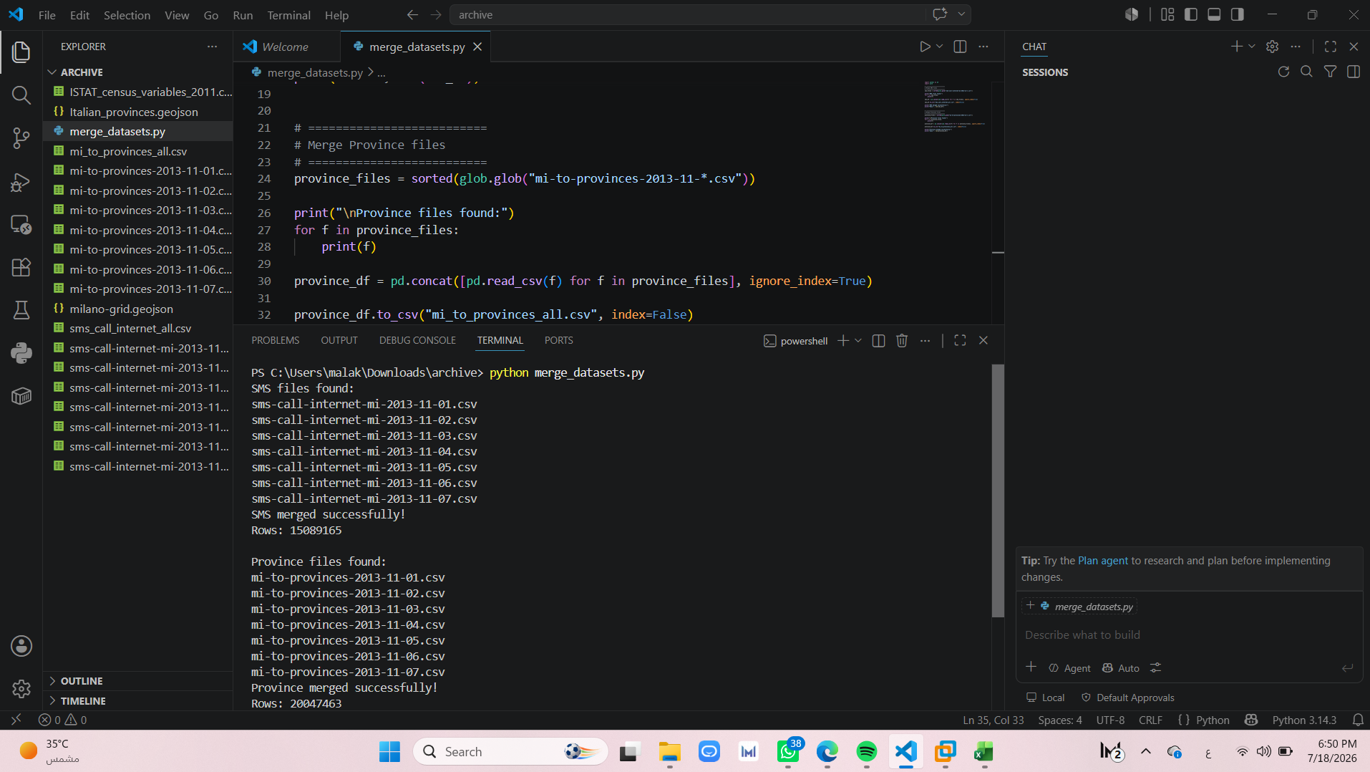

Slide 6
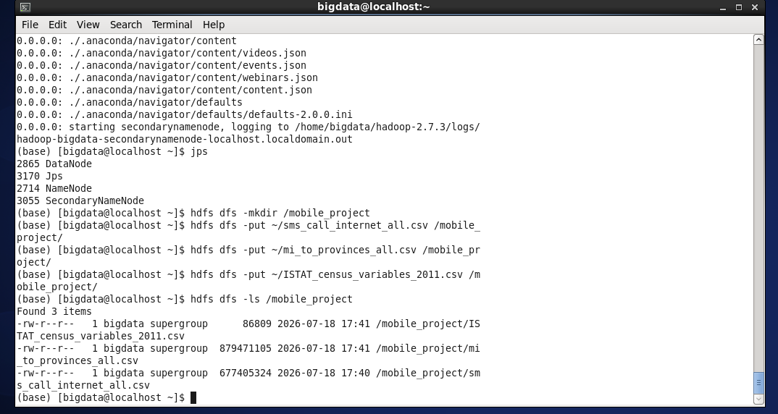

Slide 7


SYSTEM ARCHITECTURE
End-to-End Architecture
Raw CSV Files
Merge Datasets
Upload to HDFS
Apache Spark
Hive Warehouse
Power BI Dashboard
Data flows sequentially from raw ingestion through distributed processing to business-ready visualization.
5

Slide 8

DATA PROCESSING PIPELINE
ETL Workflow
01
02
03
Merge daily datasets
Upload to HDFS
Spark processes data
04
05
06
Hive stores analytics
Hive creates views
Dashboard visualizes results
6

Slide 9


SPARK ANALYTICS
Analytics Generated
Land Use Classification
Urban Vitality
Spatial Diversity
Aggregates SMS, Calls, and Internet traffic per Square ID.
Computes the Urban Vitality Index.
Analyzes activity during business and residential hours.
Classifies each area as Business or Residential.
Computes Shannon Entropy.
Measures communication diversity between areas.
7

Slide 10
HIVE DATA WAREHOUSE
Warehouse Design
Spark Tables
Hive Views
urban_vitality
Dashboard View
KPI Summary
land_use_classification
Activity Summary
Dashboard Map
Internet Hotspots
SMS Hotspots
spatial_diversity
Call Hotspots
Business Zones
Residential Zones
8

Slide 11

BUSINESS QUESTIONS
What Can TelePulse Answer?
Which areas are most active?
Which cells exchange the most SMS?
Where is internet usage highest?
Which cells generate the most calls?
Which areas are residential?
Which locations have the highest communication diversity?
Which areas are business districts?
11

Slide 12
DASHBOARD
Dashboard Components
KPI Cards
Urban Vitality
Internet Usage
SMS Activity
Call Activity
Land Use
Spatial Diversity
Cell Ranking
Cropped screenshots of each visual can be added to these panels.
10

Slide 13
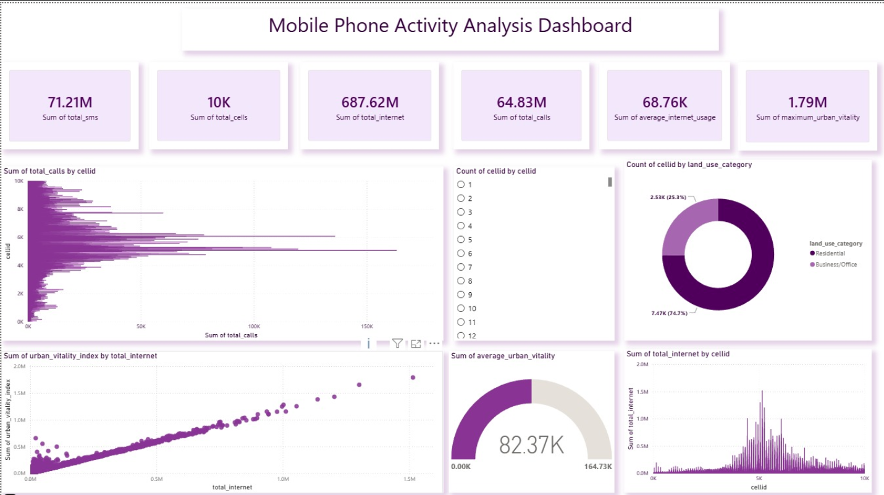
The dashboard consumes Hive analytical views to provide interactive business insights.
9

Slide 14


CHALLENGES
Challenges & Solution
CHALLENGES
Solution
Large dataset integration
Spark ↔ Hive integration
Exported Hive analytical views as CSV when direct Hive connectivity was unavailable — keeping the dashboard fully functional without depending on a live Hive connection.
Docker networking
Hive schema compatibility
Power BI connectivity
12

Slide 15


RESULTS
Project Deliverables
A GitHub repository containing:
Distributed Storage
Spark Analytics
Hive Database
Analytical Views
Interactive Dashboard
Dockerized Deployment
github.com/Doha-Ahmed-E/TelePulse
13

Slide 16



FUTURE WORK
Next Version
Incremental batch ingestion
Upload API
Automated validation
Airflow orchestration
Cloud deployment
The architecture is designed to evolve without changing the existing analytical pipeline.
14

Slide 17

Thank You
Questions?
Thank you for your time.
15

