Slide 1
Diabetics Prediction Using Logistic Regression

Slide 2
1- What is The Business Question?
Given 8 explanatory variables describing aspects of a person's health like Age, Glucose Level, Blood Pressure, Skin Thickness and Insulin.
we want to predict whether this person is diabetic or not.

Slide 3
2- Data Understanding
Each record in the data represents a person. There are 768 records and 9 columns.
Each column represents an aspect of this person’s health like blood pressure, skin thickness, months of pregnancy, glucose level, BMI, Age and whether this person is diabetic or not.
There are no null values in the data.
We can see the range of values for each attribute through histograms and scatter plots.
We can see the correlation between attributes through the heat map.

Slide 4
3- Data Preparation
Through the process of data understanding, we can see the existence of outliers such as a person with 0 Skin Thickness or a persons with 0 insulin level.
To remove these outliers, First, I replaced the zero values with the mean of each of those columns.
Second, I used the Interquartile Range (IQR) formula to remove outliers from the data.
And then I scaled the data to ensure that the comparison between values is accurate using the data normalization formula.
Finally, I split the data between 60% train data and 40% test data.

Slide 5
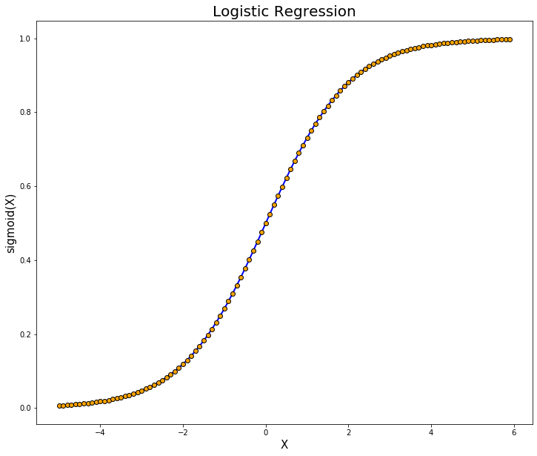
4- Model Used
The model used was Logistic Regression.

Slide 6
5- Evaluation
I used three evaluation techniques, Accuracy, Confusion Matrix and Classification Report.
Accuracy was used to show the ratio of correct predictions to the total number of input samples which was 78%.
Confusion Matrix was used to show the ratio between True Positives, False Positives, True Negatives, False Negatives.
Classification Report was used to show the values of precision, recall and f1-score.

