Slide 1
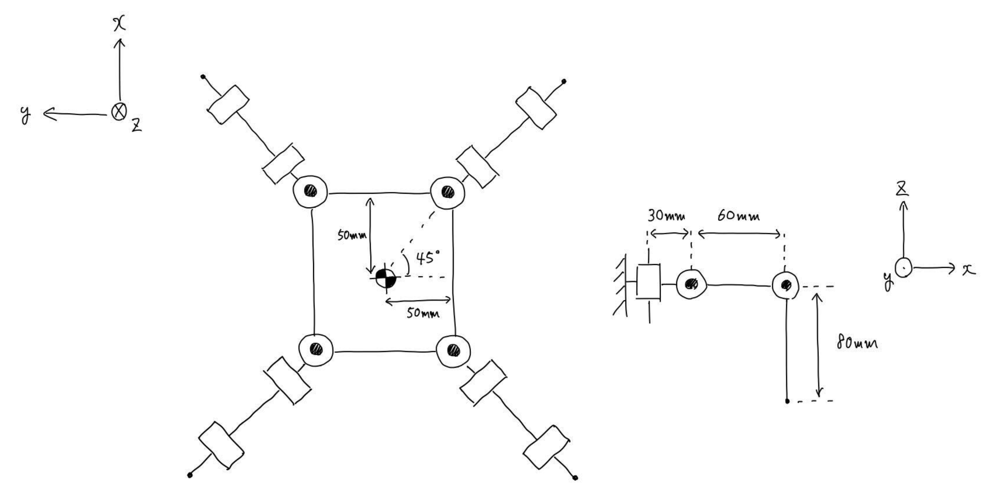







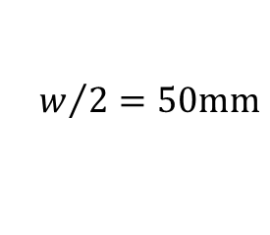



























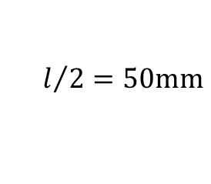

座標変換
$$Σ_{body}→Σ_{10}$$
$$\left[\begin{aligned}x_{10} \\ y_{10} \\ z_{10}\end{aligned}\right]=\left[\begin{matrix}0 & 1 & 0 \\ −1 & 0 & 0 \\ 0 & 0 & 1\end{matrix}\right]\left[\begin{aligned}x_{body} \\ y_{body} \\ z_{boxy}\end{aligned}\right]+\left[\begin{matrix}−w/2 \\ l/2 \\ 0\end{matrix}\right]$$
$$Σ_{body}→Σ_{20}$$
$$\left[\begin{aligned}x_{20} \\ y_{20} \\ z_{20}\end{aligned}\right]=\left[\begin{matrix}0 & 1 & 0 \\ 1 & 0 & 0 \\ 0 & 0 & 1\end{matrix}\right]\left[\begin{aligned}x_{body} \\ y_{body} \\ z_{boxy}\end{aligned}\right]+\left[\begin{matrix}−w/2 \\ −l/2 \\ 0\end{matrix}\right]$$
$$Σ_{body}→Σ_{30}$$
$$\left[\begin{aligned}x_{30} \\ y_{30} \\ z_{30}\end{aligned}\right]=\left[\begin{matrix}0 & −1 & 0 \\ 1 & 0 & 0 \\ 0 & 0 & 1\end{matrix}\right]\left[\begin{aligned}x_{body} \\ y_{body} \\ z_{boxy}\end{aligned}\right]+\left[\begin{matrix}w/2 \\ l/2 \\ 0\end{matrix}\right]$$
$$Σ_{body}→Σ_{40}$$
$$\left[\begin{aligned}x_{40} \\ y_{40} \\ z_{40}\end{aligned}\right]=\left[\begin{matrix}0 & −1 & 0 \\ −1 & 0 & 0 \\ 0 & 0 & 1\end{matrix}\right]\left[\begin{aligned}x_{body} \\ y_{body} \\ z_{boxy}\end{aligned}\right]+\left[\begin{matrix}w/2 \\ −l/2 \\ 0\end{matrix}\right]$$
$$LEG1$$
$$LEG4$$
$$x$$
$$θ_{11}=−π$$
$$y$$
$$z$$
$$θ_{13}$$
$$θ_{12}$$
$$Σ_{20}$$
$$y$$
$$θ_{41}>0$$
$$z$$
$$θ_{11}=0$$
$$x$$
$$Σ_{10}$$
$$x$$
$$θ_{41}=0$$
$$y$$
$$x$$
$$z$$
$$y$$
$$z$$
$$l/2=50mm$$
$$Σ_{Body}$$
$$Σ_{30}$$
$$z$$
$$y$$
$$θ_{21}=0$$
$$x$$
$$w/2=50mm$$
$$x$$
$$θ_{31}=0$$
$$y$$
$$Σ_{40}$$
$$z$$
$$θ_{21}>0$$
$$θ_{31}<0$$
$LEG$2
$LEG$3

Slide 2









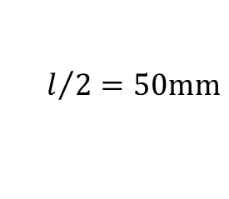




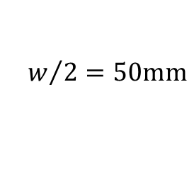



$$LEG1$$
$$LEG4$$
$$x$$
$$θ_{11}=−π$$
$$y$$
$$z$$
$$x$$
$$θ_{13}$$
$$y$$
$$z$$
$$l_{1}=30mm$$
$$l_{2}=60mm$$
$$l_{3}=80mm$$
$$x$$
$$θ_{12}$$
$$x$$
$$θ_{41}>0$$
$$y$$
$$z$$
$$z$$
$$θ_{11}$$
$$y$$
$$z$$
$$θ_{11}=0$$
$$θ_{41}=0$$
$$y$$
$$x$$
$$x$$
$$Σ_{11}$$
$$l/2=50mm$$
$$y$$
$$z$$
$$Σ_{Body}$$
$$θ_{X2}>0$$
$$θ_{21}=0$$
$$w/2=50mm$$
$$θ_{31}=0$$
$$θ_{21}>0$$
$$θ_{31}<0$$
$$θ_{X3}>0$$
$$LEG2$$
$LEG$3

Slide 3

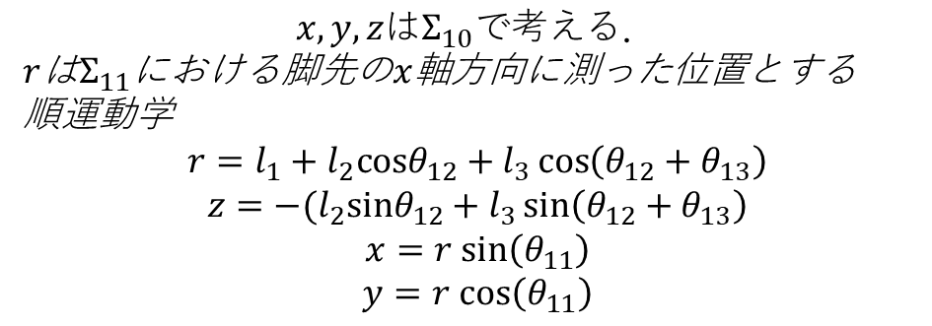







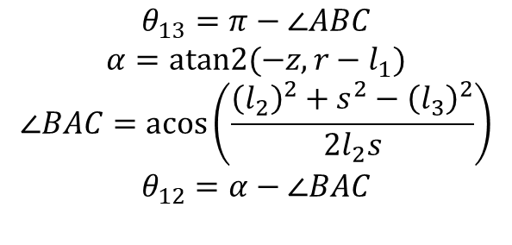








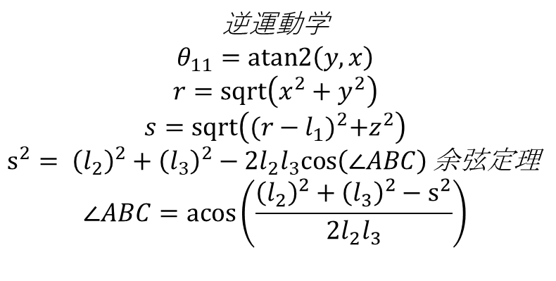
座標系$Σ_{10}$, $Σ_{11}$で考える（運動学）
$$x,y,zはΣ_{10}で考える．$$
$r$は$Σ_{11}$における脚先の$x$軸方向に測った位置とする
順運動学
$$r=l_{1}+l_{2}cosθ_{12}+l_{3}\cos\left(θ_{12}+θ_{13}\right)$$
$$z=−(l_{2}sinθ_{12}+l_{3}\sin\left(θ_{12}+θ_{13}\right)$$
$$x=r sin\left(θ_{11}\right)$$
$$y=r cos\left(θ_{11}\right)$$
$$Σ_{11}$$
$$z$$
$$A$$
$$x$$
$$y$$
$$B$$
$$l_{2}$$
$$θ_{12}$$
$$l_{1}$$
$$l_{3}$$
$$s$$
$$α$$
$$θ_{13}$$
$$C$$
逆運動学
$$θ_{11}=atan2\left(y,x\right)$$
$$r=sqrt\left(x^{2}+y^{2}\right)$$
$$s=sqrt\left({(r−l_{1})}^{2}+z^{2}\right)$$
$s^{2}= {\left(l_{2}\right)}^{2}+{\left(l_{3}\right)}^{2}−2l_{2}l_{3}cos\left(∠ABC\right)$ 余弦定理
$$∠ABC=\operatorname{acos}\left(\frac{{\left(l_{2}\right)}^{2}+{\left(l_{3}\right)}^{2}−s^{2}}{2l_{2}l_{3}}\right)$$
$$(r,z)$$
$$θ_{13}=π−∠ABC$$
$$α=atan2(−z,r−l_{1})$$
$$∠BAC=\operatorname{acos}\left(\frac{{\left(l_{2}\right)}^{2}+s^{2}−{\left(l_{3}\right)}^{2}}{2l_{2}s}\right)$$
$$θ_{12}=α−∠BAC$$

