Slide 1
Twitter Feed analysis
Srihari Seshadri

Slide 2
Executive Summary
Social media platforms like twitter are excellent platforms for reaching out to prospective candidates and require engaging content with timed delivery for maximum impact.
We analyzed the profiles of several key Twitterers to model a scheme that can improve reach to the vast users of twitter, and attract candidates with higher potential.
Some key recommendations to improve social media outreach were specified. The main factors that determine reach are Time, Content length and Originality. These factors are explored in this presentation

Slide 3
Data Overview
Twitter data can be scraped using the twitter API released to the public. It is a comprehensive data structure that contains several key features used for this analysis.
Tweet (text)
Hashtags
User info
Re-tweet flags
Original tweet (if this is a retweet)
Original tweet user info
Location information
A full list of all available features can be found here

Slide 4
Methodology
Characteristics of key users such as timing, geographical location, content and frequency were studied to generate insights
Tweets were continuously scraped from the web using Twitter API.
Hashtags were used as the primary filter for selected competitive universities with significant social media presence
Patterns relating to frequency, content and volume of tweets were analyzed for chosen universities

Slide 5
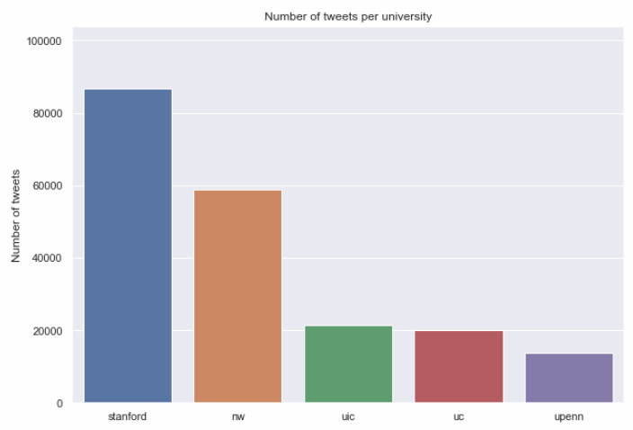
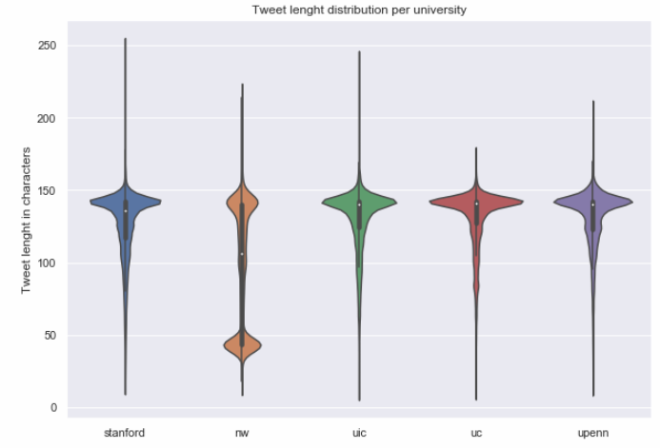
Tweet Volume
Stanford has had the highest number of tweets in the last 2 years, followed by Northwestern University.
University of Illinois, Chicago and University of Chicago are very close in volume activity.
Most tweets have a similar distribution in terms of number of characters (length).
Northwestern University is the outlier in terms of having a bi-model distribution, with more emphasis on shorter tweets

Slide 6
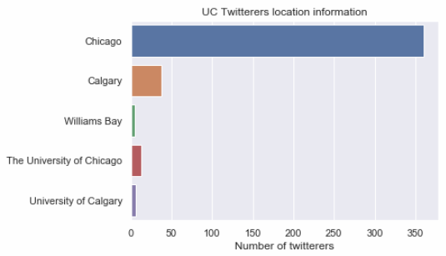
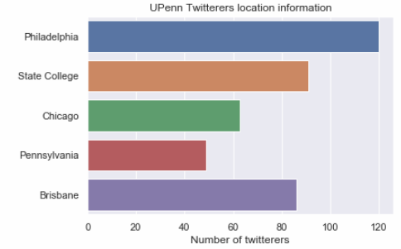
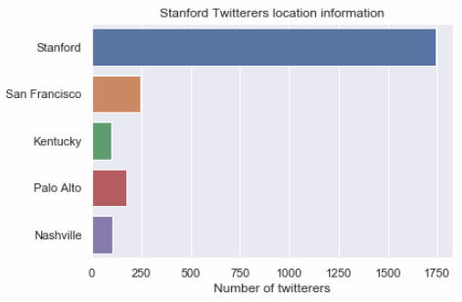
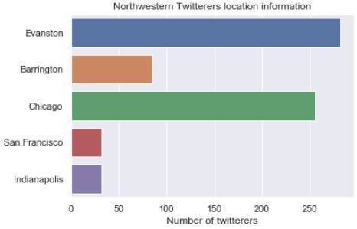
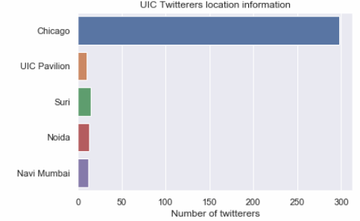
Geographical analysis
UC, Stanford and UIC have similar patterns with respect to location, i.e., they have a large bias towards a single location.
University of Pennsylvania and Northwestern have a large spread across several cities and suburbs

Slide 7
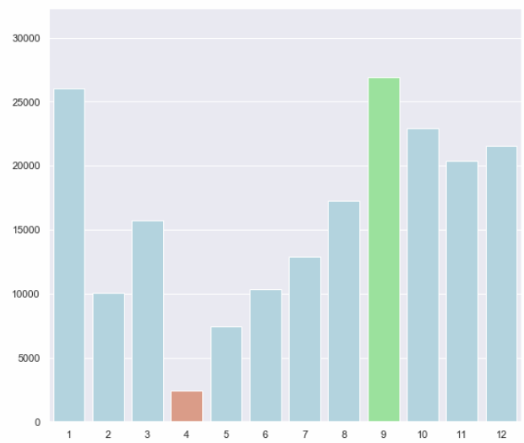
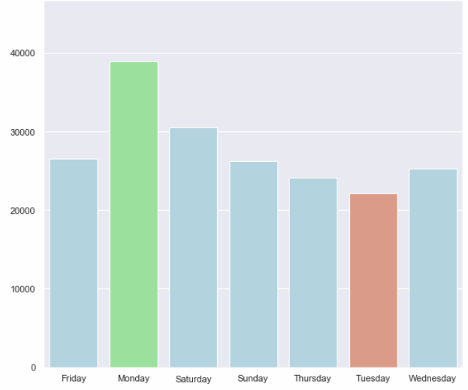
Tweets over time
There is significant traffic during the beginning of Fall season across a year, and a significant dip at the beginning of Spring.
This could correspond to the beginning of university classes and Spring break respectively.
When we have a closer look at a weekly level, Monday seems to generate the most traffic, with Tuesday having the least.

Slide 8
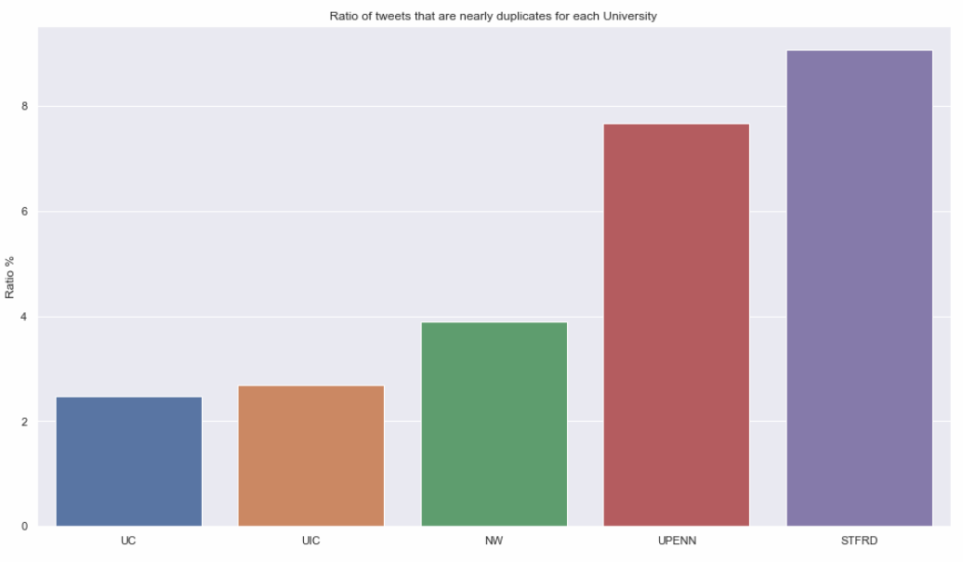
Message uniqueness
While re-tweet redundancy was filtered out, the study for uniqueness in content of the tweets for each university was assessed as well.
Stanford had the maximum number of tweets that were nearly replicas followed by University of Pennsylvania.
The University of Chicago and the University of Illinois, Chicago, proved to have the least number of duplicated tweets in their social media.

Slide 9
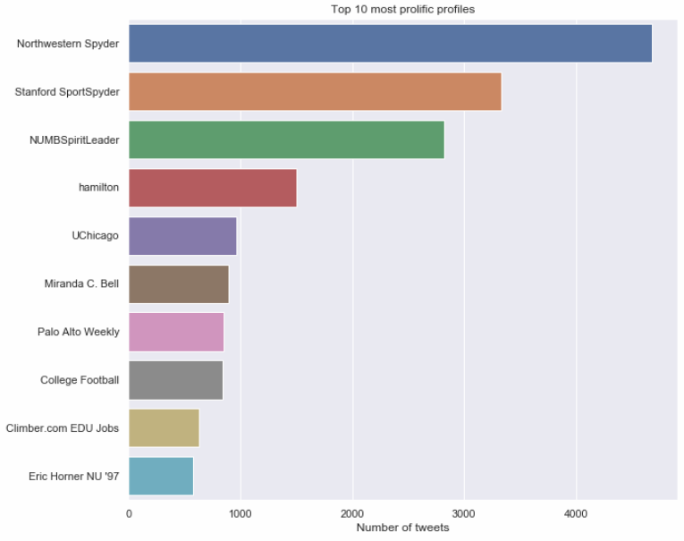
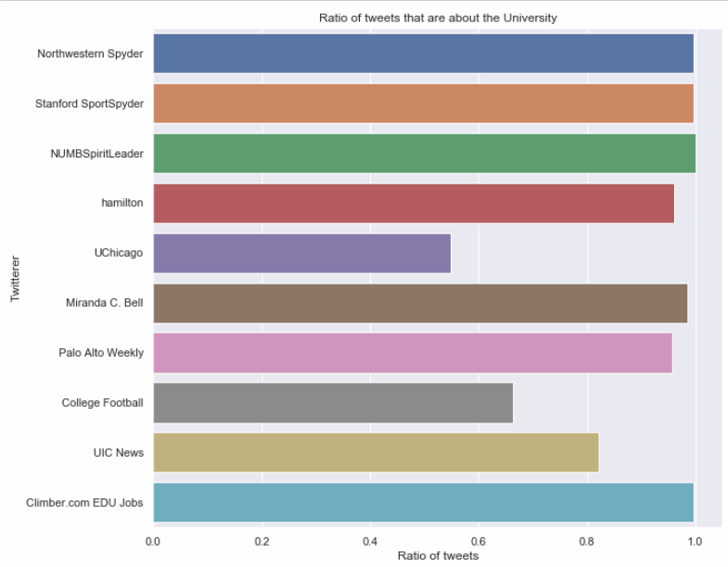
Author identification
10 Key profiles were identified cross-university.
These users were observed on their volume of tweets and how often do they tweet on their respective universities.
Northwestern Spyder and Stanford Spyder for Northwestern & Stanford University respectively lead with the most number tweets overall.

Slide 10
Recommendations
There are three key factors to consider when trying to increase social media presence
When – There are clear trends visible on when maximum twitter traffic is generated at a given time. The Beginning of Fall season has been observed to contain the most amount of traffic. Likewise, Mondays within a week also have the most traffic.
Content – Duplicated tweets do not add value. Having novel content can play a key role. Universities such as Stanford and U.Pennsylvania severely restrict the value of their content by having several tweets that are near-duplicates.
Focus – Tweeters that consistently keep their content related to the university can help in maintaining focus on reaching out to potential candidates. Having a high ratio of tweets related to the University vs. Other content can have a large impact.

Slide 11
Thank you

