Slide 1
Classifying 3’s and 8’s with various machine learning techniques
Nathan Walter
Department of Nuclear, Plasma, and Radiological Engineering
Program of Computational Science and Engineering
University of Illinois at Urbana-Champaign

Slide 2
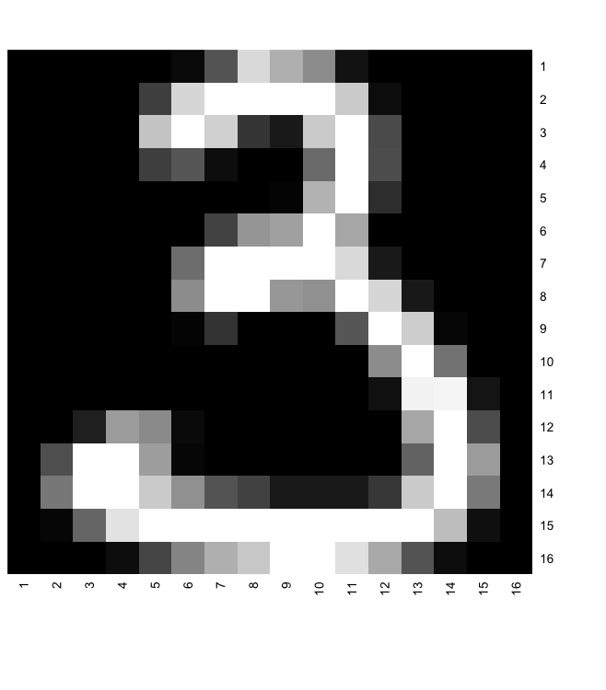
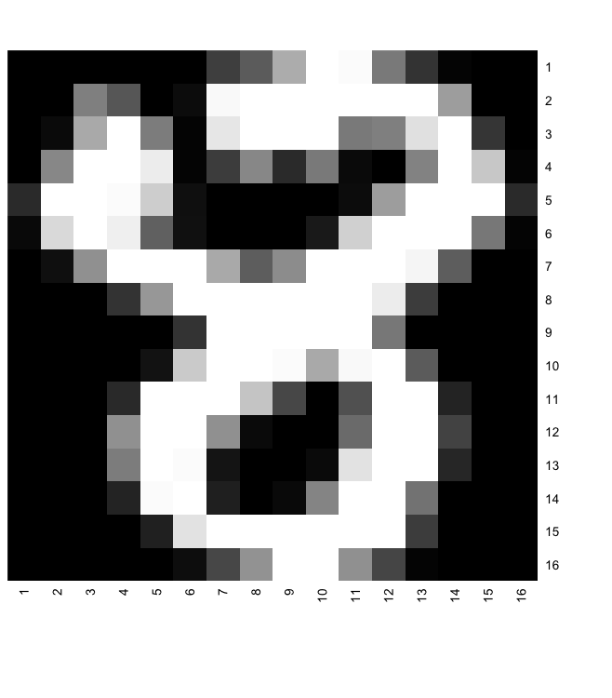
The Problem
Classify handwritten 3’s and 8’s
Data is pixelated into a 16x16 grid, thus we have 256 variables. To add complexity to the problem, the data set also has 200 noise variables
Each pixel is given a grey scale value between -1 and 1, -1 is black and 1 is pure white.
1200 train data cases, 542 cases of an 8 and 658 cases of a 3
332 test data cases, 166 cases of an 8 and 166 cases of a 3
Methods applied (LDA, naïve bayes (parametric and non-parametric), Logistic Regression, AIC/BIC/Lasso/PCA reduction, SVM, Tree, and Random Forest
Cleaning the data:
Because some of the pixels are always black (usually the corners) these were removed (especially since this eases the difficulty for each method to create a model).

Slide 3
Linear Discriminant Analysis (LDA)
Goal is to predict the probability that a particular case belongs to each possible classification, by using Bayes theorem (a fundamental idea for conditional probability)
We assume that the population distribution of each classification is the same as in the training data.
Then, we assume that the distribution of values of data values for each classification is a multivariate Gaussian distribution
The means are determined for each classifier and the covariance is determined from the entire data set
Lastly, we use the above equation to determine the probability a case belongs to each of the possible classifiers (in our case a 3 or an 8) and assign a class based on the highest probability.
Variables:
Predicted classification
Possible classification
Case data
predictor matrix
Number of Classifications
Percentage of train data belonging to each classification
vector containing the means of the data matrix x for classifier k
covariance matrix
number of predictors

Slide 4
LDA in 2-D for Easy Visualization
Data is composed of 2 classes (orange and blue)
Data is composed of 2 predictors (x1 and x2)

Slide 5
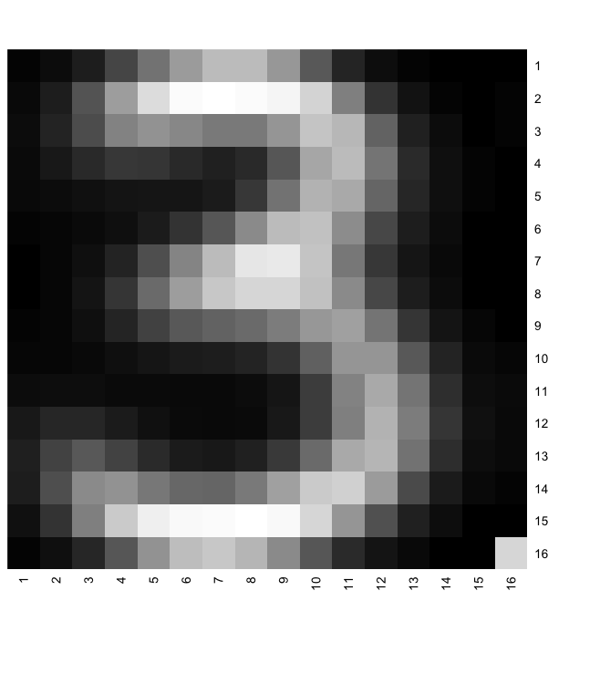
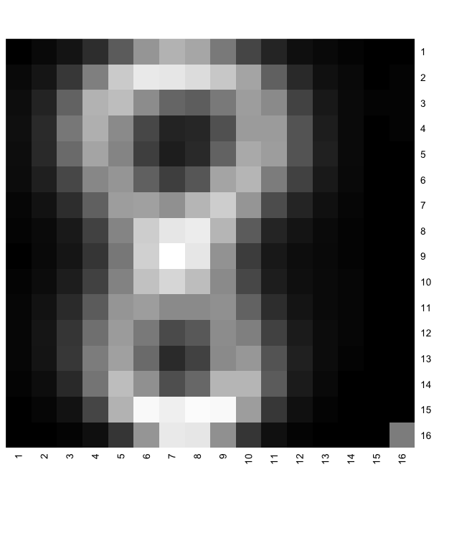
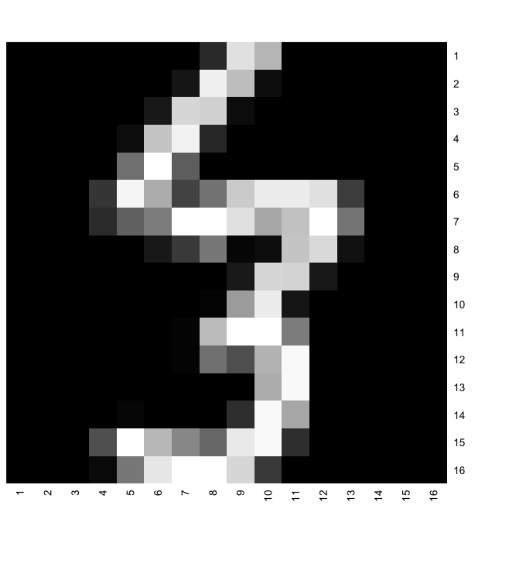
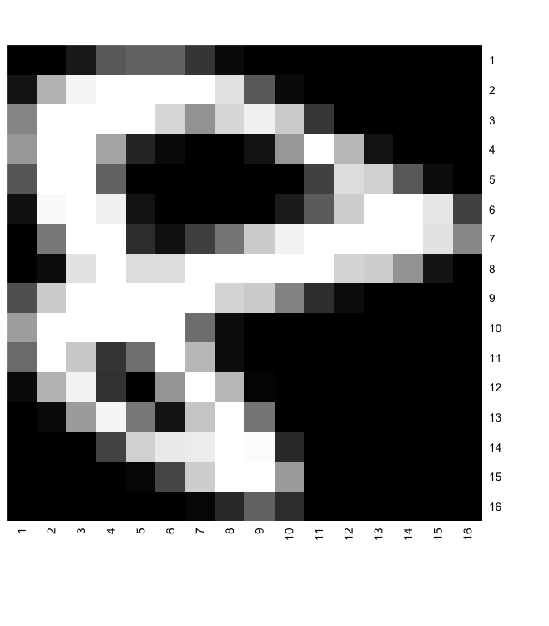
LDA applied to the data set
LDA was used to create a predictive model. Below are the model 3 and 8
Model 3
Model 8
When applied, the test error was ~6%, meaning 6% were misclassified as a 3 or an 8
This is a misclassified 3
This is a misclassified 8

Slide 6
Naïve Bayes
Goal is to predict the probability that a particular case belongs to each possible classification, by using Bayes theorem (a fundamental idea for conditional probability)
We assume that the population distribution of each classification is the same as in the training data.
Then, we assume that the predictors are independent, and the distribution is gaussian
The means and standard deviations are determined for each classifier
Lastly, we use the above equation to determine the probability a case belongs to each of the possible classifiers (in our case a 3 or an 8) and assign a class based on the highest probability.
Variables:
Predicted classification
Possible classification
Case data
predictor matrix
Number of Classifications
Percentage of train data belonging to each classification
vector containing the means of the data matrix x for classifier k
covariance matrix
number of predictors

Slide 7
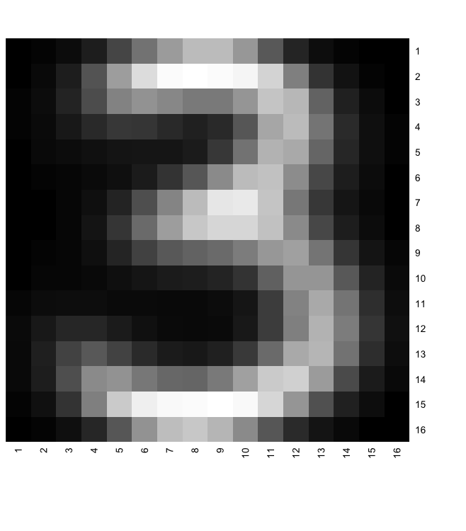
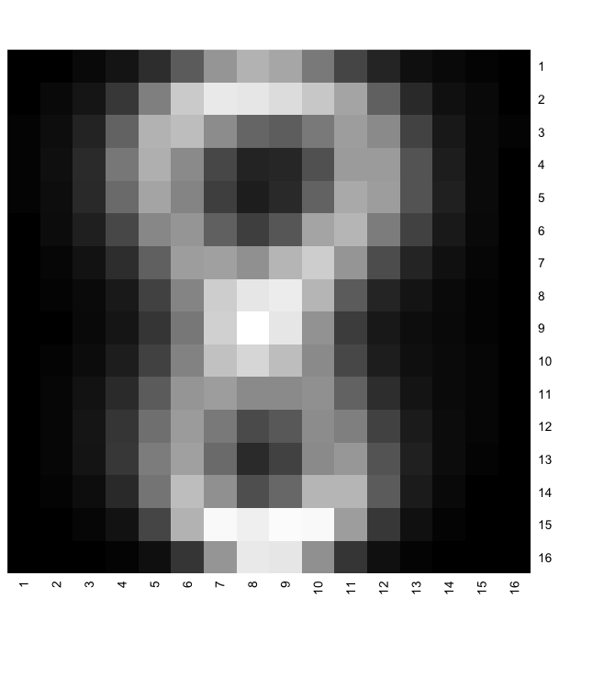
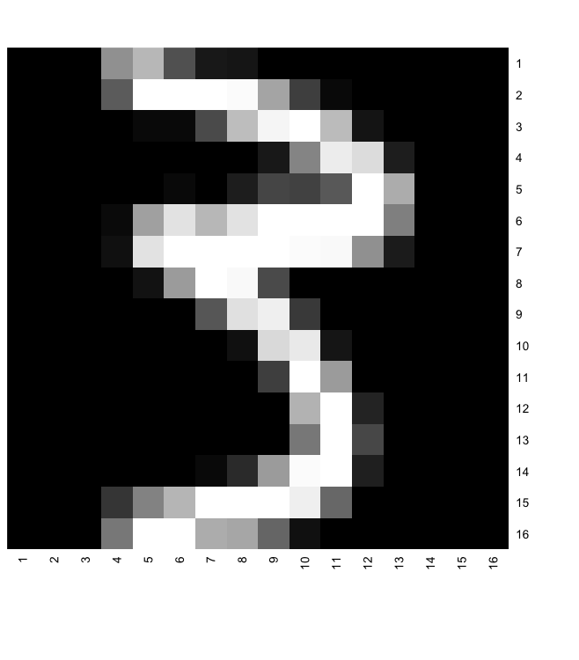
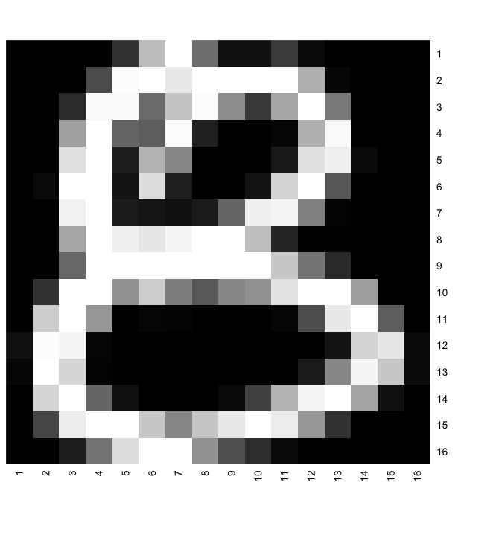
Naïve Bayes applied to the data set
Naïve Bayes was used to create a predictive model. Below are the model 3 and 8
Model 3
Model 8
When applied, the test error was ~13%, meaning 13% were misclassified as a 3 or an 8
This is a misclassified 3
This is a misclassified 8

Slide 8
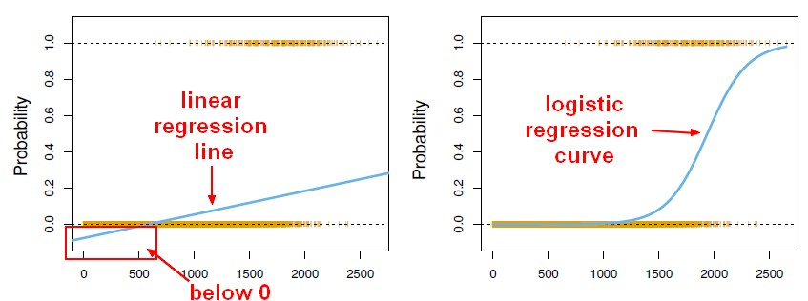
Logistic Regression
Logistic regression uses the training data to fit the following model
Choose a threshold value, T, as a cutoff. T is chosen to reduce the residual error in train data
Benefit over linear regression because there are no values outside 0 and 1
When applied with lasso variable reduction, the test error was ~4%, meaning 4% were misclassified as a 3 or an 8

Slide 9
Tree Method
Tree method starts with all the predictors available
Then it choses a predictor to split the data. Predictor can be chosen many ways, most common is to chose the predictor that reduces the deviance of the error the most
Then this is iteratively done until all predictors are chosen.
This often leads to overfitting, thus the tree can be “pruned” or shortened so that overfitting is no longer a problem
Pruning can be chosen by deviance as well, this results in a simplier tree
Lastly, the test cases is applied to the tree until it reaches a “leaf” or node and that is how the classification is made.

Slide 10
Tree Method Applied
Error rate of 6%
Error rate of 5%

