Slide 1

Reinforcement Learning on HKUSTurkey
http://www.free-powerpoint-templates-design.com

Slide 2


Our Team Members
Kuang Bingran
Zheng Dongjia
Wang Yutong
Xie Zhongkai
Gao Yang
20565874
20546149
20541402
20550477
20550946

Slide 3
Content
Project Introduction
This project is about the application of reinforcement learning, our goal is to train the HKUSTurkey
to find an optimal path of searching several site
in the maze…..
01
Reinforcement Learning
02
Reinforcement learning is a branch of machine
learning that is concerned with how learners
perform tasks by taking actions in an environment
so as to maximize a numerical reward signal…
Q-Learning
Q-Learning is a value iteration algorithm which
calculates the value or utility of each "state" or
"state-action" and then tries to maximize it when performing the action…
03
Result
04
????????????

Slide 4
Project Introduction
This is a project about maze solving problem.
In this project we are going to apply the technique of reinforcement learning to train the Turkey in the maze to find the logo of HKUST.
We have two goals for this project :
1 train the Turkey to find the HKUST logo.
2 optimized path for solving this problem.

Slide 5
Reinforcement Learning
Reinforcement learning is a branch of machine learning that is concerned with
how learners perform tasks by taking actions in an environment so as to maximize a numerical reward signal.

Slide 6

Reinforcement Learning
State
Current situation of the agent
Reward
Feedback from the environment
Action
The agent’s movement in each step
Environment
The world in which the agent operates

Slide 7
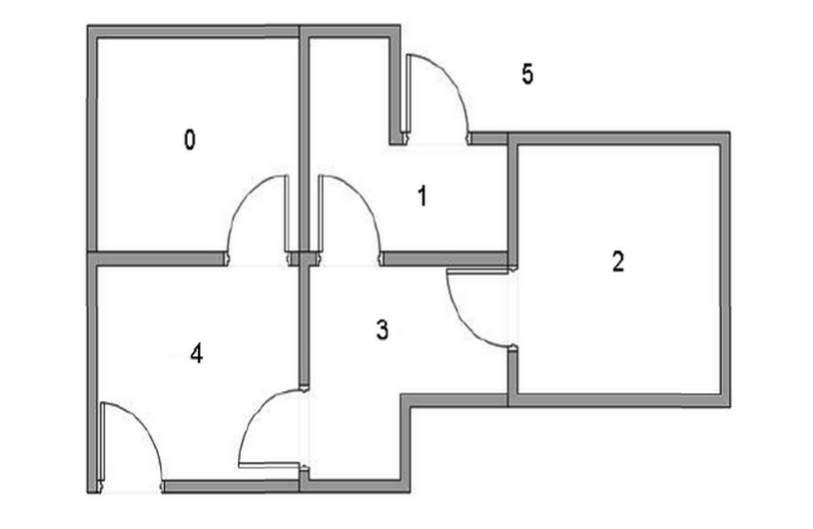
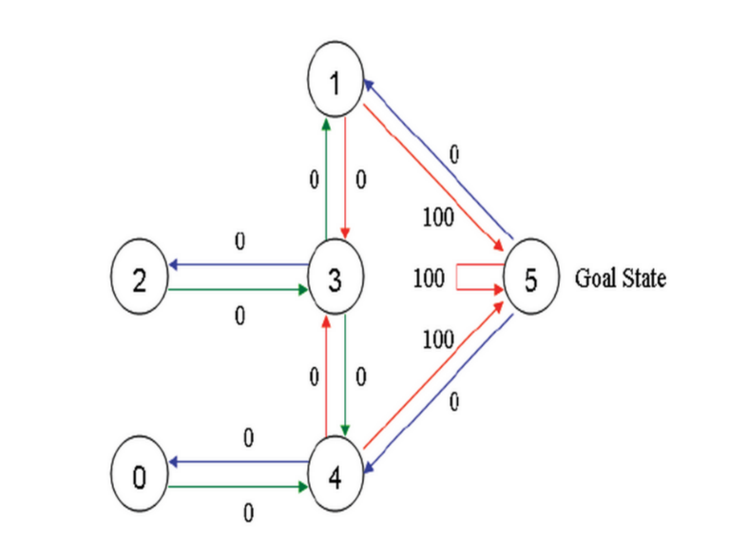
Q-Learning

Slide 8
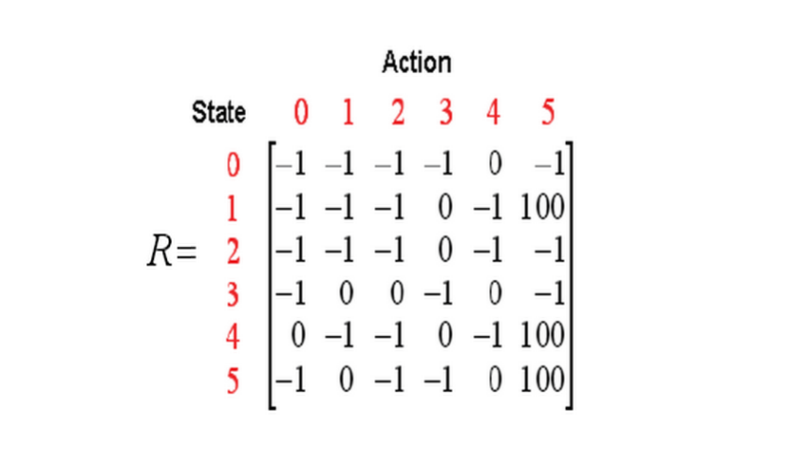
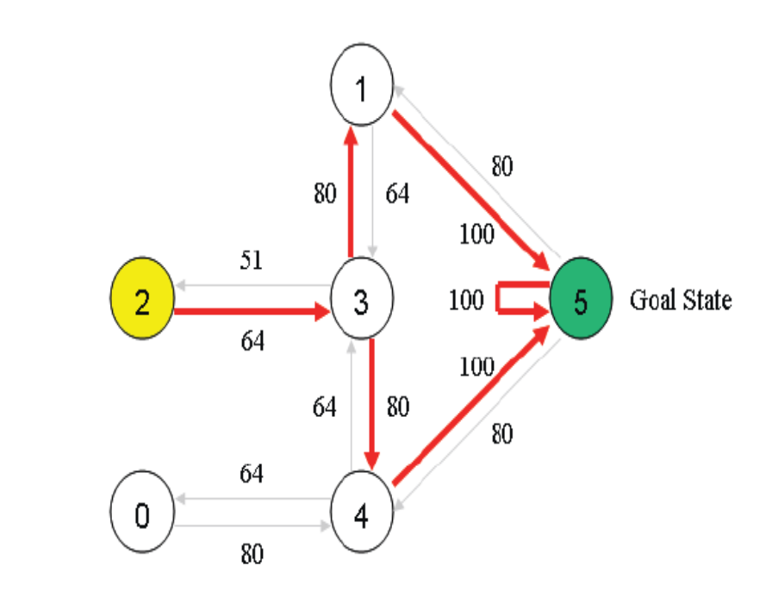
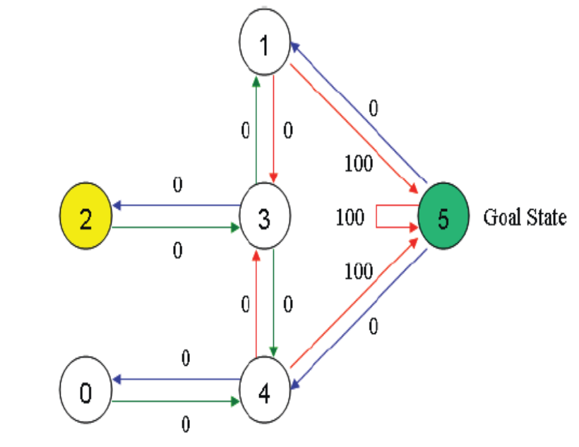
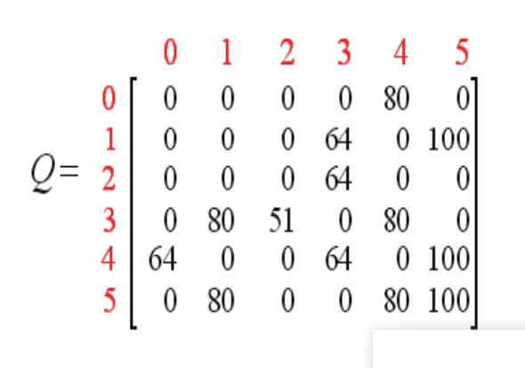
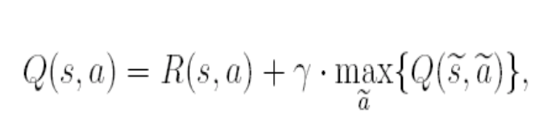
Q-Learning

Slide 9
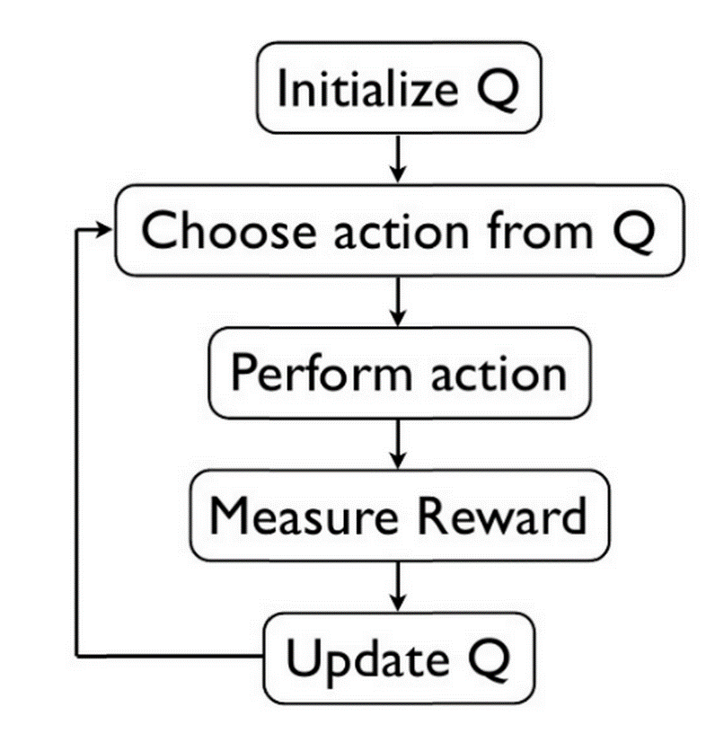
Q-Learning
Q-Learning：
A value iteration algorithm
Calculates the value or utility of each "state“
Try to maximize reward for each step

Slide 10
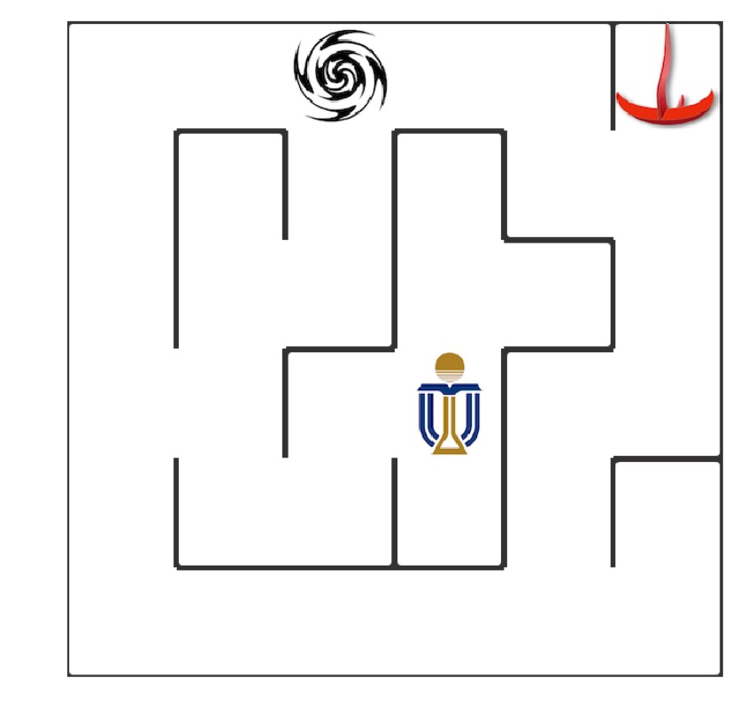



Applications
Goal：The turkey can automatically find the optimal path to the HKUST logo
The agent
The barrier
The destination

Slide 11

Applications
State：Use the coordinate of the turkey in the maze to present the state.
Action: Go Upper, Down, Left, Right
Rewards:
: -30
: -10
: +50
Others: -0.1
Finally,the turkey can automatically find the optimal path to the HKUST logo

Slide 12
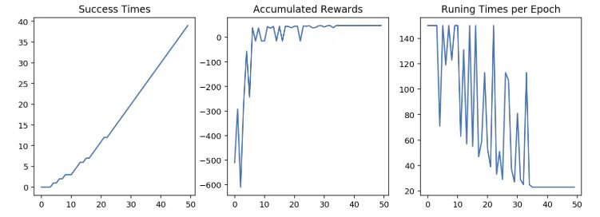
Results
The performance

Slide 13
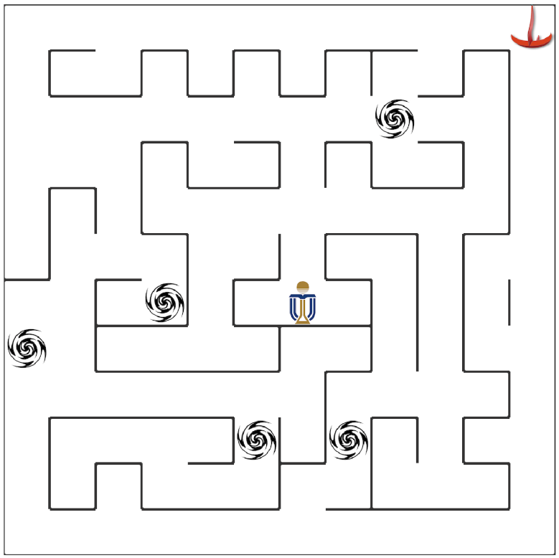
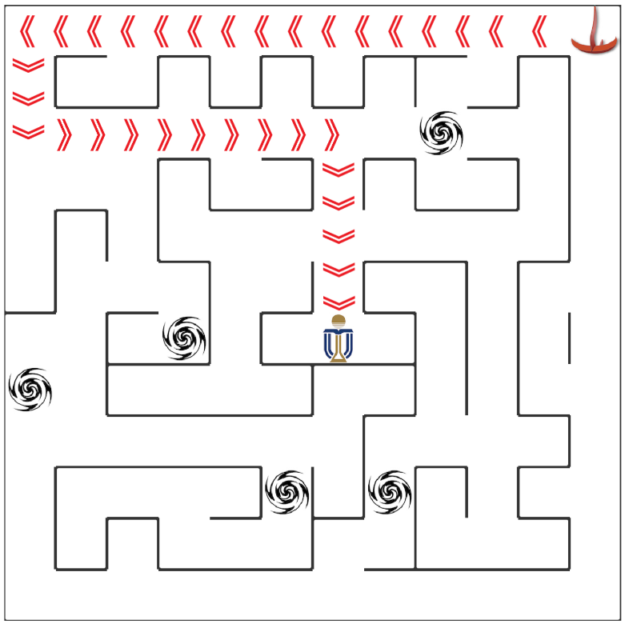
Results
After training
35 epoch

Slide 14
Thank you

