Slide 1

Real-time Stock Analysis Platform
ZHANG, Xichen | 20527341
ZHENG, Dongjia | 20546139
LI, Haoyang | 20533364
WANG, Yuxian | 20533364
Notes:
Hello, everyone, we are group 16, and our project is Real-time stock analysis platform

Slide 2
Contents
01. Task Description
02. Data
03. System
04. Demo
05. Problems & Possible Improvements

Slide 3

01. Project Description
Notes:
Firstly, we will talk about the project description

Slide 4
Background
Unpredictable Price
Stock price changes in real time
Hard to predict with traditional methods
Complex Features
Features lead to price change are complex
Technology Development
Big Data technologies are developed and can be applied in many areas
Notes:
stock price changes rapidly in every second and different kind of features can influence the price of stocks. it is hard to use traditional methods to conduct the real time analysis for those stocks. As the technology develop fastly, we try to deal the problem with spark.

Slide 5
About the Project - Reasons
comparision | big data technologies | traditional methods
real-time | yes | no
large volume of data | yes | no
inference frequency | high | low
Real-time analysis is important in stock market
Strength over traditional methods
Notes:
Our project have the following strength over traditional methods, which makes our project different from other stock related projects. firstly, our project can realize the real-time process, then our projects can deal with large volume of data, and the inference frequency is quite high

Slide 6
About the Project - Goals
Build A Data Processing Platform Based on Spark
Real-time Clustering
clustering stocks with similar price change into the same clusters find influencing factors for each cluster
Real-time price prediction according to cluster results
predict stock prices for each cluster in real time
Notes:
Our goal in the projects include three parts : Build A Data Processing Platform Based on Spark, realise Real-time Clustering and make Real-time price prediction according to cluster results. This is because we prefer to learn more about the general trend for those similarly stocks in the market.

Slide 7
About the Project - Techniques
Data storage and usage | Mango DB & Spark SQL
Data process | RDD, DataFrame, Spark Streaming, Spark MLlib
Interface | Flask
Data Visualization | Vue.js; E-Chart
Notes:
Here is a table shown the techniques we use. For data storage, we use Mango DB and write queries to get data. For data process, RDD; Spark; Spark Streaming; Spark mllib; Spark SQL; Flask are used, and APIs are written for interface. and Vue.js ansd E-Chart are used for Data Visualization.

Slide 8
02. Data

Slide 9


Data Analysis
Tushare: a free, open-sourced financial data API for python, which provide tick data (simulation of streaming) of stocks.
Data API
time: the time of deals (seconds)
price: the stock price
stock code: the index of each stock
change: the change of stock price
volume: the number of deals
amount: the amount of money
type: the buying/selling status of deals
Data Column
Notes:
Now let’s look at the dataset we have. We acquire the financial data from Tushare, which is a free and open-sourced API for python. We can get tick data of stocks from it. It’s good for the streaming process we are gonna do later on. The dataset contains these columns: time, price, stock code, change, volume, amount and type. The volume is the trading volume at that time, the amount means the amount of money being traded.

Slide 10
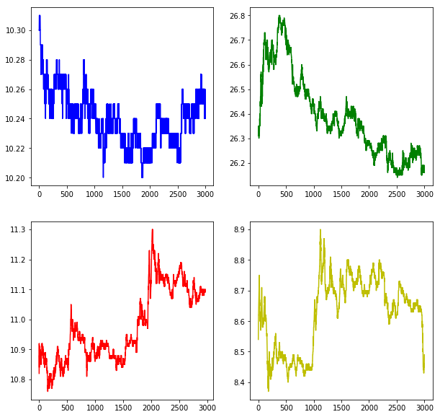
Data Analysis - Stock price graphs
Some of them have similar trend --> Clustering
Notes:
Here are some data analysis of our dataset. We randomly pick several stocks to visualize the trend of the stock prices. We can see that some of them have similar trend and some of them may not. That give an idea that we can cluster the stock into different clusters based on their similar characteristics, and then do more analysis inside different clusters later on.

Slide 11
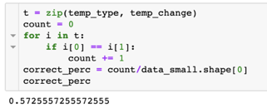
Data Analysis - Interesting feature
‘type’
buying: deal at price ‘ask1’, most investors want to buy, price will go up
selling: deal at price ‘bid1’, most investors want to sell, price will go down
Random pick 10 stocks to analyze the relationship between ‘type’ and ‘change’.
The accuracy is around 57%.
Notes:
There is a column in our dataset named ‘type’, which means that whether the trade is dealed at the buying side or the selling side in the trading order book. If ‘type’is equal to ‘in’, it means that the trade is dealed at price ask1, so most investors want to buy, indicating that price will go up. If ‘type’is equal to ‘out’, it means that the trade is dealed at price bid1, so most investors want to sell, indicating that price will go down. I think this feature can be used to predict the stock price because it indicates the market status at that moment. So I multiply the type and volume and amount as a new feature and then check the relationship between the new feature and the change direction of price. As we can see here, the accuracy is over 50% so it may be a good indicators for us to predict the price.

Slide 12
Feature engineering - Granularity aggregation
time | price
14:45:01 | 10.33
14:45:04 | 10.45
14:45:08 | 10.29
14:45:09 | 10.23
…… | ……
time | price
14:45:05 | 10.39
14:45:10 | 10.26
…… | ……
5s
avg
Notes:
Here comes the feature engineering. In term of timestamp, the tick data we get is not uniform distribution. It’s not convenient for us to do the streaming analysis. So we aggregate the data into 5-second granularity and take average of each column.

Slide 13
Feature engineering - Shift
volume
29
8
50
101
……
volume | v-lag1 | v-lag2
29 | Null | Null
8 | 29 | Null
50 | 8 | 29
101 | 50 | 8
…… | …… | ……
5s
avg
Notes:
Then we do the shift of each columns. For example, we shift one and two time units here to be the new features, which contain historical information and the time feature.

Slide 14
Feature engineering
Standardization
values of each feature in different scale
Tendency indicators
new column: bsn = volume * amount * type
Crossing moving average
classical trading strategy
short MA line cross long MA line: bullish
long MA line cross short MA line: bearish
Notes:
And also, we do the standardization coz the values of each feature are in different scale. The tendency indicators is done like I said before. And the crossing moving average is a classical trading strategy. We compute two moving average values. When the short moving average line cross the long one, it indicate that it’s a bullish market. When the long moving average line cross the short one, it indicate that it’s a bearish market.

Slide 15
03. System

Slide 16
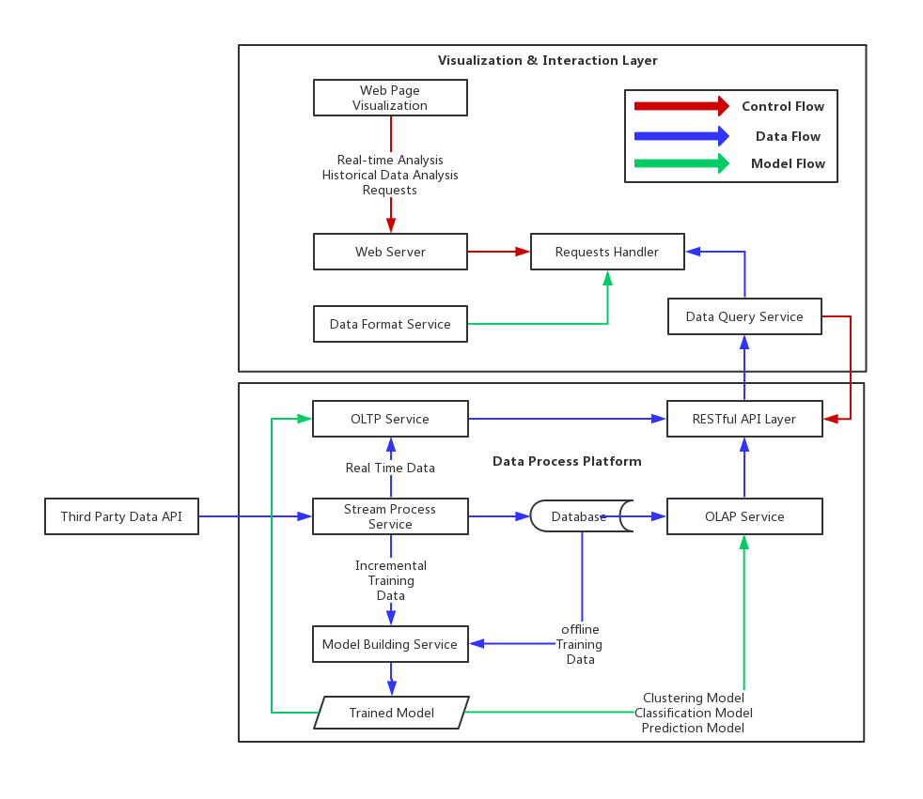
System Architecture
Data API
tushare Impl
file Impl
Data Process Platform
OLTP
OLAP
DB
Model
Visualization & Interaction layer
Real-time analysis
Historical data analysis
Notes:
This is the general system structure, here are mainly three layers in our design: Data Producer Layer, Data Process Platform and Visualization Layer. The data API layer would be a wrapper of third party APIs to make our system compatible with multiple data sources. The second layer which is the most important part of the system is Data Process Platform. It consists of multiple services with and supports the fundamental functions of the system such as stream and batch data analysis. And on the top is the visualization and interaction layer, it's basically an Dashboard App with some other business functions.
Now, let's look at each part one by one

Slide 17
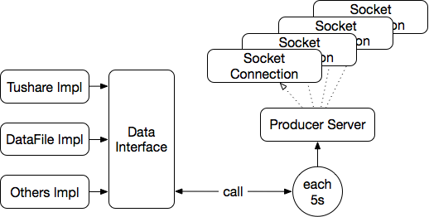
Data Producer
Simulate streaming stock data
Sending All stocks’ data at current time point
Update for each 5 seconds
Notes:
Firstly, the data producer should be compatible with different datasource, and output the datastream as an uniformed format. For this project, since our data is coming from tushare API, to prevent being blocked for calling too frequent, we have downloaded some of the data for testing, therefore, we also have an dataFile implementation to mimic the streaming data. Here we set the data interval as 5s. Once a socket connection is setup, the producer will keep throwing current data of all stocks to the receiver until the connection was shutdown.

Slide 18
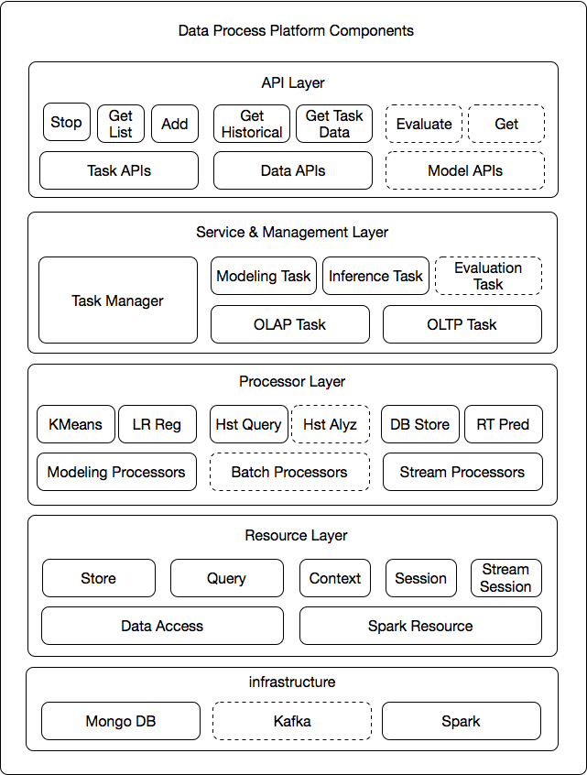
Process Platform
Extentable
For ML models
For processing algorithms
Modularity
Uncoupling Between Layers
Uncoupling Between Components
Competible
With Bottom Techniques.
With Different Data API
* The modules with dotted line means not implemented yet. And some of the features are still under development.
Notes:
For the core part of the system, this picture shows the modules in the data process platform, There are 5 layers from top to the bottom: API, Service, Processor, Resource, Infrastructure. For now, the platform was built based on the MongoDB and Spark. The resource layer will do the management of connections and interactions with lower level. Above, the Processor implement the basic unit of algorithms of the system such as modeling, streaming & batch operations. Higher level is the service layer which manage tasks of the system. One task consists of multiple processors, and it is a single process in Linux. The Task Manager will keep tracking and communicate with them. Finally, on the top level are the APIs provide to outside, which covers Task / Data / Model management.
Next I'll introduce the some of the core parts in the platform. Task Manager & Stream Processor.

Slide 19
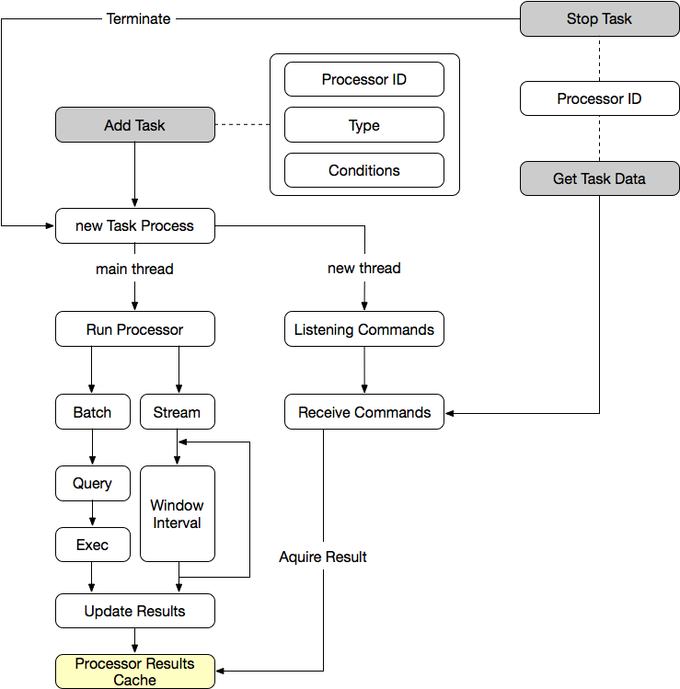
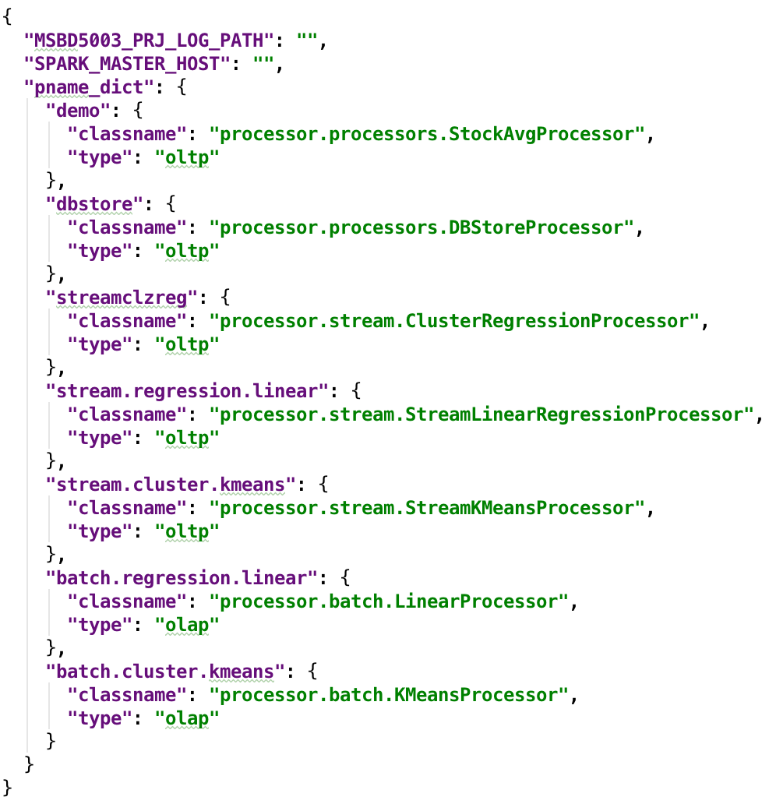
Process Platform
Task Manager
Configuration Files
Notes:
This graph illustrate how the APIs interact with Task Manager to create / stop a task and acquire the data generated in time. When user add an Task, the system will initial a task instance running in a single process, such task process will have two thread, one is to listening to the communication commands from the task manager, another thread is the actually job executor to handle the batch or stream jobs. The calculation results will be stored in the local cache of the task process. When a data request coming, the task manager can retrive the newest data from the process cache through internal command.
The configuration file of the data process platform is simple. And it support add new features without shutdown the system.

Slide 20
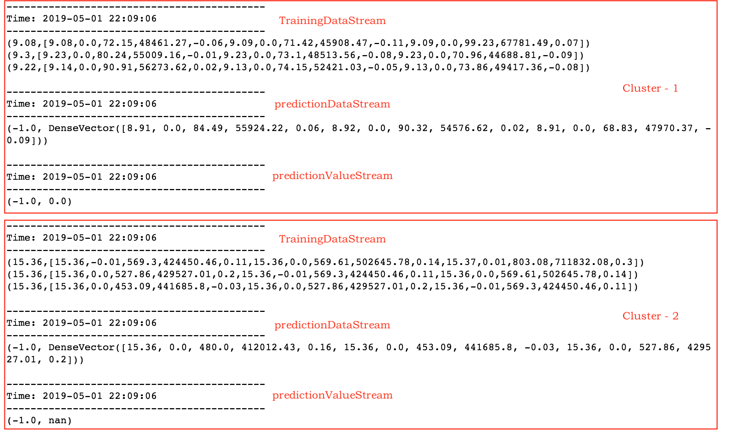
Streaming Process
Process:
Sliding window
Feature engineering
Train & Inference
Streaming Models
Clustering: streaming k-means
Regresion: streaming linear regression
Notes:
Now, let's look at the detail of the Streaming Process. In general, our process can be described as following 3 stages: clustering, aggregation and then regression. For each interval , the output is the prediction on the stock price of each cluster. The reason to do so, is that we believe, if there are some hidden factors, doing the regression on stock clusters could be more representative and helpful. In this case, to reduce the computational cost and the complexity, we use Streaming KMeans & Streaming LinearRegressionWithSGD to do the clustering and regression respectively.
Here shows an intermediate DStream. The red box separate 2 clusters, and each cluster have their own training, prediction and the result DStream. For now, we set the window as 3 times of the batch length, and the sliding interval as 1 batch length, which means, for each output, the models will be incrementally trained with previous 3 data points, and the prediction of next future time point will based on current data and features.

Slide 21
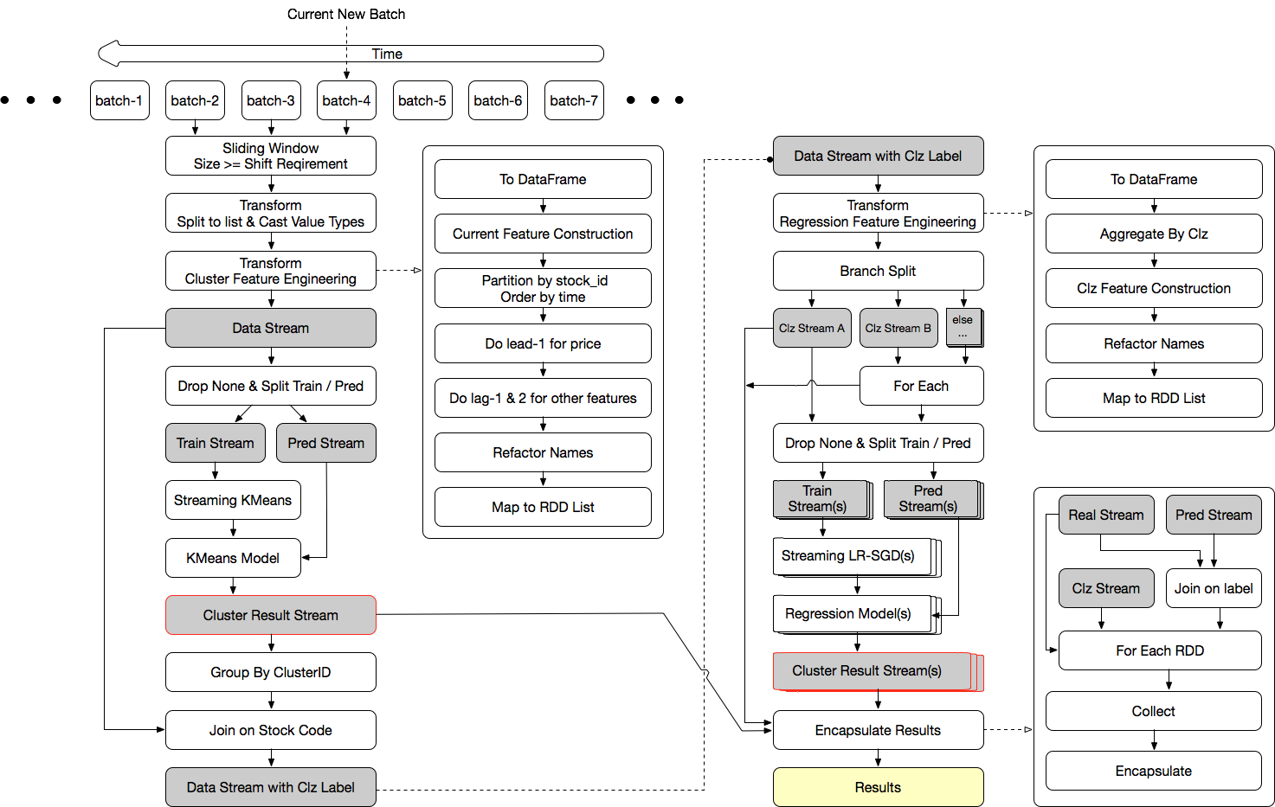
Notes:
Then this flow chart gives the detail about our streaming process procedures.
The reason to using the sliding window is that, we need to using the previous data to build current features, and future data to build current label.
As the original string data keep coming, the first transformation will split and cast each value to list structure, then the next transformation can do the feature engineering. Due to the Structured Streaming is still on experimental stage, we decide to not use it. Instead, to take advantage of DataFrame operations, we call rdd.toDF in the transformation to build features. As mentioned before, the feature engineering part include at least 3 shifting operation and several column operations. Since the restriction of MLlib usage, we split the stream to 2 branches, one for training the model, another for the inference of current stocks' cluster.
After join the data and cluster label together and aggregate the stocks in the same cluster, from the code structure aspect, the following procedures are similar to above, except that we'll assign each cluster a regression model to do the prediction. As you can see the items in the right bottom corner are mostly stack squares.
Finally, we encapsulate the current price, predicted future price and cluster result to a single structure and store it in the process cache.

Slide 22
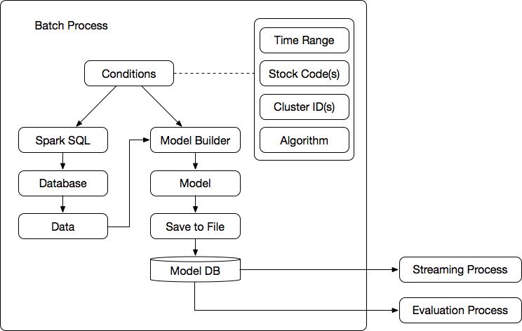
Batch Process (Unfinished)
Historical Data Modeling
Spark SQL + MongoDB + SparkML
More complex model support
For streaming inference
Notes:
About the Batch Processing, due to the time limitation, we haven't finished this part yet. When it was done, we hope it can use more complex, advanced, offline-trained models to support the real-time inference and evaluation functions.
Next, my teammate will introduce the Visualization and Interaction Layer and show the demo. Thank you.

Slide 23
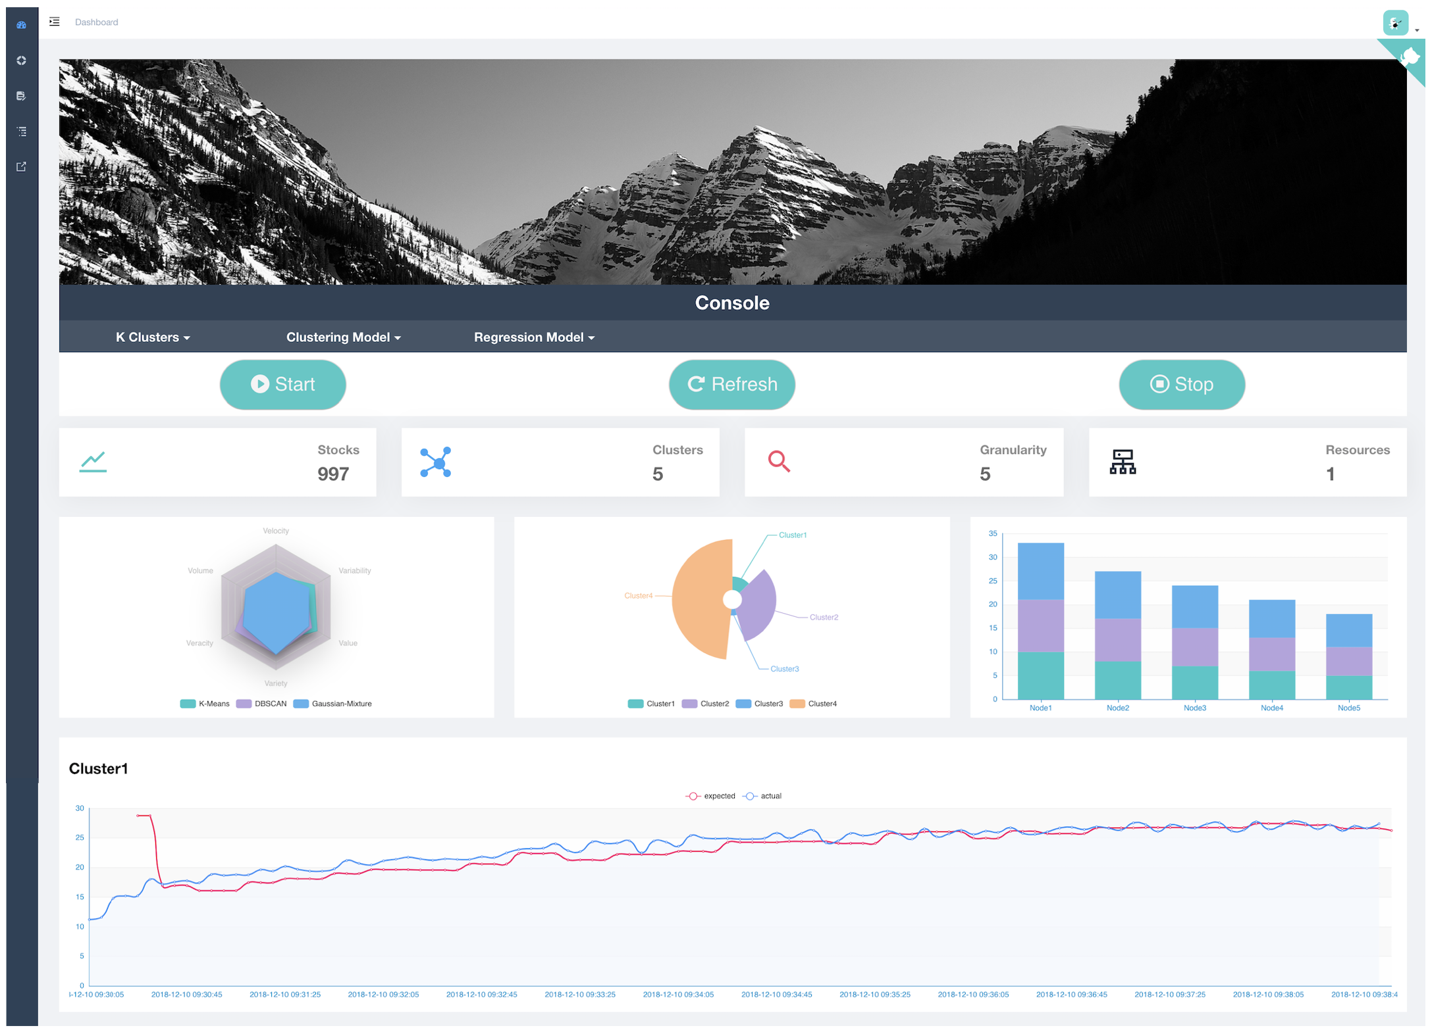
Visualization & Interaction
Techniques & Tools
Vue.js
E-Chart
Modules
Real-time analysis
Historical data analysis

Slide 24
04. Demo

Slide 25
Result Show (demo)

Slide 26
05. Problems &
Possible Improvements

Slide 27
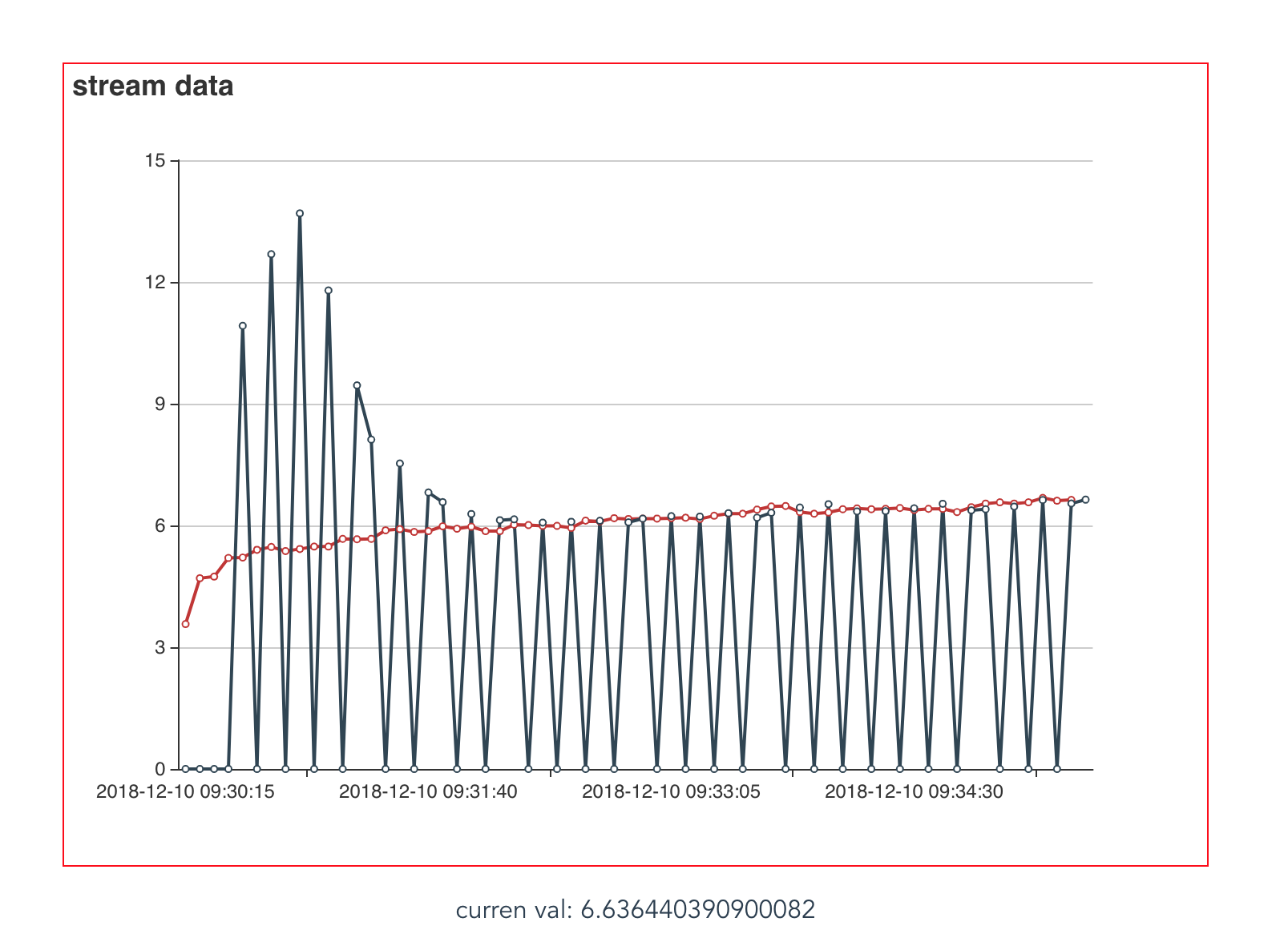
Problems & Potential Improvements
Processing Performance
Data Caching - Kafka
Reduce time cost of each interval - Structrued Streaming
Reduce the chance of prediction skip.
Should running in cluster instead of local machine.
Model Output & Accuracy
Longer prediction distance. - future 30s or more
More and better feature engineering
Model variety
Integrate with more advanced ML algorithms
Other Features
Model / Result Evaluations
Historical Data Modeling & Streaming inference
Configurable Models & Parameters
Notes:
Because this is quite a big system, there are still many problems to solve. For example, you can see the graph in the right. The red line is the real trend while the black is the prediction. You see there are many missing points on the prediction value, and it is quite regular. That’s because we are just testing the system on our own computer, the processing speed cannot catch up the coming data, which will result in the jump on prediction value. To solve this, one is using a real cluster rather than PCs, another is using Kafka to do the data caching. However, the later one may result in to delay on prediction speed.

Slide 28
“Predict The Unpredictable”
- USTWolf
Notes:
One more thing, this is the slogan of our team & product. -- Predict The Unpredictable

Slide 29
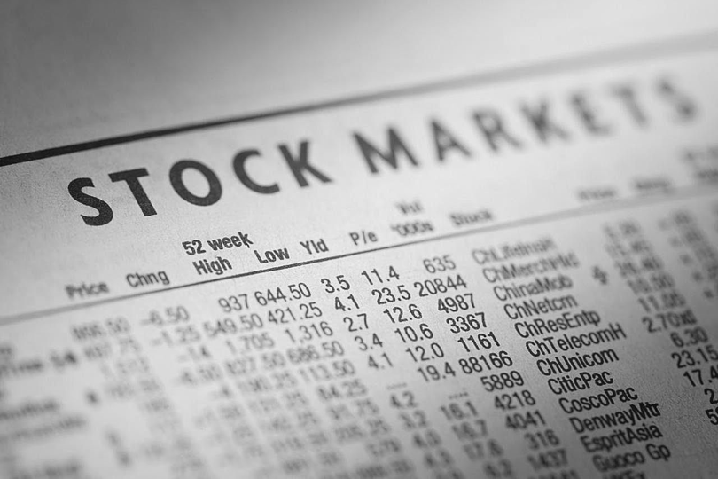
Thanks!
Code Link:
https://github.com/cchencool/real-time-stock-analysis-platform
Notes:
Thank you, that’s all.

