Slide 1
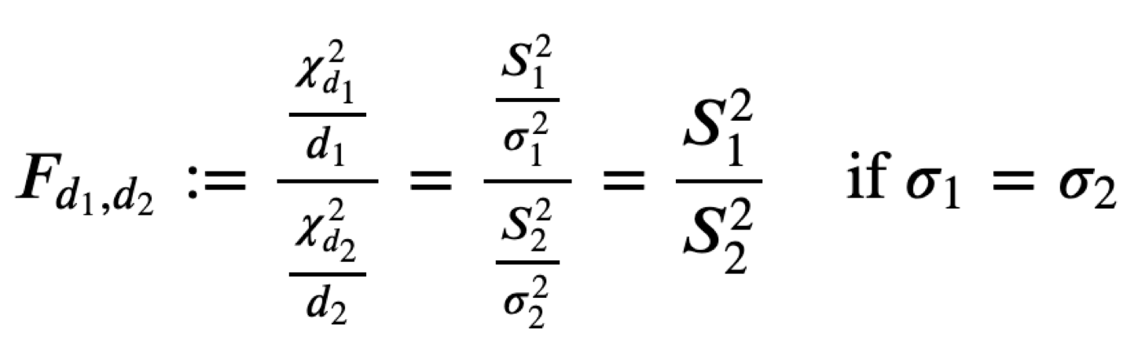

F Test

Slide 2
F Test
Two-Tail Test
One-Tail Test

Slide 3
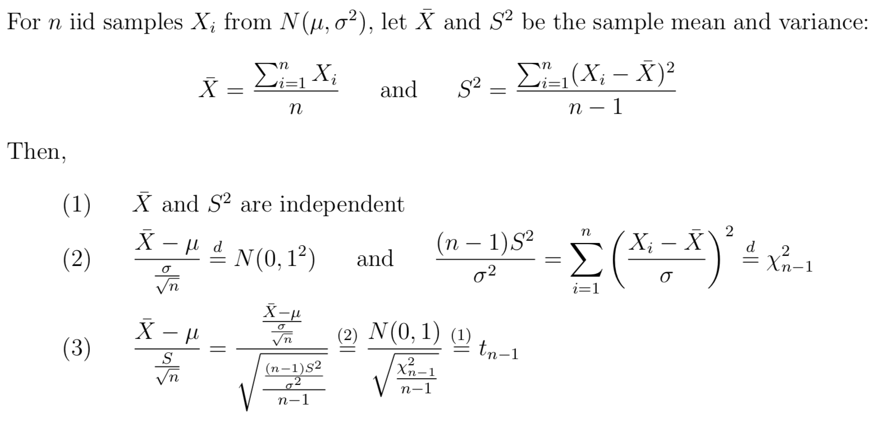

Slide 4
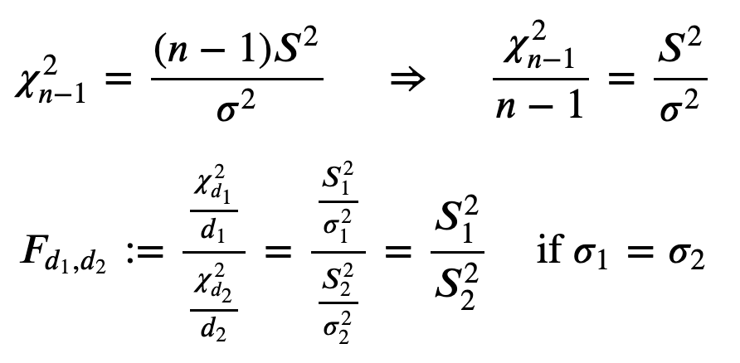

Slide 5
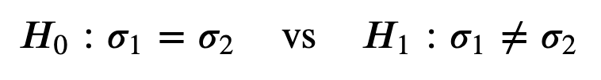
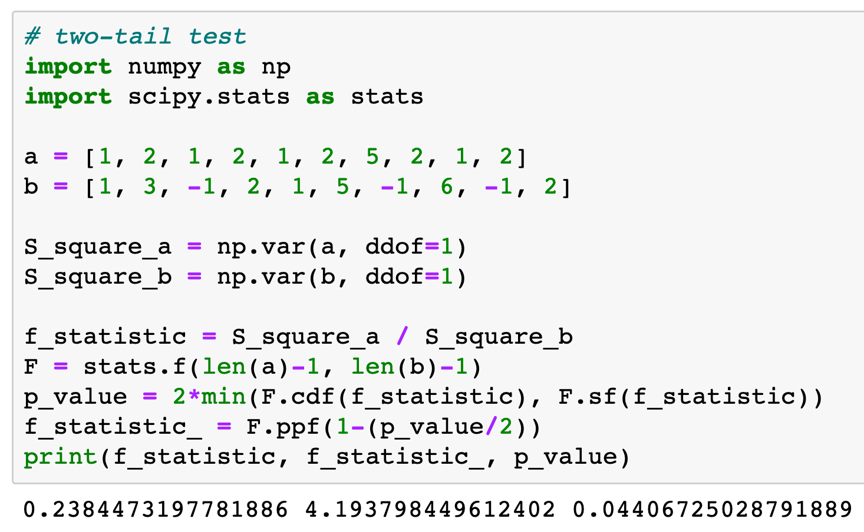
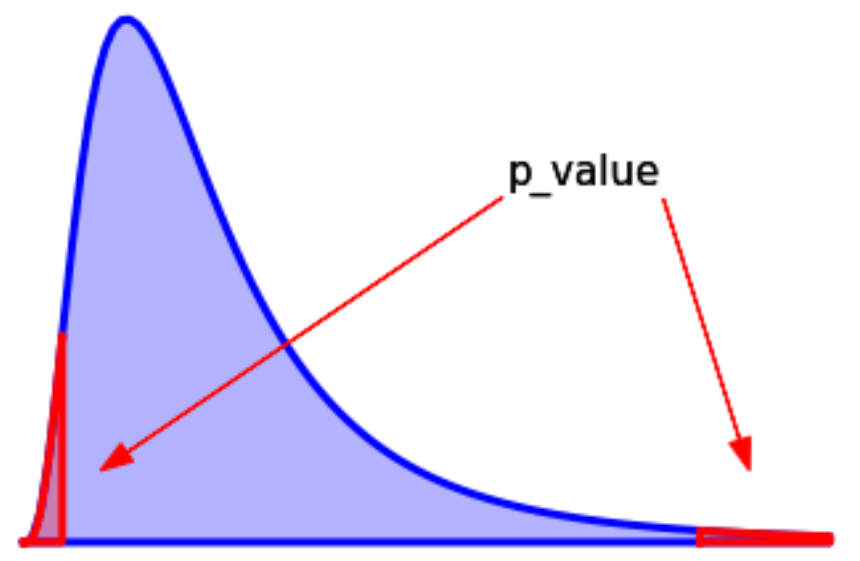
Two-Tail Test

Slide 6

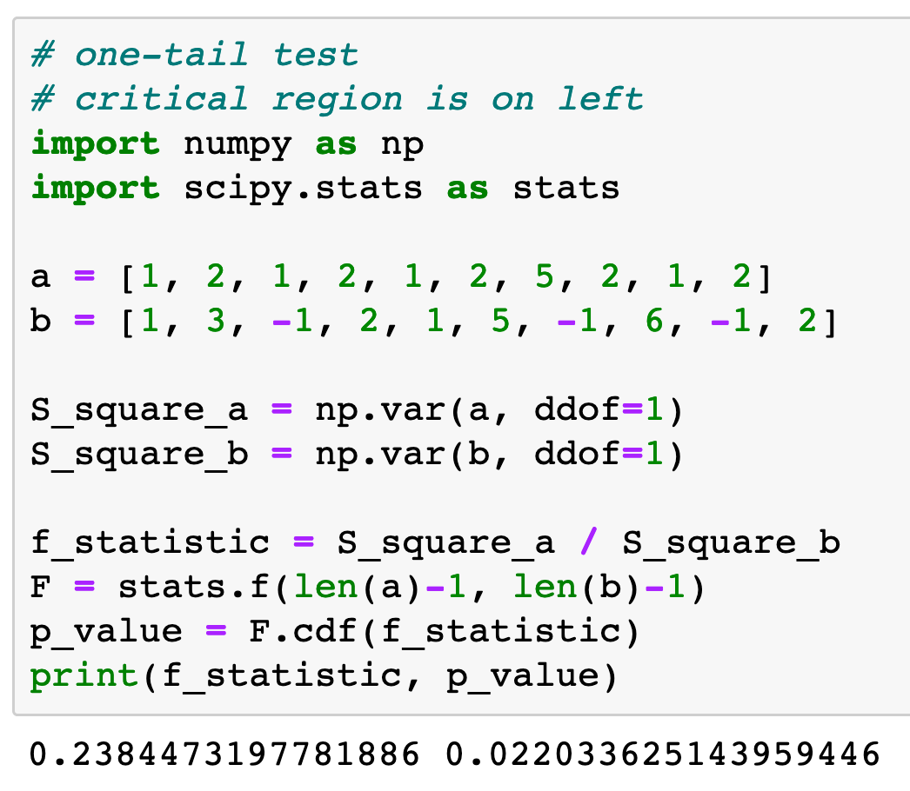
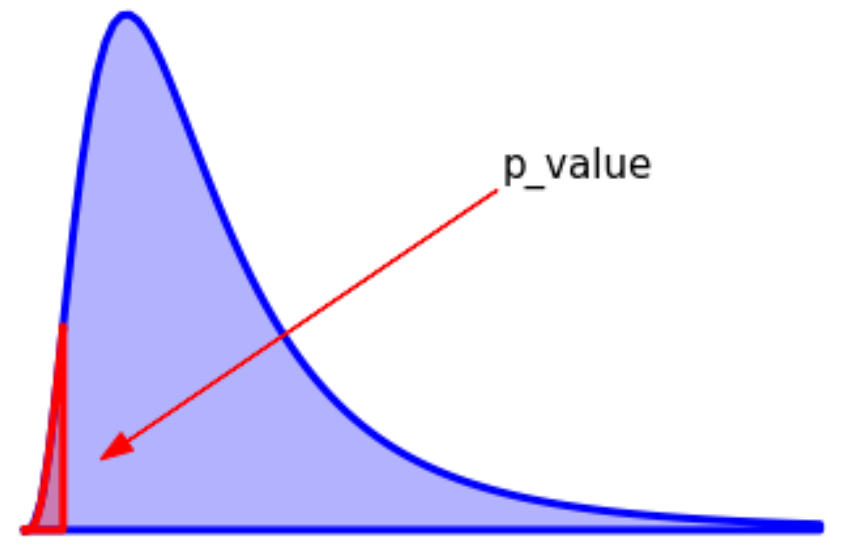
One-Tail Test

Slide 7

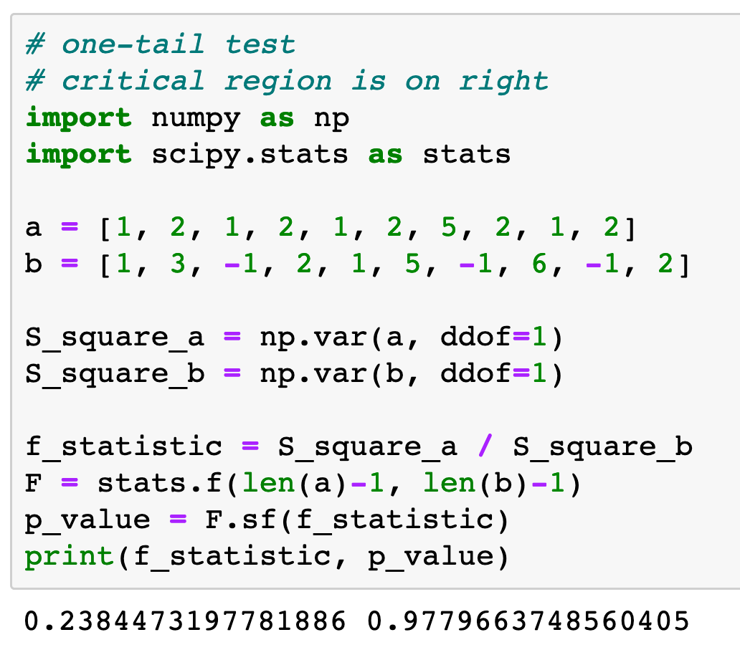
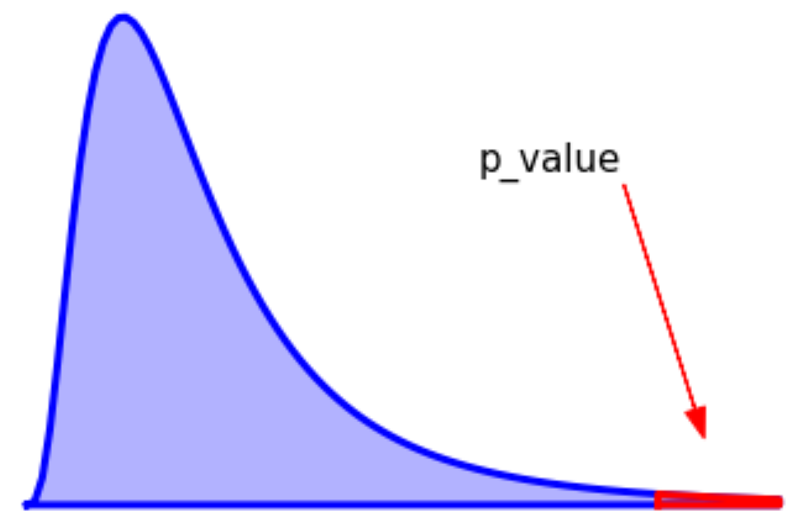
One-Tail Test

Slide 8
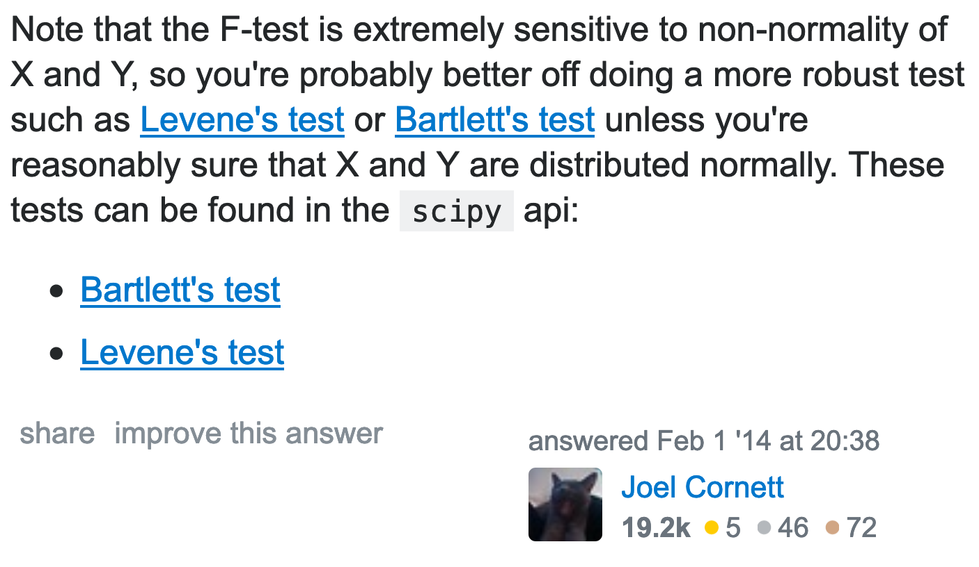
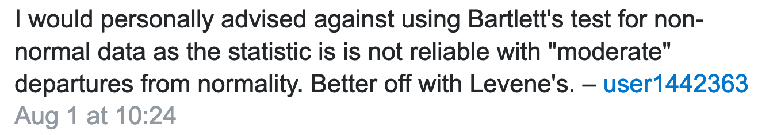
https://stackoverflow.com/questions/21494141/how-do-i-do-a-f-test-in-python

Slide 9
Levene’s Test

Slide 10
Equal Variance Test
Normal ?
Yes
No
F Test
Levene’s Test

Slide 11
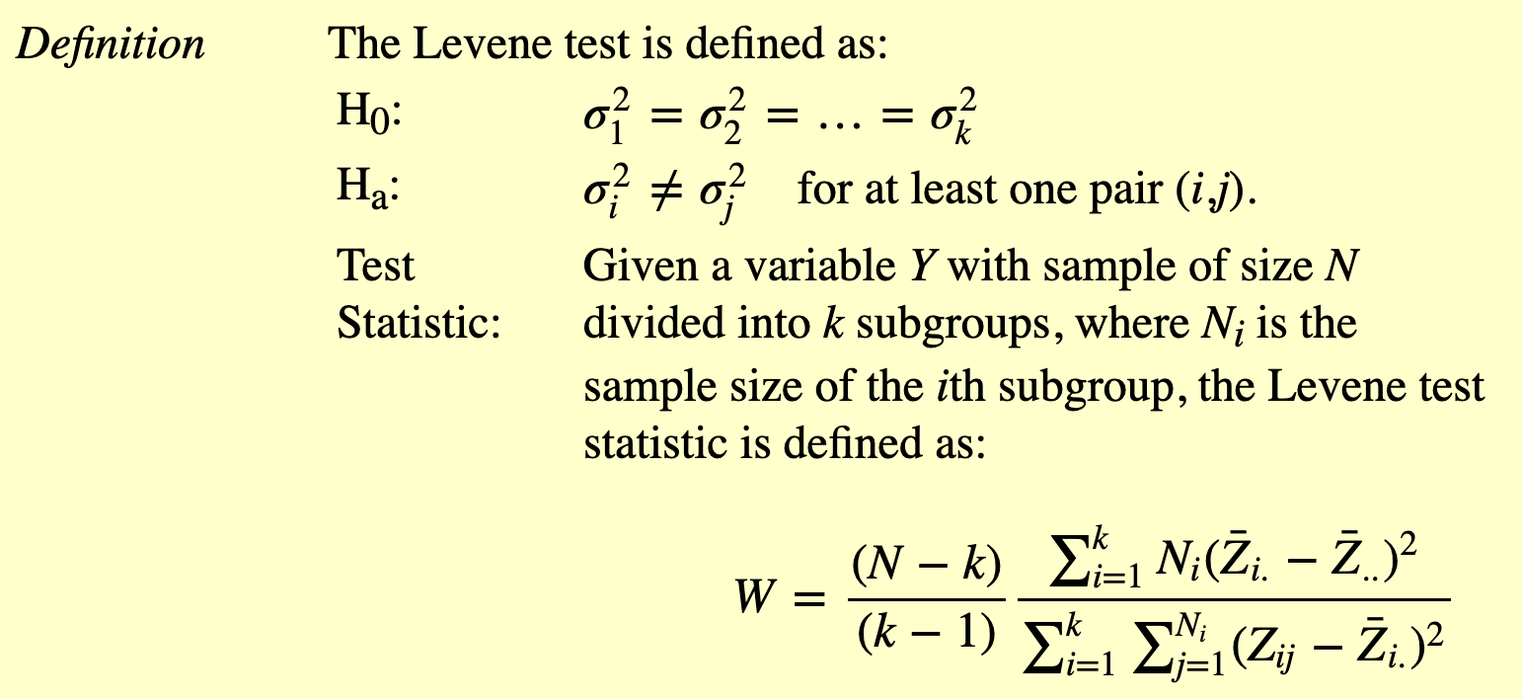
https://www.itl.nist.gov/div898/handbook/eda/section3/eda35a.htm

Slide 12
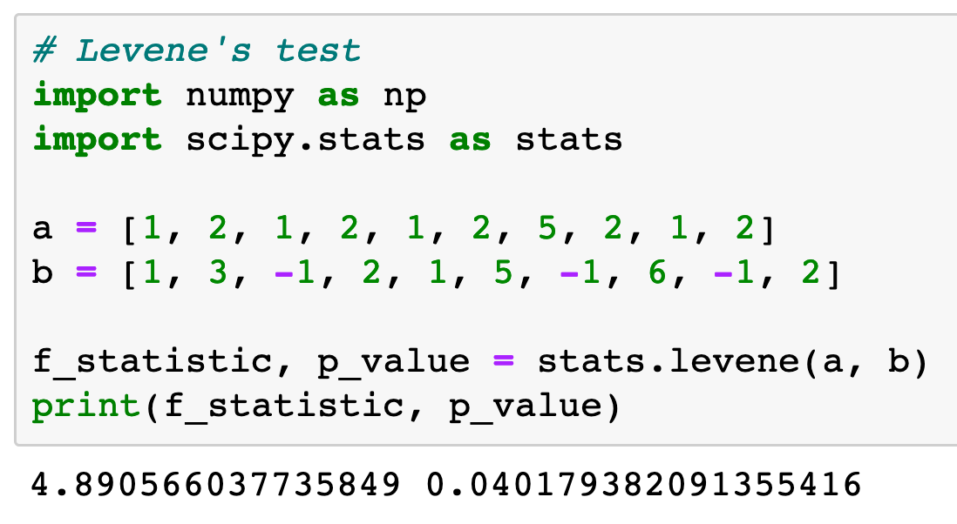
Levene's Test

