Slide 1
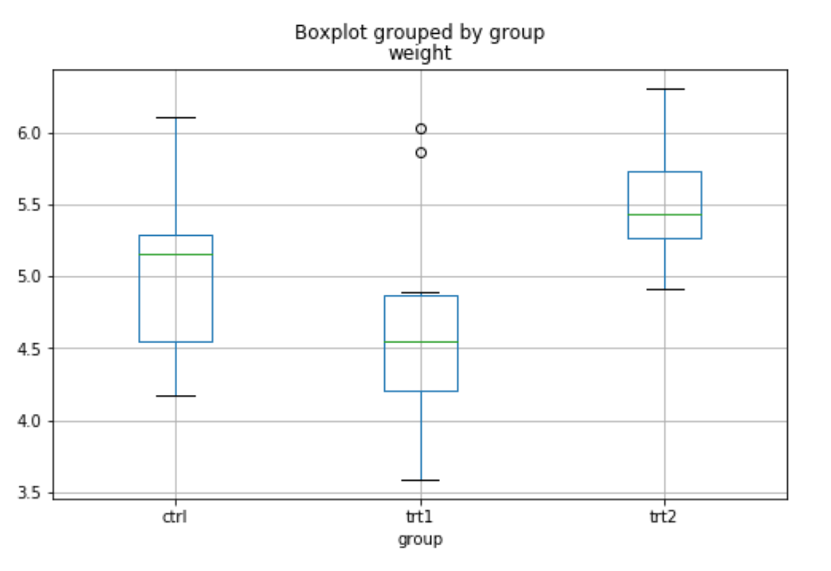
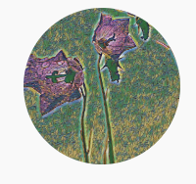
ANOVA

Slide 2
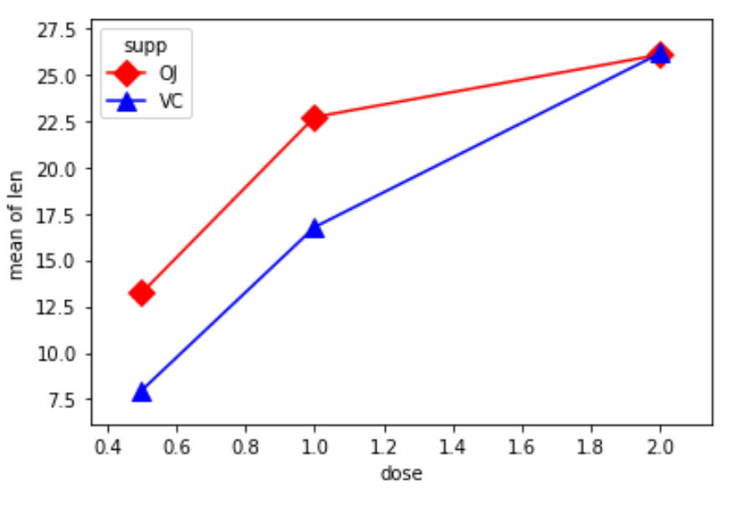
One-Way ANOVA Two-Way ANOVA

Slide 3

One-Way ANOVA

Slide 4
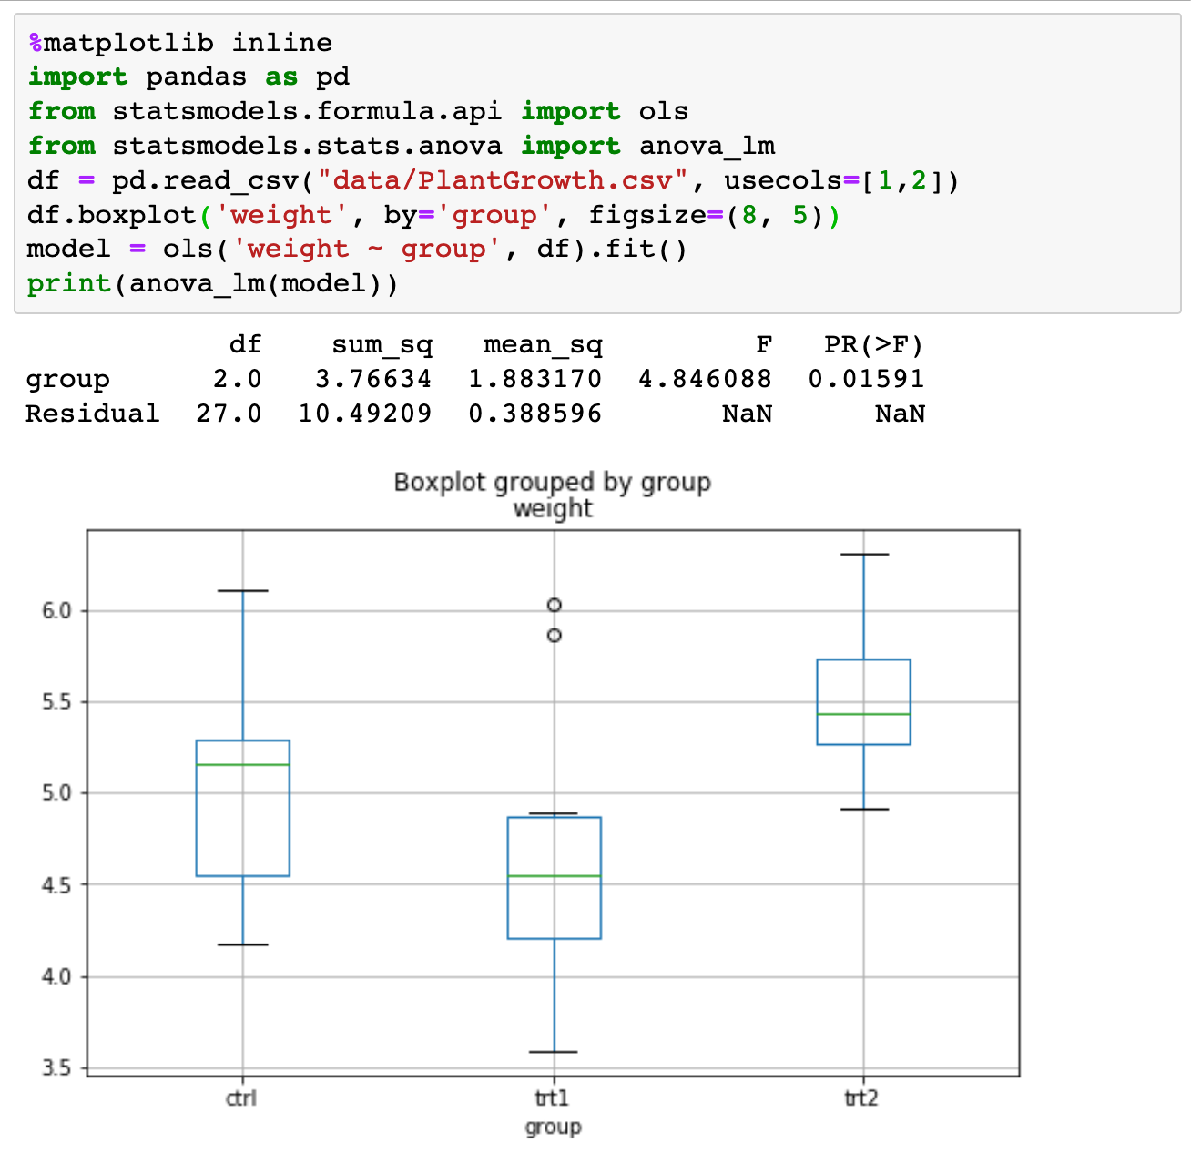

Slide 5

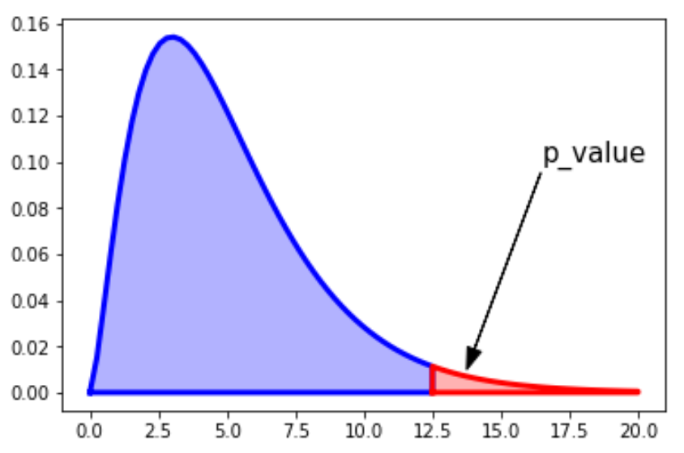


Slide 6

Two-Way ANOVA

Slide 7
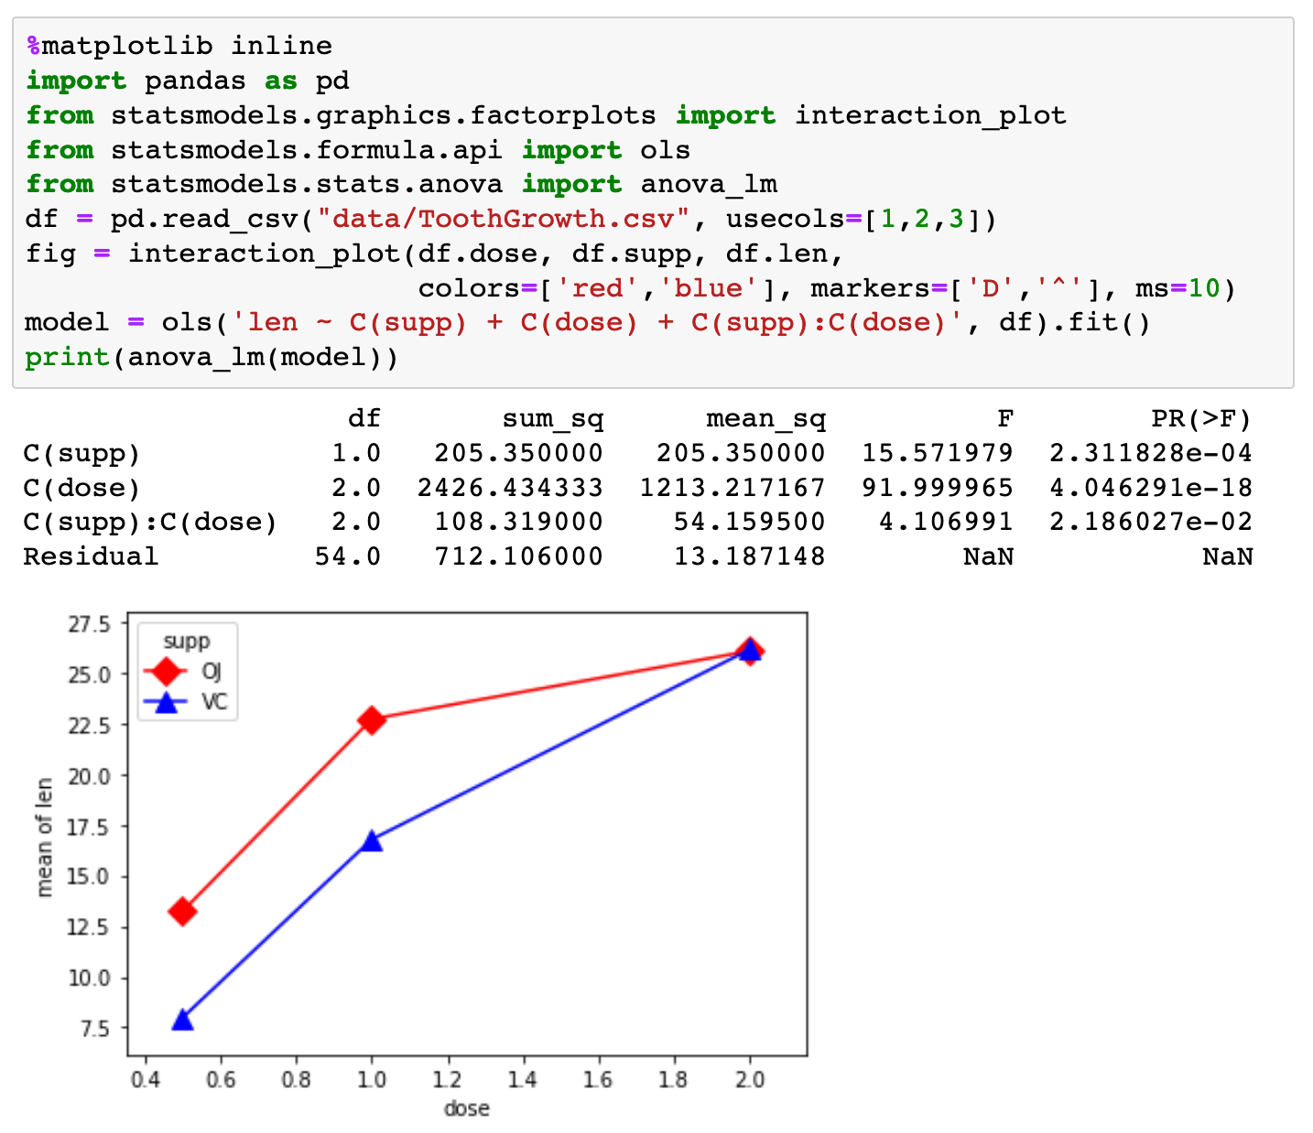

Slide 8




