Slide 1

Problems on Confidence Interval 2004

Slide 2
Reference
Data
Youtube
Code

Slide 3
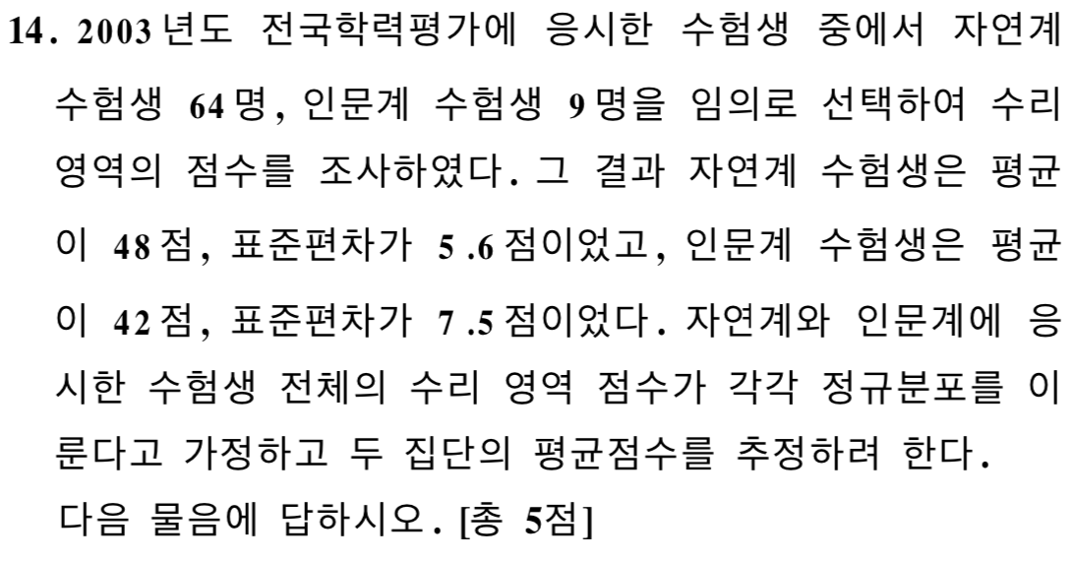
[2004]

Slide 4
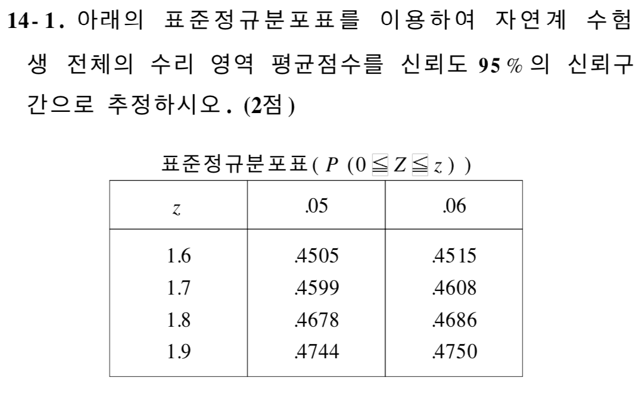
[2004]

Slide 5
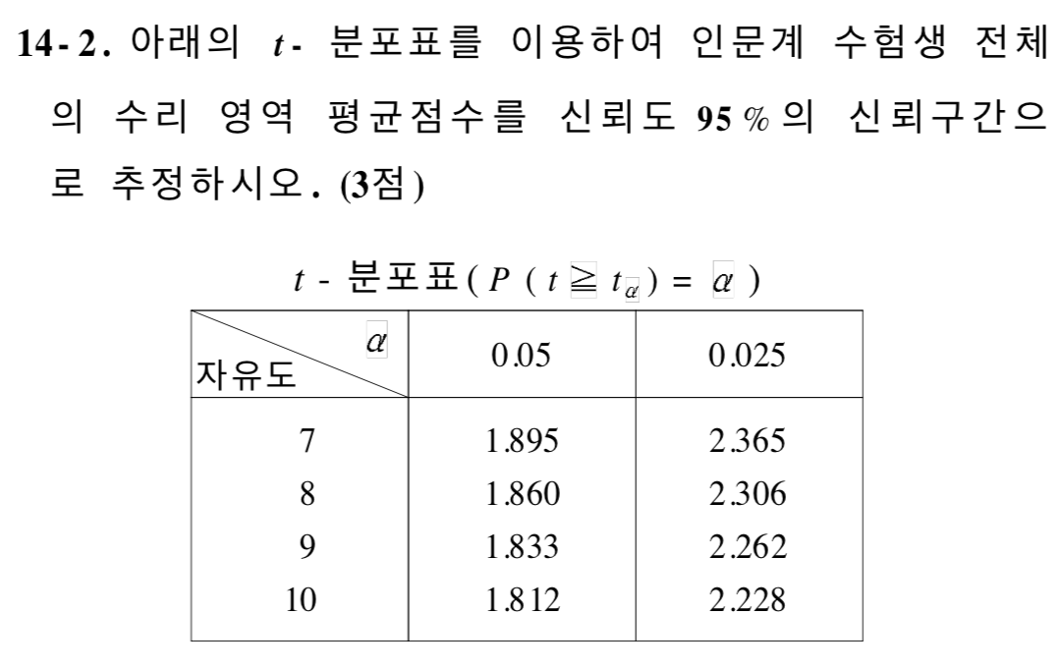
[2004]

Slide 6


Slide 7
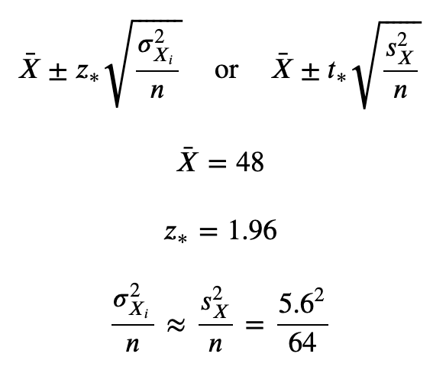


Slide 9
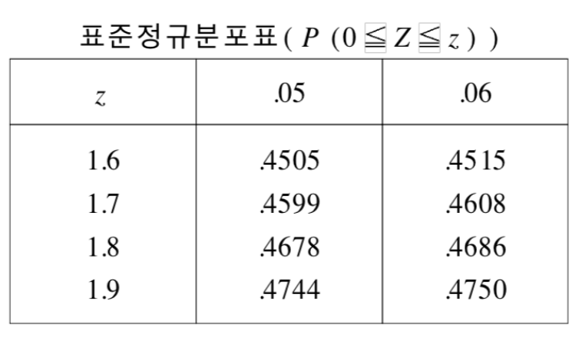

Slide 13

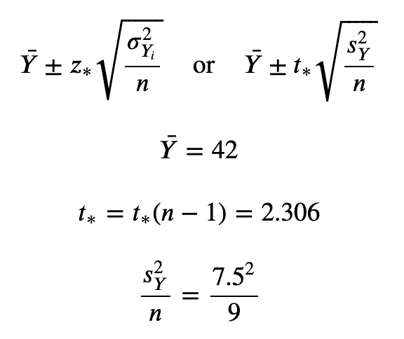

Slide 16
