Slide 1

Problems on Confidence Interval

Slide 2
Reference
Data
Youtube
Code

Slide 3
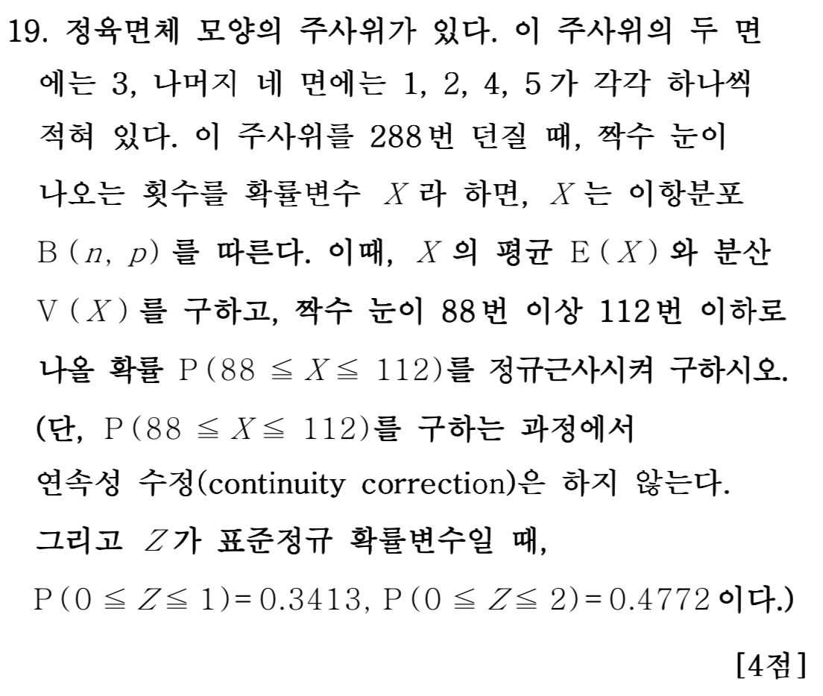
[2006]

Slide 4
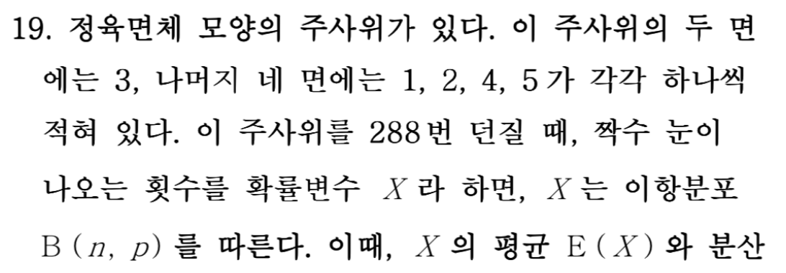



Slide 7
