Slide 1

Problems on Confidence Interval 2019

Slide 2
Reference
Data
Youtube
Code

Slide 3
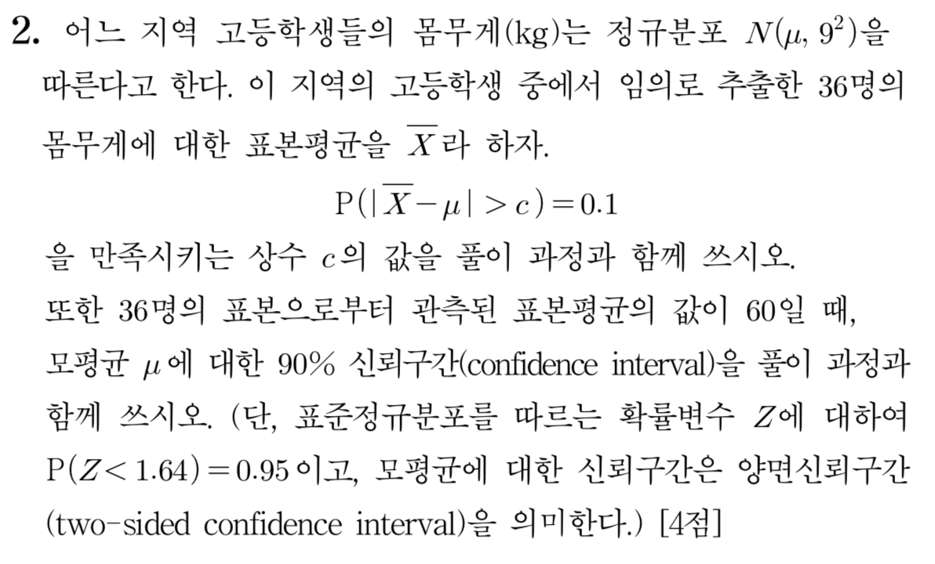
[2019]

Slide 4
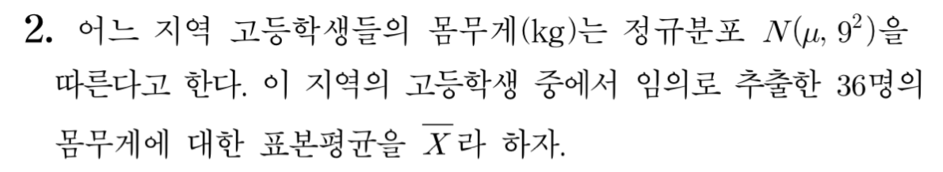

Slide 5
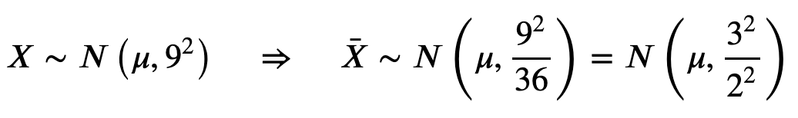

Slide 8


Slide 9
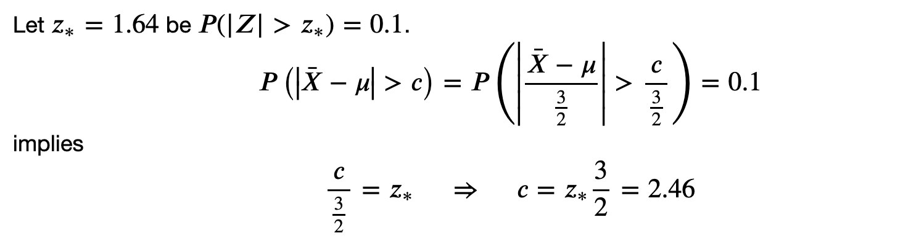


Slide 13
