Slide 1

Normality Test

Slide 2
Figure
Histogram
QQ Plot

Slide 3
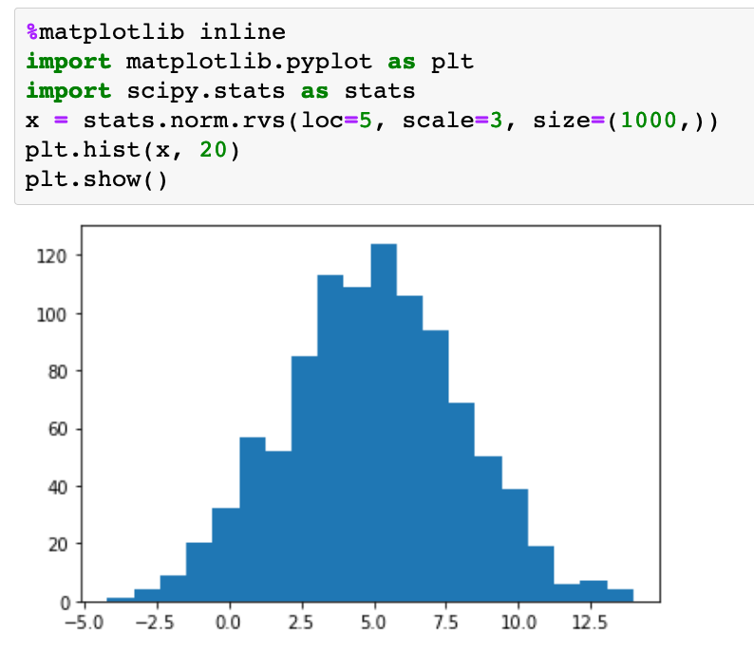
Histogram

Slide 4
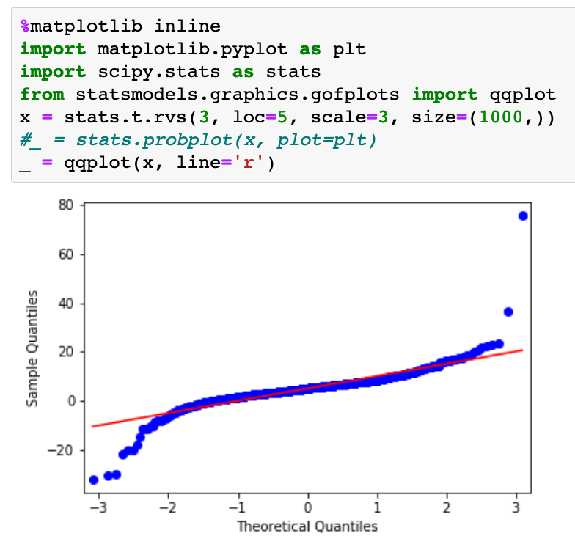
QQ-Plot

Slide 5
Skewness and Kurtosis Test
Skewness Test
Kurtosis Test

Slide 6
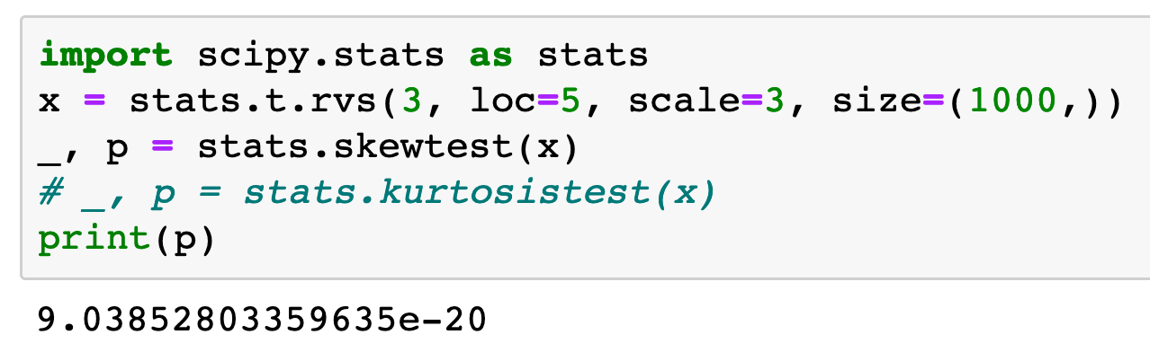
Skewness Test

Slide 7
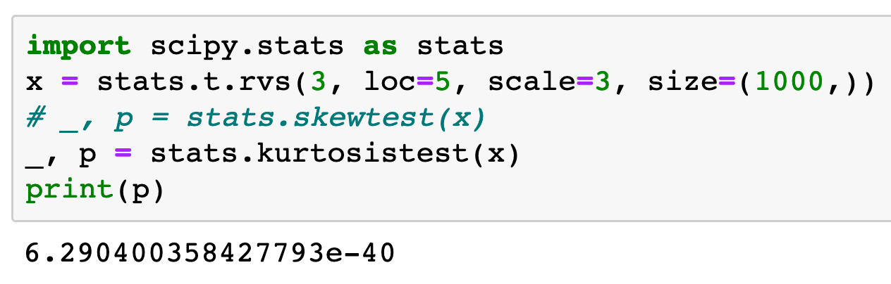
Kurtosis Test

Slide 8
Test
D’Agostino-Pearson
Jarque-Bera
Shapiro-Wilk
Kolmogorov-Smirnov

Slide 9
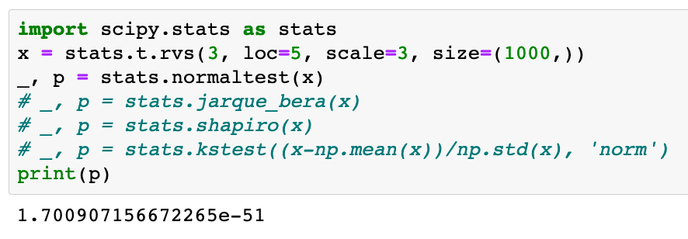
D’Agostino-Pearson

Slide 10
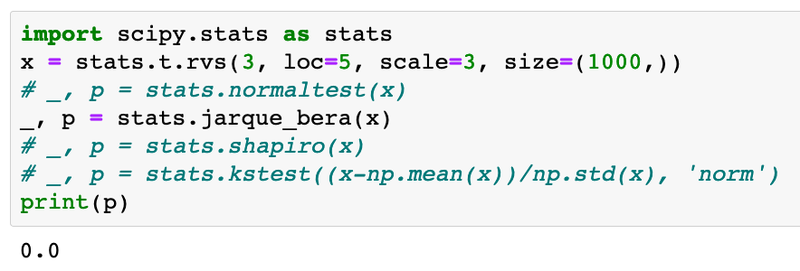
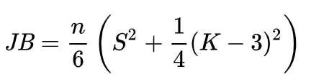
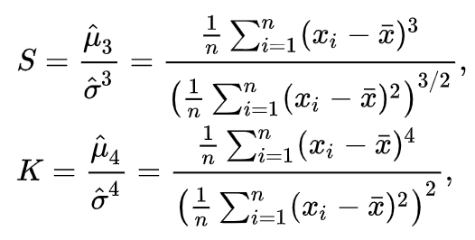
Jarque-Bera

Slide 11
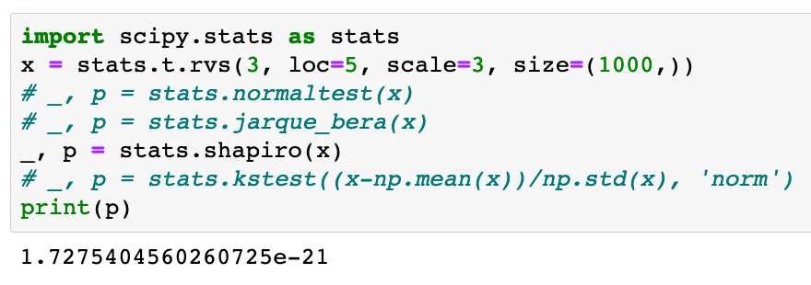
Shapiro-Wilk

Slide 12
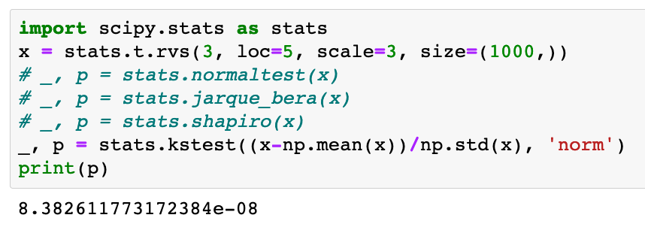
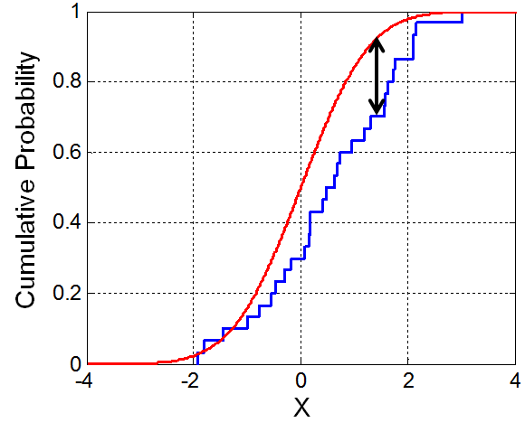
Kolmogorov-Smirnov

