Slide 1

Chi-Square Test

Slide 2
Three Chi-Square Tests
Goodness of Fit
Independence
Homogeneity

Slide 3
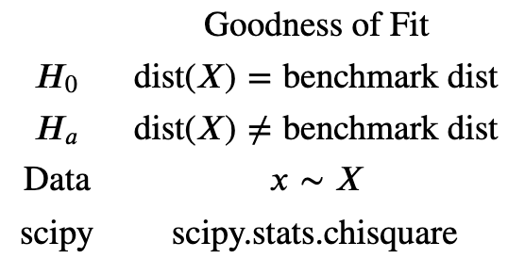

Slide 4
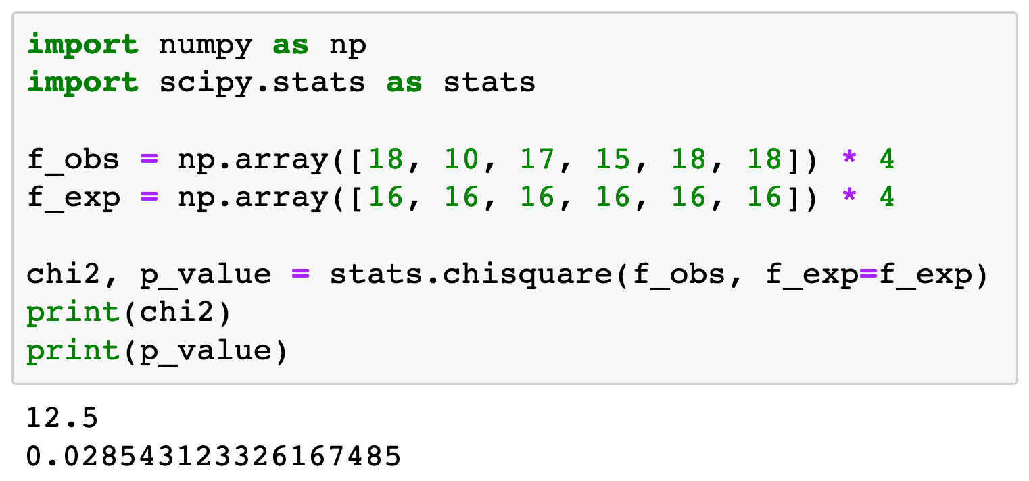

Slide 5


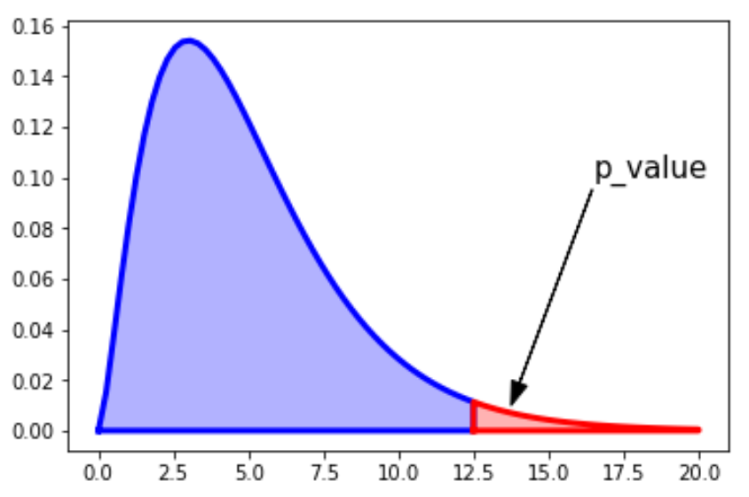


Slide 6

Conditions for Goodness of Fit

Slide 7


Slide 8
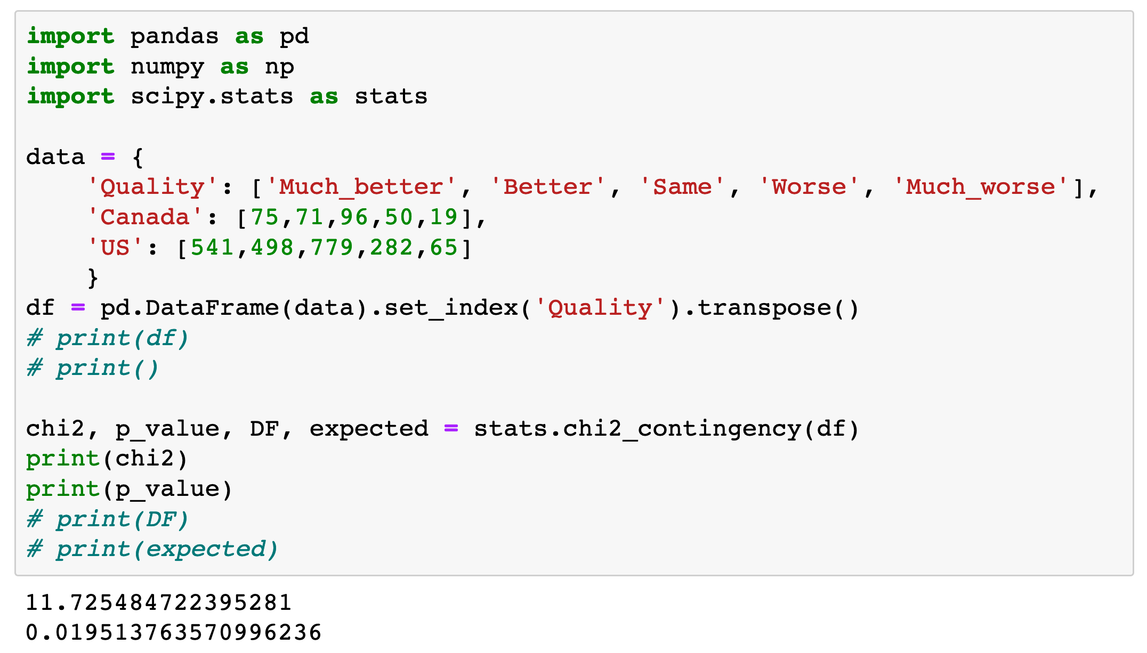

Slide 9



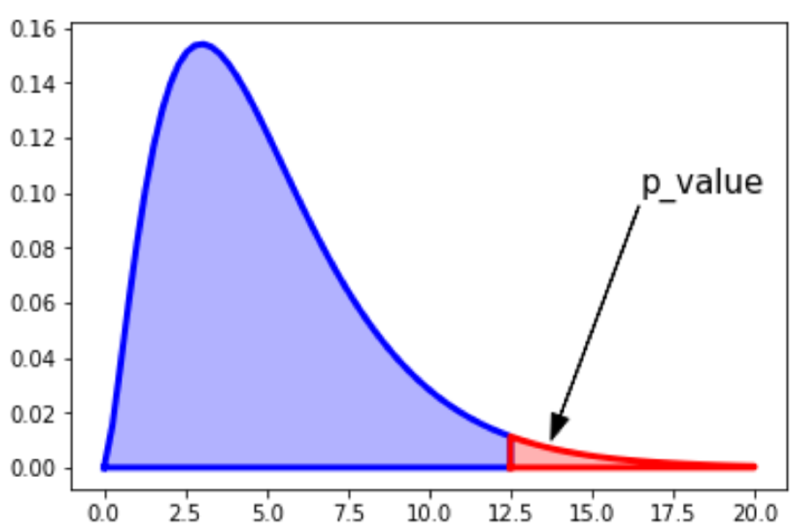


Contingency Table
or df
df_expected

Slide 10

Conditions for Homogeneity

Slide 11


Slide 12
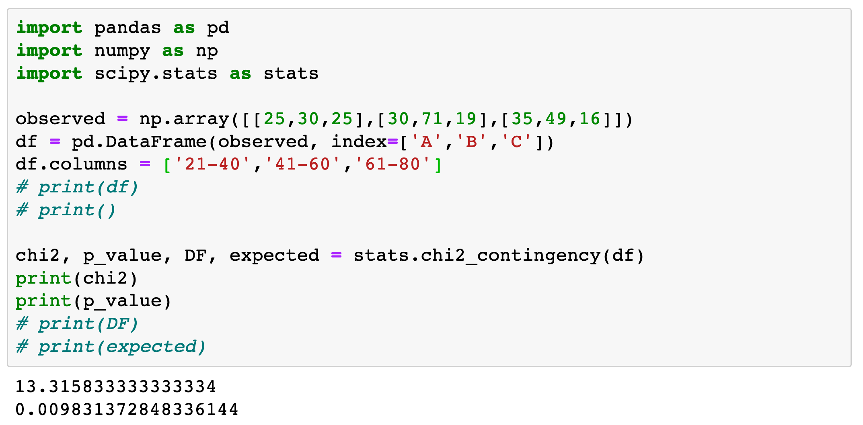

Slide 13
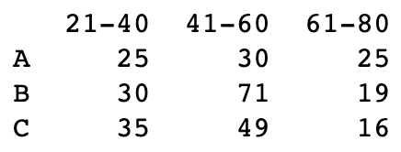

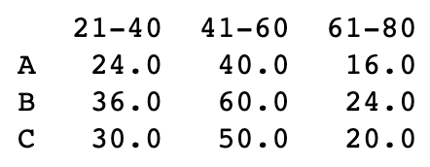
Contingency Table
or df
df_expected

Slide 14
Conditions for Independence

