Slide 1

Testing

Slide 2
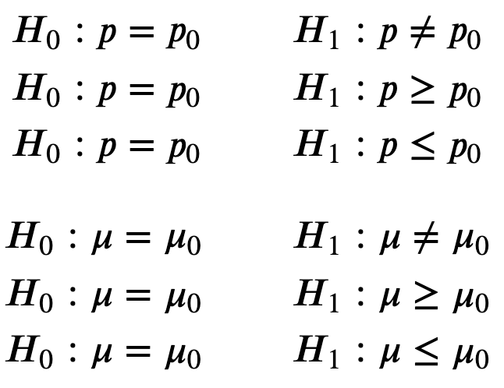
H0 vs H1

Slide 3
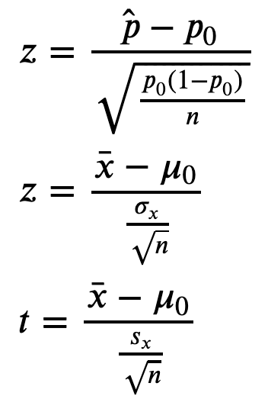
When to use z or t test

Slide 4
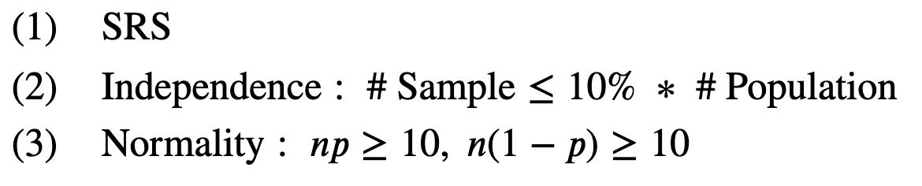
Conditions for a z test about p

Slide 5
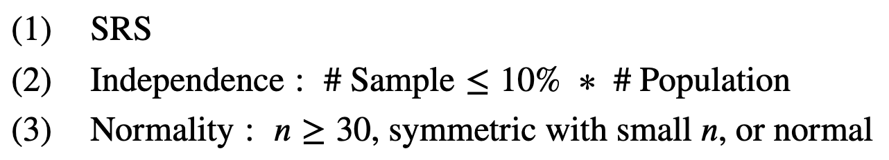

Conditions for a test about $μ$

Slide 6
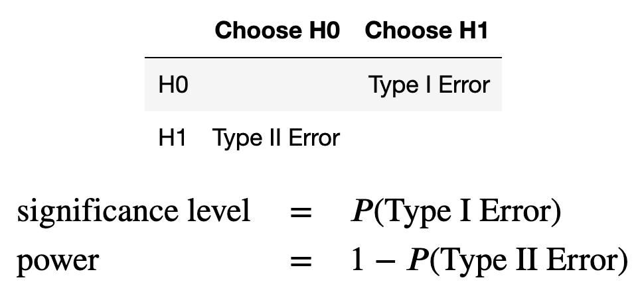
Type I and II Error

Slide 7
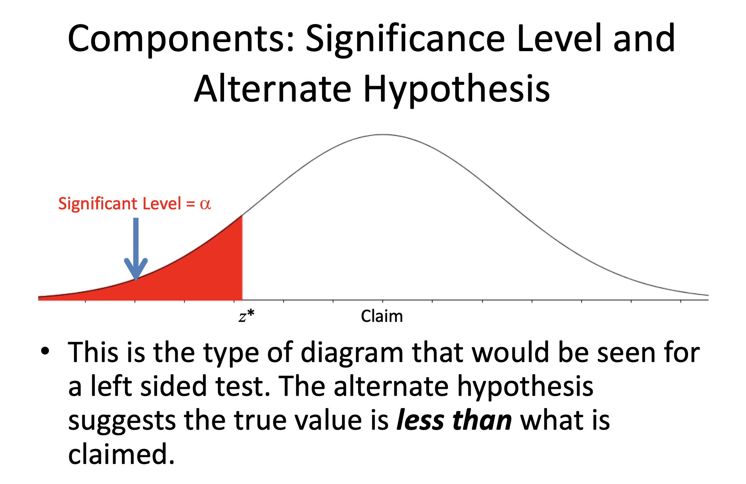
significance level and critical value
https://www.slideshare.net/JeremyLane3/hypothesis-testing-47094061?from_action=save

Slide 8
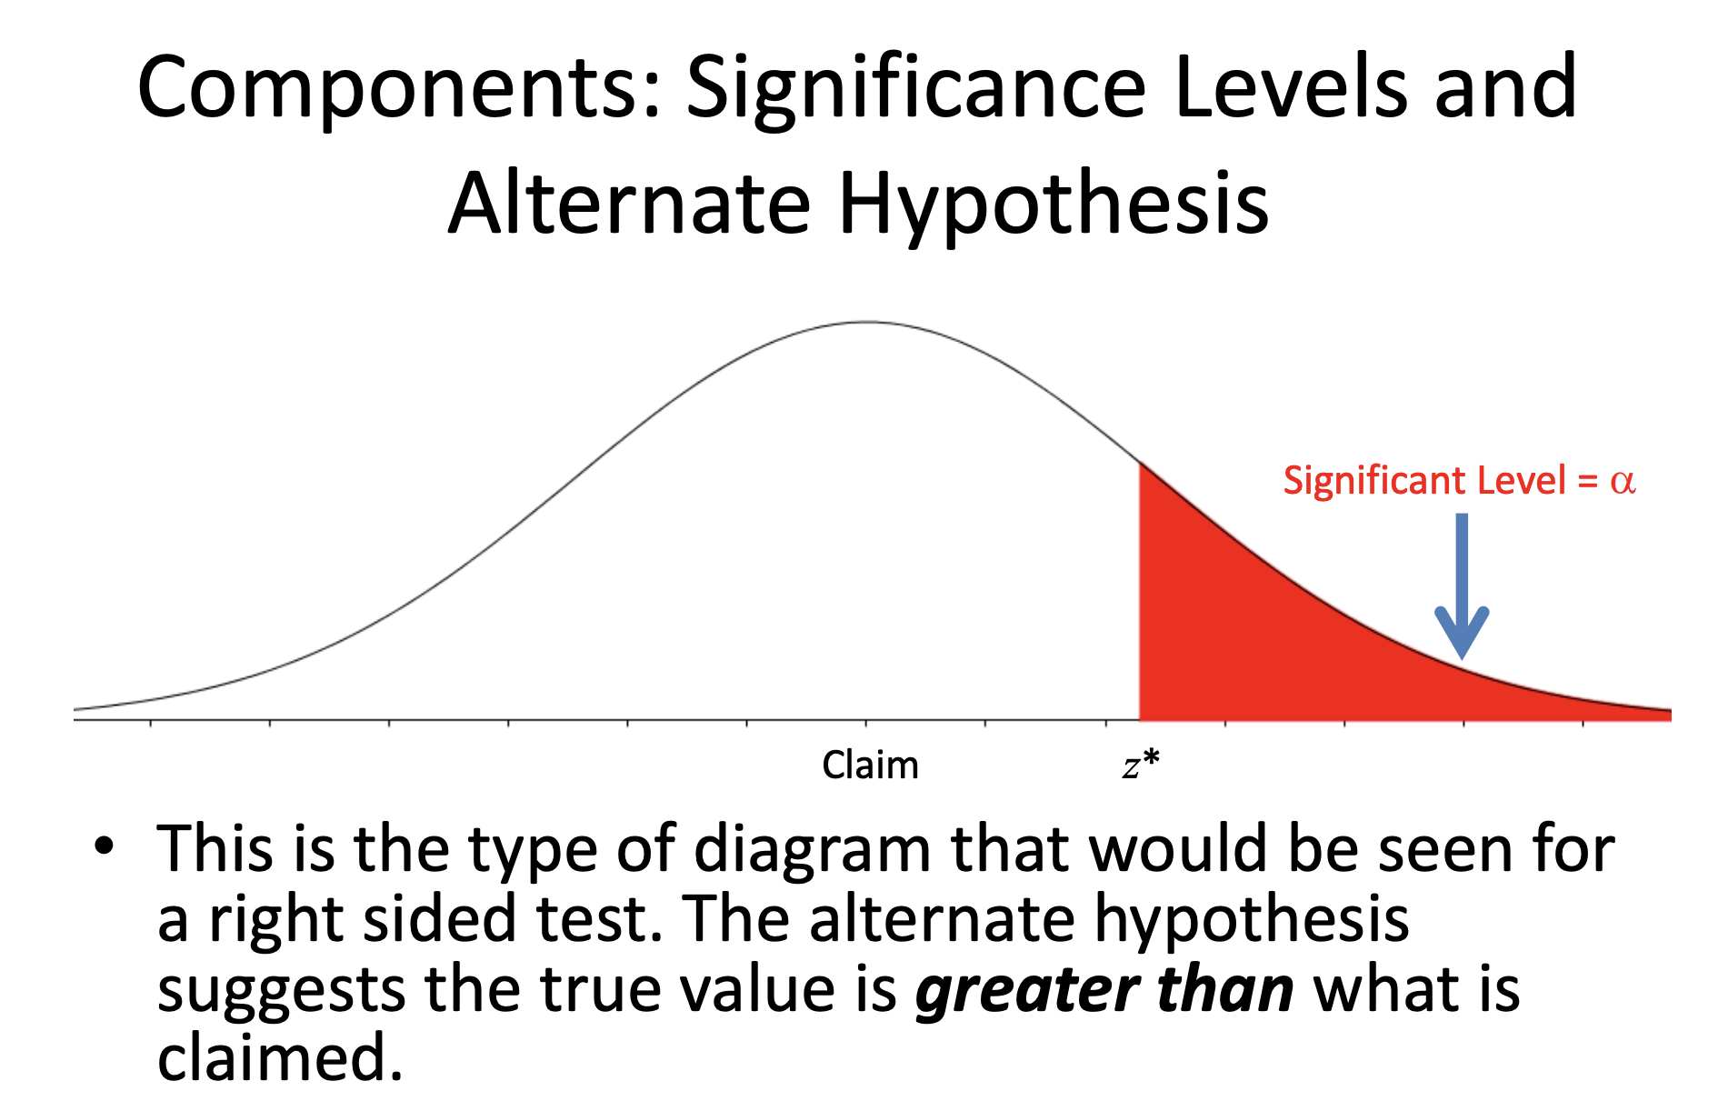
significance level and critical value
https://www.slideshare.net/JeremyLane3/hypothesis-testing-47094061?from_action=save

Slide 9
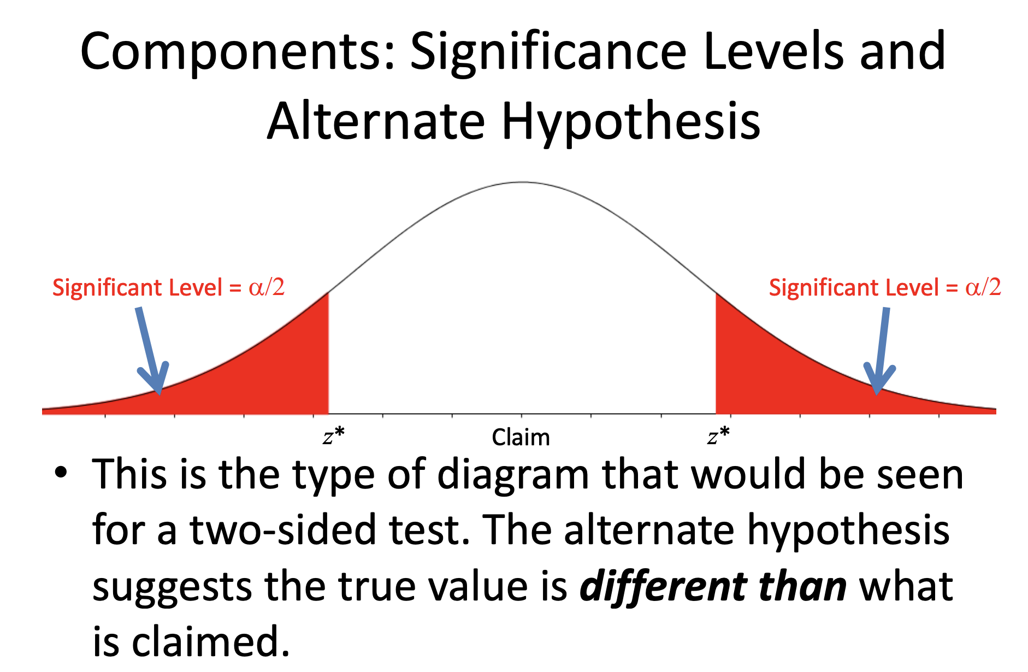
significance level and critical value
https://www.slideshare.net/JeremyLane3/hypothesis-testing-47094061?from_action=save

Slide 10
p-value

Slide 11
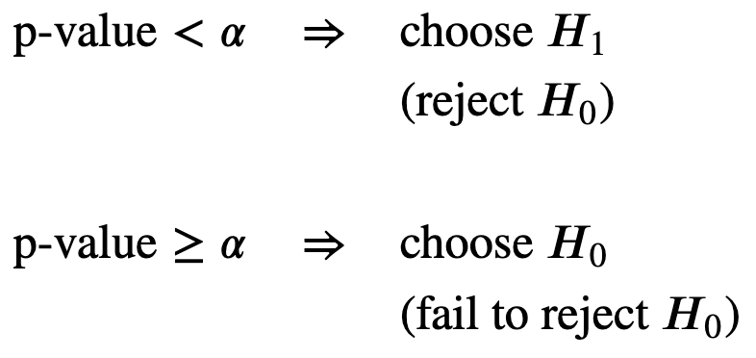
p-value and significance level

Slide 12
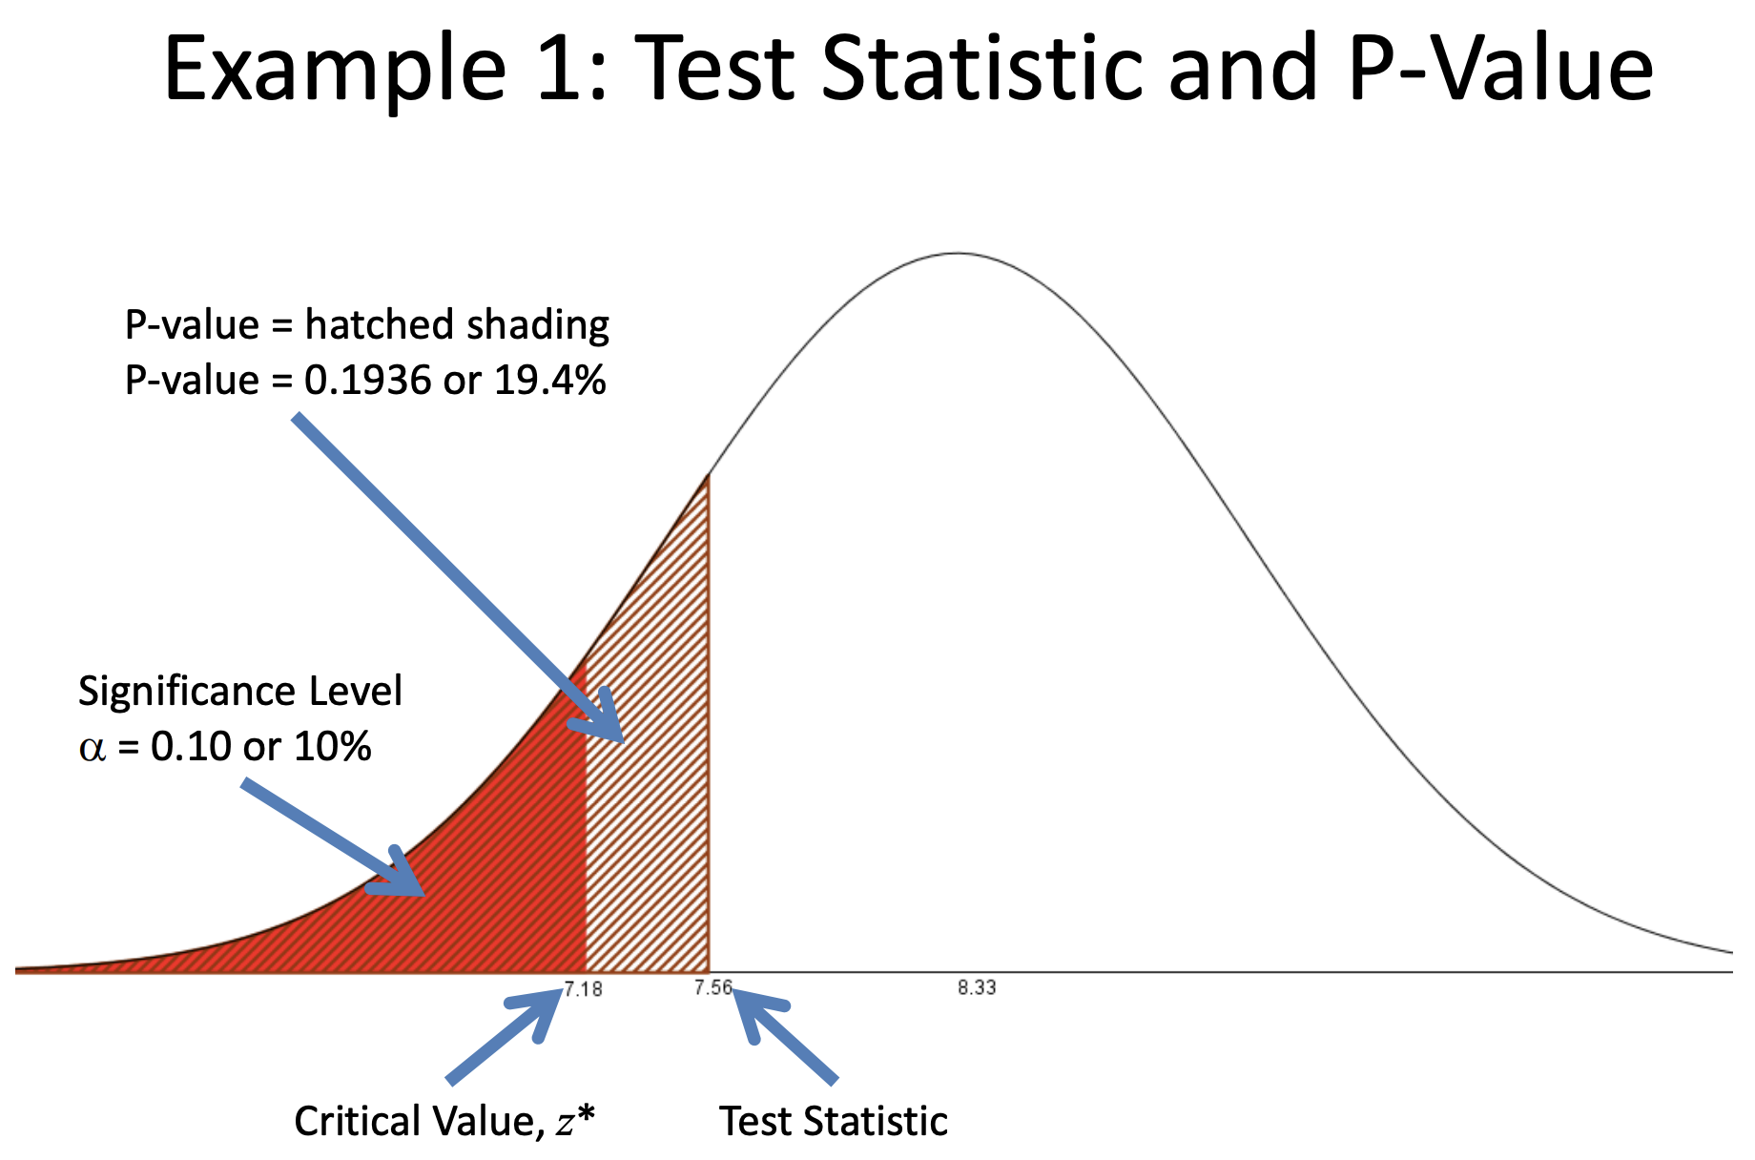
https://www.slideshare.net/JeremyLane3/hypothesis-testing-47094061?from_action=save

Slide 13
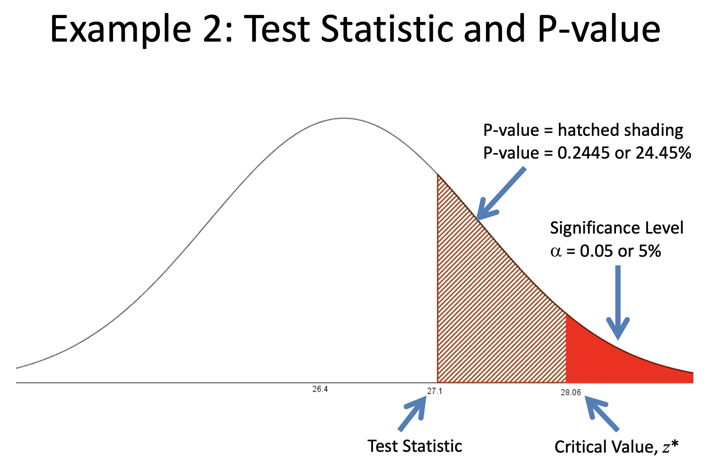
https://www.slideshare.net/JeremyLane3/hypothesis-testing-47094061?from_action=save

Slide 14
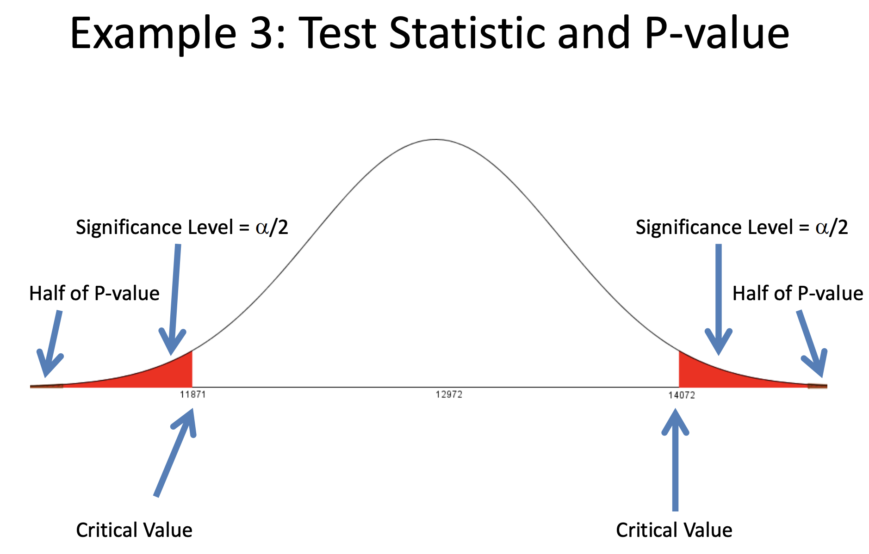
https://www.slideshare.net/JeremyLane3/hypothesis-testing-47094061?from_action=save

Slide 15
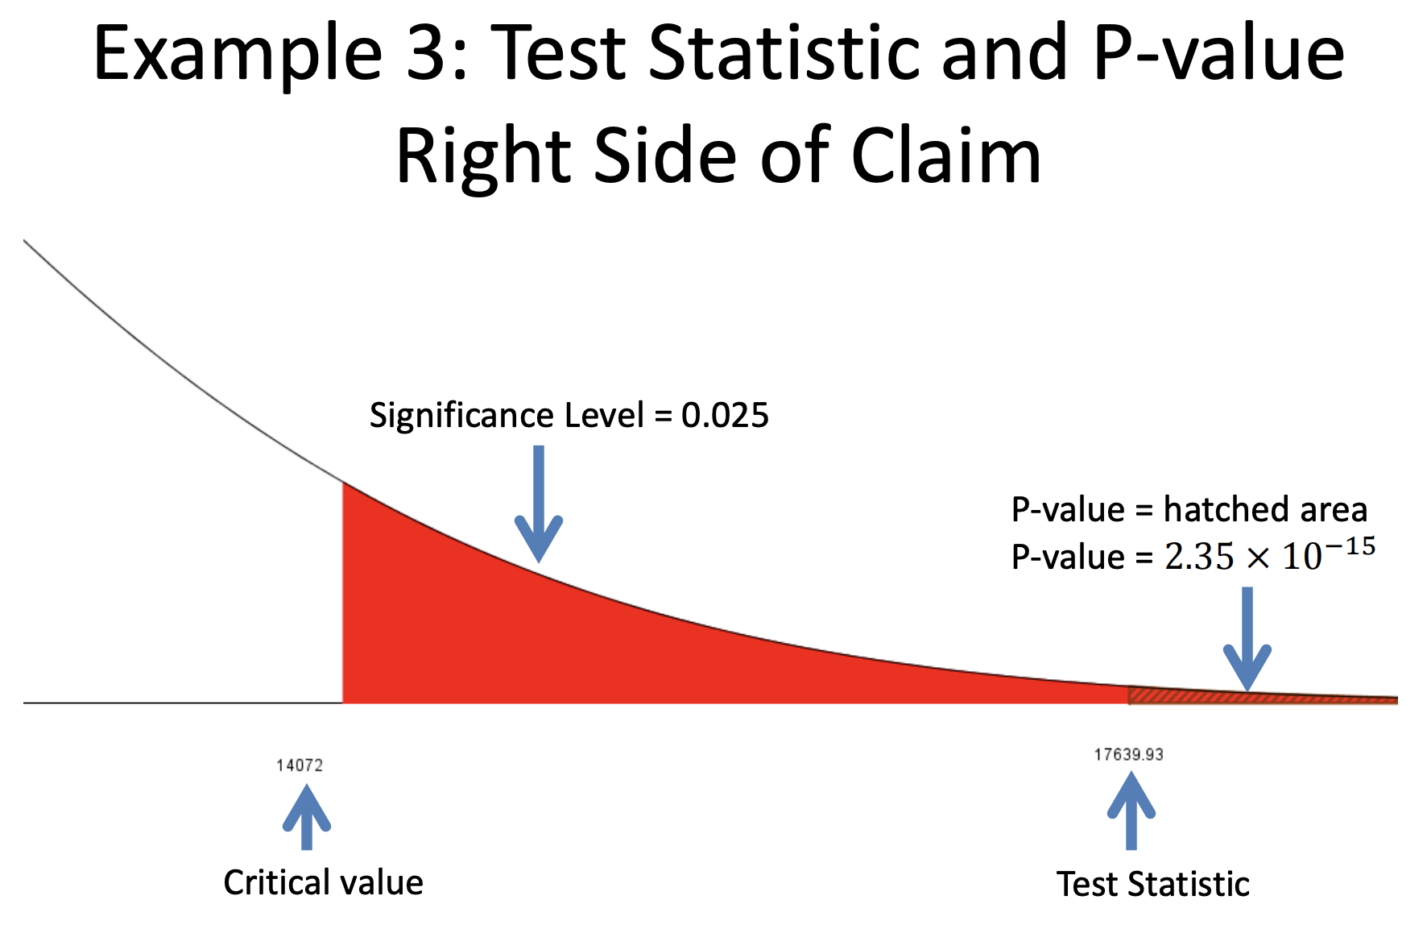
https://www.slideshare.net/JeremyLane3/hypothesis-testing-47094061?from_action=save

Slide 16
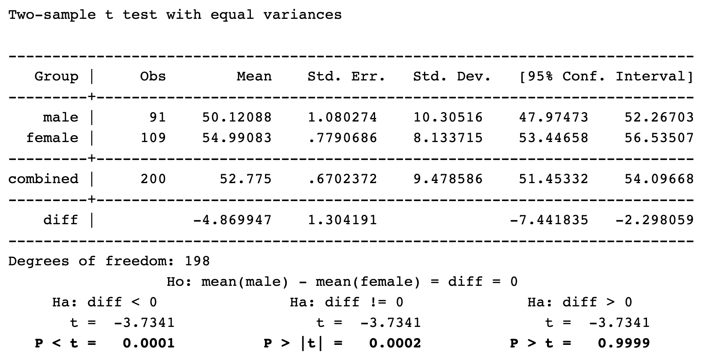
https://stats.idre.ucla.edu/other/mult-pkg/faq/general/faq-what-are-the-differences-between-one-tailed-and-two-tailed-tests/

Slide 17
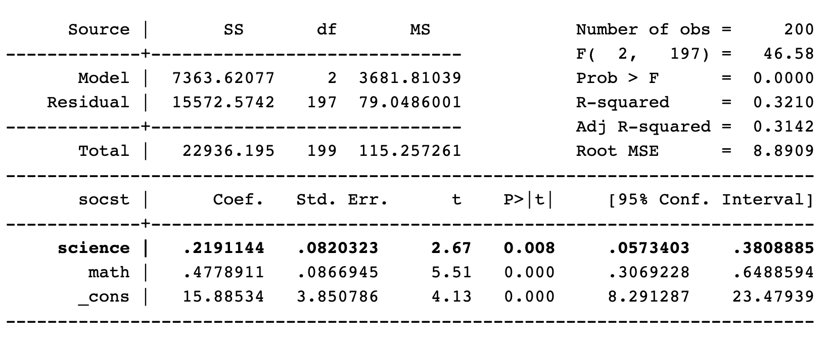
https://stats.idre.ucla.edu/other/mult-pkg/faq/general/faq-what-are-the-differences-between-one-tailed-and-two-tailed-tests/

