Slide 1
Review
June, 2024

Slide 2
Evaluation
Final exam: 60%
Lab reports: 20%
Homework: 20%

Slide 3
About the final exam
Time: 14:00-16:00, June 13, 2024
Place: 27-301/302
Scope: ch1-ch13
8 pages
Multiple Choice（单选）: 2points * 5
True/False: 2points * 5
Analysis and Short Answer: 10points * 3
Basic Algorithm: 10points * 3
Design and Programming: 20points * 1
Use answer card for multiple-choice & true/false

Slide 4
About weekly assignments and labs
Deadline: 23:59, Jun 13th, 2024

Slide 5
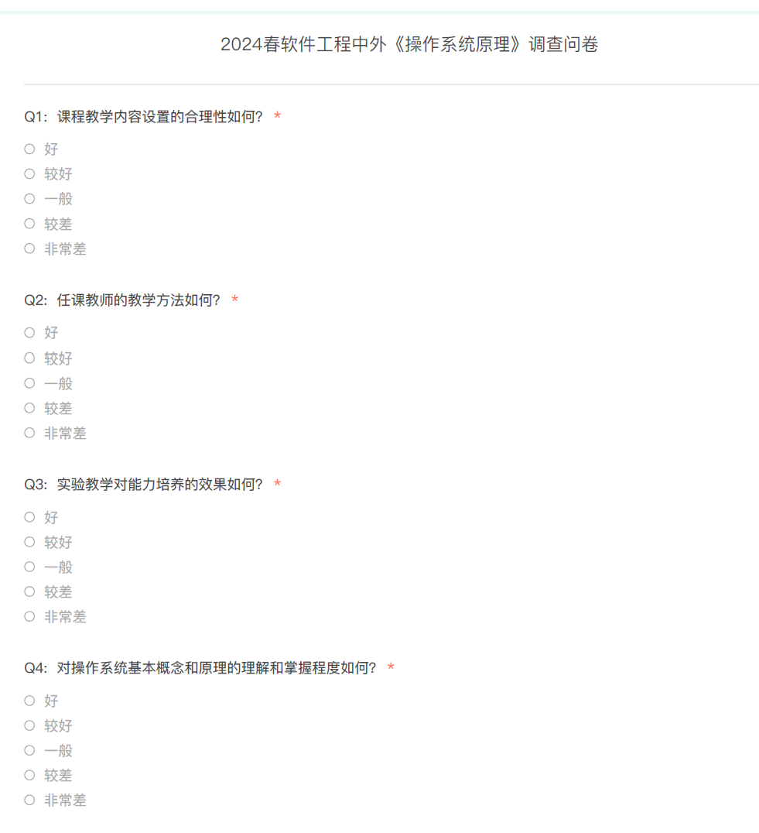
About the OBE Survey
Deadline: 23:59, Jun 25, 2024

Slide 6
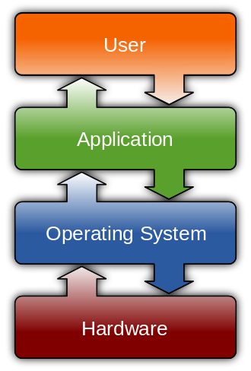
Operating System

Slide 7
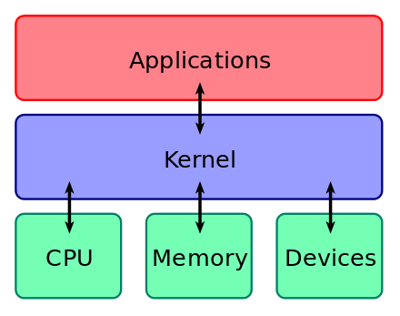
Operating System

Slide 8
Operating System
Concurrency
Virtualization
Sharing
CPU
Memory
Device

Slide 9
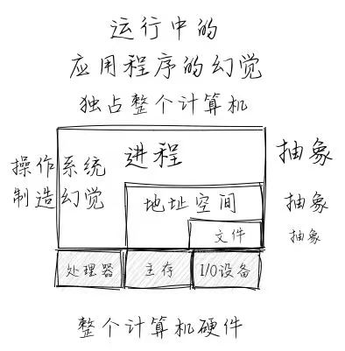
Operating System

Slide 10
Thank you & good luck!

