Slide 1
Lab1-1: Review of C++ C++面向对象编程
September, 2023

Slide 2
Self-introduction
Name: 赵恒军
Position: Software Engineering
Phone: 18302301799
Mail: zhaohj2016@swu.edu.cn

Slide 3
Outline
Classes（类）
Objects（对象）
Inheritance（继承）
Overloading（重载）
Operator（运算符）
Lab Assessment

Slide 4
A Survey
The C++ Programming Language
The Development Toolkit

Slide 5
A Test: Hello World!
Visual Studio
Project

Slide 6
Classes（类）
Fields（域，属性）
data member
Methods（方法，函数）
member function（成员函数）
Constructor（构造器）
Destructor（析构器）

Slide 7
Objects（对象）
An object is an instance of a given class
Object-oriented（面向对象）
Encapsulation（封装）
Inheritance（继承）
Polymorphism（多态）

Slide 8
Data Abstraction（数据抽象）
Data abstraction is about the separation of what a class provides to users from how the class is defined
A user’s code should not access the implementation details of the class used
User’s view vs. developer’s view

Slide 9
User’s view
What information is needed by a user from the class? How is the class used by the user?
Method interface（界面，接口）
Precondition (true) （前置条件）
Postcondition（后置条件）
Method heading（方法头）[public]

Slide 10
Method Interface
// precondition
<return type> <method name> (<parameter list…>);
// postcondition

Slide 11
Developer’s View
How to satisfy the user’s need?
What information?
Fields
How to provide the information?
Method body（方法体）

Slide 12
Contract（契约）
User ensures that the precondition is true before invoking a method
Developer guarantees that the post- condition will be true after execution of the method

Slide 13
Class Declaration（声明）
header file *.h
class <class name>
{
private:
(fields)
public:
(method interfaces)
};
Developer’s view
User’s view
访问修饰符

Slide 14
Class Definition（定义、实现）
source file *.cpp
<return type> <class name>::<method name> (<list …>)
{
...
}
Body
Developer’s view
作用域限定符

Slide 15
Company
A company
The leader wants to know who earns most
How to find?

Slide 16
Find the Best-Paid Employee
Store all the employee
Input one by one
The best-paid employee
How to output?
Employee bestPaidEmployee
findBestPaid()
printBestPaid()

Slide 17
The Best-Paid Employee
Employee
Name
Salary
Input
Compare
Output
Copy
name
salary
input()
output()
compare()
copy()
Constructor!!!

Slide 18
Demonstration
Build a project with multiple *.h and *.cpp files

Slide 19
Inheritance（继承）
class <derived class> : public <base class>
{
…
}
派生类
基类

Slide 20
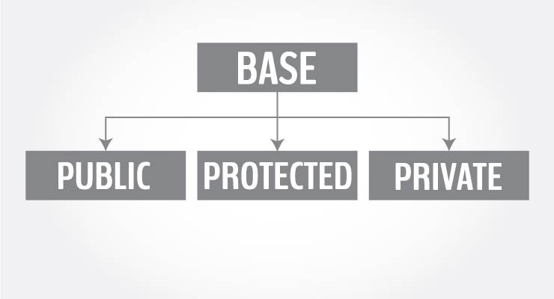
Inheritance

Slide 21
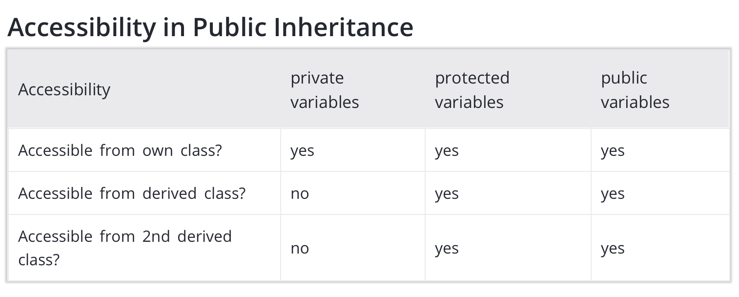
Inheritance

Slide 22
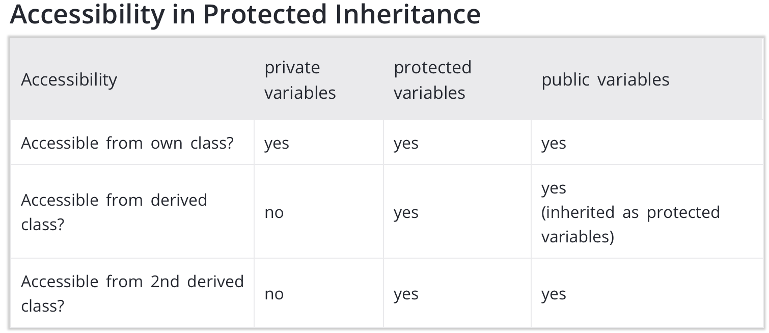
Inheritance

Slide 23
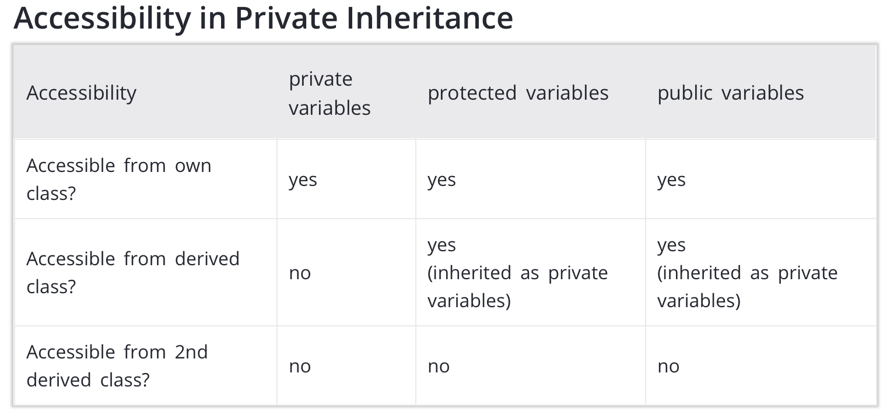
Inheritance

Slide 24
Monthly Paid Employee
A new class?
Name
Gross Salary
Months
Salary per month
Input
Compare
Output
Copy

Slide 25
Hourly Paid Employee
A new class?
Name
Gross Salary
Months
Salary per month
Input
Compare
Output
Copy

Slide 26
Hourly Paid Employee
A new class?
Name
Gross Salary
Months
Salary per month
Input
Compare
Output
Copy
Code reuse!
Open-Closed Principle
extension
modification
开闭原则

Slide 27
New Company
Employee bestPaidEmployee
findBestPaid()
printBestPaid()
Name
Gross Salary
Months
Salary per month
Input
Compare
Output
Copy

Slide 28
New Company
Employee bestPaidEmployee
findBestPaid()
printBestPaid()
Name
Gross Salary
Months
Salary per month
Input
Compare
Output
Copy

Slide 29
New Company
Employee bestPaidEmployee
findBestPaid()
printBestPaid()
Name
Gross Salary
Months
Salary per month
Input
Compare
Output
Copy

Slide 30
New Classes
Employee（派生）
months
salary per month
input()
Company（派生）
findBestPaid()

Slide 31
Overloading （重载）
C++ allows you to specify more than one definition for a function name or an operator in the same scope, which is called function overloading and operator overloading respectively.

Slide 32
Review of Best Paid Employee
Try to improve the implementation
Overloading operators（运算符重载）
compare()
copy()
<return type> operator<op> (parameter list);

Slide 33
Lab Assessment

Slide 34
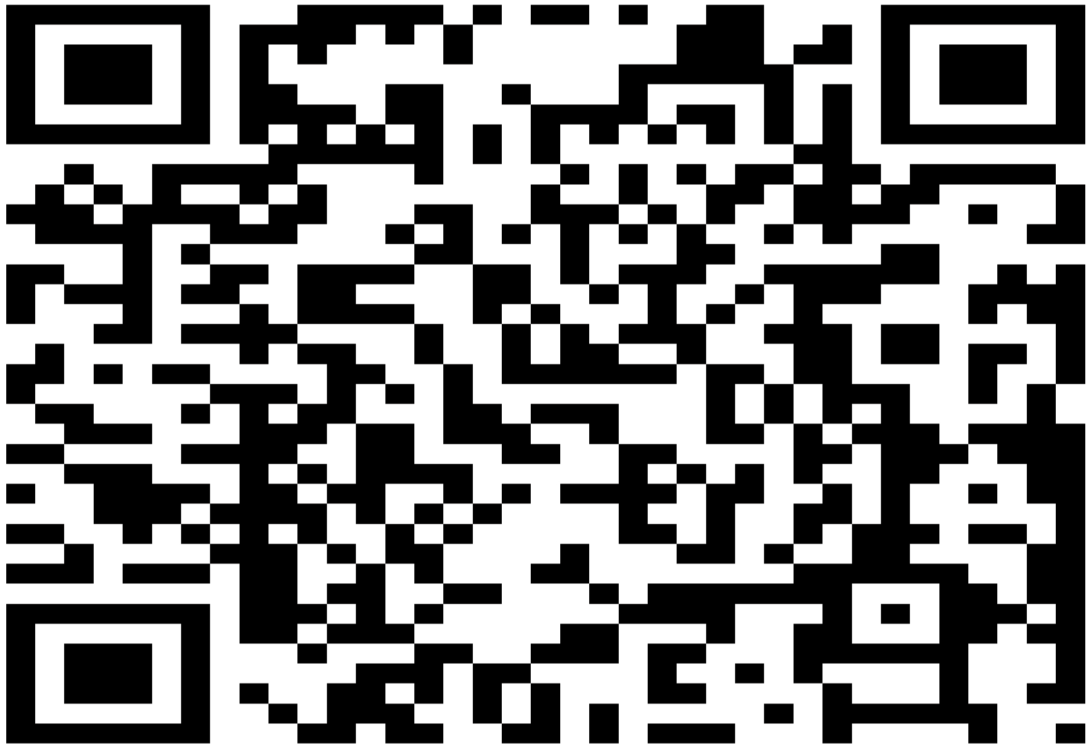
Course Website
https://www.scholat.com/course/ds2023fall

Slide 35
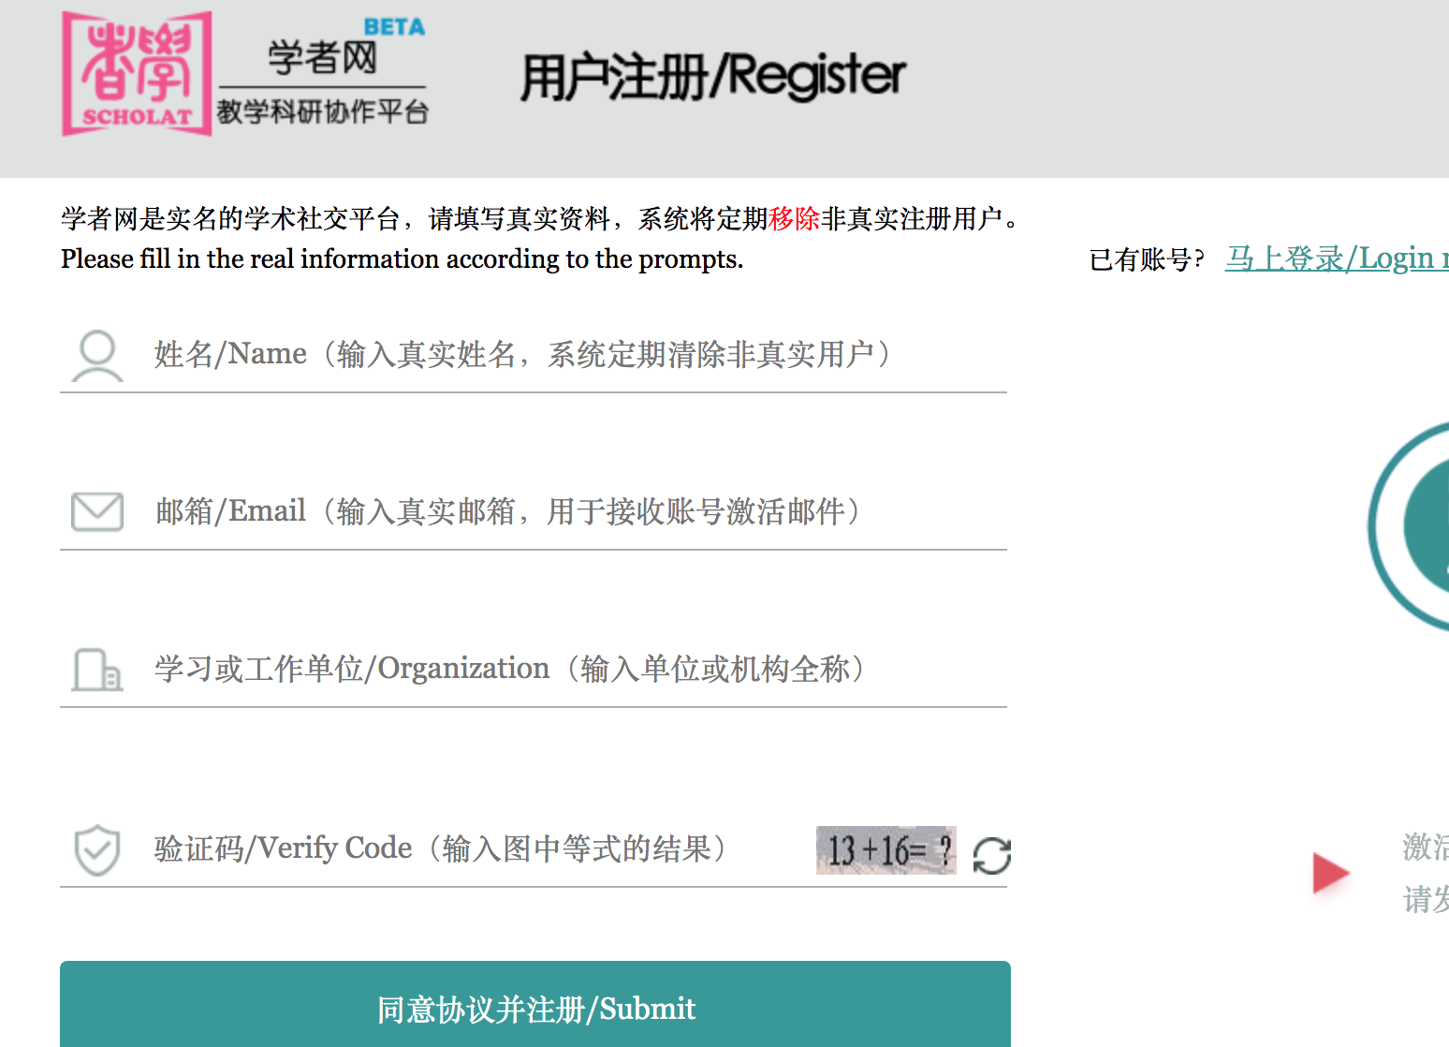
Registration
请实名！

Slide 36
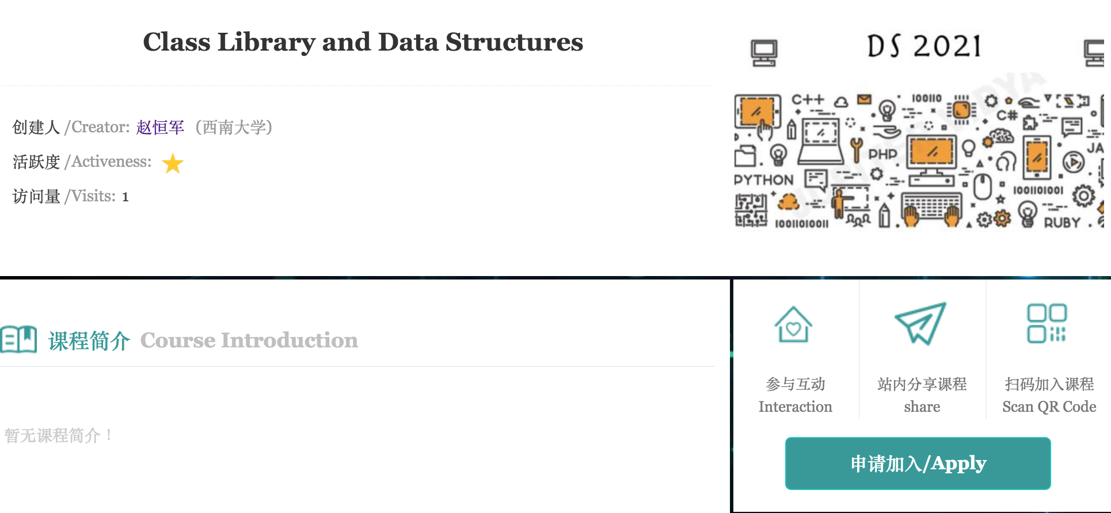


Application

Slide 37
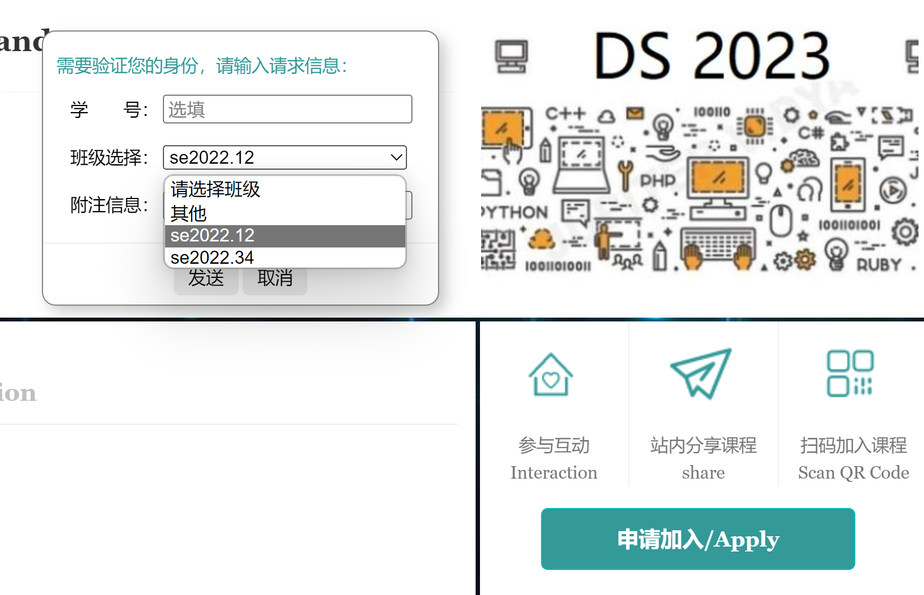
Application
学号
班级

Slide 38
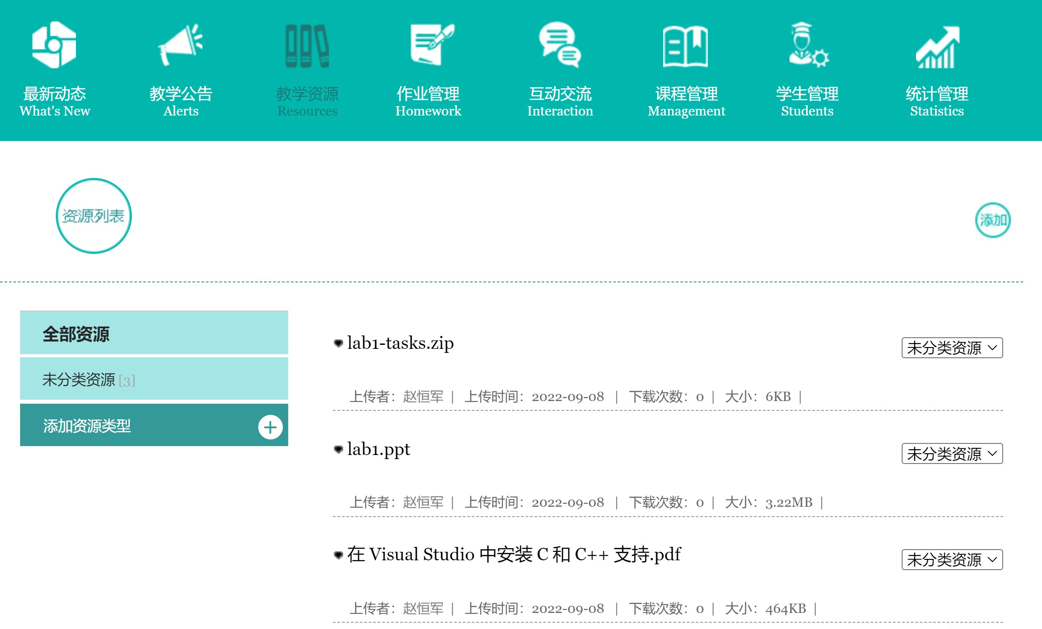
Resources & Assignments

Slide 39
Evaluation
Labs (20%)
7 labs
Lab report!!! （实验报告）

Slide 40
Requirements for Lab Reports
X
Plagiarism!!!（抄袭）
Just code and screen snapshot!!!
Non-compressed pictures!!!
Upload the complete project!!!
Overdue!!!（逾期）
X
X
X
X

Slide 41
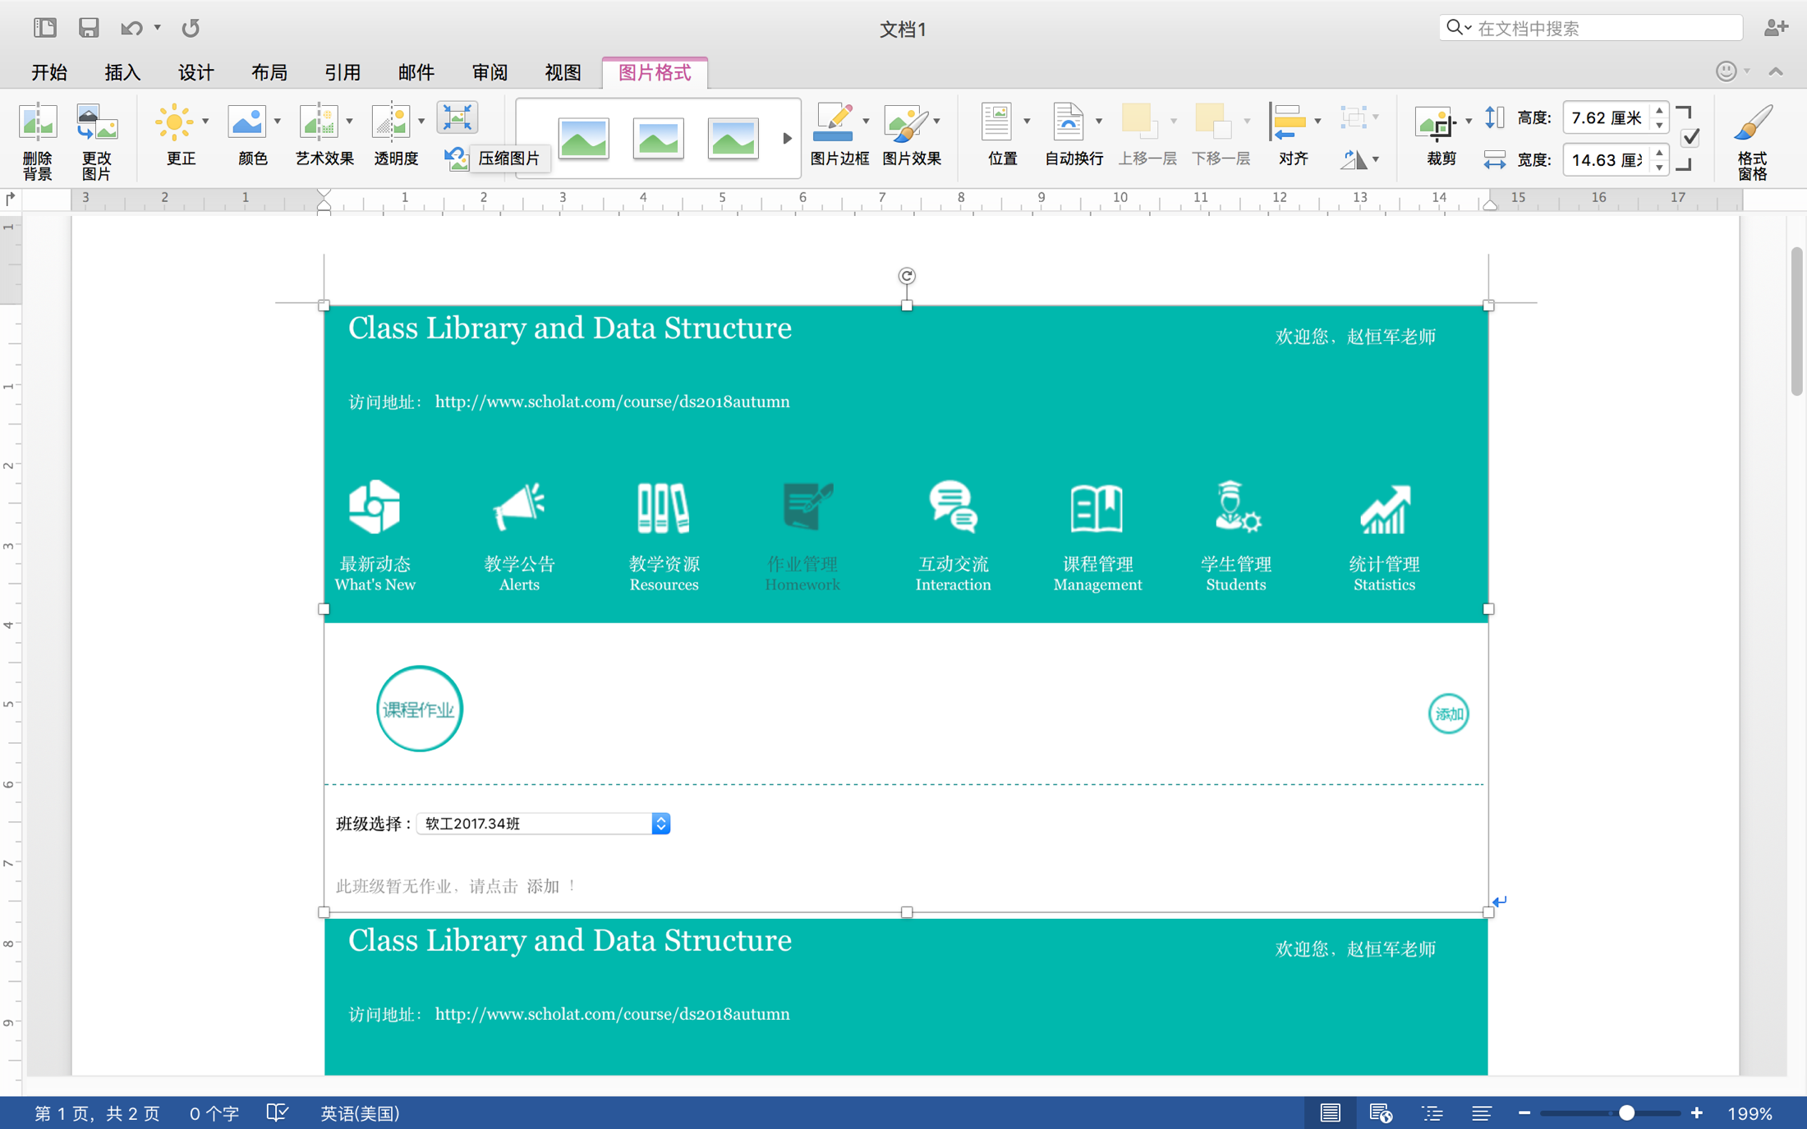
Attention Please!
Compress
Pictures
图片压缩

Slide 42
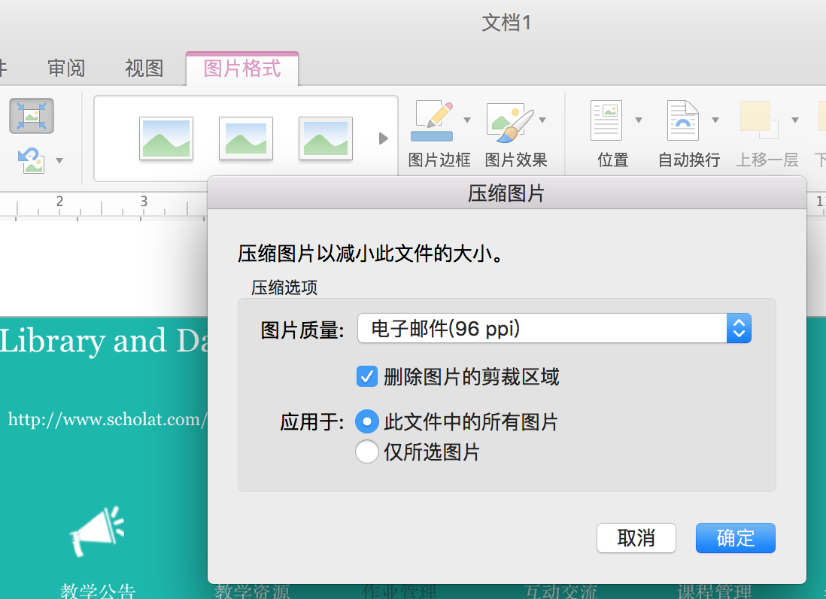
Attention Please!

Slide 43
No plagiarism! 严禁抄袭！

Slide 44
Thank you!
Questions?
谢谢！问题？

