Slide 1
Lab 2: Time Complexity （时间复杂度）
October, 2023

Slide 2
Outline
Time complexity（时间复杂度）
Runtime Analysis（运行时分析）

Slide 3
Time Complexity （时间复杂度）

Slide 4
Big-O Notation（大O表示法）
Complexity: a function of the “size” of the problem
Size: of input n
Time complexity, space complexity
Worst, best, average
Big-O
Approximate analysis（渐近分析）
An upper bound（上界）

Slide 5
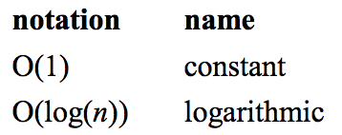
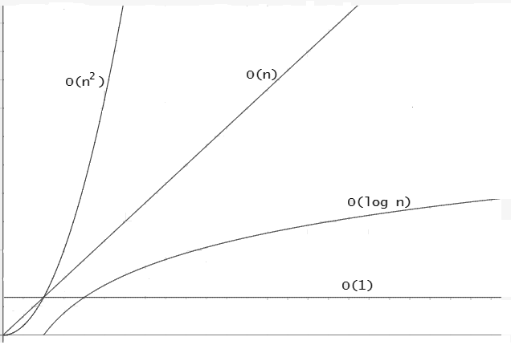
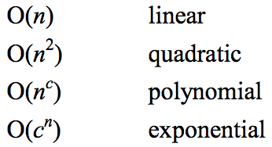
Big-O Notation

Slide 6
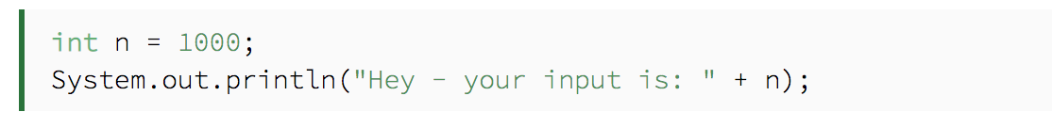
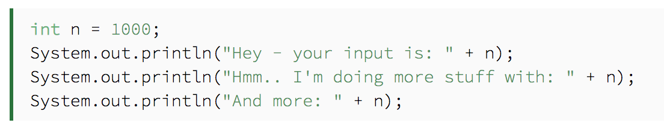
Example

Slide 7
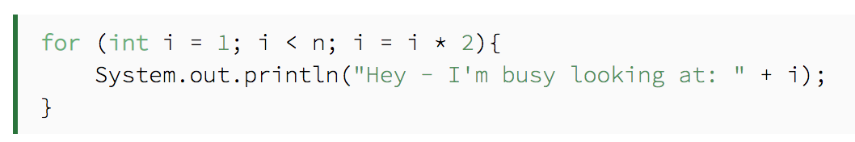
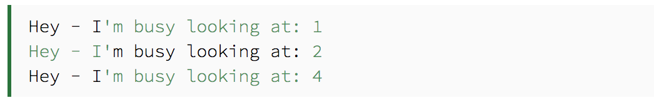
Example

Slide 8
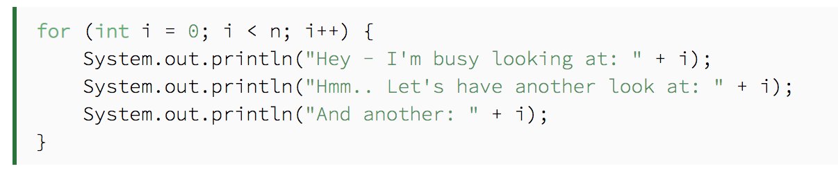
Example

Slide 9
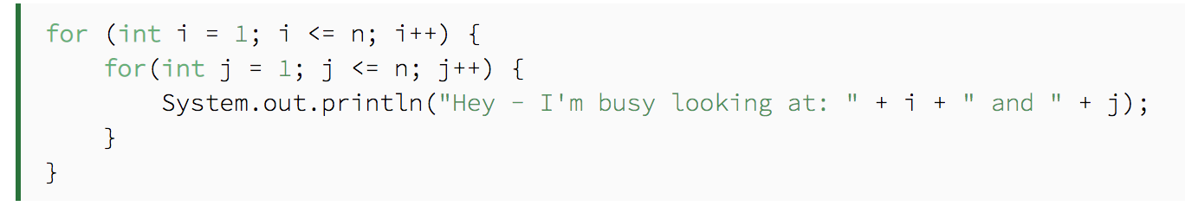
Example
i

Slide 10
Runtime Analysis （运行时分析）

Slide 11
Random number generation（随机数生成）
#include <cstdlib>
// Header file needed to use srand and rand
#include <ctime>
// Header file needed to use time
time_t time(time_t *t);
//get the number of seconds elapsed since 00:00 hours, Jan 1, 1970
void srand(unsigned int seed);
//set seed for random number generation
srand((unsigned int)time(0))
int rand(void);
//generate random number
int number = rand() % MAX
//[0, MAX-1)
Notes:
time_t type: Alias of a fundamental arithmetic type capable of representing times, as those returned by function time. For historical reasons, it is generally implemented as an integral value representing the number of seconds elapsed since 00:00 hours, Jan 1, 1970 UTC (i.e., a unix timestamp). Although libraries may implement this type using alternative time representations.
rand(): Generate random number
Returns a pseudo-random integral number in the range between 0 and RAND_MAX. This number is generated by an algorithm that returns a sequence of apparently non-related numbers each time it is called. This algorithm uses a seed to generate the series, which should be initialized to some distinctive value using function srand. RAND_MAX is a constant defined in <cstdlib>. A typical way to generate trivial pseudo-random numbers in a determined range using rand is to use the modulo of the returned value by the range span and add the initial value of the range:

Slide 12
Measure the Time Cost of Programs
#include <ctime>
// Header file needed to use time
clock_t clock(void); //time units: clock tick
clock_t start_t, end_t, elapsed_t;
start_t = clock();
// code segment whose time cost is to be measured
end_t = clock();
elapsed_t = end_t - start_t; //in milliseconds
(double)elapsed_t / CLOCKS_PER_SEC; //in seconds
Notes:
clock_t type: Clock type
Alias of a fundamental arithmetic type capable of representing clock tick counts. Clock ticks are units of time of a constant but system-specific length, as those returned by function clock. This is the type returned by clock.
clock(): Returns the processor time consumed by the program. The value returned is expressed in clock ticks, which are units of time of a constant but system-specific length (with a relation of CLOCKS_PER_SEC clock ticks per second).
//返回的是从程序开始执行计时的clock数？ The epoch used as reference by clock varies between systems, but it is related to the program execution (generally its launch). To calculate the actual processing time of a program, the value returned by clock shall be compared to a value returned by a previous call to the same function.

Slide 13
Example of Time Measurement
Demo

Slide 14
Task 1
See the guide book and report

Slide 15
Thank you!
Questions?

