Slide 1
Review
June, 2024

Slide 2
Evaluation
Final exam: 60%
Lab reports: 20%
Homework: 20%

Slide 3
我预测考什么
Time: 14:00-16:00, June 13, 2024
Place: 27-301/302
Scope: ch1-ch13
8 pages
Multiple Choice（单选）: 2points * 5
True/False: 2points * 5
Analysis and Short Answer: 10points * 3（计算XX率，空间大小，给资源和进程判断是否会产生死锁）
Basic Algorithm: 10points * 3（调度算法，磁盘搜索，页面置换算法）
Design and Programming: 20points * 1(互斥，信号量)
Use answer card for multiple-choice & true/false
https://www.bilibili.com/video/BV1194y1f7vr?t=188.6&p=24

Slide 4
最后考了什么
Time: 14:00-16:00, June 13, 2024
Place: 27-301/302
Scope: ch1-ch13
8 pages
Multiple Choice（单选）: 2points * 5
True/False: 2points * 5
Analysis and Short Answer: 10points * 3（进程的几个状态填空，物理地址映射和计算页表大小，磁盘的读写）
Basic Algorithm: 10points * 3（SJF抢占调度以及gantt图，页面置换算法，计算几次scan扫描到的请求的平均磁盘读写的延迟）
Design and Programming: 20points * 1(互斥，信号量)
Use answer card for multiple-choice & true/false

Slide 5
About weekly assignments and labs
Deadline: 23:59, Jun 13th, 2024

Slide 6
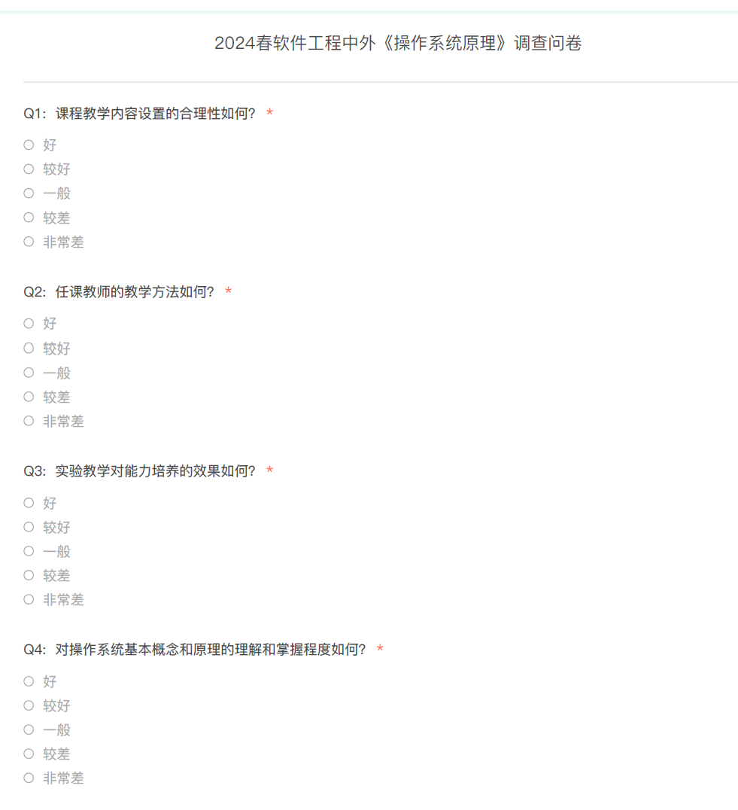
About the OBE Survey
Deadline: 23:59, Jun 25, 2024

Slide 7
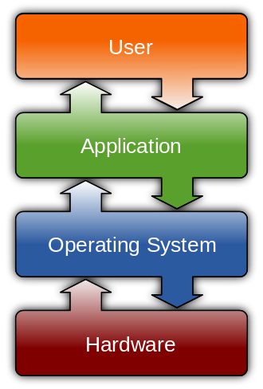
Operating System

Slide 8
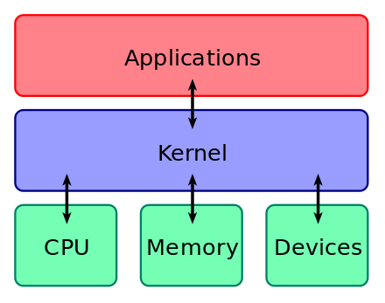
Operating System

Slide 9
Operating System
Concurrency
Virtualization
Sharing
CPU
Memory
Device

Slide 10
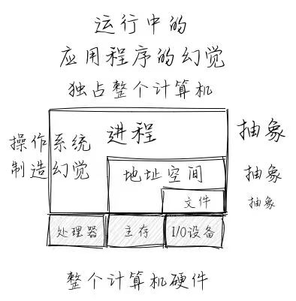
Operating System

Slide 11
Thank you & good luck!

