Slide 1
Lab 4: Recursion and Backtracking（递归和回溯）
October，2023

Slide 2
Outline
Recursion（递归）
Backtrack（回溯）
Maze（迷宫）
8-Queen（8皇后）

Slide 3
Recursion
Base case（基础步）
Induction（归纳步）
Factorial（阶乘）

Slide 4
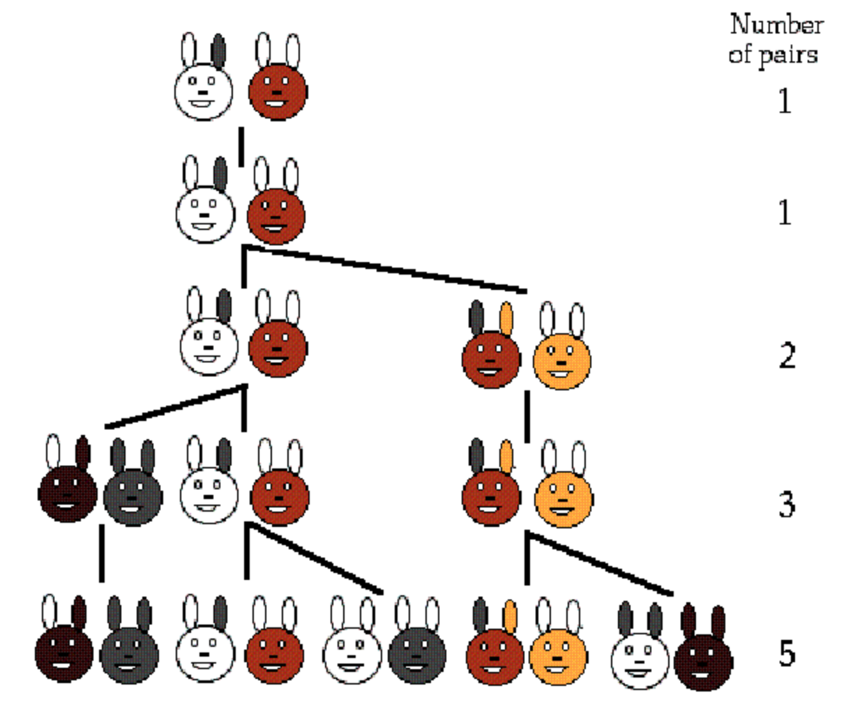
Fibonacci（斐波那契数列）

Slide 5
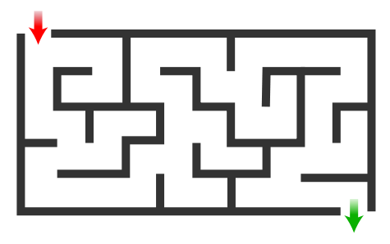
Maze（迷宫）

Slide 6
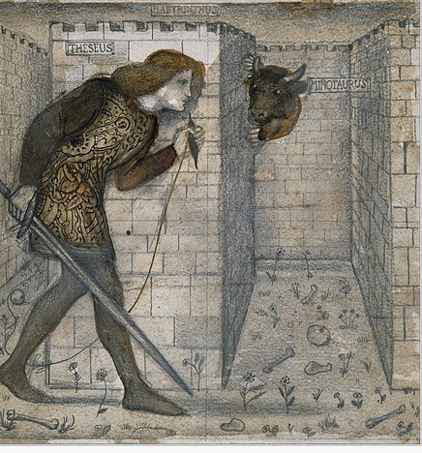
Backtracking（回溯）

Slide 7
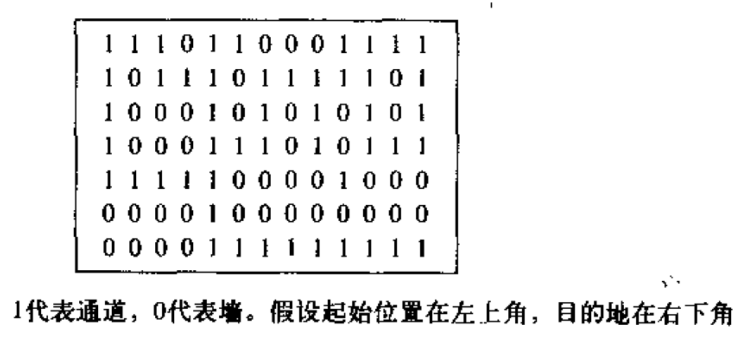
Maze （8*13）

Slide 8
What are the general ideas?
An initial configuration（初始格局）
A start position（开始位置）
Make process（前进）
Go back to a previous position（后退）
Try another possible choice（更换选择）
Success（成功）

Slide 9
Framework: Idea（框架）
Extract the general ideas and build a backtracking framework
Code reuse（代码重用）
Focus on a specific problem

Slide 10
Framework: Details
A BackTrack Class
Define the backTrack() method
Contains an object of the Application class
A main() method
Declare an object of the Application class
Declare an object of the BackTrack class
Call the backTrack() method

Slide 11
Framework: Details
An Application Class
application.h: common methods of different applications
initialize()
getStart()
progress()
goBack()
success()
isValid()
print()
application.cpp: implementation of a specific application

Slide 12
Framework: Details
A Position Class
In the Application class, define methods
From current position
Iterate through all the possible next positions
An Iterator inner class

Slide 13
Framework: Code
Fixed
main.cpp
backtrack.h
backtrack.cpp
application.h
To be implemented
position.h
position.cpp
application.cpp (including the iterator)

Slide 14
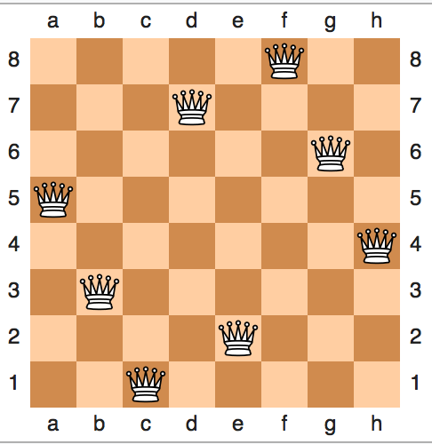
8-Queen Puzzle Example

Slide 15
Thank you!
Questions?

